Slide 1
MongoDB
macf@web-platform

Slide 2
Agenda
Introduction
Definition
Storage
Scalability
Extra Forces
Performance

Slide 3
Introduction

Slide 4
NoSQL Ecosystem
Not require fixed table schemas
Avoid join operations
No ACID gurantee
Scale horizontally
Notes:
http://en.wikipedia.org/wiki/NoSQL

Slide 5
Option I – Key Value
Key-Value:
store data in key/value pairs
Very efficient for performance.
Highly scalable
Difficult to query for real world problems

Slide 6





Key-Value Storage

Slide 7
Option II (TODO)
Tabular:
Easy for scale (depends)
Limited Sort support

Slide 8




Option II
Mnesia

Slide 9
Conclusion
Key-value stores don’t know anything about the content of their values; they’re very simple. As a result of the simplicity they scale extremely well.
A relational database has a rich understanding of the structure of your data.

Slide 10
Introduction
Design Goals
Between a key-value store and a relational database. Scales really well, but still understands something about your data.

Slide 11
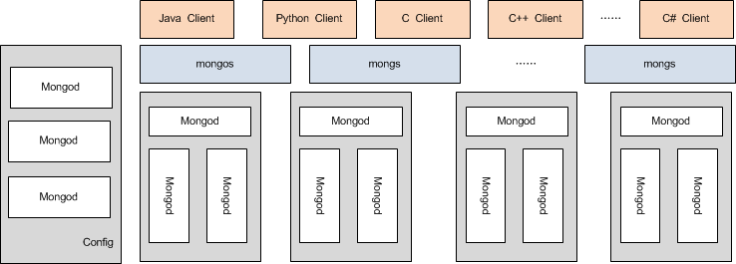
MongoDB architecture

Slide 12
Data modelling
Durability and Repair
Data Modeling
Index
Notes:
http://effectif.com/mongodb/mongodb-schema-design
http://www.paolocorti.net/2009/12/06/using-mongodb-to-store-geographic-data/

Slide 13
Data Model
DB
Collection
Document
Document
collection
The basic unit is Document
Collection is a group of BSON document
Document is a BSON (binary JSON).
Usually, in one collection, BSON has the same structure.
In one collection, Partition rule and index rule is usually the same.
{
app : ‘LDSF',
errHead: “Too many open files”,
errBody: “Exception: ……”,
errTime: “2010-9-14 10:10:10”,
dc: ”san jose”,
shard: “sh1”
}
Binary JSON

Slide 14
Data Model - Collection
System namespaces
128 characters
collection1
Collection 1 Index 1
Collection 1 Index 2
Meta-data
logs
Logs.index1
logs.index2
logs.ldsf
logs.ldsf.index2
logs.ldsf.index2
logs.ldsf.host1
24,000 namespaces
One collection name is a namespace
One Index is a namespace
Collections can be capped
One Collection has a default index “_id”
So basically only 12,000 collections
Notes:
> db.system.indexes.find()
{ "name" : "_id_", "ns" : "mp.user", "key" : { "_id" : 1 } }
{ "name" : "comment_1", "ns" : "mp.user", "key" : { "comment" : 1 } }
{ "name" : "_id_", "ns" : "mp.user2", "key" : { "_id" : 1 } }
> db.system.namespaces.find()
{ "name" : "mp.system.indexes" }
{ "name" : "mp.user" }
{ "name" : "mp.user.$_id_" }
{ "name" : "mp.user.$comment_1" }
{ "name" : "mp.user2" }
{ "name" : "mp.user2.$_id_" }

Slide 15
Data Model – (Document) BSON
http://www.bsonspec.org/
BSON is a binary-encoded serialization of JSON-like documents.
fast to traverse
fast to encode and decode
Notes:
http://www.mongodb.org/display/DOCS/BSON

Slide 16

Index
B-Tree index
An index is always created on _id
Manually assign an index
Index is not only String, int … but also a BSON
1 (ascending) or -1 (descending)
Notes:
http://www.mongodb.org/display/DOCS/Index-Related+Commands

Slide 17
Preallocation

Slide 18
Connections

Slide 19
Scalability
Replication
Sharding
Master-Slave

Slide 20
Sharding
Notes:
http://bbs.linuxtone.org/thread-5356-1-1.html
http://bbs.linuxtone.org/forum-27-1.html

Slide 21
APIs

Slide 22
Full Text Search
Notes:
http://www.mongodb.org/display/DOCS/Full+Text+Search+in+Mongo

Slide 23
Monitoring

Slide 24
Management

Slide 25
MonogoDB meta-data
The <dbname>.system.* namespaces in MongoDB are special and contain database system information. System collections include:
system.namespaces lists all namespaces.
system.indexes lists all indexes.
Additional namespace / index metadata exists in the database.ns files, and is opaque.
system.profile stores database profiling information.
system.users lists users who may access the database.
local.sources stores replica slave configuration data and state.
Information on the structure of a stored object is stored within the object itself.

Slide 26
Extra Forces
Map-Reduce

Slide 27
Benchmarks
Notes:
http://blog.zhaojie.me/2010/02/mongodb-tokyo-tyrant-benchmark-2-concurrent-insert.html
http://www.mongodb.org/display/DOCS/Benchmarks
http://www.mongodb.org/display/DOCS/Comparing+Mongo+DB+and+Couch+DB
Perf

Slide 28
Limitations

Slide 29
User Cases

Slide 30
Real World Cases
Notes:
http://www.javaeye.com/topic/748322
http://blog.wantongchina.com/?p=14
http://www.quora.com/What-are-the-advantages-and-disadvantages-of-using-MongoDB-vs-CouchDB-vs-Cassandra-vs-Redis

