Slide 1


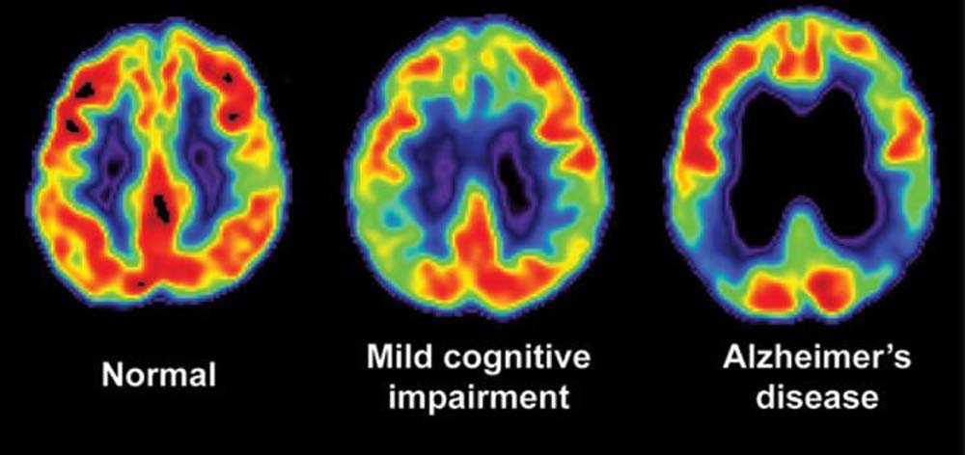
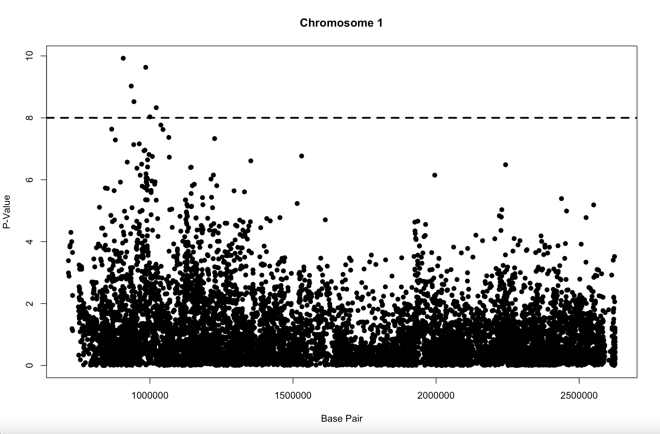
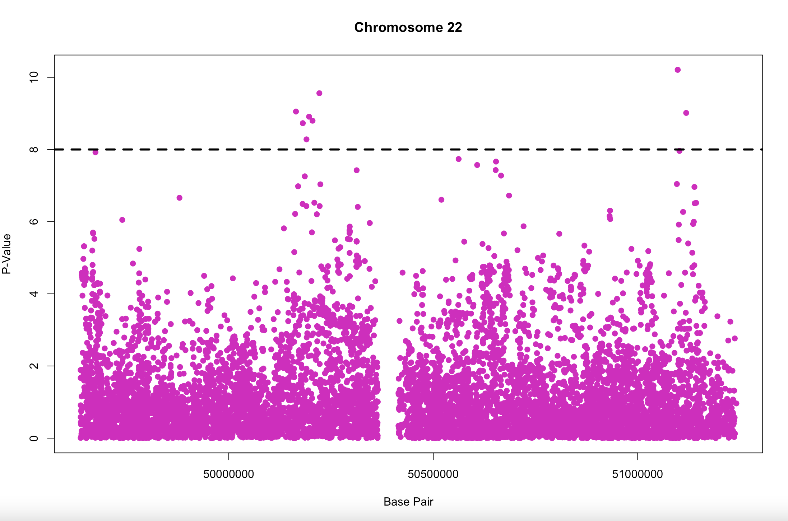
Using a Genome-Wide Association Study (GWAS) to Identify New Loci and Functional Pathways Influencing Alzheimer’s Disease Risk Aidan Fisher, Maureen Cassidy and Courtney Defosses College of Life Sciences and Agriculture, University of New Hampshire
Background
Materials and Methods
Discussion
Alzheimer’s disease (AD) is the most common neurogenerative disease and can by characterized by the progressive loss of memory and cognitive function and are accompanied by many behavioral disorders.
AD is due to the presence of extracellular plaques of insoluble β-amyloid peptide and neurofibrillary tangles that contain hyperphosphorylated tau protein in the neuronal cytoplasm of the brain.
AD has over 20 disease-associated loci and undiscovered loci remain.
A Genome-Wide Association Study (GWAS) is an observational study of a whole genome set of genetic variants.
The goal of GWAS is to observe the entire genome of many individuals to associations between genetic variants and their disease outcomes.
In this study, a large GWAS of clinically diagnosed AD patients and AD-by-proxy was performed to identify genetic factors that contribute to the risk of AD development.
Methods from the study:
455,258 individuals of European ancestry were meta-analyzed in 3 phases.
Phase 1- involved 24,087 clinically diagnosed late-onset AD cases paired with 55,058 controls.
Phase 2- consisted of AD-by-proxy phenotype were analysis of 47,793 cases and 328,320 controls.
Phase 3- Meta-analysis all individuals of phase 1 and phase 2 together and tested for replication in an independent sample.
Due to the independent statistical tests being performed simultaneously, a Bonferroni correction as applied.
No association survived the Bonferroni correction based on the linking gene-based P value.
Our methods:
The summary statistics file of Genome-wide meta-analysis identifies new loci and functional pathways influencing Alzheimer’s disease risk was downloaded.
Chromosome number, base pair, effect allele, non-effect allele, SNP, z-score, p-value, sum, effect sample size, effect allele frequency, beta and standard error.
Using Visual Studio Code, the data was taken and consolidated.
The data was imported into RStudio, where two individual Manhattan plots were made, using 'GWASTools,' with base pair on the x-axis and the –log(p-value) on the y-axis.
Based on the Bonferroni correction, the determined threshold was 8, based on SNP significance.
Looking at Figure 1, there is 1 significant SNPs found for chromosome 1 that correlates with Alzheimer’s disease, as there is 1 cluster of dots above the threshold.
Looking at Figure 2, there are 2 significant SNPs found for chromosome 22 that correlate with Alzheimer’s disease, as there are 2 separate clusters of dots above the threshold
The study suggests that multiple traits/genes have an effect on AD, and the findings from this study would provide a resource to identify targets for AD drug development.
In the future, the group plans on sequencing, and making Manhattan plots for each chromosome of the entire genome.
Results
References and Acknowledgements
Jansen, Iris E, et al. “Genome-Wide Meta-Analysis Identifies New Loci and Functional Pathways Influencing Alzheimer's Disease Risk.” Nature Genetics, U.S. National Library of Medicine, Mar. 2019, https://www.ncbi.nlm.nih.gov/pmc/articles/PMC6836675/.
Silva, Marcos, et al. “Alzheimer's Disease: Risk Factors and Potentially Protective Measures - Journal of Biomedical Science.” BioMed Central, BioMed Central, 9 May 2019, https://jbiomedsci.biomedcentral.com/articles/10.1186/s12929-0190524- y#:~:text=Alzheimer's%20disease%20(AD)%20is%20the,as%20apathy%2C%20ag gressiveness%20and%20 depression.
Figure 1: A Manhattan plot showing base pair (x-axis) and p-value (y-axis) of chromosome 1.
Figure 2: A Manhattan plot showing base pair (x-axis) and p-value (y-axis) of chromosome 22.
Notes:
Bon feroni correction of the p value = threshold

