Slide 1
Using A Function Derived From Darts to Visualize Global Optimization Algorithms
Max Caragozian

Slide 2
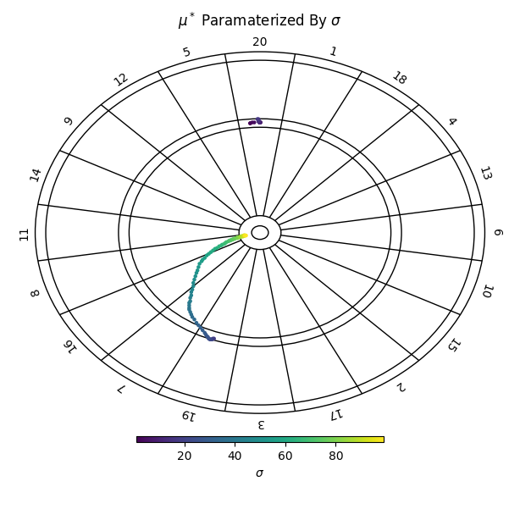
Quantifying the Relationship Between Skill and Optimal Aiming Point
A skilled player and an unskilled player should aim at different places to maximize their respective scores.
We quantify skill by the standard deviation of the distribution with which he/she throws the darts.
This approach was adopted from “A Statistician Plays Darts,” by Tibshirani, Price, and Taylor[3].

Slide 3
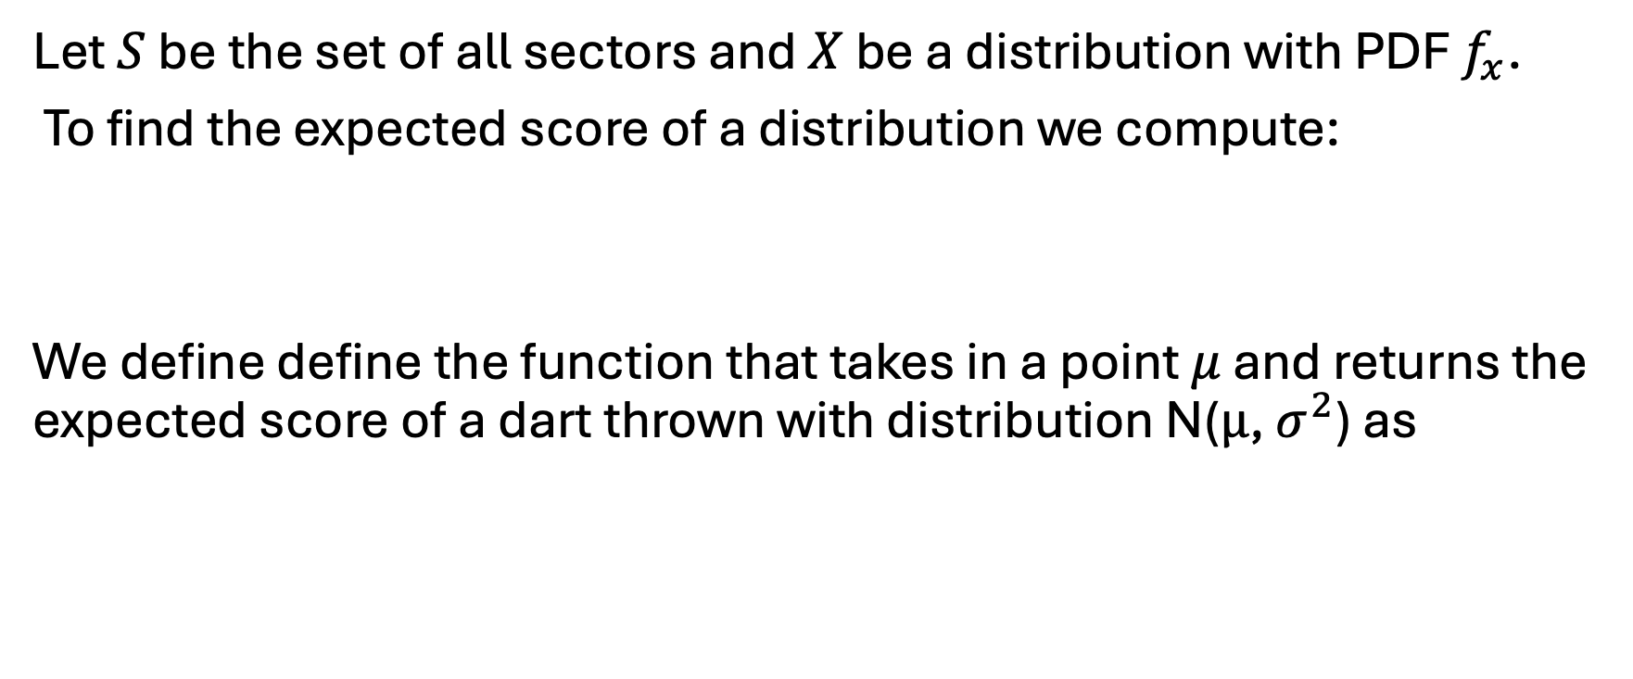
Method 1: Direct Integration
Let $S$ be the set of all sectors and $X$ be a distribution with PDF $f_{x}$.
To find the expected score of a distribution we compute:
We define define the function that takes in a point $μ$ and returns the expected score of a dart thrown with distribution N($μ$, $σ^{2}$) as

Slide 4
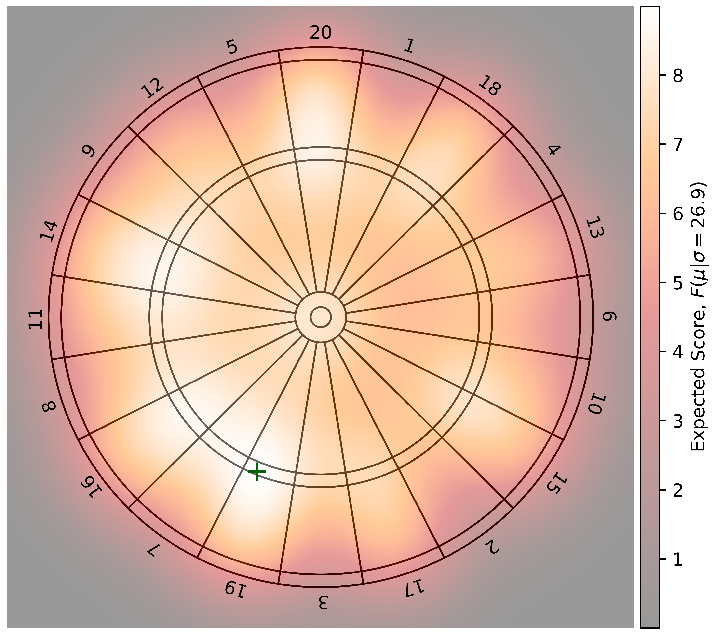

Slide 5
Method 2: Basin Hopping

Slide 6
References
[1] The Scipy Community. scipy.optimize.basinhopping. url: https://docs. scipy.org/doc/scipy/reference/generated/scipy.optimize.basinhopping. html#scipy.optimize.basinhopping.
[2] Tijmen Stam. Dartboard diagram.svg. 2014. url: https://commons.wikimedia. org/wiki/File:Dartboard_diagram.svg.
[3] Ryan Tibshirani, Andrew Price, and Jonathan Taylor. “A Statistician Plays Darts”. In: Journal of the Royal Statistical Society Series A 174 (2011), pp. 213–226

