Slide 1
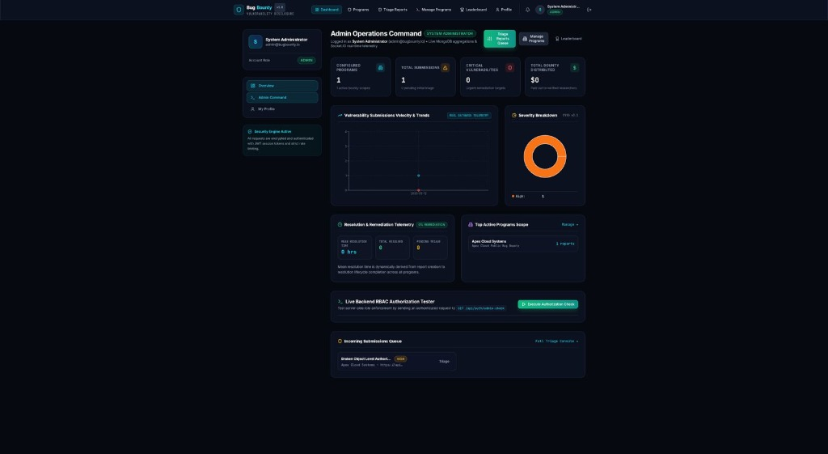
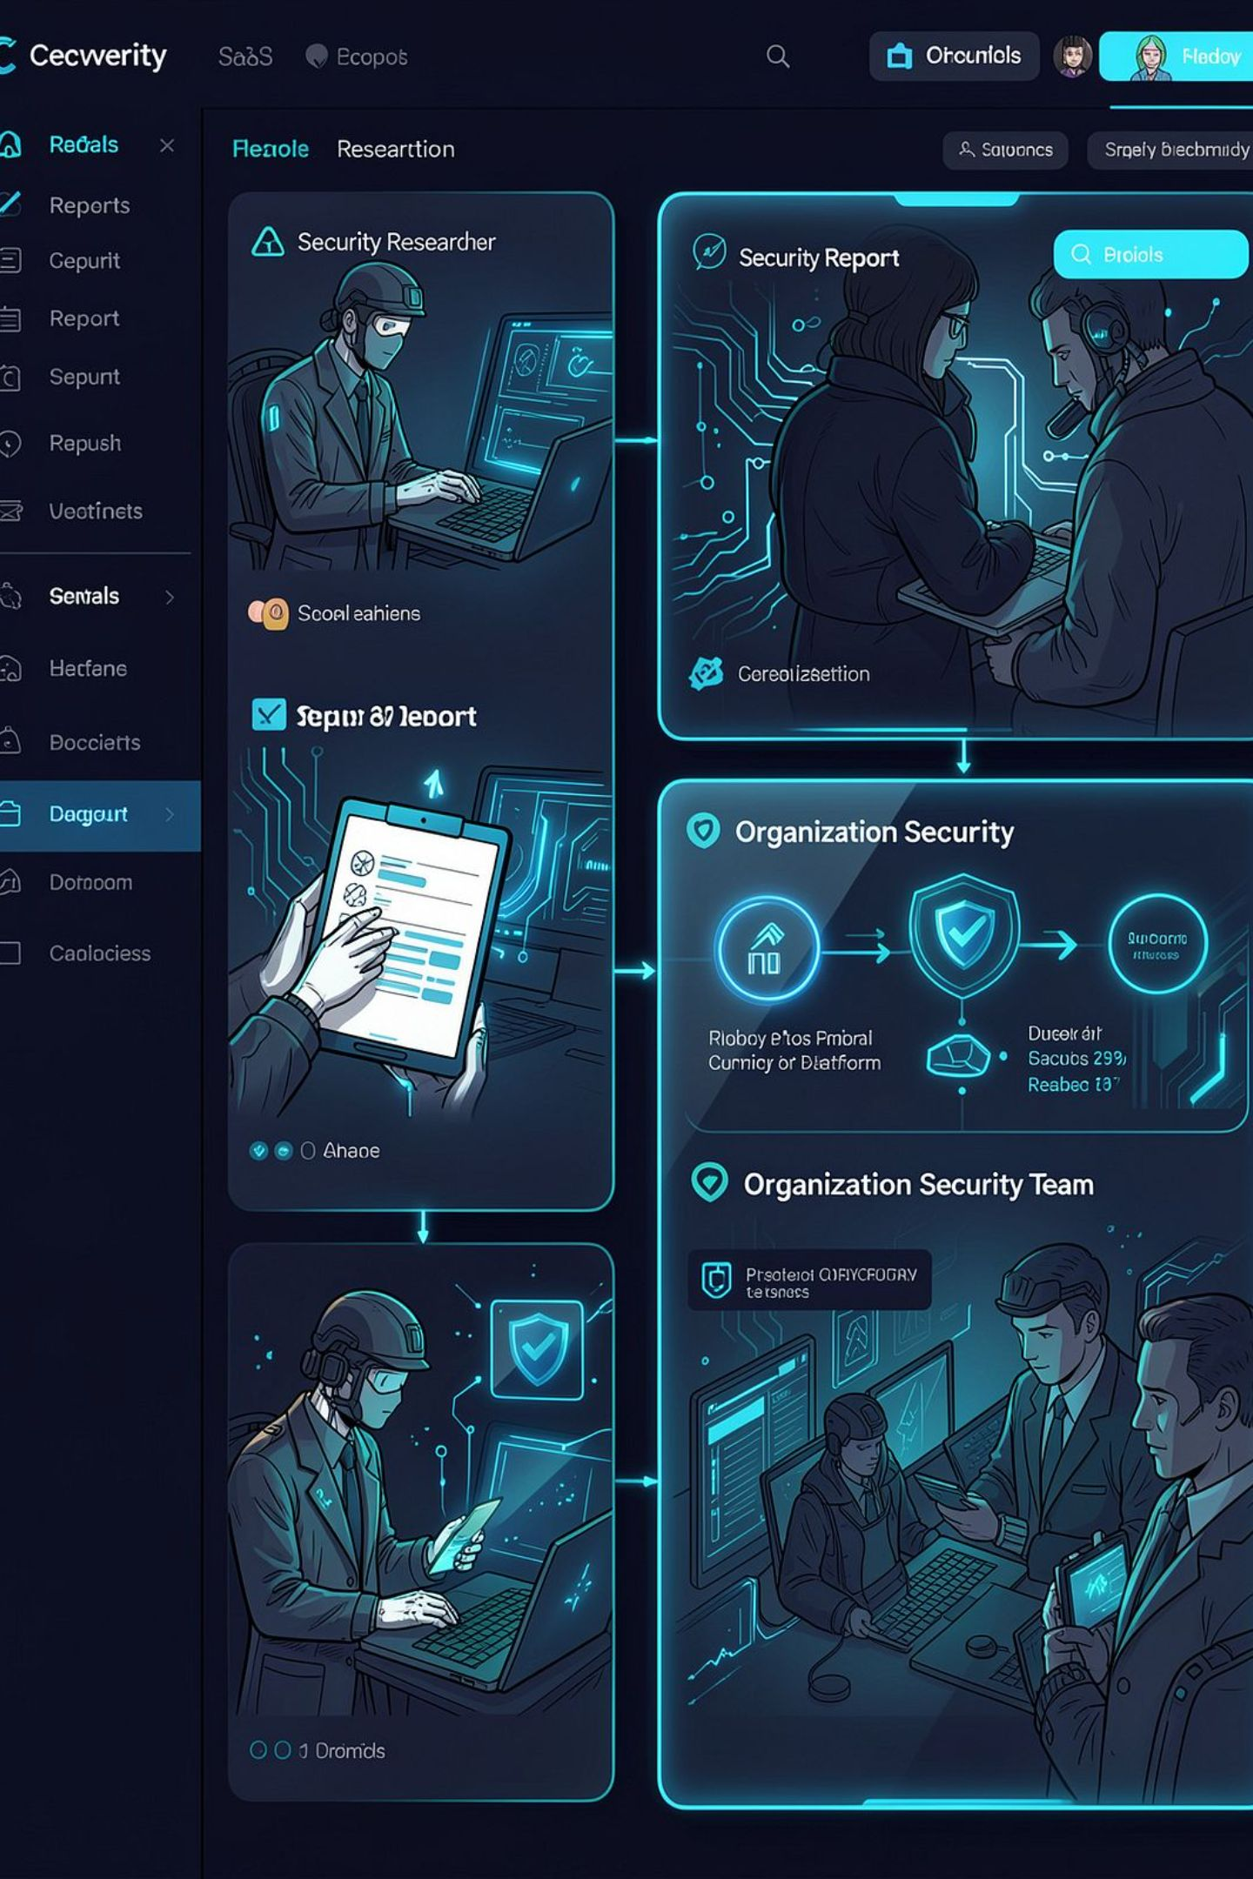
BugBounty
Enterprise Vulnerability Reporting & Bug Bounty Management Platform
Full‑stack MERN cybersecurity platform providing a secure bridge between security researchers and organization security teams. Implements structured reporting, triage, deterministic risk scoring, duplicate detection, rewards & reputation, real‑time notifications, and analytics.
Tech Stack: React 18 • Vite • Node.js 20 • Express • MongoDB/Mongoose • Socket.IO • JWT • Tailwind CSS • Recharts

Slide 2
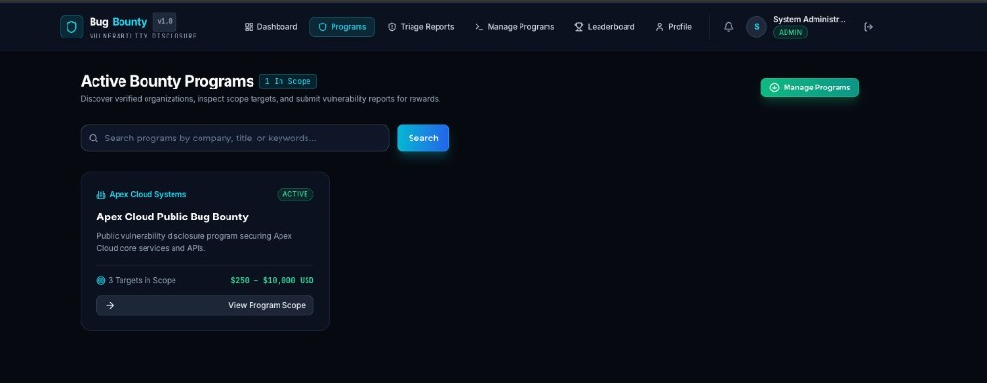
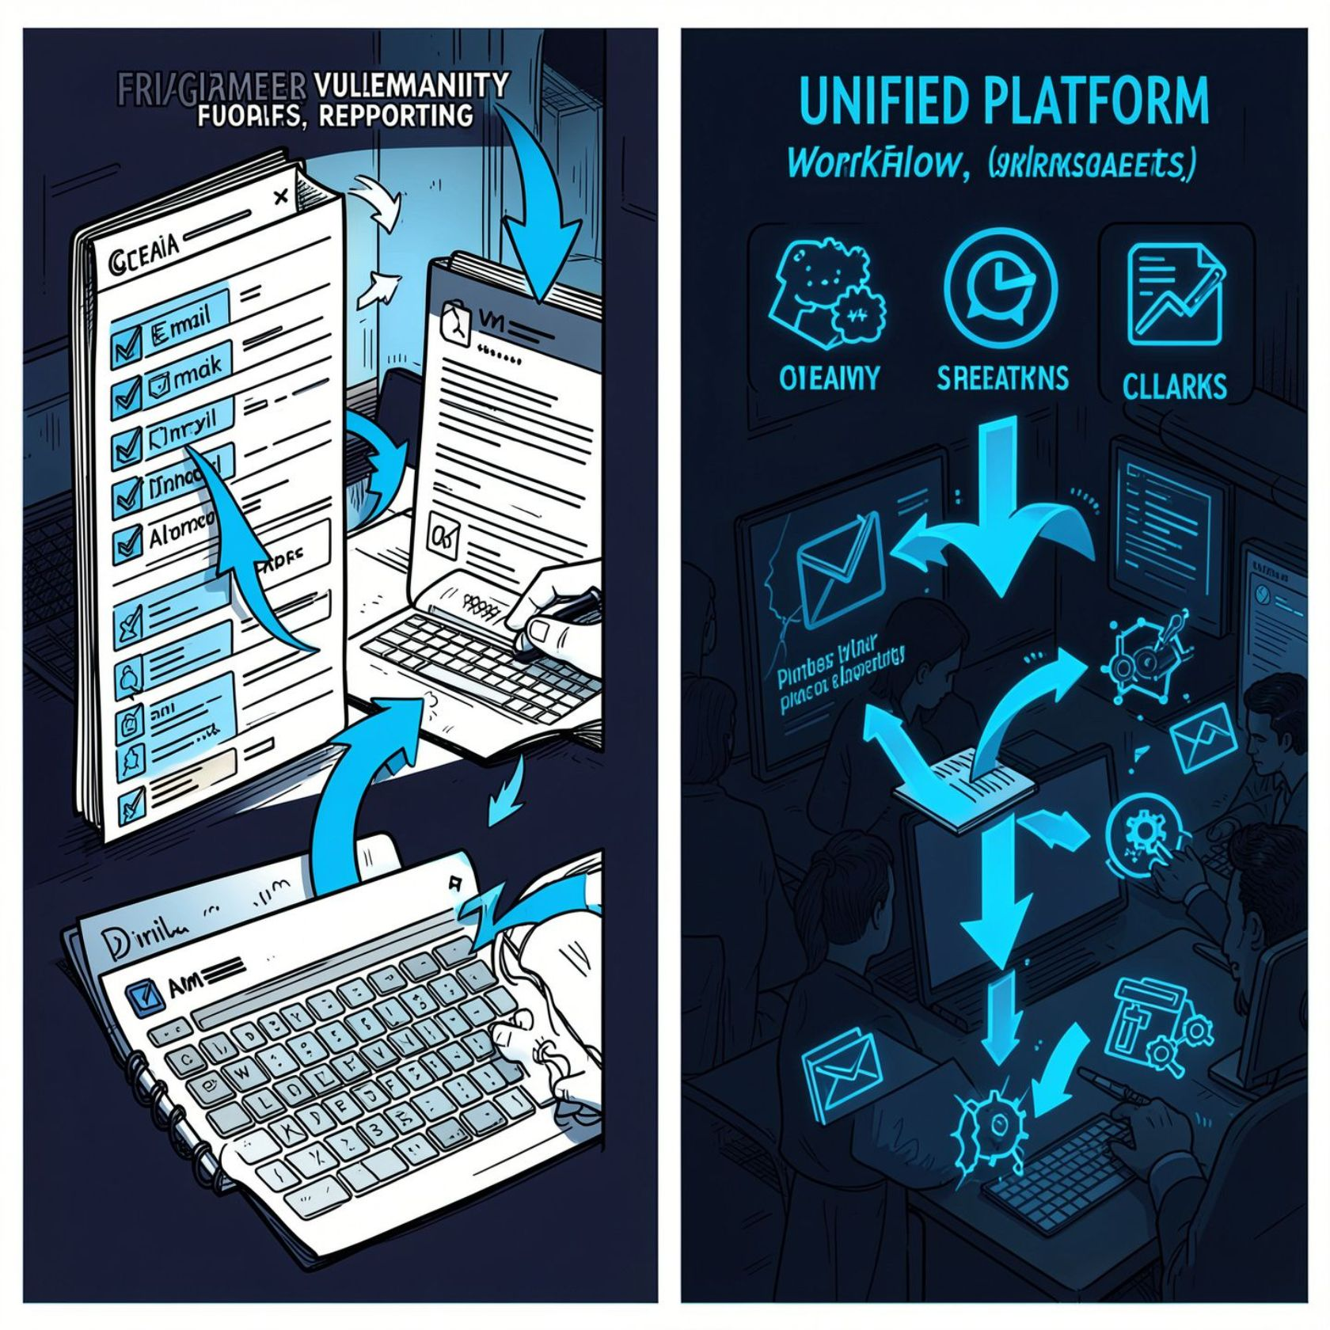
The Problem: Vulnerability Reporting Is More Than Filing a Ticket
Researcher-side challenges
No centralized discovery for active bounties
Poor ways to submit PoC evidence and reproduction steps
Unclear post-submission status / stale communication
No transparent reputation / reward trail
Organization-side challenges
High report volume and duplicate submissions
Manual, inconsistent severity and risk assessment
Lack of auditable lifecycle and delayed researcher feedback

Slide 3
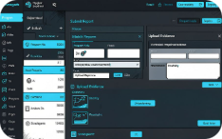
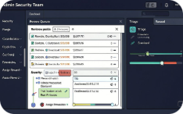


Solution: An End-to-End Vulnerability Lifecycle Platform
Researcher Portal
Admin / Security Team
Automated Intelligence
Security Controls
Browse active programs, submit structured reports with evidence, track lifecycle, reputation and leaderboard, receive real‑time notifications.
Create/manage programs, triage and assign severity & rewards, resolve findings, view program analytics and audit trails.
Deterministic risk scoring, multi-signal duplicate detection, severity recommendations, reputation calculation, real‑time notification pipeline.
JWT auth, RBAC, IDOR checks, request validation, rate limiting, Helmet headers, MongoDB sanitization, secure evidence upload validation.

Slide 4
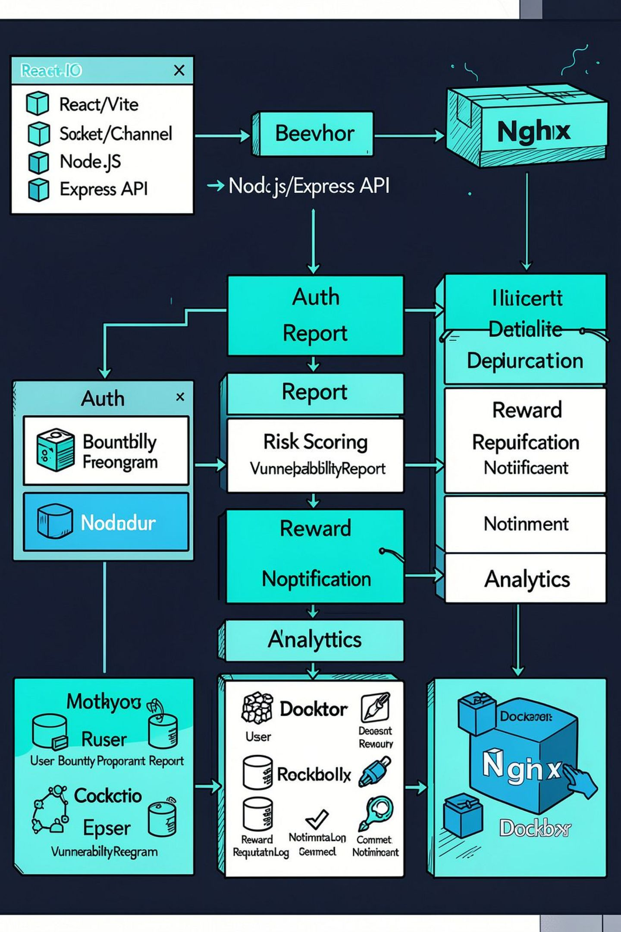
System Architecture
Frontend Layer: React 18 + Vite SPA, React Router, Tailwind CSS, Recharts for real-time telemetry visualizations, Axios, and Socket.IO client.
API & Business Logic: Node.js 20 + Express modular architecture featuring service controllers for deterministic scoring, duplicate detection, workflow state machines, and reward distribution.
Data & Storage Layer: MongoDB with Mongoose schemas, persistent local collection indexes, and Docker/Nginx production deployment scaffolding.
Real-Time Infrastructure: Authenticated Socket.IO event channels providing room-isolated communications for researcher updates, admin notifications, and triage lifecycle broadcasts.

Slide 5
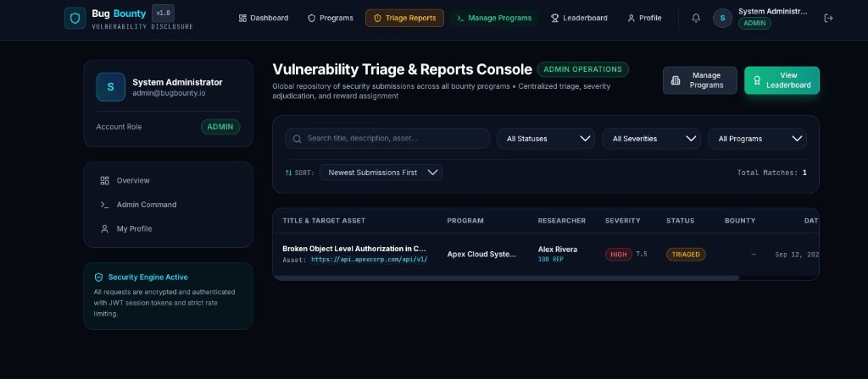
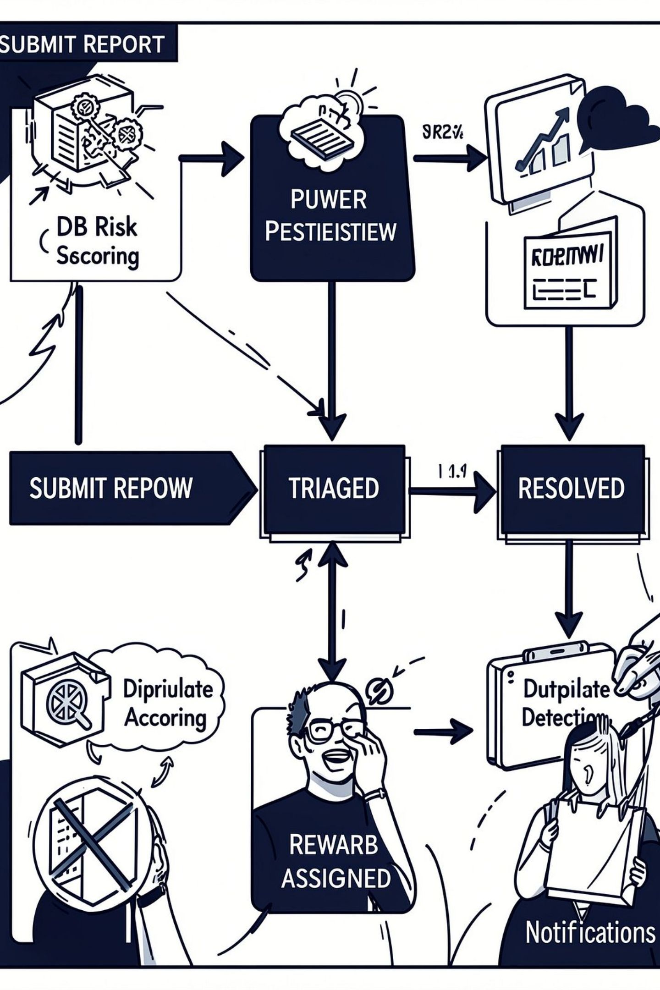
From Vulnerability Discovery to Resolution
Workflow implemented in backend uses a controlled state‑transition graph: 1) Submit Report → 2) Under Review → 3) Triaged → 4) Accepted → 5) Reward Assigned → 6) Resolved. Rejection path routes back into review states as configured.
At submission
On acceptance
On reward assignment
Program validation • Risk score calculation • Duplicate detection • Persist report • Admin notification
Reputation points awarded • Researcher notified via Socket.IO
Create/update Reward record • Update report reward metadata • Notify researcher
On resolution
Lifecycle closed • Analytics capture resolution metrics

Slide 6
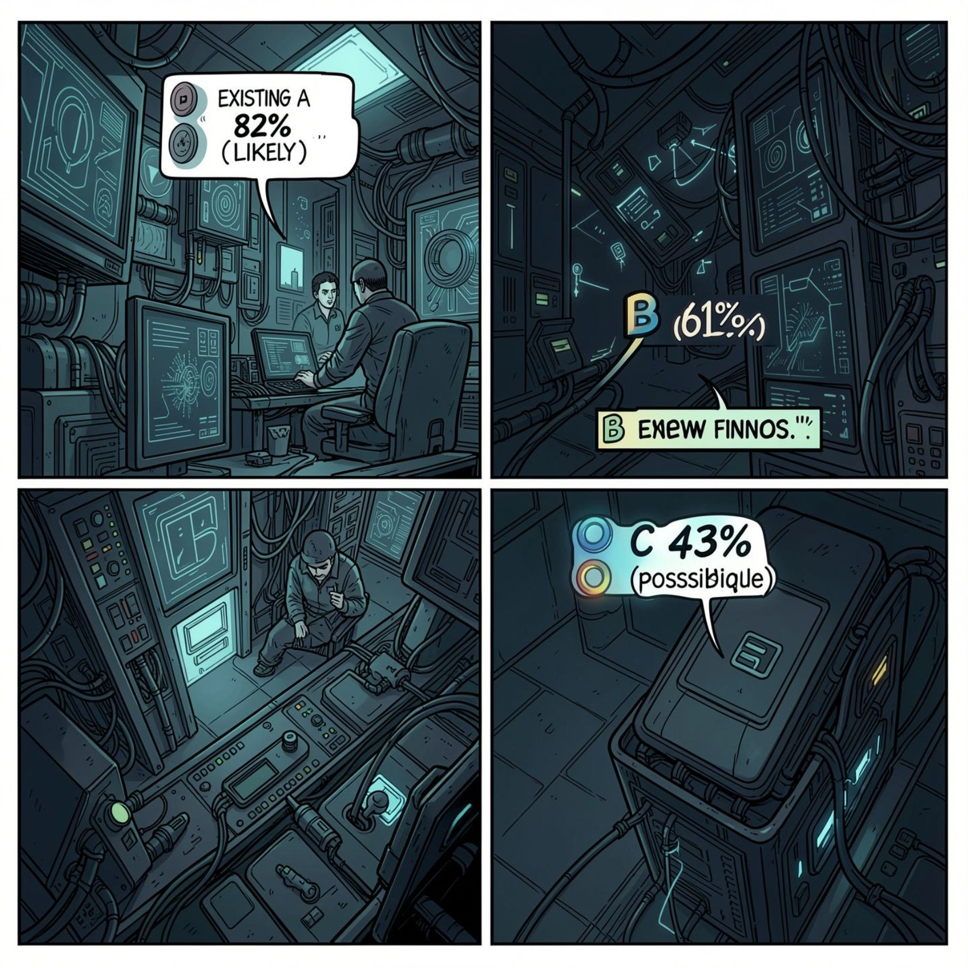
Automated Security Intelligence
Deterministic Risk Scoring
Duplicate Detection (Multi‑signal)
Project implements a transparent, deterministic scoring engine inspired by CVSS principles.
Factors: Impact, Exploitability, Attack Vector, Data Exposure, Authentication Requirements.
Weighted Multi-Signal Evaluation:
Title: 25% • Asset Target: 25% • Category: 15% • Content: 35%
Similarity Algorithm:
Combines Jaccard token set similarity with exact asset endpoint matching into a weighted composite score.
Recommendation Thresholds:
< 45%: Unique Report (Proceeds to regular triage)
45% – 70%: Possible Duplicate (Flagged for review)
≥ 70%: Likely Duplicate (Auto-linked to primary submission)
Score = clamp((Impact × Exploitability × Attack Vector
× Auth Requirements) + Data Exposure, 0–10)
Risk Bands: 0 None • <4 Low • 4–<7 Medium • 7–<9 High • ≥9 Critical.
Emphasis: Explainable recommendations tailored to project requirements, not an opaque CVSS score.

Slide 7
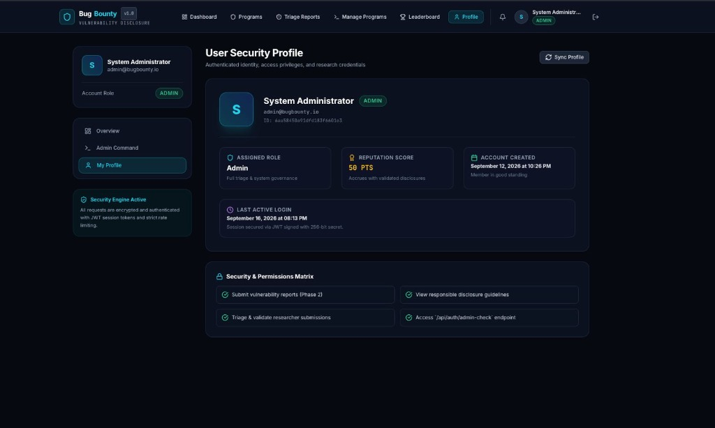
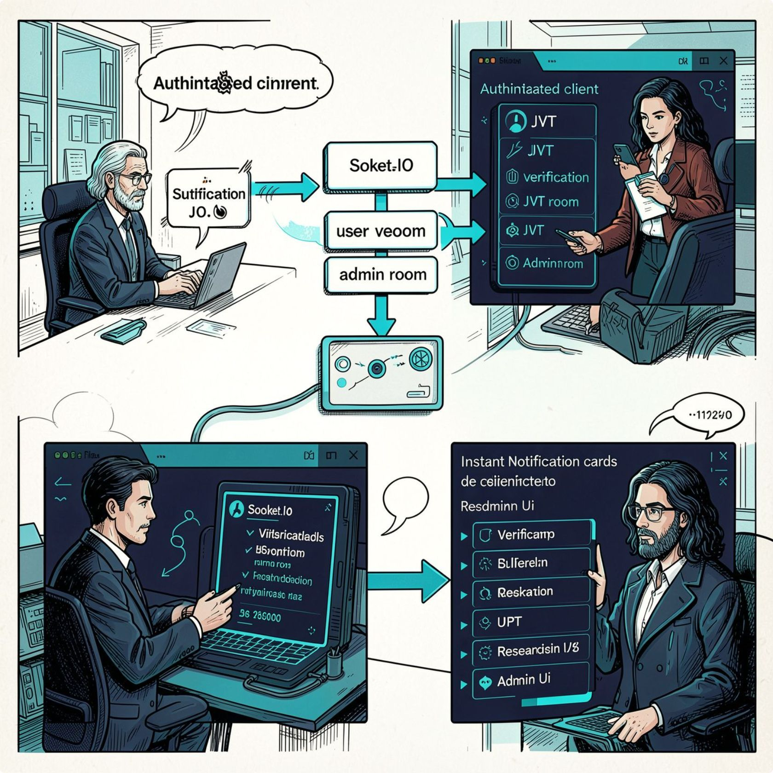
Security by Design + Real-Time Communication
Security Controls
Real-Time Engineering
Authentication: JWT bearer tokens, session expiry handling, and active account state verification.
Authorization: Role-based access control (researcher vs. admin) and strict resource ownership checks.
API Defenses: Helmet security headers, rate limiting, centralized error handling, and payload limits.
Database Protections: MongoDB sanitization against NoSQL injection and schema type enforcement.
Evidence Upload Controls: MIME and extension whitelisting, 5 MB file size limit, and max 5 files per submission.
IDOR Prevention: Backend validates ownership—researchers strictly access only their submitted reports.
Real-time events emit immediately following state transitions: report status updates, severity adjustments, bounty reward assignments, and new submission alerts. Socket services integrate directly with notification emitters.

Slide 8
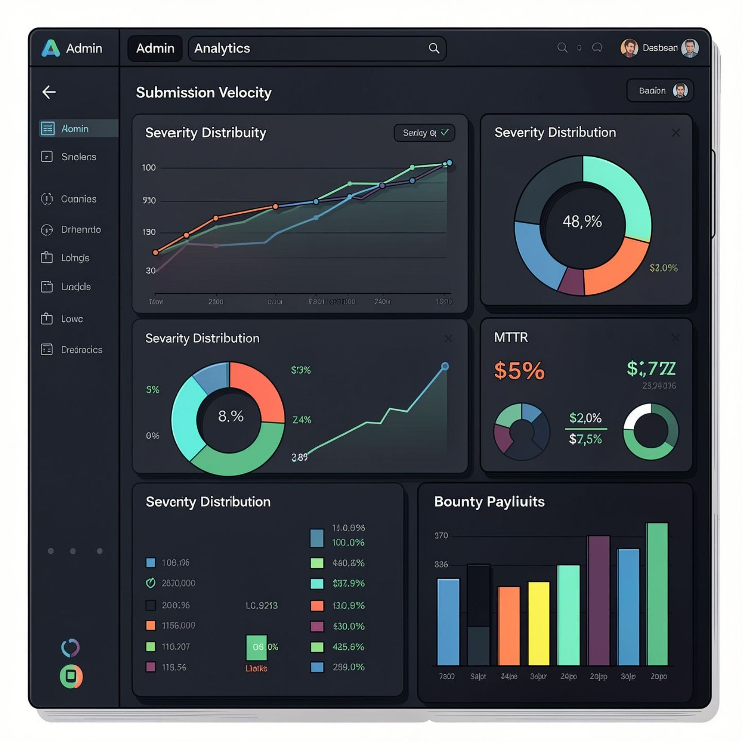

Observability, Analytics & Verification
Admin Analytics (Recharts)
Testing & Engineering Quality
74 Automated Test Suites:
Comprehensive test coverage spanning JWT authentication, RBAC authorization, report intake, triage state machine transitions, and reward assignment.
Security Attack Validations:
Explicit scenario tests verifying resistance against IDOR, privilege escalation, expired JWT tokens, malformed payloads, and NoSQL injections.
Evidence Upload Sanitization:
Validates file extension whitelists, MIME-type verification, 5 MB file size constraints, and secure attachment isolation.
Aggregations: Submission trends, severity breakdown donut charts, mean time to resolve, reward distributions, and active program metrics.
Researcher Analytics
Personal researcher dashboard tracks submissions over time, acceptance rates, reputation trajectory, and historical bounty earnings.

Slide 9
Why This Platform Matters
Structured
Explainable
Secure
Actionable
Defined lifecycle for every report—submission → triage → resolution—ensuring auditable traceability.
Deterministic risk scoring and weighted duplicate detection provide inspectable reasoning rather than opaque outputs.
Auth, RBAC, sanitization, rate limits, upload controls, and ownership checks are enforced across the stack.
Integrated triage workflows, rewards, realtime notifications, and analytics give security teams operational capability.
Future Development (clearly future work)
Advanced semantic and ML-powered duplicate detection
External vulnerability intelligence & automated security scanner integrations
Cloud-scale multi-tenant deployment architectures & Enterprise SSO / OAuth
CVSS 4.0 compatibility refinements and compliance audit reporting
“BugBounty transforms vulnerability disclosure from a fragmented reporting process into a structured, measurable security lifecycle.”
GitHub: github.com/mac20060630/bug-bounty

