Slide 1
BH003 START BUTTON NOT FUNCTIONING ROLANDO GONZALES FTM/TEST

Slide 2
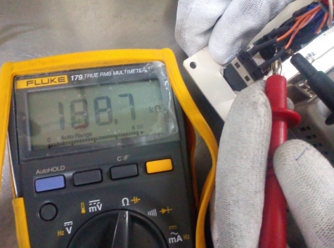
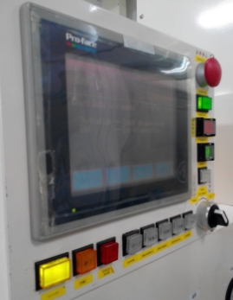
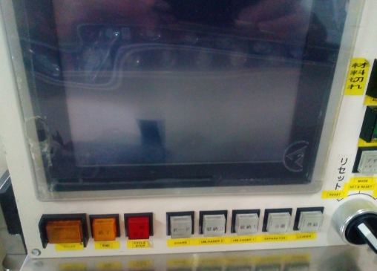
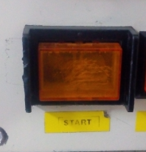
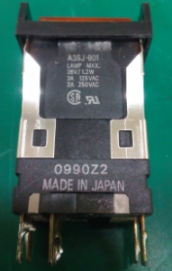
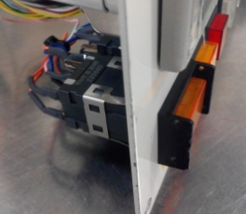
Machine Model: SBI-4525M
Error Isolation:
Machine Number: BH003
Package: SSOP16
Family Name: LC70F520VQ-E
Problem: START BUTTON NOT FUNCTIONING
Details of the Problem:
ACTION DONE | WHEN | WHO
Check Wiring Connection of start button switch(Good) | 17.06.05 | ROLANDO
Check switch using DMM (No Good) | 17.06.05 | ROLANDO
Found open normally close of switch | 17.06.05 | ROLANDO
Replaced Defective switch (A3SJ-801) | 17.06.05 | ROLANDO
Details of the Root cause: DEFECTIVE START BUTTON SWITCH

Slide 3
END

