Slide 1
OVEN ALARM DURING POWER ON HEATER (PRIOR TO BURN-IN) AT BI009 ROLANDO GONZALES BURN-IN

Slide 2
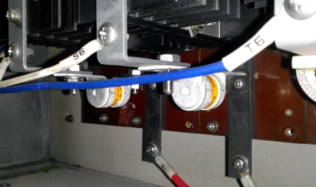
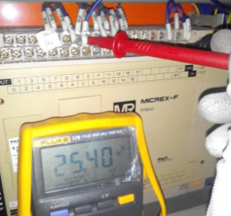
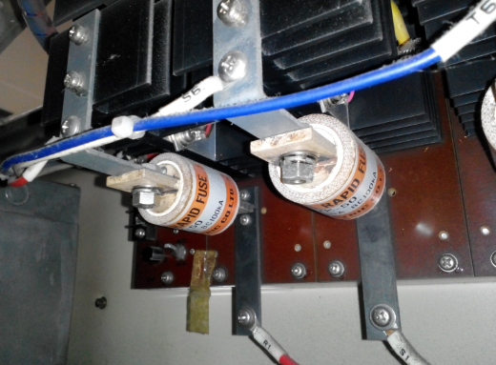
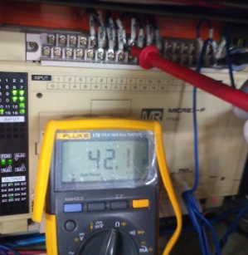
Machine Model: ATS-18100S
Error Isolation:
Machine Number: BI009
Package: SQFP144
Family Name: LC786963PW-23UF
Problem: OVEN ALARM DURING POWER ON HEATER (PRIOR TO BURN-IN)
Details of the Problem: WRONG SEQUENCE OF STOPPING BURN-IN OVEN
Details of the Root cause:
ACTION DONE | WHEN | WHO
CHECK ALL WIRING CONNECTED TO HEATER(GOOD) | 17.07.08 | ROLANDO
CHECK RELAYS(GOOD) | 17.07.08 | ROLANDO
CHECK SUPPLY VOLTAGE(NO GOOD), FOUND NO 24V SUPPLY | 17.07.08 | ROLANDO
CHECK FUSE(NO GOOD) FOUND 2 FUSE BUSTED(250V 50A), DONE REPLACED FUJI SUPER RAPID FUSE 250V 50A | 17.07.08 | ROLANDO
AFTER REPLACED CHECK 24V SUPPLY(GOOD), LOAD PROGRAM, RUN FOR 30 MINS (GOOD) | 17.07.08 | ROLANDO
2 BUSTED FUSE(250V-50A)
NO 24V SUPPLY W/ 42 ohms resistance

Slide 3
END

