Slide 1
BIN 31 SQ – fail PAT (NCP153) issue

Slide 2
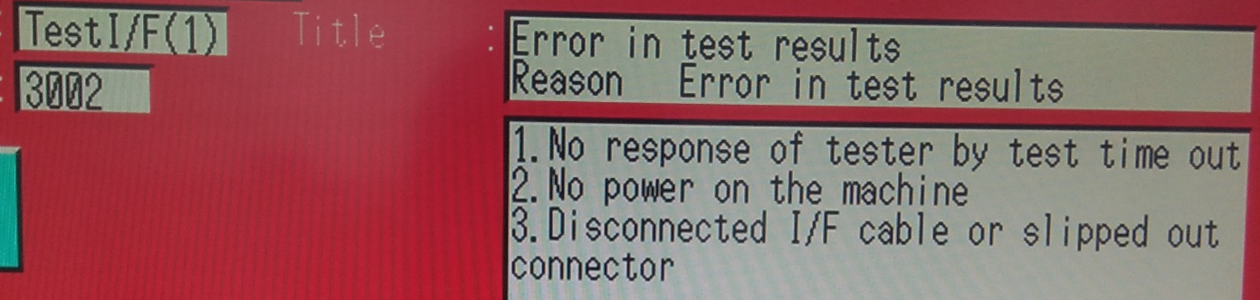
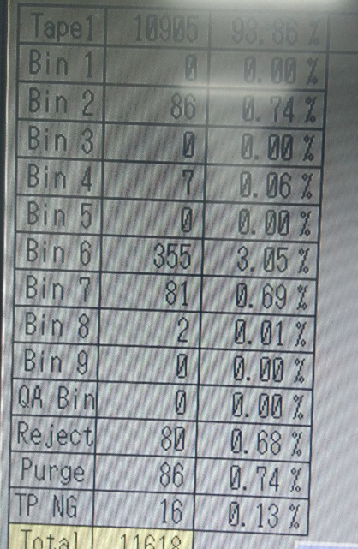
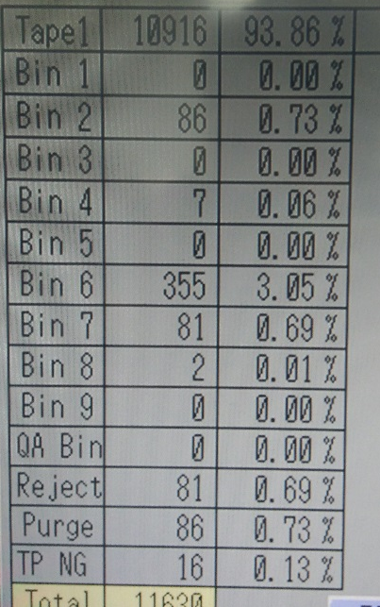
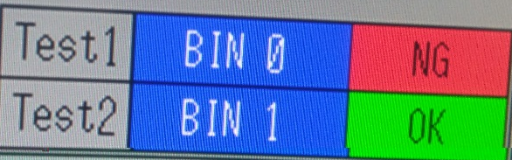
BIN 31 S – fail PAT NCP153 Validation
Handler Error
Before error
After Error
Test Hardware Bin Result
Note: The Bin 31(SQ – fail PAT) fail will sort to reject bin before good devices(Bin 1) lane
BEST PRACTICE:
Handler should have an End of Test Signal to determine the end of a test cycle. An error message should be triggered if no bin result or uncategorized bin result is received after each test cycle and handler will automatically sort the unit to the reject/purge bin

Slide 3
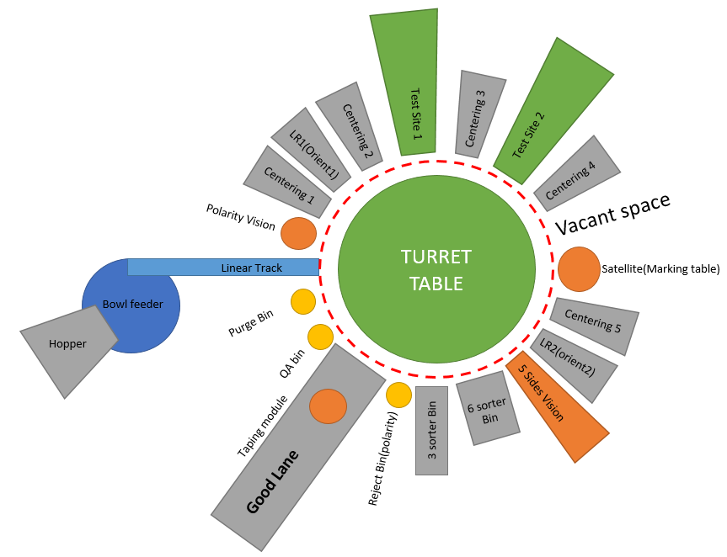
UENO handler layout
Bin 31 SQ – fail PAT reject location
Note: The Bin 31 fail will sort to reject bin before good devices(Bin 1) lane

Slide 4
