Slide 1
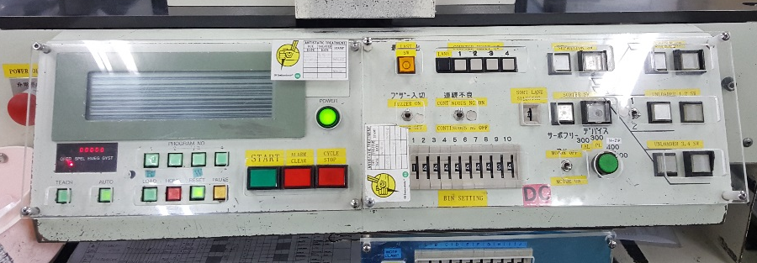
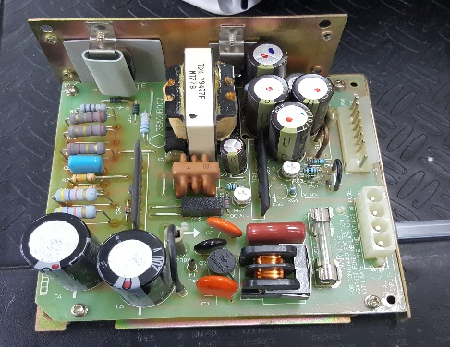
POST MORTEM
Problem Description: NO PANEL DISPLAY NO LIGHT ON CONTROL BUTTON | Machine Model : DIPDZ | Machine No: HD188 | Package : HZIP
1) Details of the Problem:
4)Pictures and Illustrations
1. Machine display panel and control button malfunction after power cycle
2) Containment Actions
 | What | Who | When | Remarks
1 | Check 24V power output | Drix / Eugene | 17.07,06 | Done
2 | Check 5V power output | Drix / Eugene | 17.07,06 | Insufficient power output, it measures 4.7V, trimmer for voltage adjustment is already at max
3 | Replace 5V power supply then adjust trimmer | Drix / Eugene | 17.07,06 | Done
Adjust trimmer to satisfy control panel voltage requirement, adjusted to 5.6V
5V Power Supply
TDK
ESX05-6R0
5) CAPA and Recommendations:
3)Root cause analysis:
Machine | Why1 | Why2 | Why3 | Why4 | Why5
 | Insufficient supply | Power supply component breakdown | Run to fail
Outflow | Why1 | Why2 | Why3 | Why4 | Why5
Systemic Root cause
 | Why1 | Why2 | Why3 | Why4 | Why5
Permanent Solutions and Recommendation
 | What | Who | When | Remarks
1 | Replace power supply | Drix |  | done
2

