Slide 1
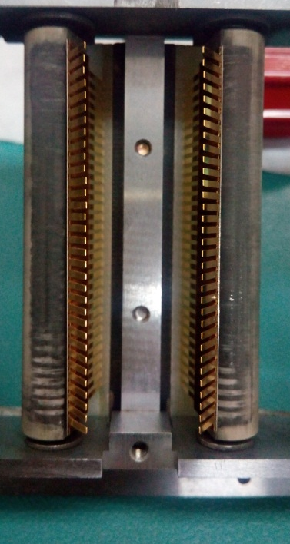
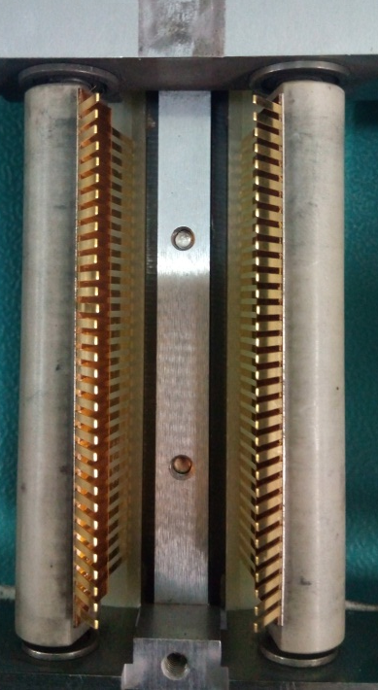
Intermittent Test Result
Problem Description: Intermittent Test Result | Machine Model:EA5204H Machine No:HD168 | Package: DIP30SD | Work Week: 32.1
1) Details of the Problem:
3)Pictures and Illustrations
Continuous fail
Worn-out roller of contactor result to intermittent test result
Condition upon Reverting roller
2) Containment Actions/Interim Actions:
 | What | Who | When | Remarks
1 | Pull-out contactor assemble revert the roller of contactor | Milo | 17.08.04 | Ok
2 | Aligned contactor with respect to device leads | Milo | 17.08.04 | OK
3 | Auto run machine and conducted leads sampling | Milo | 17.08.04 | Ok
3) Root cause analysis: Worn –out roller of contactor
Machine | Why1 | Why2 | Why3 | Why4 | Why5
 | Worn-out contactor roller | No specific lifetime when to replace | Not included in PM check item | Run to fail
Outflow | Why1 | Why2 | Why3 | Why4 | Why5
 | No defined tool life
Systemic Root cause
 | Why1 | Why2 | Why3 | Why4 | Why5
4) Recommendations :
 | What | Who | When
1 | Include in check item/check sheet | PM Group | Scheduled PM

