Slide 1
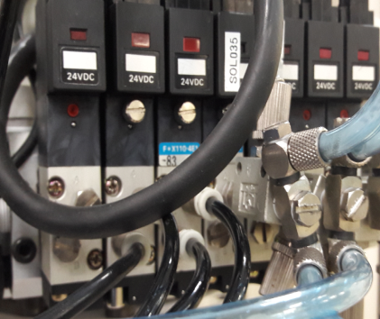
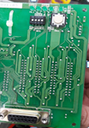
POST MORTEM
Problem Description: System error 27 and No Vacuum Supply | Machine Model : HE3000 | Machine No:HD064 | Package : HSOP28
1) Details of the Problem:
4)Pictures and Illustrations
2) Containment Actions for No Vacuum Supply of Hand 2
Resolder the connector of solenoid valve
Replaced i/o board no. 2 and no. 5
 | What | Who | When | Remarks
1 | Check the battery of manipulator | Breakthrough | 17.08.22 | done
2 | Resolder the cable of Solenoid valve | Breakthrough | 17.08.23 | done
3 | Replaced I/O board no. 2 | Breakthrough | 17.08.24 | done
4 | Calibrate the Machine | Breakthrough | 17.08.24 | done
5 | Reteach all points | Breakthrough | 17.08.24 | RTP
5) CAPA and Recommendations:
3) Containment Actions for system error 27:
Permanent Solutions and Recommendation
 | What | Who | When | Remarks
1 | Check the board of manipulator | Breakthrough | 17.08.24 | Done
2 | Check the program of SRC | Breakthrough | 17.08.24 | Done
3 | Check the DIP switch of I/O board no. 5 set to standard setting | Breakthrough | 17.08.24 | RTP
4
 | What | Who | When | Remarks
1 | Inform P.M group to check the setting of I/O board before install | Breakthrough | 17.08.24 | done
2 | Turn off the machine when soldering | Breakthroug | 17.08.24 | done

