Slide 1
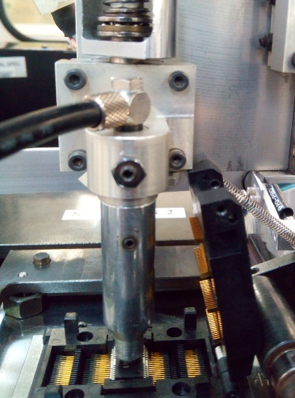
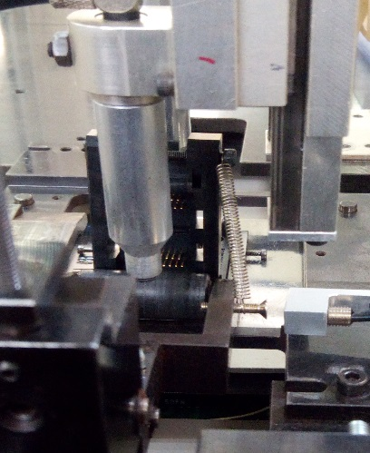
POST MORTEM
Problem Description: speed loss due to pick up miss at stn.2 | Machine Model : MFPDIX | Machine No:HD224 | Package : SOIC10
1) Details of the Problem:
4)Pictures and Illustrations
Device hit the bolt when turning
Speed loss due to pick up mis at stn.2
Hand hit the socket cap
2) Containment Actions / Interim Acttions
 | What | Who | When | Remarks
1 | set to stn2 for checking | Jher | 17.07.02 | OK
2 | unable to pick device at socket(hand obstruct by socket)hssop socket | Jher | 17.07.02 | adjust alignment of clamper retract(ok)
3 | encountered hand 2 chuck miss (device dropped when turning) | Jher | 17.07.02 | cause is the bolt that holds the spring (too long)
4 | low reading of vacuum setting when pick (hand 1) | Jher | 17.07.02 | replaced hose and directly inserted on the vacuu filter
5) CAPA and Recommendations:
Permanent Solutions and Recommendation
3) Root Cause Analysis
 | What | Who | When | Remarks
1 | Proper set-up and adjustment when dealing set-up at MFPDIX(HSSOP 28) | jher | WW27 | Closed
Machine | Why1 |  | Why2 | Why3 | Why4 | Why5
 | Pick up miss stn.2 |  | Unable to pick device at socket | Hand obstruct/hit the socket when picking | Not properly arranged socket inclination
Outflow | Why1 |  | Why2 | Why3 | Why4 | Why5
 | No proper procedure on how to set-up HSSOP device at MFPDIX
Systemic Root cause
 |  | Why1 | Why2 | Why3 | Why4 | Why5

