Slide 1
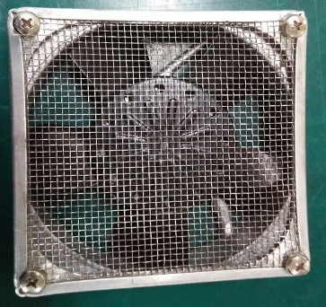
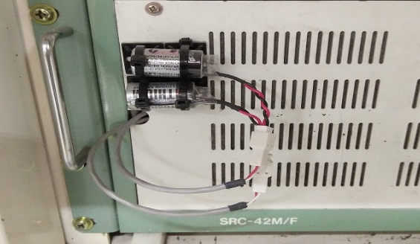
POST MORTEM
Problem Description: System error 00-0000 & 95 | Machine Model : HX8000 | Machine No:HD307 | Package : QUAD
1) Details of the Problem:
1.System error due to corrupted program on main CPU
4)Pictures and Illustrations
2) Containment Actions for system error 00-0000:
Disconnected battery on main CPU on SRC
Defective exhaust fan on SRC
 | What | Who | When | Remarks
1 | Check battery | Nante | 17.05.24 | Done
2 | Check battery on drive B and drive A found out no program on drive A | Nante / Gilbert | 17.05.24 | Done
3 | Re-load program on drive main CPU | Nante / Gilbert | 17.05.24 | Done
4 | Replaced actuator cylinder | Nante / Gilbert | 17.05.24 | Done
5 | Re-teach sort shuttle unit | Nante / Gilbert | 17.05.24 | Done
5) CAPA and Recommendations:
3) Containment Actions for system error 95:
Permanent Solutions and Recommendation
 | What | Who | When | Remarks
1 | Check all limit switch | Nante/ Gilbert | 17.05.26 | Done
2 | Check air supply | Nante/ Gilbert | 17.05.2 | Done
3 | Check exhaust fan on SRC= malfunction of fan | Nante/ Gilbert | 17.05.2 | Done
4 | Replaced defective exhaust fan | Nante/ Gilbert | 17.05.2 | RTP
 | What | Who | When | Remarks
1 | Inform LSG NW team to do not disconnect the battery on SRC controller | Nante | WW24 | open

