Slide 1
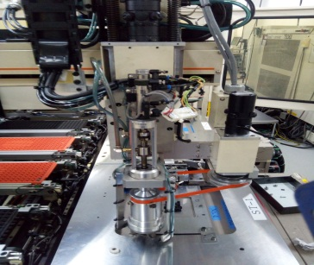
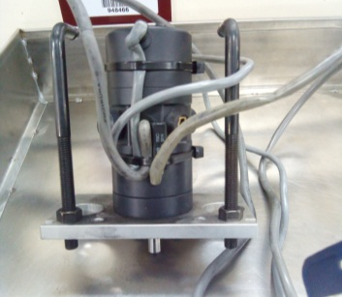
POST MORTEM
Problem Description: System error 124 | Machine Model : HX-8100 | Machine No:HD349 | Package : QUAD
1) Details of the Problem:
4)Pictures and Illustrations
System error 124
2) Containment Actions/Interim Actions:
Stacked z motor
Replaced z motor
 | What | Who | When | Remarks
1 | Checked handler z axis motor | Jher/pong | 17.07.19 | Ok
2 | unable to moved z axis assy | jher/pong | 17.07.19 | Done
3 | Stacked up z axis motor | Jher/pong | 17.07.19 | NG z motor
5) CAPA and Recommendations:
Permanent Solutions and Recommendation
3) Root cause analysis: Defective actuator cylinder and loose cam follower lock nut
 | What | Who | When | Remarks
1 | Replaced z motor | Jher/pong | WW29 | OK
2 | Recommend checking of motors every PM schedule | PM robot |  | open
Machine | Why1 | Why2 | Why3 | Why4 | Why5
 | Stacked z axis assy | unable to moved | Defective gear
Outflow | Why1 | Why2 | Why3 | Why4 | Why5
 | Undefined tool life
Systemic Root cause
 | Why1 | Why2 | Why3 | Why4 | Why5

