Slide 1

xFN Hardware Group
LE3VNCP161 LOADBOARD REPAIR
Marvin Marcos

Slide 2
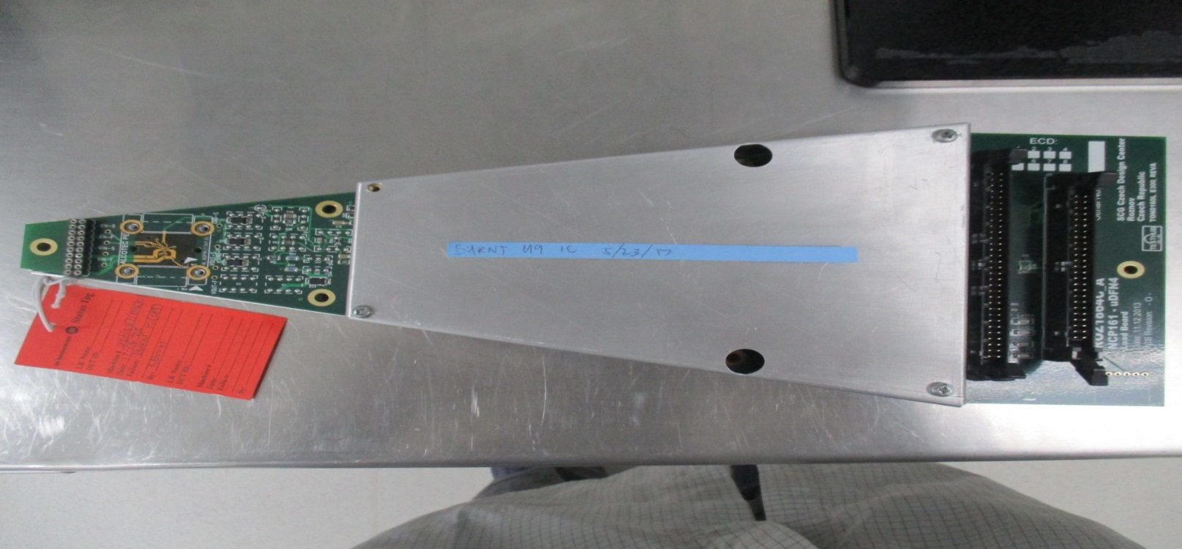
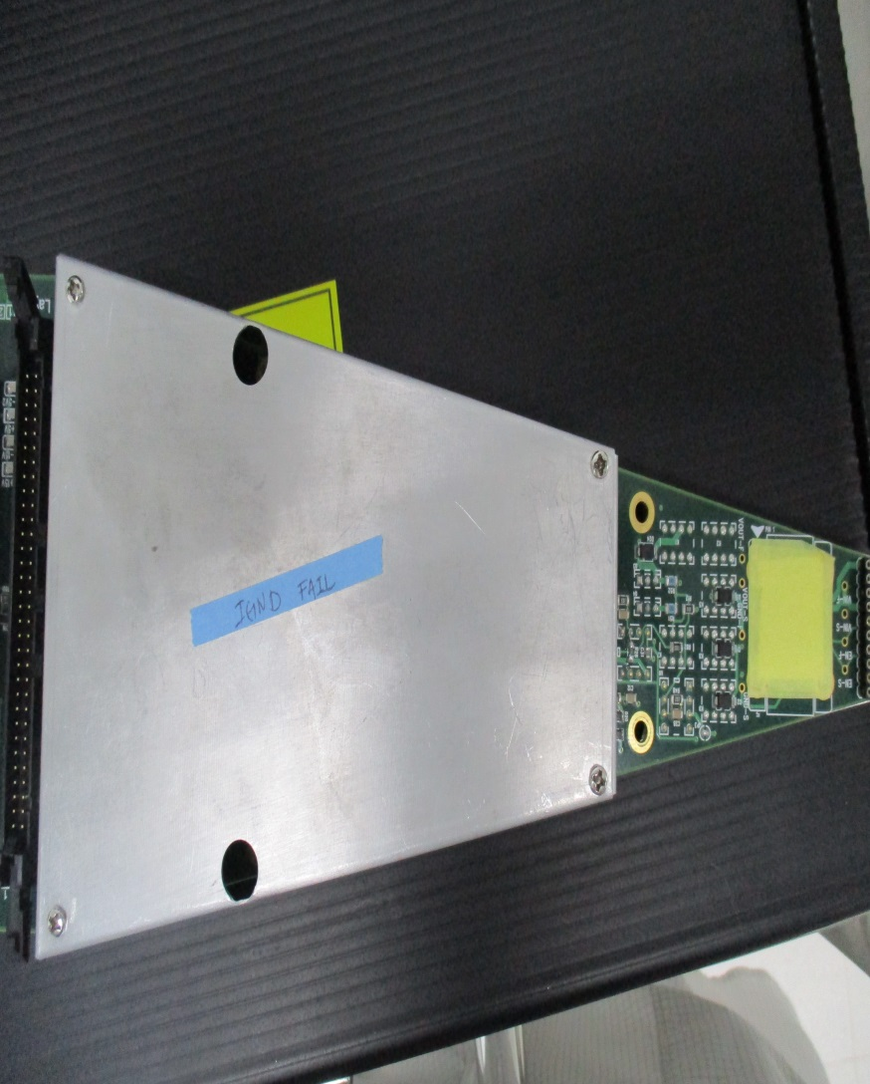
NCP161 Load board Repair
Problem :
- 2 load board of NCP161 _uDFN4 ROZ1864C_A are verified reject at test parameter “fail continuity test and IGND failure”.
LE3VNCP706 LB serial # 1 - Continuity
Failure
LE3VNCP706 LB serial # 6 IGND Failure

Slide 3
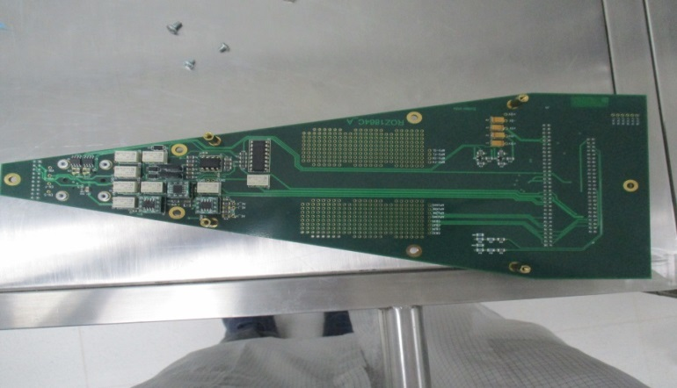
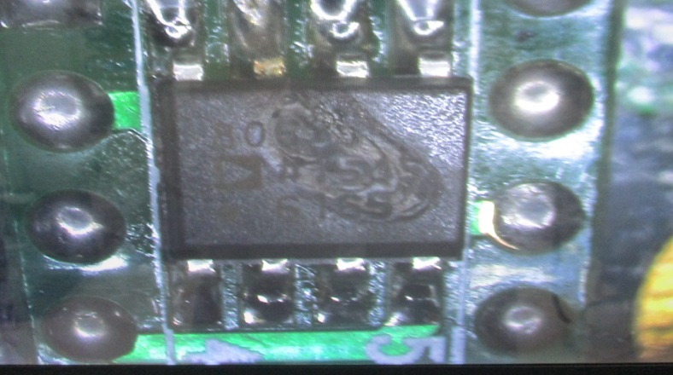
Problem Isolation in LB Serial # 1
Inspect visually all the components, traces and contact pads for any abnormalities (damage, broken, dent, burnt , etc.).(Found 1 burnt IC U9 with part no. AD8065)
Test all the components using multimeter. ( No other defective components)
Replaced defective IC.
Verify the load board using autocorr and test the board 100 consecutives times. (Result - Passed)
Analysis
- The caused of the problem is due to burnt IC
Solution
- Replaced burnt IC.

Slide 4
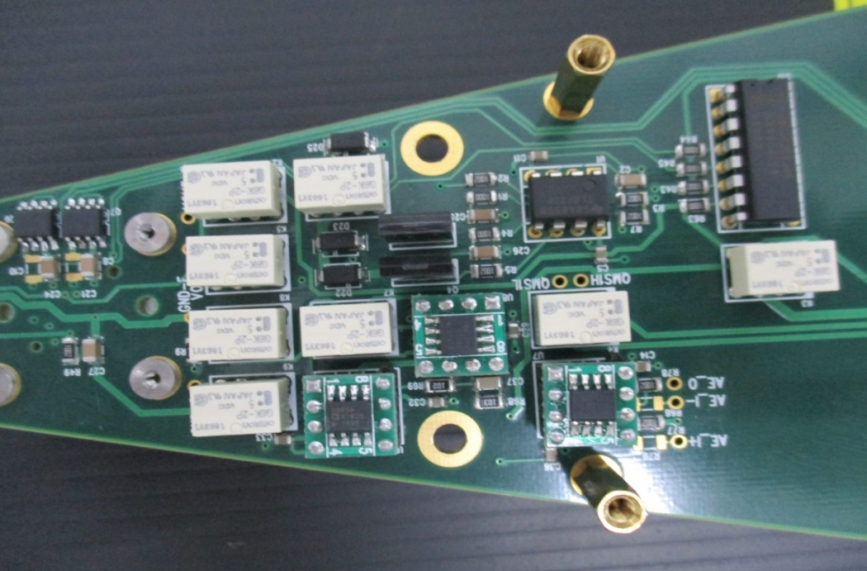
Problem Isolation in LB Serial # 6
Inspect visually all the components, traces and contact pads for any abnormalities (damage, broken, dent, burnt , etc.).(No abnormalities seen)
Test all the relay, transistor, resistors, diodes and capacitor using multimeter , all passive and active components passed (done no defective component).
Reseat all IC and relay.
Test and verify the load board using autocorr. Result passed
Test the board 100 consecutives times. (Result - Passed)
Analysis
- The main root cause of the problem is due to poor contact at relay socket that causing marginal reading in IGND test parameter.
Solution
- Reseat all the relay / IC and replaced relay sockets.

Slide 5
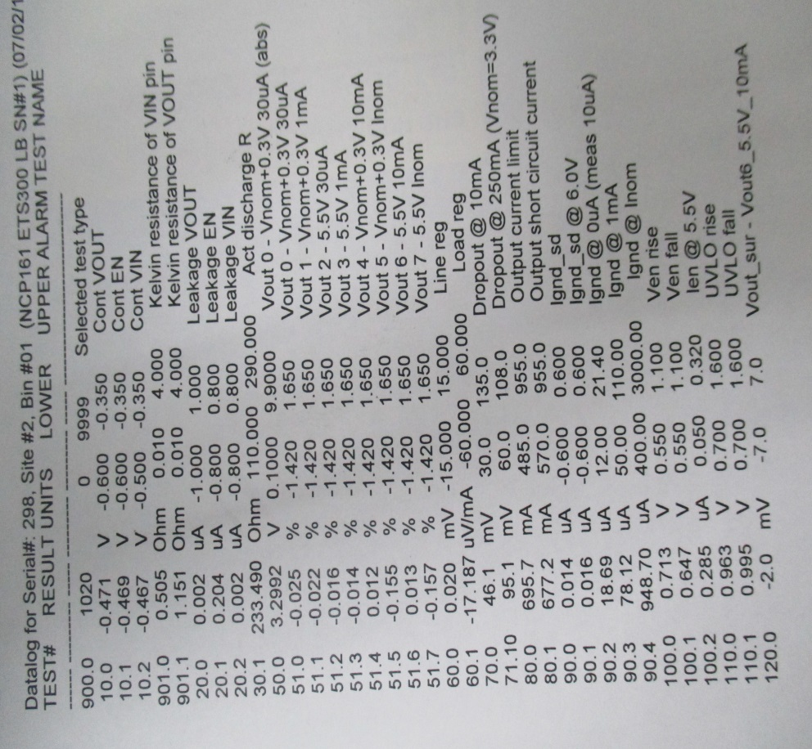
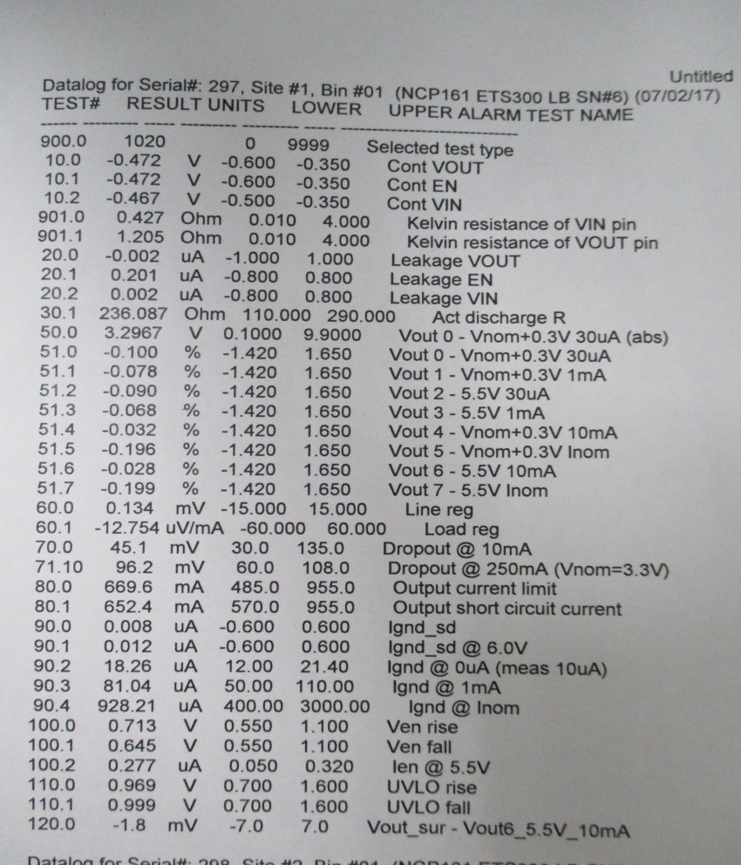
Result
- Test results at ETS303
- LE3NCP161 LB serial #1
- LE3NCP161 LB serial #6

