Slide 1
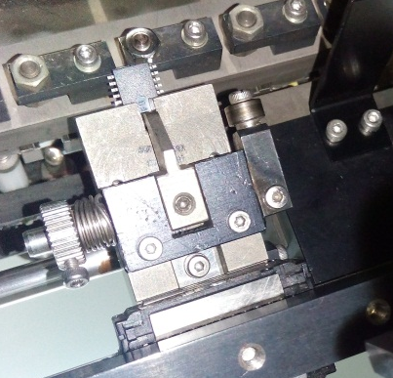
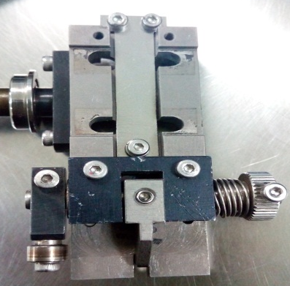
Broken Package at Drop shuttle
Problem Description: Broken Package | Machine Model:LT-930H222 Machine No:HD278 | Package: MFP24SJ | Work Week: 31.7
1) Details of the Problem:
3)Pictures and Illustrations
Broken Package
Broken package stops at drop shuttle inlet (Bottom view)
Drop shuttle assemble
2) Containment Actions/Interim Actions:
 | What | Who | When | Remarks
1 | Checked condition of drop shuttle | Milo | 17.08.04 | Ok
2 | Reduce Speed of drop shuttle actuator | Milo | 17.08.04 | OK
3 | Pull-out drop shuttle assy . And fix device stopper | Milo | 17.08.04 | Ok
Stack-up assy.of drop shuttle
3) Root cause analysis: Very tight compression spring
Machine | Why1 | Why2 | Why3 | Why4 | Why5
 | Stack-up device stopper | Very tight compression spring | No specific lifetime when to replace | Not included in PM check item | Run to fail
Outflow | Why1 | Why2 | Why3 | Why4 | Why5
 | No defined tool life
Systemic Root cause
 | Why1 | Why2 | Why3 | Why4 | Why5
4) Recommendations :
 | What | Who | When
1 | Include in check item/check sheet | PM Group | Scheduled PM

