Slide 1
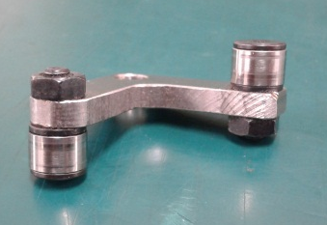
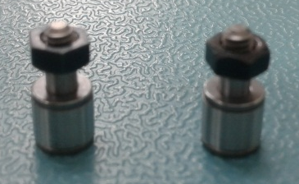
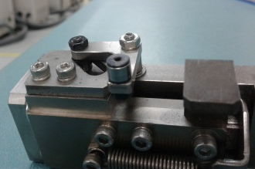
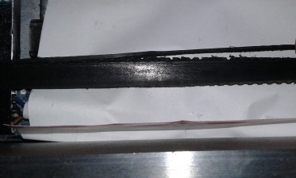
POST MORTEM
Problem Description: Input Tray Error Result to Dropped Device | Machine Model : MCE243 | Machine No: HD344 | Package : QUAD | Work Week : 24.3
1) Details of the Problem:
4)Pictures and Illustrations
1.Frequent Input Tray Error
Defectives cam follower
New cam follower
2) Containment Actions:
 | What | Who | When | Remarks
1 | Checked Tray separator | Milo G. | 17.06.12 | ok
2 | Verify if tray was having warp problem | Milo G. | 17.06.12 | ok
3 | Replaced cam follower of input tray shuttle | Milo G. | 17.06.12 | ok
4 | Cut the damaged parts of timing belt | Milo G. | 17.06.12 | ok
Location of cam follower
Damages Parts of timing belt
5) CAPA and Recommendations:
3)Root cause analysis:
Permanent Solutions and Recommendation
Machine | Why1 | Why2 | Why3 | Why4 | Why5
 | Run to fail | No defined lifespan | Not included on checklist during PM | No procedure
Outflow | Why1 | Why2 | Why3 | Why4 | Why5
Systemic Root cause
 | Why1 | Why2 | Why3 | Why4 | Why5
 | What | Who | When | Remarks
1 | Replaced defective cam follower | Milo | WW24.3 | DONE
2 | Removed whisker of timing belt | Milo | WW24.3 | DONE

