Slide 1
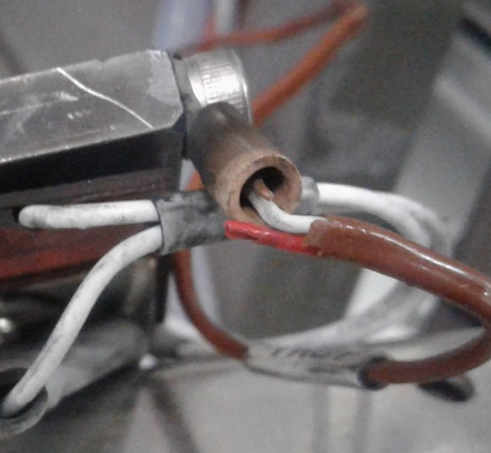
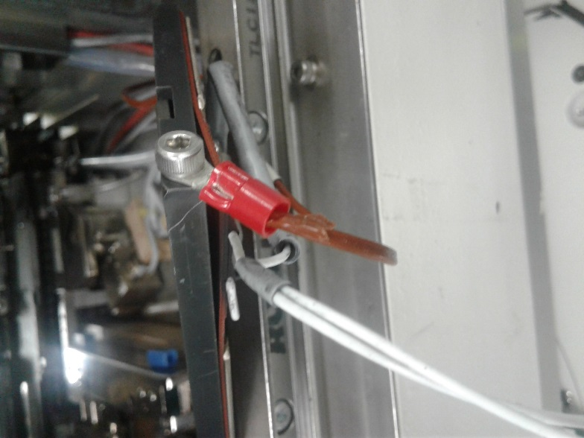
POST MORTEM
Problem Description: Temperature Communication Error | Machine Model : MCE243 | Machine No: HD361 | Package : QUAD | Work Week : 23.4
1) Details of the Problem:
4)Pictures and Illustrations
1.Temprerature Communication Error
2) Containment Actions:
 | What | Who | When | Remarks
1 | Checked wiring connections | Milo G. | 17.06.06 | ok
2 | Verify RTD connections at eyelet | Milo G. | 17.06.06 | broken
3 | Replaced eyelet connector | Milo G. | 17.06.06 | Done
4 | Auto run machine at DEMO mode to checked response of temperature during operation. | Milo G. | 17.06.06 | ok
Broken RTD Wire
Newly replaced eyelet connector of RTD
5) CAPA and Recommendations:
3)Root cause analysis:
Permanent Solutions and Recommendation
Machine | Why1 | Why2 | Why3 | Why4 | Why5
 | Run to fail | No defined lifespan | Not included on checklist during PM | No procedure
Outflow | Why1 | Why2 | Why3 | Why4 | Why5
Systemic Root cause
 | Why1 | Why2 | Why3 | Why4 | Why5
 | What | Who | When | Remarks
1 | Re-connect broken RTD wire and new eyelet connector | Milo | WW23.4 | DONE
2

