Slide 1
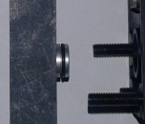
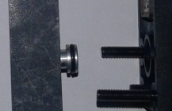
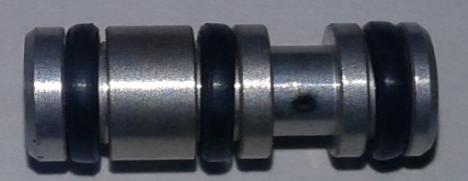
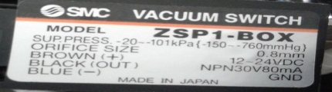
POST MORTEM
Problem Description: Arm 1 frequent suction error | Machine Model : NS5000 | Machine No: HD338 | Package : QUAD | Work Week : 25.6
1) Details of the Problem:
4)Pictures and Illustrations
Proper Spool position
1.Arm 1 –left Frequent suction error
Wrong Spool position
2) Containment Actions:
 | What | Who | When | Remarks
1 | Manually triggered solenoid valve manual override | Milo G. | 17.06.22 | ok
2 | Cleaned solenoid valve | Milo G. | 17.06.22 | ok
3 | Revert position of vacuum switch spool | Milo G. | 17.06.22 | ok
Spool
Specs and Maker
3)Root cause analysis:
5) CAPA and Recommendations:
Permanent Solutions and Recommendation
Machine | Why1 | Why2 | Why3 | Why4
 | Run to fail | Not included during PM | No specific life span
Outflow | Why1 | Why2 | Why3 | Why4
Systemic Root cause
 | Why1 | Why2 | Why3 | Why4
 | What | Who | When | Remarks
1 | Fully cleaning of spool | Milo | WW25.6 | DONE
2 | Set spool to its proper position | Milo | WW25.6 | DONE
3 | Checked functionality | Milo | WW25.6 | DONE

Slide 2
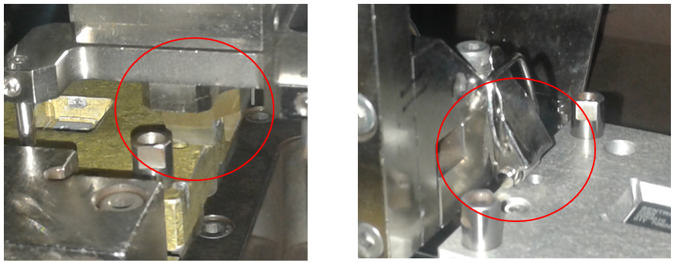
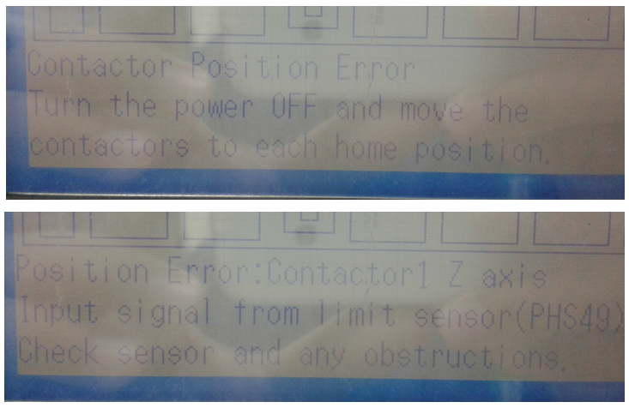
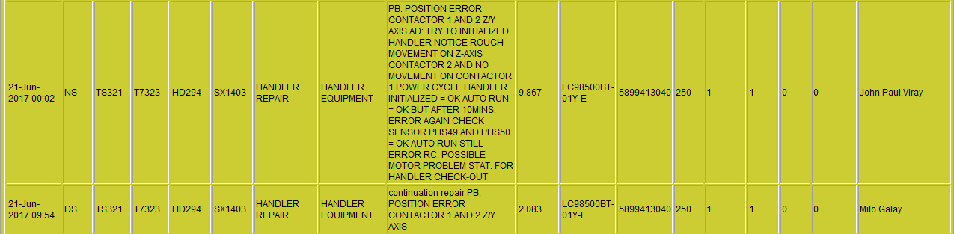
Cause of Damage Work press
Collation of work press assy. at input and out shuttle result to damage work press.
Cause by dried lubricant on Lm guide of contactor 1 and 2 this result to unstable movement ups and down.
History of machine same error occurred

