Slide 1
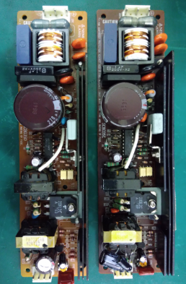
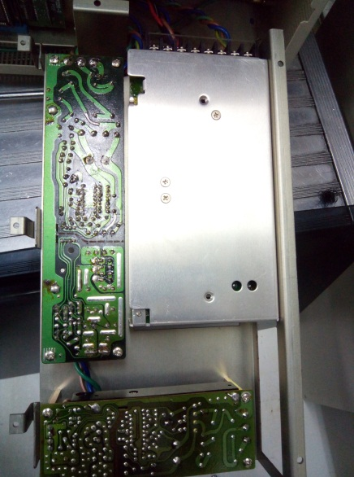
POST MORTEM
Problem Description: System error 46 | Machine Model : NS5000 | Machine No:HD359 | Package : QUAD
1) Details of the Problem:
4)Pictures and Illustrations
1.System error 46 due to defective power supply unit on SRC
1
Defective power supply unit on SRC
2) Containment Actions / Interim Acttions
 | What | Who | When | Remarks
1 | Check power supply unit 2 | JHER | 17.06.20 | OK
2 | Check power supply unit 1 | JHER/DRIX | 17.06.20 | no output
3 | Replaced power supply unit (repaired by hardware team) | JHER/DRIX | 17.06.21 | NG
4 | Replaced power board supply | JHER/DRIX | 17.06.21 | NG
5 | Re-check power supply unit 1 | JHER/DRIX | 17.06.21 | Fluctuating output voltage
6 | Replaced power supply unit 1 | JHER/DRIX | 17.06.21 | OK
2
5) CAPA and Recommendations:
Permanent Solutions and Recommendation
3) Root Cause Analysis
 | What | Who | When | Remarks
1 | Replaced power supply unit | JHER | WW29 | Closed
Machine | Why1 |  | Why2 | Why3 | Why4 | Why5
 | No 24V output on PSU 2 |  | Defective power supply unit | Run to fail
Outflow | Why1 |  | Why2 | Why3 | Why4 | Why5
 | No defined tool life
Systemic Root cause
 |  | Why1 | Why2 | Why3 | Why4 | Why5

