Slide 1
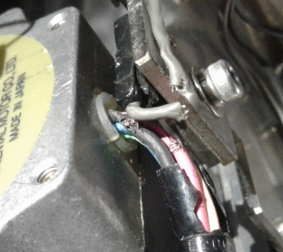
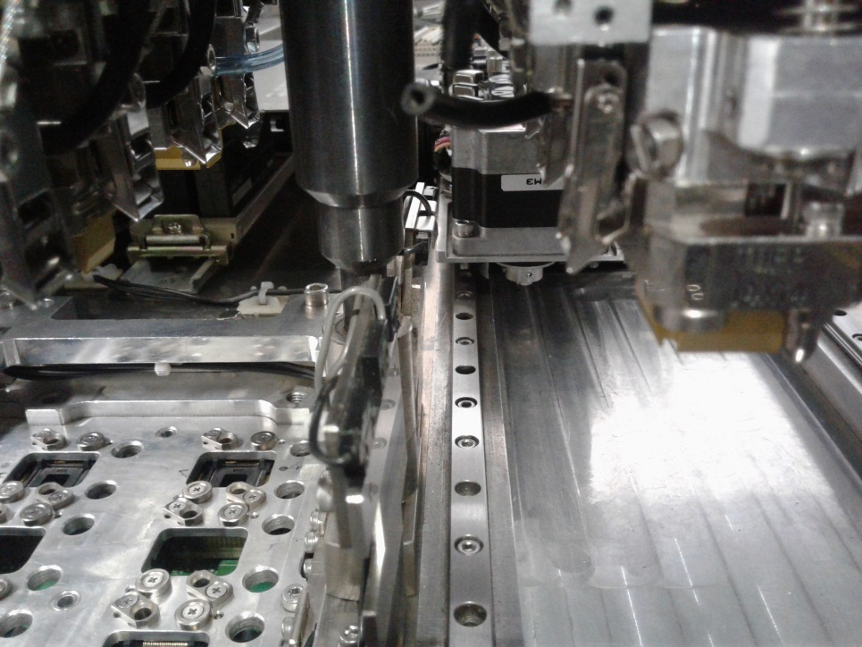
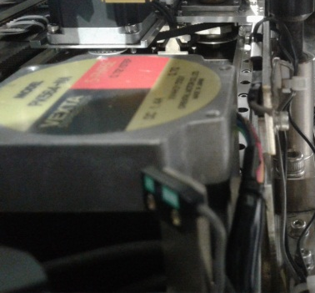
SF DEVICE ROTATION FAILURE(2-H&2-D)
Problem Description: Frequent sf device rotation failure(2-H and 2-D) | Machine Model:RT2158 Machine No:HD364 | Package: TQFP281L | Work Week: 29.2
1) Details of the Problem:
3)Pictures and Illustrations
Long down time due to frequent sf device rotation failure
Broken wires of motor and sensor cause during collision
Poor alignment of sensor holder result to damage
2) Containment Actions/Interim Actions:
 | What | Who | When | Remarks
1 | Conducted pin to pin checking | Milo | 17.07.16 | Ok
2 | Checked cables of sf motor unloader rotation2 | Milo | 17.07.16 | With broken wire
3 | Re-soldered broken wires | Milo | 17.07.16 | Ok
4 | Changed position of SF unloader rotation2 motor | Milo | 17.07.16 | Ok
5 | Replace Defective sensor | Pong | 17.07.16 | Ok
Position of motor wires facing to sensor result to damaged
3) Root cause analysis: Poor alignment of sensor Holder
Machine | Why1 | Why2 | Why3 | Why4 | Why5
 | Deformed sensor holder | Untighten/Loose cap screws | No specific lifetime when to replace | Not included in PM check item | Run to fail
Outflow | Why1 | Why2 | Why3 | Why4 | Why5
 | No defined tool life
Systemic Root cause
 | Why1 | Why2 | Why3 | Why4 | Why5
4) Recommendations :
 | What | Who | When
1 | Include in check item/check sheet | PM Group | Scheduled PM

