Slide 1
1.0x1.0mm Marking reference dislocation
Machine No.: SRM01
Prepared by: Jessie Enriquez
Member: Leadwin Beltran

Slide 2
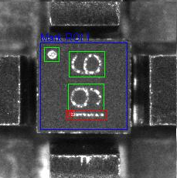
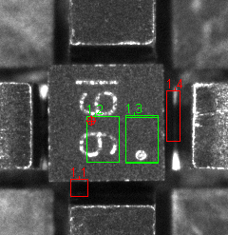
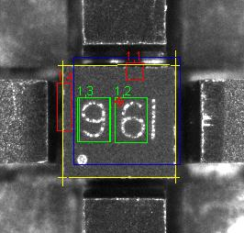
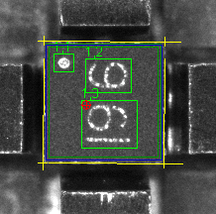
1.0x1.0mm Marking reference dislocation
Problem: Marking reference cannot locate by vision system causing dislocation of marking.
Findings: Vision system confuse to detect the mark reference due to the same character symbol 9 & 6.
Initial marking reference settings
Sample of dislocation of marking
Marking reference
Note: The bar on marking set as mark reference.
Note: Marking reference cannot capture by vision system due mark character 9 & 6. The vision system confuse on the same character symbol.
Solution: Set the 6 & bar( I ) as marking reference to prevent vision system confusion on the same character symbols.
Marking reference
Note: Set character “6I” as a marking reference to locate the proper orientation of marking

