Slide 1
SSMP Software Development Roadmap
Auto Test Summary Enabling

Slide 2
Auto Test Summary Enabling ROADMAP
Q4’15 | Q1’16 | Q2’16 | Q3’16 | Q4’16 | Q1’17 |  | Q2’17
PROJECT: AUTO TEST SUMMARY GENERATION FOR SSMP
Overall:
3%
11%
85%
100%
NW:
5%
22%
90%
100%
SW:
5%
22%
75%
100%
J750(100%)
Phase I (Manual)
Phase II (Auto)
HIGH RISK
T33XX, T73 (100%)
A1800 (100%)
T65XX (100%)
TS6010, 600MIX (100% )
TS2000/TS1000 (100%)
A340/A360 (100%)
A1800/A1600 (100%)
WL25V/ WL224C (100%)
A1800/A1600 (100%)
Wl12**, (0%)
UIC5040( (0%)

Slide 3
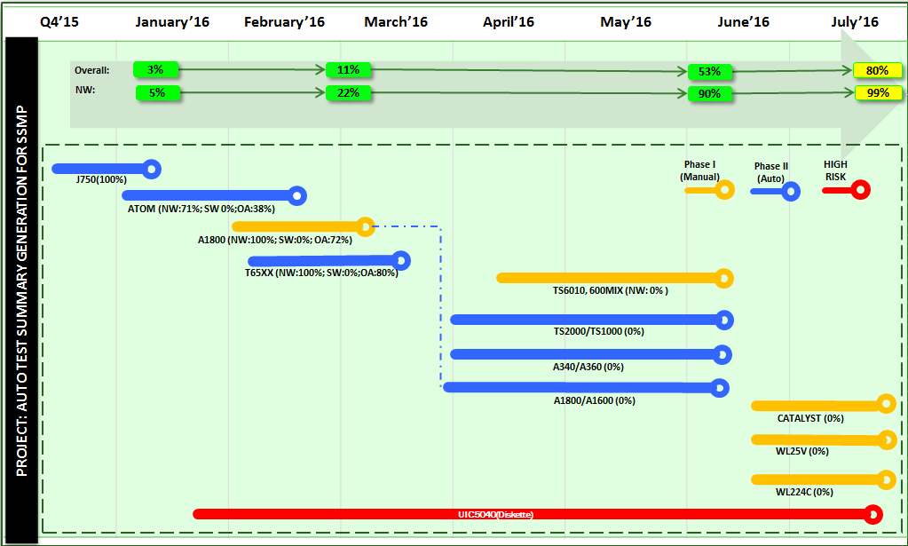
SSMP Test Printing Activity – WW31’16
# | Key Deliverables (Major Milestones) | POR | Forecast / Actual
1 | Kick-off meeting for Test Printing Project (SSMP) | WW34’15 | WW34'15
2 | Assessment of all Testers for Test Printing Capability | WW35’15 | WW35'15
3 | (Auto): J750 Test Printing | WW52'15 | WW01'16
4 | (Auto): T7323, T33XX, T3128 Test Printing | WW06'16 | WW06'16
5 | (Manual) : A1800 Test Printing | WW08'16 | WW09'16
6 | (Manual) : T65XX Test Printing | WW09'16 | WW10'16
7 | Development of new Phoenix Client (Investigation, validation, testing, UAT, etc.) | WW22’16 | WW22’16
8 | TS6010, 600MIX Test Printing | WW24'16 | WW24'16
9 | A1800/A1600 Test Printing | WW26'16 | WW27'16
10 | TS2000/TS1000 Test Printing | WW26'16 | WW27'16
11 | A340/A360 Test Printing | WW26'16 | WW27'16
12 | WL25V/WL224C Test Printing | WW30'16 | WW30'16
Highlights & Accomplishments:
100% Completion on OA SSMP Tester, remaining 14% are due to machine capability
~100% completion Test Summary printing for all capable testers. – Project Closure
Benefits of Test Summary Printing are now being seen with the help of the IPQA to audit the test summary output.
Lowlights & Issues:
None
Needed To Do Job:
None
 | Key Risks | C & MH
# | Decisions Confirmed
1 | WL12, CATALYST will be using camera as proof of Test Summary Print
2 | Probe testers are not included in the project scope

