Slide 1
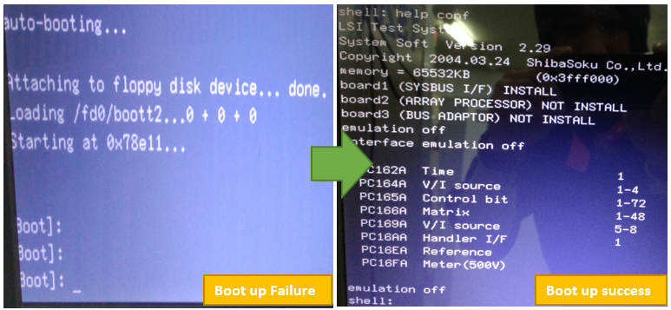
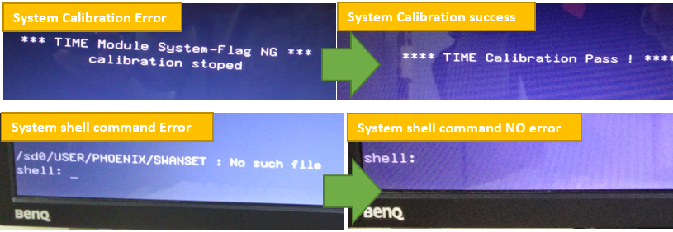
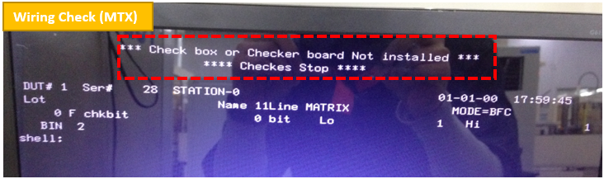
WL224C TS314 System Boot up Failure Update
OBJECTIVE: WL224C TS314 System Boot Up Failure resolution. HIGHLIGHTS & ACCOMPLISHMENTS:
Successfully resolved Boot up failure due to hard disk as a result of Controller failure thru replacing affected IDE part and able to replicate start up batch files derive from same tester platform due to multiple failure during start up. Able to debugged encountered failure of TN234 with open readings thru debugged tool and replace affected modules with allotted spare.
LOWLIGHTS & ISSUES
Multiple errors and module failure after start up. Obsolete Parts and has No more OEM support (Discontinued Product) Machine relocation as a result of troubleshooting interruption. Help Need: Hardware and modules reparability
# | Key Deliverables (Major Program Milestones) | POR | Fcst / Actual
1 | Tester’s boot up assessment | WW31.3 | WW31.3
2 | Troubledhooting boot up failure | WW31.4 | WW31.4
3 | Boot up failure resolved | WW31.5 | WW31.5
4 | Diagnostic and calibration troubleshooting | WW31.6 | WW31.6
5 | RTP | WW31.7 | WW31.7 WW32.2 (Troubleshooting was interrupted due to machine relocation)
# | Key Risks / Issues (Top 5 +/- 2) | H,M,L
1 | Obsolete Parts / No OEM | H
2 | Data and Test Program hard to retrieved | M
# | POR Decisions
1

