Slide 1
Machine hung-up UENO01

Slide 2
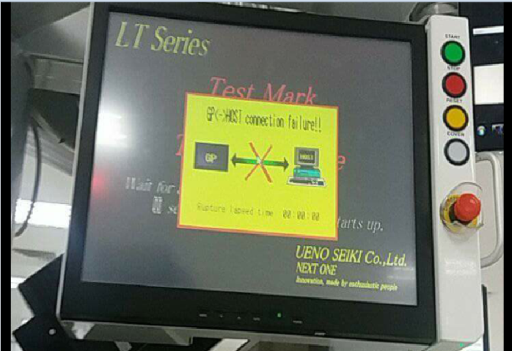

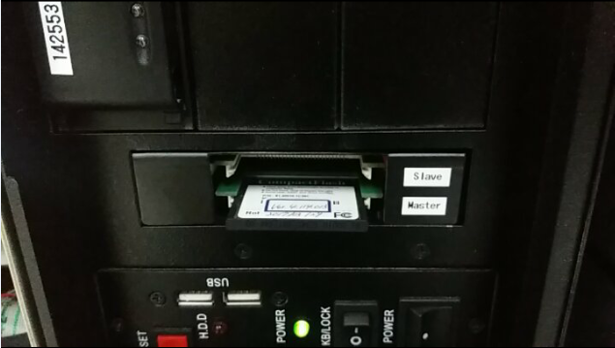
GBIB ERROR
PANEL FREEZE
MEMORY SLAVE AND MASTER (cf card)
Bios setting:
Press up or down button, highlight advanced chipset features, then press enter to select
Press PCI express root port function
Change all ports settings from auto to change to disabled, highlight auto setting pressing arrow up and down, then press enter. Select disabled setting by pressing up and down, then enter
After setting is done, press F10 to save the setting.
Reboot mc then power on-same GPIB error
Encounter pop-up error application(the memory could not be written)
Restart MC then reinsert slave and master card-same GPIB error
Machine power off, take out slave card
Machine power on, 3 mins machine power off
Connect slave card then power on-same
Try to reboot without slave card then insert slave card on 40 sec. count-machine progress
Restart machine-machine reboot
Return to original position then run to production
ROOT CAUSE: CF card not detected
Recommendation: possible replacement for CF card

