Slide 1
Problem encountered on Ueno06.
Machine Serial No. 142553-1
Machine module: Taping module

Slide 2
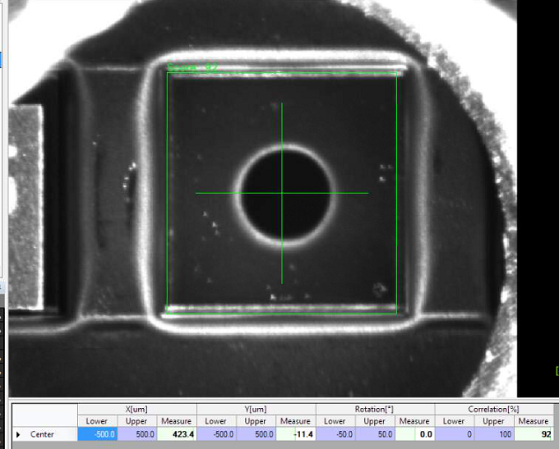
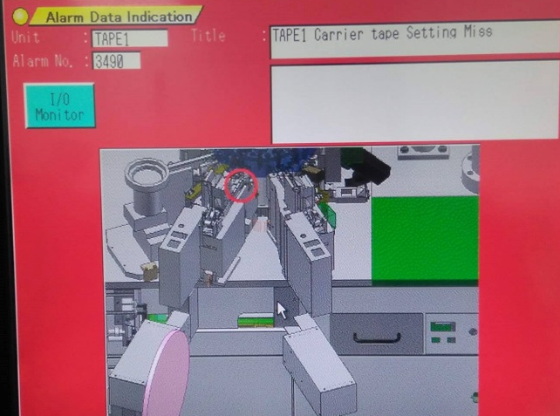
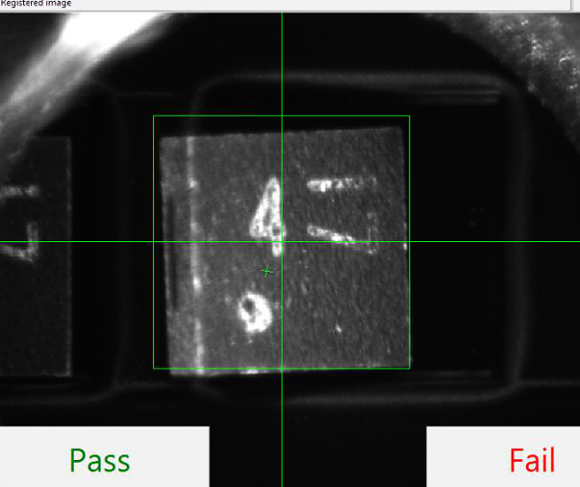
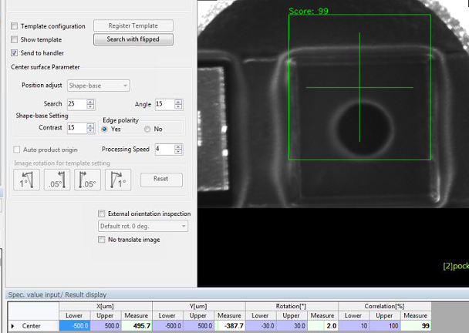
Problem encountered on Ueno06 frequent taping offset pocket
Sample 1
423.4microns
ERROR DISPLAY
TILTED DEVICE
Sample 2
Problem: Frequent carrier tape pocket offset( backward)
Note: Already patched 400 microns compensation. But we still encountered more than 400 microns pocket offset.
Suggestion: Please make the carrier tape pocket offset up to 600 microns pocket offset as stated on the previous report.
Error encountered: PKG insertion error( jam at tape insertion ).
Risk assessment: Possible will cause of device bottom scratches and chipping on top package.
495.7 microns

Slide 3

Problem: Tape pocket frequently dislocated backward during machine running.
Tape vision system
Turret nozzle
Insertion jam detection
Gap = 2 mm
Harmonic Drive Motor
Center distance carrier tape pocket
Offset backward carrier tape pocket
Note: Folded carrier tape causing offset pocket
Bottom base
Distance = 72 mm
Findings/Root cause: Harmonic drive motor angular speed is greater than Feed2 offset motor angular speed causing folded carrier tape during carrier tape indexing resulting to frequent pocket offset.
Harmonic Drive motor = 700 pulse
Feed2 offset motor value = 500 pulse
Corrective action: Set the Feed 2 offset motor angular speed greater than Harmonic drive motor angular speed
Harmonic Drive motor = 200 pulse
Feed2 offset motor value = 500 pulse
Note: Machine set up for 3M carrier tape.
Preventive Action/s:
Review and Setup all Ueno handler taping module angular speed differences of harmonic drive and feed2 offset motors.
Set the machine capability to align the pocket offset up to 600 microns compensation.
Revise Ueno documentation included to setup and conversion procedure.

Slide 4


Taping Module good Set up
Tape Sealing system
Turret nozzle
Urethane clamper
Tape vision system
F2
F1
Carrier tape Output
Feed2 offset motor
Tension spring
Harmonic drive motor
C-curve
Carrier tape input
Good Setup: Feed2 offset motor > Harmonic drive motor
Controller Setup: Feed2 move offset > Feed2 origin offset
F2>F1

