Slide 1
UENO07 GPIB connection error
Machine No.: UENO07
Serial No.: 142616-2
Date: 170818

Slide 2
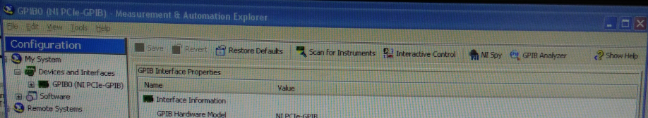
Problem: The handler has no communication to tester
Change point: The handler cannot reboot after hang up occurred.
Time of down: 13:36H 17.08.18
Isolations done:
Rebooted the handler & reinserted the master & slave CF card– Handler rebooted successfully.
Upon running handler & tester it has no communication.
Verify the GPIB module & interface cable with other handler – Still no communication.
Verify communication using tester application [ GPIB0 (NI PCIe-GPIB) ]. Verified handler has no response to tester after scanning for instruments.
Verify other handler(UENO02) – communication responded.

Slide 3
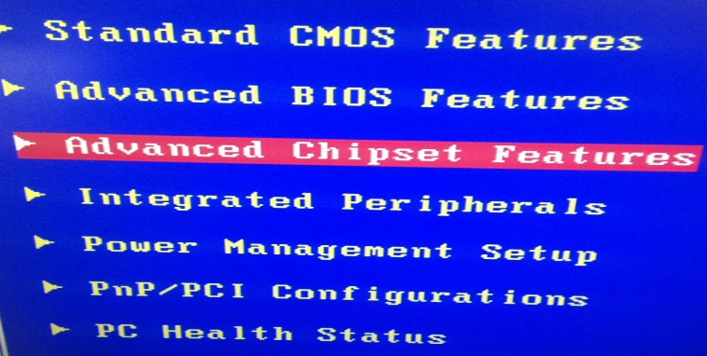
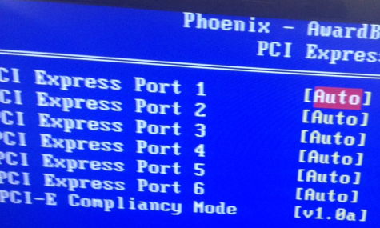
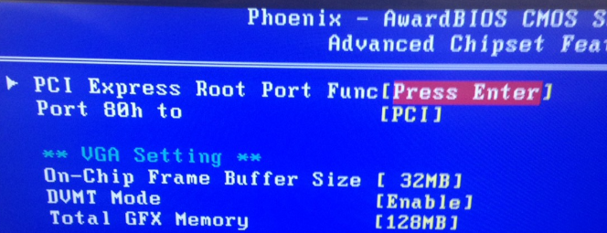
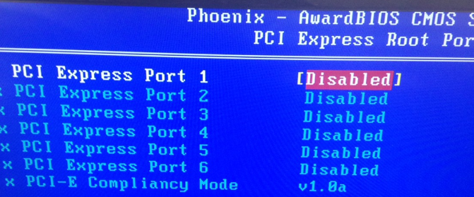
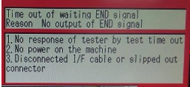
Rebooted the handler using monitor screen for manipulation of AwardBIOS CMOS Setup.
Set up the AwardBIOS CMOS from auto mode to disabled mode – still no communication
1
2
3
4
Changed the LAN connection from GPIB module to handler CPU, port 2 to port 1. handler responded on the tester.
During machine running after ~12 devices was tested, the tester & handler communication has no response.

Slide 4
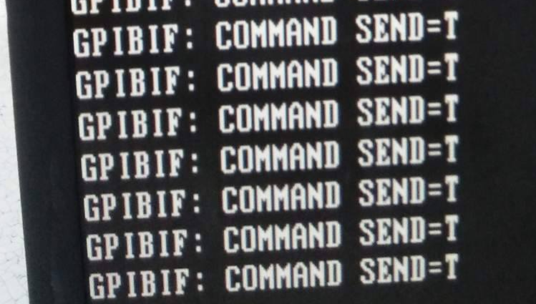
Returned the LAN port from port 1 to port 2 and reboot the handler.
Verify the running condition of the machine, result continuously communication of tester and handler.
Handler monitor
Possible root cause: BIOS module has no communication due to low battery as per discussed with UENO team.
Action: Request quotation for BIOS module battery and Identify frequency of change.

