Slide 1
EXCEL MISSING TOOLBARS
Machine No.: UENO07
Serial No.: 142616-2
Date: 170818

Slide 2
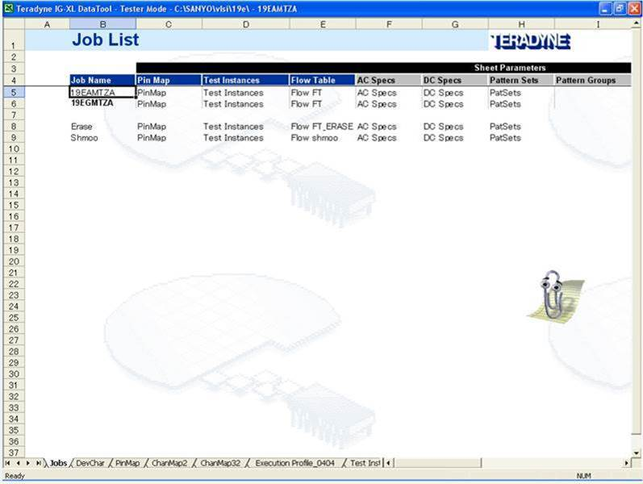
TOOL BARS ARE MISSING
Root cause: Unknown, why toolbars are disappear.
Solution: Press Alt+F11 to open the developer window. In immediate window, paste and run this code to
Root cause: Unknown, why toolbars are disappear.
Solution: Press Alt+F11 to open the developer window, paste and run this code to restore the toolbars
Sub SampleProc ()
Dim x
On Error Resume Next
For x = 1 To Application.CommandBars.Count
With Application.CommandBars(x)
.Reset
.Enabled = True
End With
Next x
End Sub

