Slide 1
Pearl Challenge Raise’24
Mayank Anand

Slide 2
About Data
Data is about Indian Farmers. The training dataset contains 53279 unique farmer records.
Feature Categories:
Demographic and Household info
Seasonal Agriculture Data (Kharif and Rabi)
Environmental and Geographic Features
Village level Socio-Economic Indicators
Credit and Income information
Survey and Metadata
Temporal Coverage
Metadata | Count
Farmer | 53279
Region | 5
State | 17
District | 405
City | 2760
ZipCode | 4632
Village | 5774

Slide 3
Data Cleaning
2. Entity Grouping (Reducing Cardinality)
1. Outliers
Target Variable / Total Income:
Lower Cap: 100
Upper Cap: 2,165,000
Quantile based binning for variables:
Active loan in bureau:
zero_nos_active_loan: 0 active loan
one_nos_active_loan: 1 active loan
low_nos_active_loan: [2, 3] active loan
mid_nos_active_loan: 4 active loan
high_nos_active_loan: >4 active loan
Count Based: Entity with low (5 nos.) count in data grouped as ‘others’
Village
District
ZipCode
3. Drop Duplicates
Duplicate Seasonal Data for 2022, 2021 and 2020
Cropping Density
Irrigated Area
Seasonal Soil Types Features

Slide 4
Feature Engineering
YoY Change:
Environmental:
Ground water thickness
Ground water replenishment
Average Rainfall
Agricultural:
Cropping Density
Seasonal agricultural Performance
Seasonal agricultural score
Bins based on non-agricultural income:
Village
District
Zipcode
Bins based on Agricultural land:
Village
District
Zipcode

Slide 5
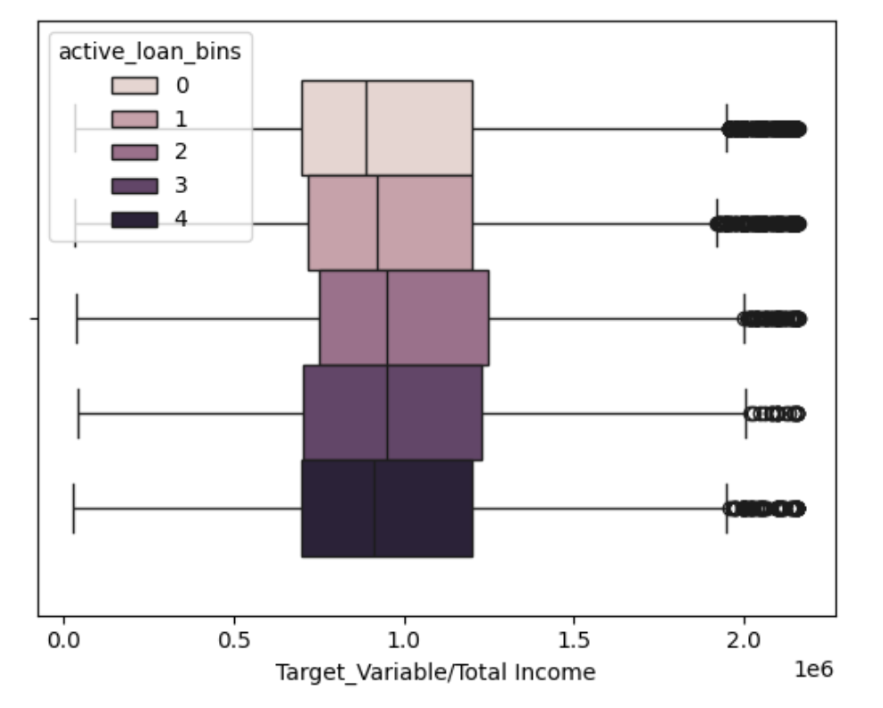
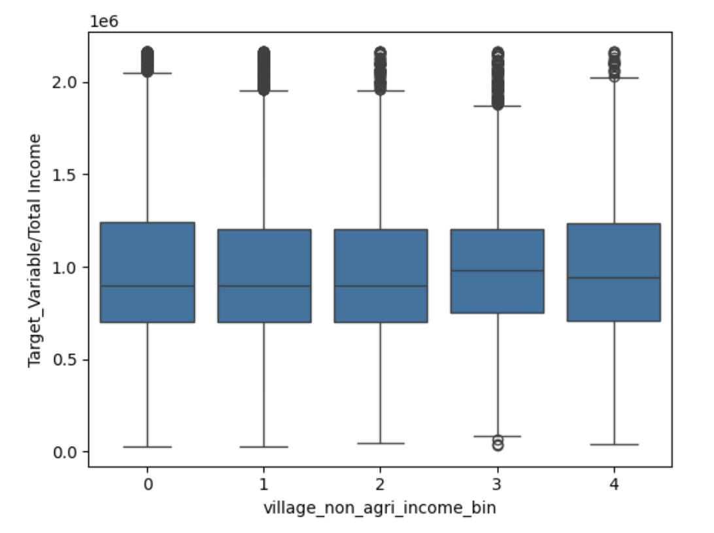
Feature Engineering
Feature | Target Variable Distribution | Remarks
Active Loans in Bureau |  | Active loans in bureau count is binned and mapped to labels: [0, 1, 2, 3, 4]. 0: Zero active loans or NO loan 1: Only one active loan 2: Two or Three active loans in Bureau 3: Four active loans in Bureau 4: More than four active loans in Bureau Kruskal Wallis Test: 2.25e-45 (pvalue)
Village bins based on Non-Agricultural income |  | Because data is zero skewed, quartile cut is applied to data with non-zero non-agricultural income records separately. Intervals: [(0.499, 100000.0] < (100000.0, 145000.0] < (145000.0, 200000.0] < (200000.0, 967960.0]] Kruskal Wallis Test: 7.37e-32 (pvalue)

Slide 6
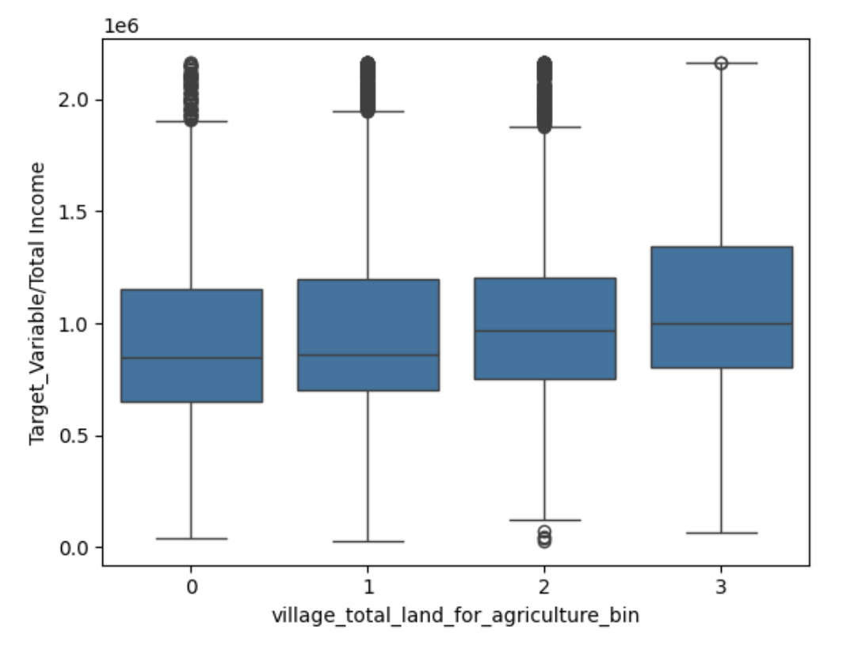
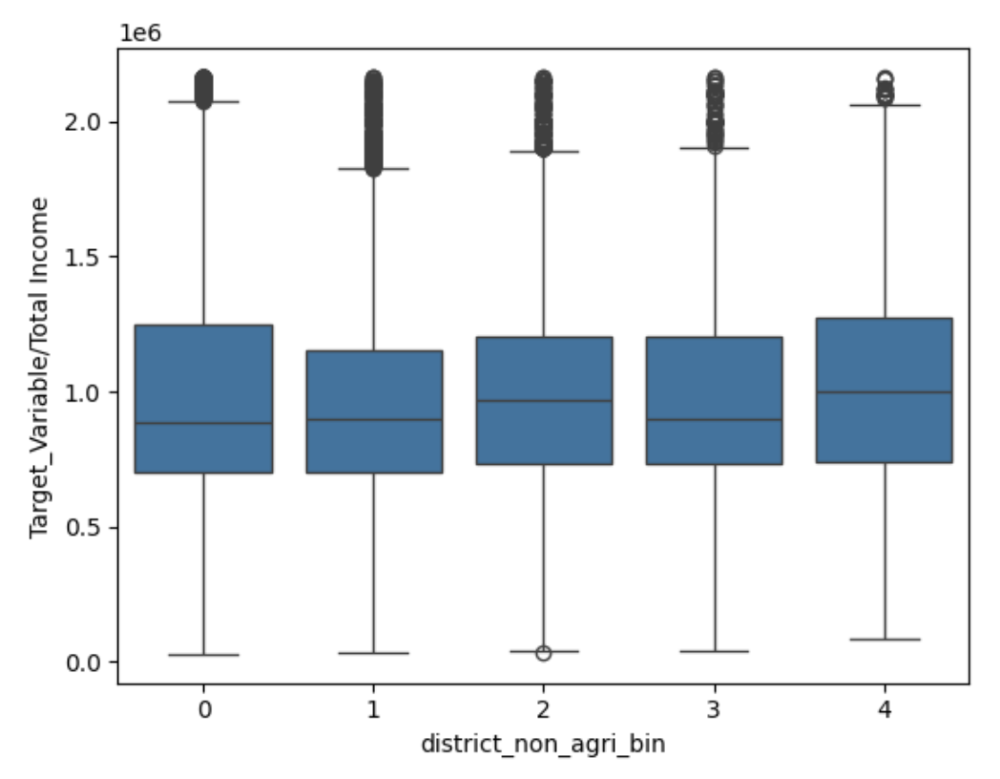
Feature Engineering
Feature | Target Variable Distribution | Remarks
Village bins based on Agricultural Land |  | Quartile cut is applied on agricultural land feature Intervals: [(1.999, 5.25] < (5.25, 9.0] < (9.0, 10.0] < (10.0, 27.0]] Kruskal-Wallis: 2.36e-255 (pvalue) This states that Target Variable has different distribution for different groups of this bins
District bins based on Non-Agricultural income |  | Same approach has been followed as with Village binning Intervals: [(0.999, 123750.0] < (123750.0, 200000.0] < (200000.0, 302000.0] < (302000.0, 740000.0]] Kruskal Wallis: 6.26e-70 (pvalue)

Slide 7
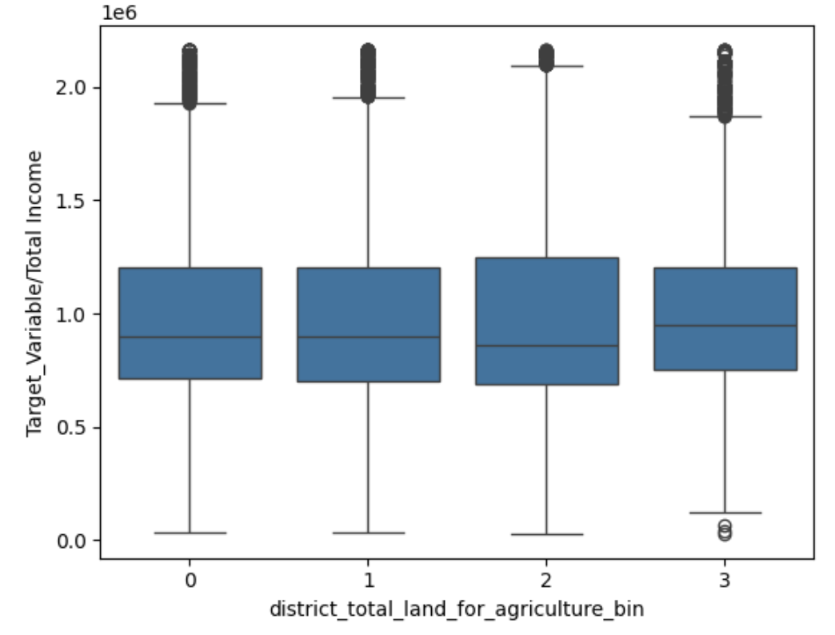
Feature Engineering
Feature | Target Variable Distribution | Remarks
District bins based on Agricultural Land |  | Quartile cut is applied on agricultural land feature Intervals: [(1.999, 5.25] < (5.25, 9.0] < (9.0, 10.0] < (10.0, 27.0]] Kruskal-Wallis: 1.8e-41 (pvalue) This states that Target Variable has different distribution for different groups of this bins

