Slide 1
Comparative analysis of selected cross-platform frameworks in relations to native development approaches
Maciej Sroczek 242450
Supervisor: dr inż. Dariusz Konieczny

Slide 2
General assumptions
Mobile applications overtake the market
Mobile development technology is constantly changing
Choosing wrong technology can be costly
There are many criteria for evaluation but performance is of high priority because UX is key today
There are numerous scenarios worth testing but the proces is labor-intensive therefore abstraction can be proposed:
Abstracting usability with single task oriented sample apps
Abstracting variety of devices by performing tests on older and newer smartphones with different hardware and software

Slide 3
Goals
Perform a comparative analysis of native and cross-platform approaches to mobile development. The primary basis for the comparison is the performance of applications created using those methods.
Analyze results
Determine possibly optimal use-cases for different implementation methods and specific frameworks
Analyze the improvement among different solutions as compared to their older versions considering breaking changes to their architecture
Find advantages and disadvantages in various aspects of single-codebase applications development

Slide 4
Research methodology
Research metrics
CPU usage
Normalized for Android (Average and Max)
Per core for iOS (Average and Max)
Memory consumption
Average
Max
Power consumption
Average
Max
Frame rate (FPS)
Average
Min
Stability

Slide 5
Research methodology
Research scenarios
Testing tool
List scrolling and filtering
Animations
File input and output
Common UI elements
GameBench Studio Pro

Slide 6
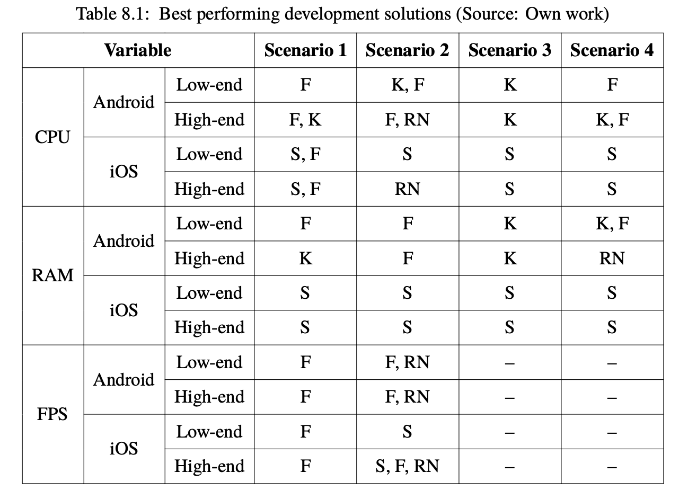
Achieved results
Use-cases

Slide 7
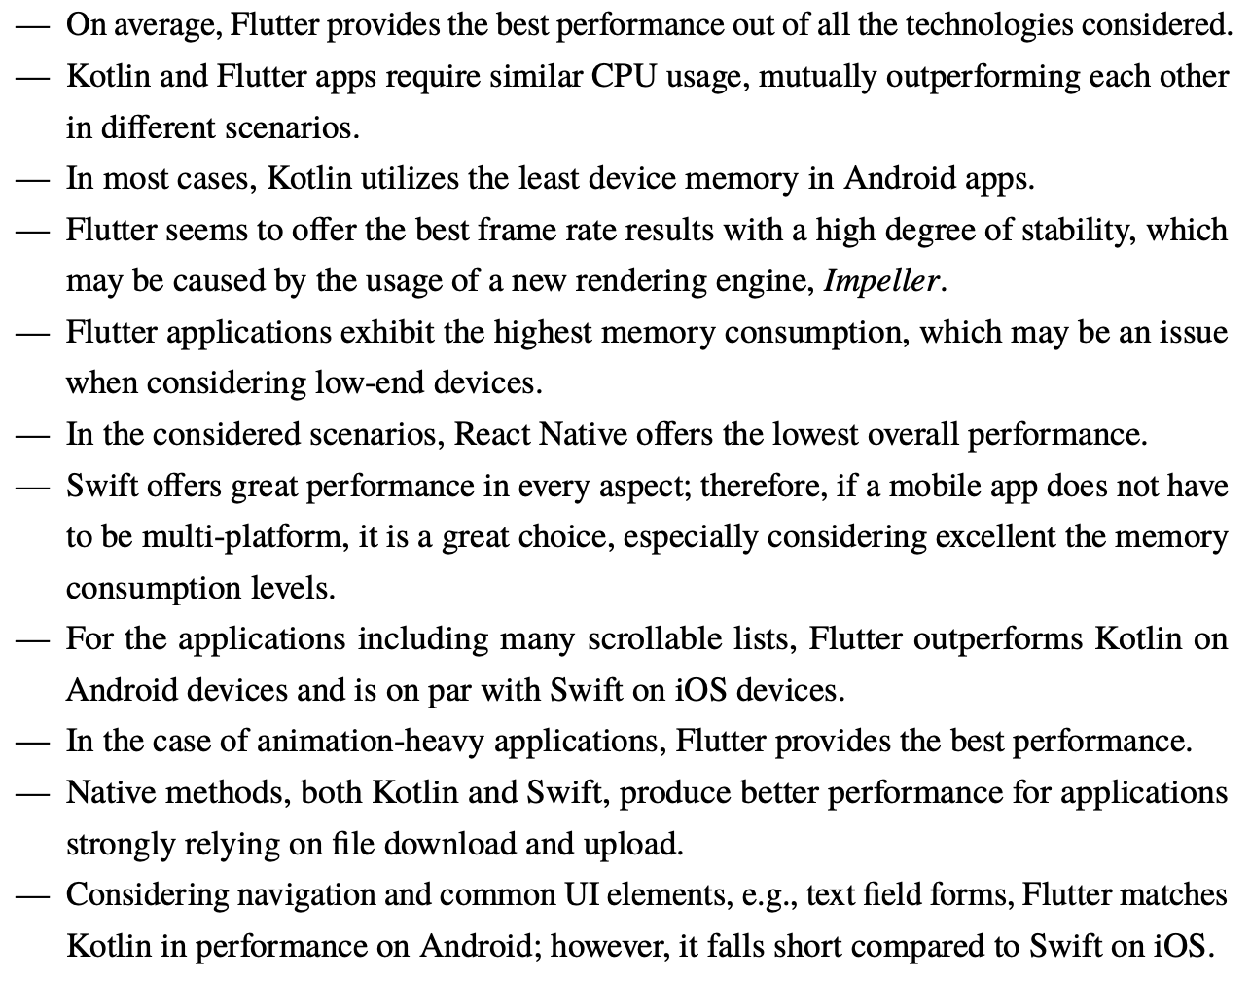
Achieved results
Use-cases

Slide 8
Achieved results
Improvement
Flutter -> Impeller
Less janky frames
More smooth / stable animations
More consistent framerate
Lower CPU and RAM usage
React Native -> New Architecture
JS bridge bottleneck elimionated
Faster rendering times
Neutral CPU and RAM usage

Slide 9
Achieved results
Advantages and disadvantages of cross-platform frameworks
Advantages
General: quicker development and maintenance, consistent user experience
Flutter: best performance overall, great documentation
React Native: small app size, more external kits, better for web developers
Disadvantages
General: sometimes native code may be difficult to add
Flutter: big app size, many custom components needed for a truly native look, worse for mobile developers
React Native: no Material3, worse performance, navigation more difficult to implement

Slide 10
Thank you for listening ☺

