Slide 1
Programming in Lib2024
Shantal Macarthur

Slide 2
Going backwards in Time…

Slide 3
Final Assignment

Slide 4
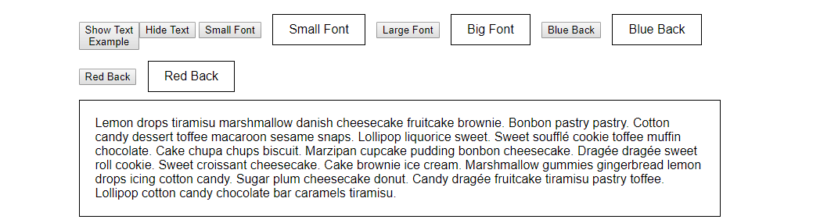
In class 3
<button onclick="show()" id="show">Show Text
<div class="btnshow" id="show">Example</div>
<button onclick="hide()" id="hide">Hide Text</button>

Slide 5
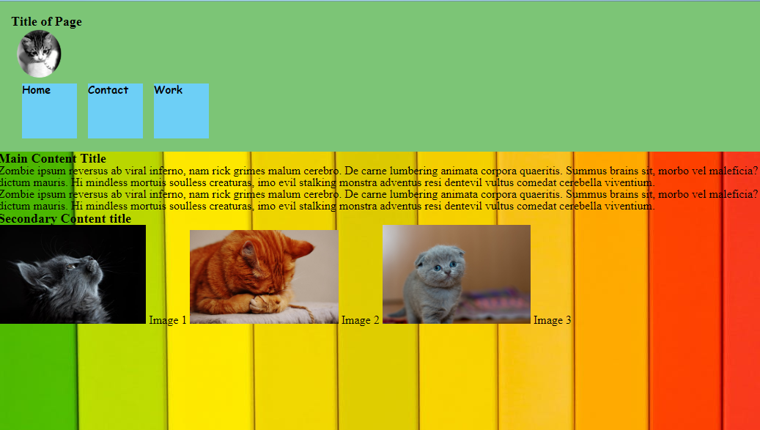
Assignment 4
.sidebar {
height: calc(length-50%);
width: 160px;
float: right;
position:absolute;
right:70px;
bottom:670px;
top:70px;
box-sizing: border-box;
/*Needs to be moved just below the header on the right side, as is it's running into text.*/
}

Slide 6
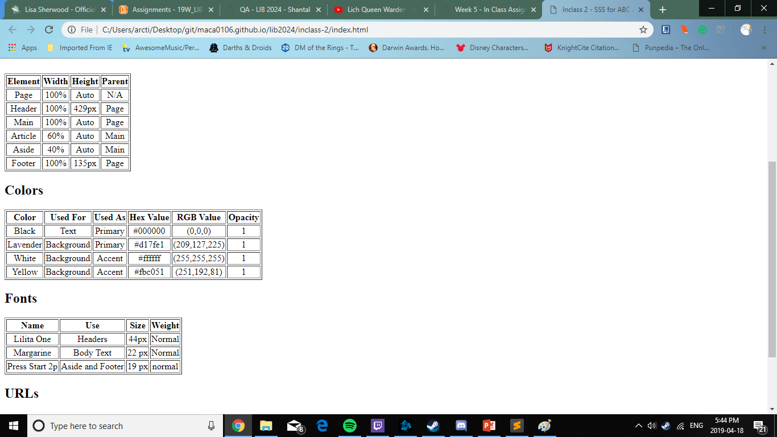
In class 2
<section id="urls">
<h2>URLs</h2>
<a href="https://fonts.google.com/specimen/Lilita+One">Lilita One</a>
<a href="https://fonts.google.com/specimen/Margarine">Margarine</a>
<a href="https://fonts.google.com/specimen/Press+Start+2P">Press Start 2P</a>
</section>

Slide 7
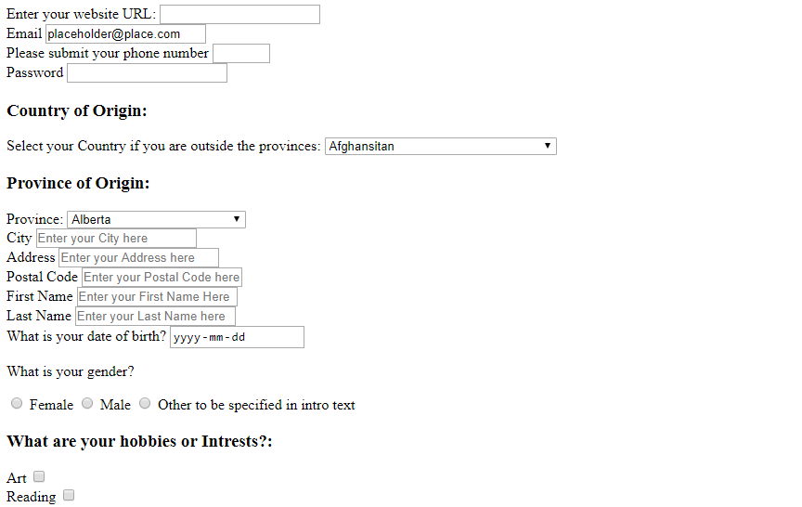
Assignment 3
<div id="country-drop-container" class="form-elm">
<!-- Drop down menu for Country -->
<h3>Country of Origin:</h3>
<label for="country">Select your Country if you are outside the provinces:</label>

Slide 8
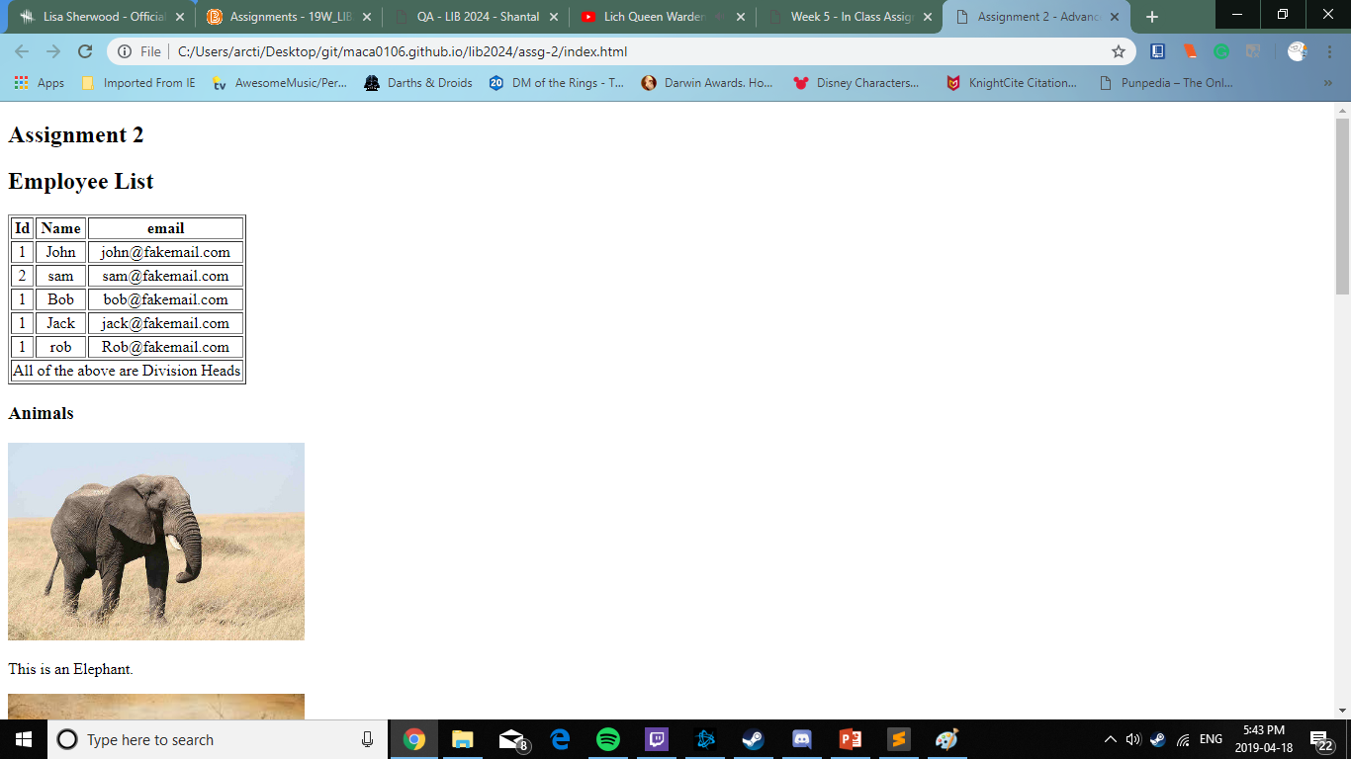
Assignment 2
<header id="list"></header><h2>Employee List</h2>
<!-- Creating a table to organzie the information about the employees. -->
<table border = "1">
<!-- Creating a table and first row of information -->
<tr>
<th align="center">Id</th>
<th align="center">Name</th>
<th align="center">email</th>
</tr>

Slide 9
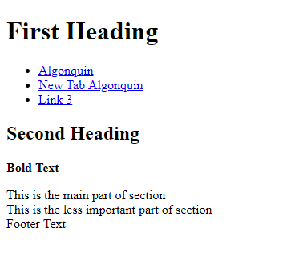
In class 1
<main>
<!-- Creating the main body of work for the program-->
<section>
<h2>Second Heading</h2>
<p><strong>Bold Text</strong></p>
<!-- First of two sections, must be in body. -->
</section>
<section>
<article>This is the main part of section</article>
<aside>This is the less important part of section</aside>
<!-- Creating a final content section for the body-->
</section>
</main>

Slide 10
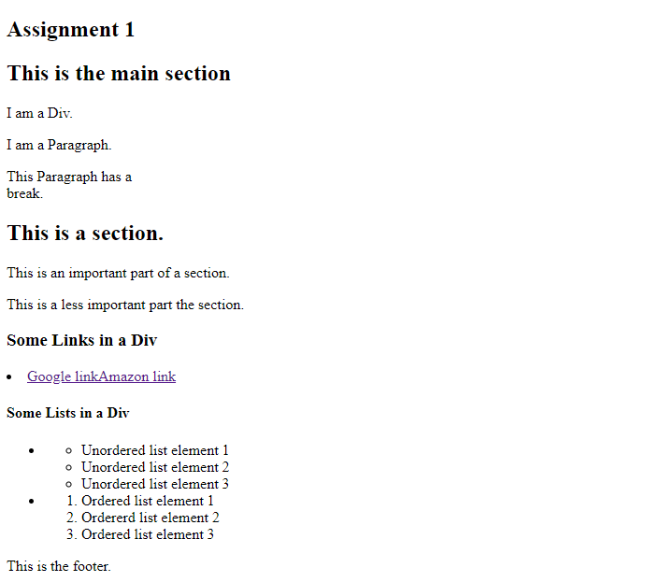
Assignment 1
<div>
I am a Div.
<!-- Creating a div tag, and finishing it off. -->
</div>
<p>
I am a Paragraph.
<!-- Creating a normal Paragraph. -->
</p>
<p>This Paragraph has a <br>break.</p>
</section>

Slide 11
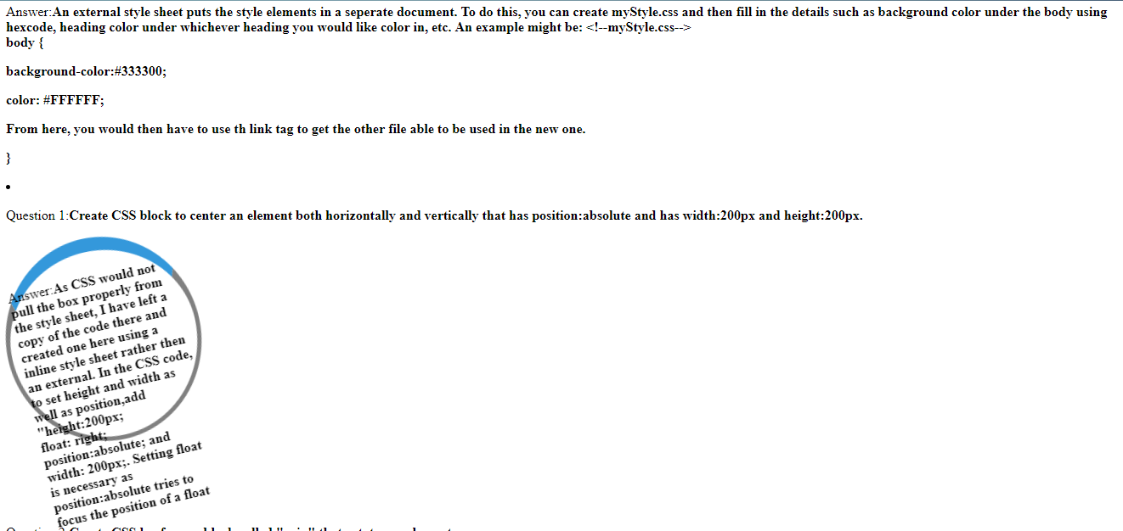
Q/A
<style type="text/css">
/*Temporary style sheet as the css is not currently working; animation for later questions*/
.box {
height:200px;
float: right;
position:absolute;
width: 200px;
padding: 10px;
border: 5px solid gray;
margin: 0;
border-radius: 50%;
border-top: 16px solid #3498db;
animation:
spin 2s linear infinite,
border-radius-change 1s ease infinite;
}

