Slide 1
RECAP OF LAST YEAR

Slide 2
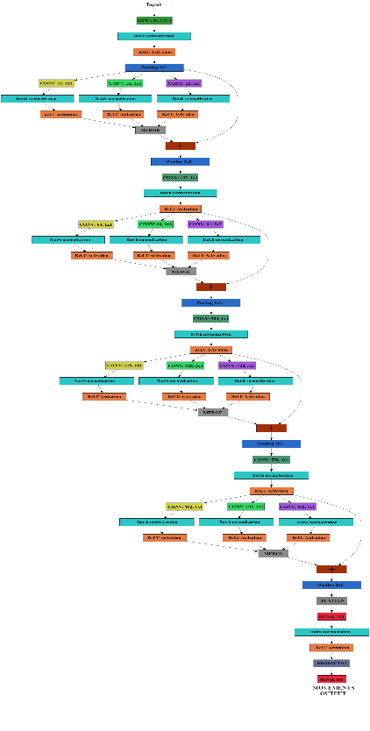
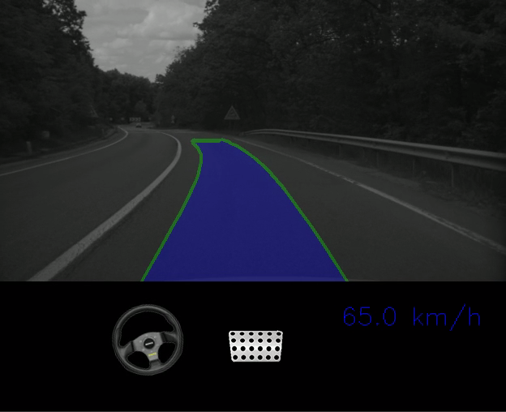
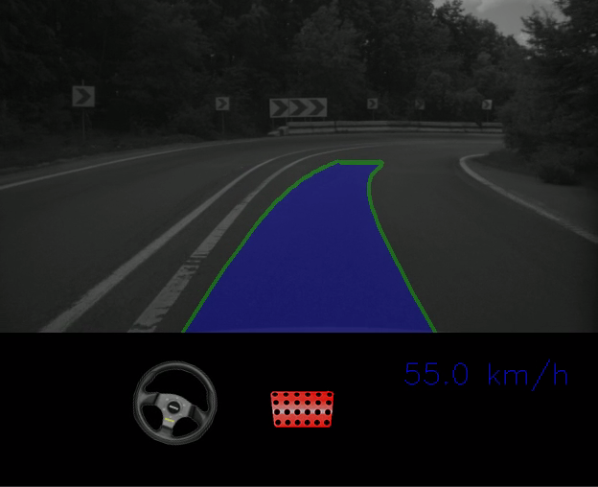
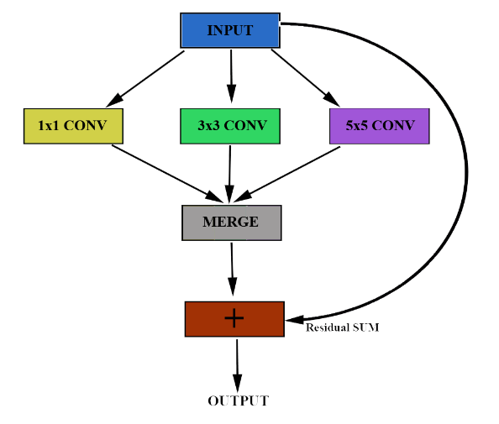
Car trajectory estimation
Recap of last year
Description
Deep learning approach for predicting the car’s near future path (or trajectory), based on disparity images
Predicts car’s movements over the next second, can be used for steering / braking
Architecture
Deep learning network built from scratch based on state of the art techniques
Current status
Part of OFT team, working of flow-based object detection (series production for FVG3)
Still keeping an eye on deep learning topics
Mentor for Road condition monitoring topic, which is needed for Motorcycle project(s)
Pass on knowledge and expertise gained
2
Automotive Electronics | RBRO/ESA1 | 2018-03-12
© Robert Bosch GmbH 2018. All rights reserved, also regarding any disposal, exploitation, reproduction, editing, distribution, as well as in the event of applications for industrial property rights.

Slide 3
ROAD CONDITION MONITORING

Slide 4

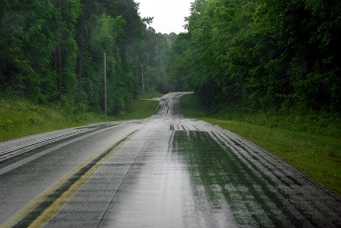
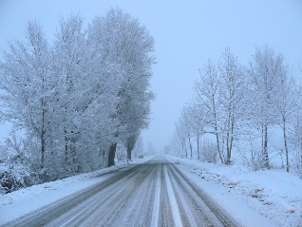
Overview
Road condition monitoring
Description
Deep learning approach for identifying the road condition: dry, wet, snow (possibly others as well later on)
Typical classification task
We can use the already available set of sequences from Bosch dataset
4
Automotive Electronics | RBRO/ESA1 | 2018-03-12
© Robert Bosch GmbH 2018. All rights reserved, also regarding any disposal, exploitation, reproduction, editing, distribution, as well as in the event of applications for industrial property rights.

Slide 5
Dataset
Road condition monitoring
Dumped images from Bosch sequences
Labeled the entire sequence with the same class -> drawbacks
~75000 training images (25k from each class)
~15000 validation images (5k from each class)
~15000 test images (5k from each class)
102 dry sequences
62 wet sequences
18 snow sequences
5
Automotive Electronics | RBRO/ESA1 | 2018-03-12
© Robert Bosch GmbH 2018. All rights reserved, also regarding any disposal, exploitation, reproduction, editing, distribution, as well as in the event of applications for industrial property rights.

Slide 6
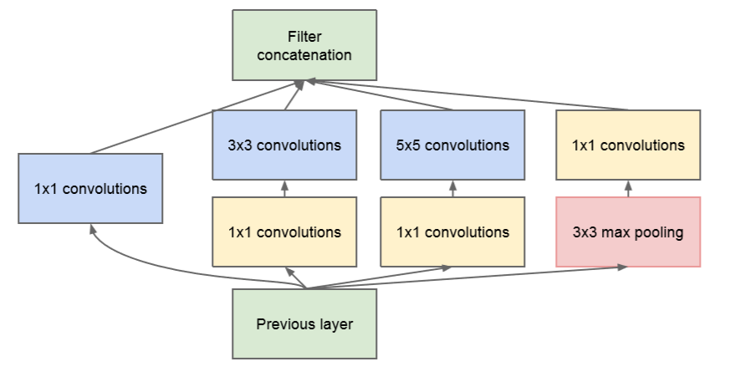
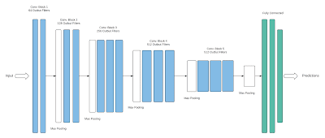
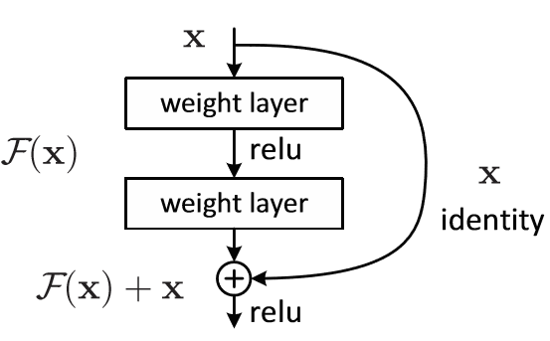
Literature study
Road condition monitoring
Network architecture based on state of the art techniques
Deep convolutional network
Parallel filters
Residual addition
Parallel filters
Deep convolutional neural network
Residual addition
6
Automotive Electronics | RBRO/ESA1 | 2018-03-12
© Robert Bosch GmbH 2018. All rights reserved, also regarding any disposal, exploitation, reproduction, editing, distribution, as well as in the event of applications for industrial property rights.

Slide 7
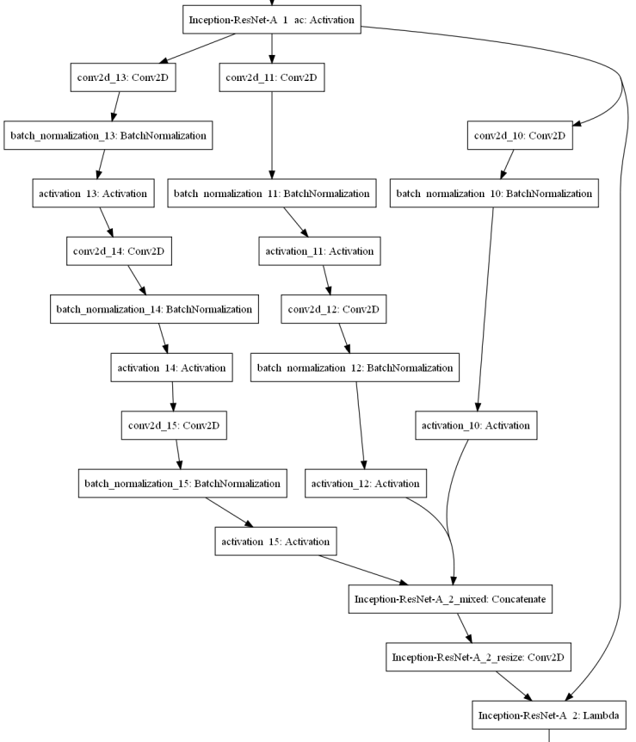
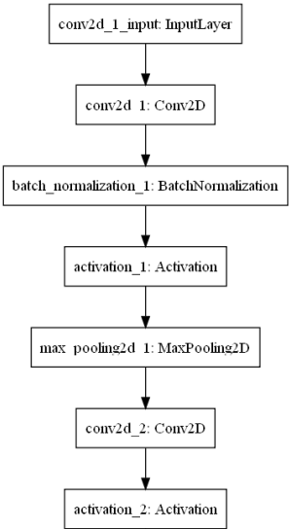
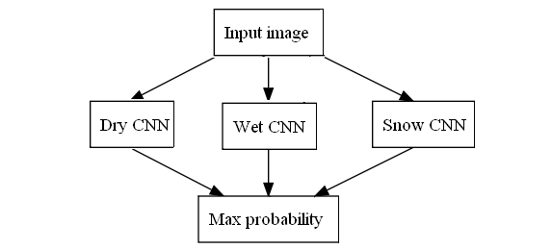
Architecture
Road condition monitoring
Deep learning network built from scratch
Work still in progress on different architectures
Simple, “classical” approach
Dedicated predictor approach
Residual & parallel model approach
7
Automotive Electronics | RBRO/ESA1 | 2018-03-12
© Robert Bosch GmbH 2018. All rights reserved, also regarding any disposal, exploitation, reproduction, editing, distribution, as well as in the event of applications for industrial property rights.

Slide 8
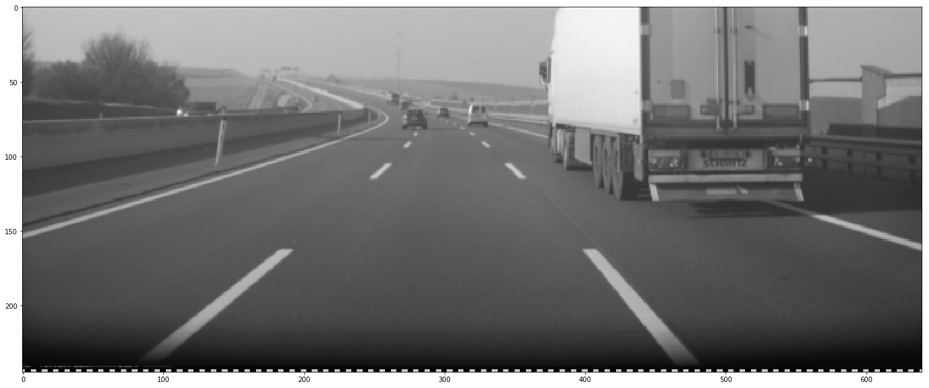
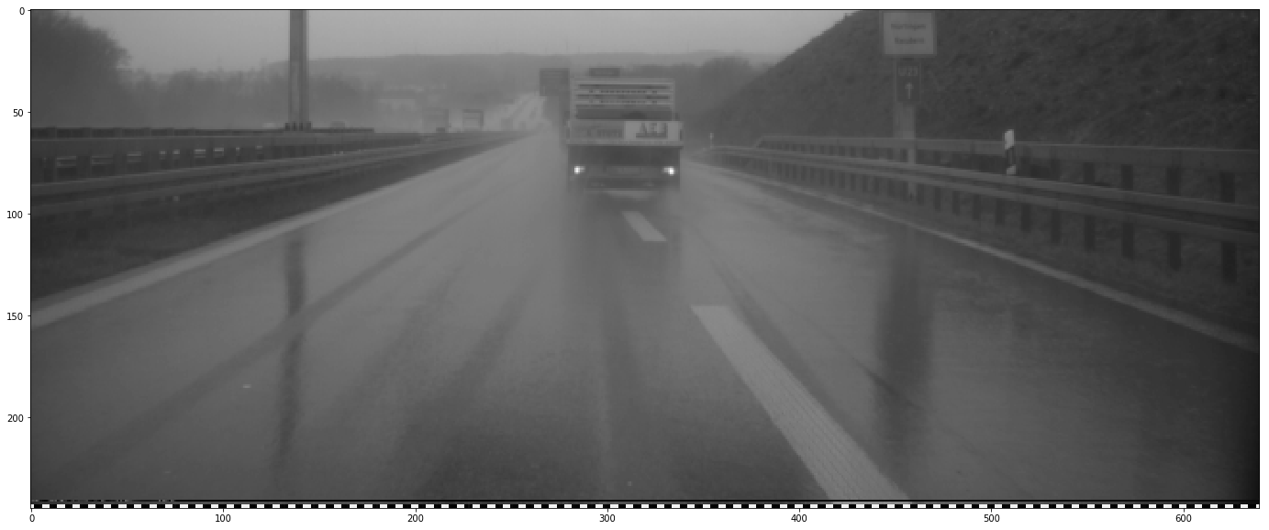
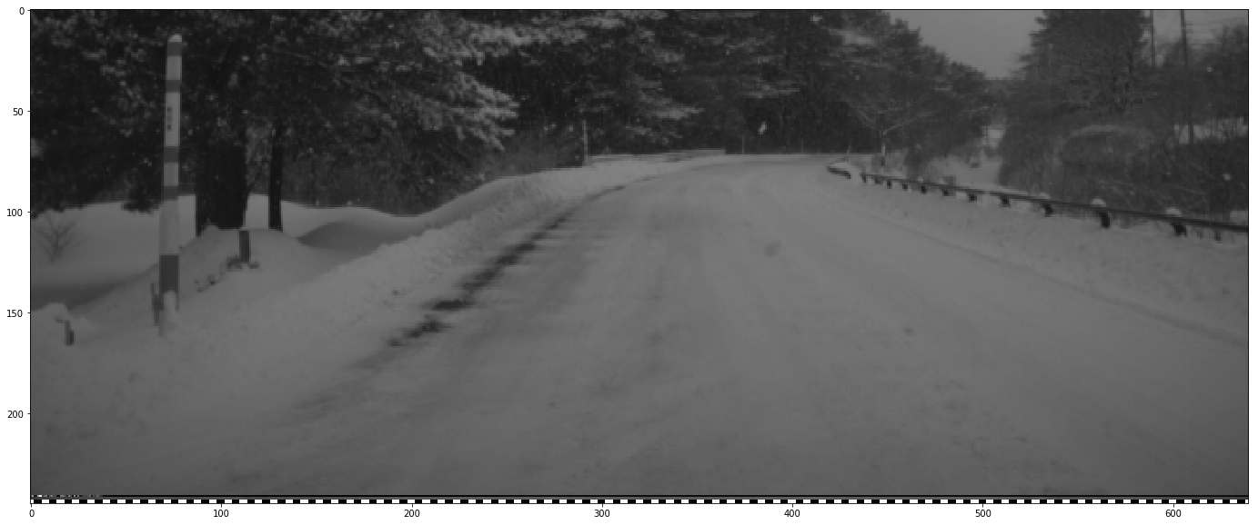
Evaluation – favourable scenarios
Road condition monitoring
Expected: Dry
Dry – 98.06 %
Wet – 1.86 %
Snow – 0.08 %
Expected: Wet
Dry – 0.06 %
Wet – 99.89 %
Snow – 0.05 %
Expected: Snow
Dry – 0.49 %
Wet – 0.14 %
Snow – 99.36 %
8
Automotive Electronics | RBRO/ESA1 | 2018-03-12
© Robert Bosch GmbH 2018. All rights reserved, also regarding any disposal, exploitation, reproduction, editing, distribution, as well as in the event of applications for industrial property rights.

Slide 9
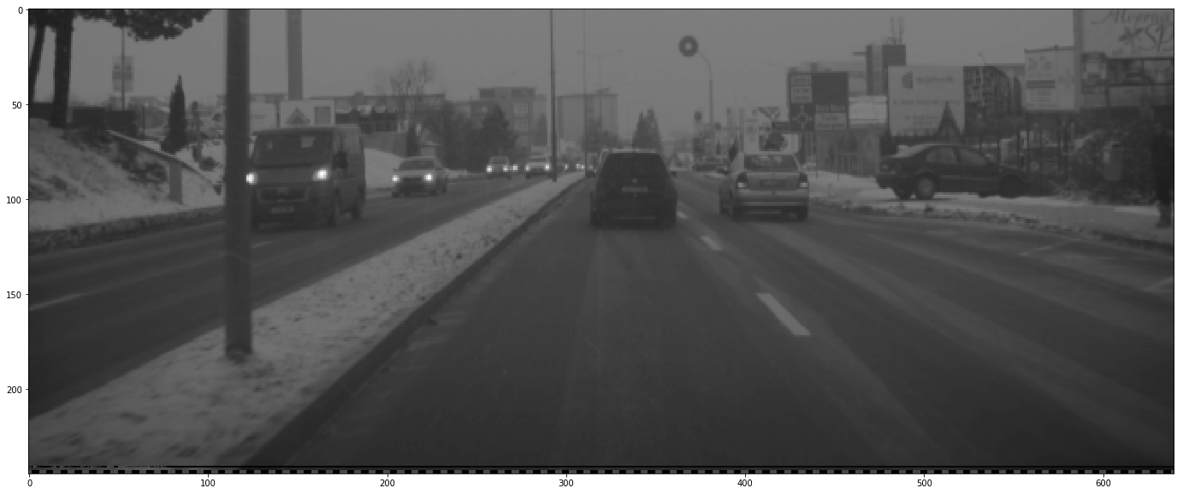
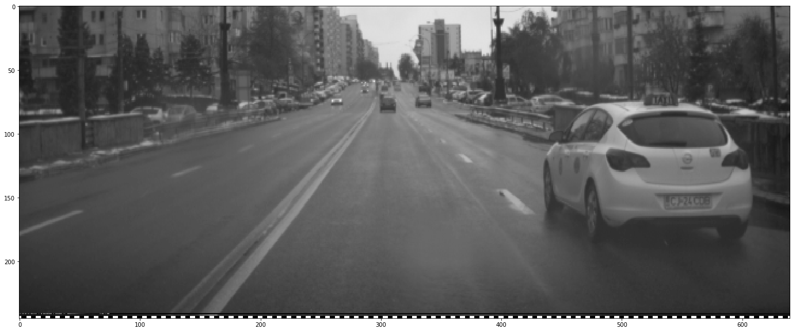
Evaluation – difficult scenarios
Road condition monitoring
Expected: Snow
Dry – 13.42 %
Wet – 56.99 %
Snow – 29.59 %
Accuracy evaluation:
Validation set: 96.10%
Test set: 86.62%
Prediction time evaluation
~10 fps
Depends on the model used
Expected: Wet
Dry - 71.75 %
Wet - 27.24 %
Snow - 1.02 %
9
Automotive Electronics | RBRO/ESA1 | 2018-03-12
© Robert Bosch GmbH 2018. All rights reserved, also regarding any disposal, exploitation, reproduction, editing, distribution, as well as in the event of applications for industrial property rights.

Slide 10
Future steps
Road condition monitoring
Train the network on a bigger dataset
Optimize the network
Implement in SIL
Reuse network structure for other tasks also:
Context estimation
10
Automotive Electronics | RBRO/ESA1 | 2018-03-12
© Robert Bosch GmbH 2018. All rights reserved, also regarding any disposal, exploitation, reproduction, editing, distribution, as well as in the event of applications for industrial property rights.

