Slide 1
Workout Log Web App
Cmpt 350 Project by:
Alex Mac
Frank Iula
Chunyi Paul lai

Slide 2
Why a workout App?
Allows you to keep an accurate record of your personal workout routine
Convenient and user friendly interface that caters to your schedule
Separates data into personalized profiles
No longer need to keep a paper log of previous routines

Slide 3
How it Works
The user is unable to access the App until the they create a unique profile
Upon a valid account creation, a login table is filled with the username and password.
A second table is created which logs the chosen date to
weight, sets, reps of the following 3 exercise:
Bench Press
Dead Life
Squats

Slide 4
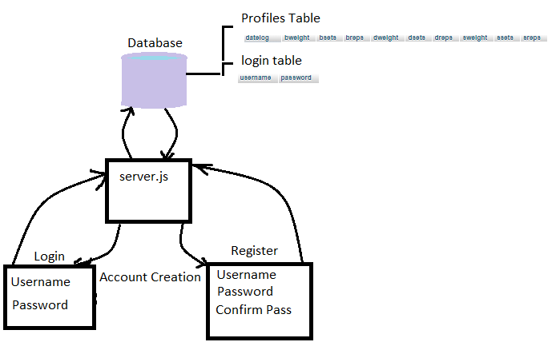
Initialization Visual

Slide 5
App Features
Follows REST architecture
Available to Scale with future growth
Has a local MySQL data base
Live social medial update – implemented with Facebook developer plugin
Launch locally with Node JS or Heroku

