Slide 1
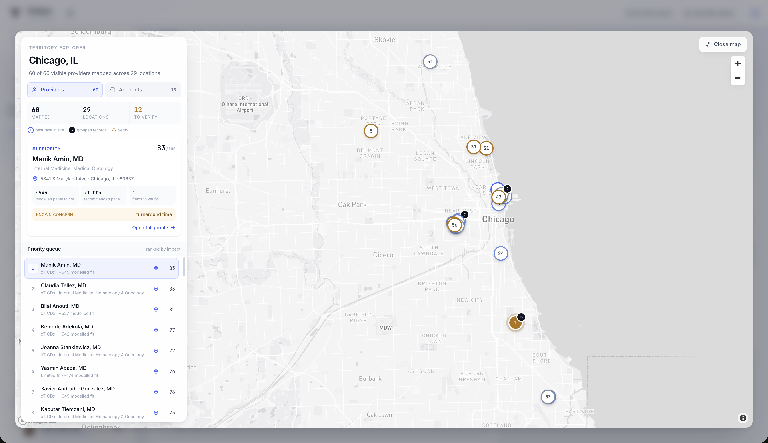
CASE-STUDY PROTOTYPE
From scattered signals
to the next best
conversation
A verifier-first sales copilot for deciding who to call, why now, and what can be said credibly.
01
02
03
WHO TO CALL
WHY NOW
WHAT TO SAY
Prioritize impact
Surface dated signals
Prepare grounded copy
Scope: sales preparation, not clinical decision support or physician-quality scoring.
Composite demo · 60-provider working set · simulated commercial inputs
01
Notes:
The problem I chose to solve is the last mile between having data and taking action. A rep covering a territory like Chicago may have hundreds of possible physicians, but useful information is split across CRM notes, market estimates, provider records, trial activity, and product evidence. Before a short meeting, the rep still has to determine who matters most, why the timing is relevant, and what can be said credibly. This is a sales-preparation problem, not a clinical recommendation or physician-quality system.

Slide 2

TEMPUS SALES COPILOT · CASE STUDY
One workflow. Three answers.
The copilot converts a territory into a call-ready, evidence-backed conversation.
1
PRIORITIZE
Rank providers and accounts by potential impact and evidence confidence.
2
EXPLAIN
Show why now, panel fit, and any identity field that needs verification.
3
PREPARE
Draft a 30-second opener and response to the known concern.
VERIFY
Uncertainty remains visible before outreach; the tool accelerates judgment rather than replacing it.
AI-DRAFTED · EVIDENCE-LINKED · REP-REVIEWED
Composite case-study prototype · simulated CRM/vendor inputs · no physician endorsement implied
02
Notes:
I translated the brief into one rep workflow. First, the system prioritizes whom to call. Selecting a physician then reveals why the opportunity is timely, which panel appears most relevant for sales planning, and any concern from the simulated CRM. Finally, it prepares a short opener and objection response using cited product evidence. The rep can still see uncertainty and contested fields, so the tool accelerates judgment rather than hiding or replacing it.

Slide 3
TEMPUS SALES COPILOT · CASE STUDY
GENAI WRITES THE MESSAGE · IT DOES NOT GENERATE THE RANK
A verifier-first build: decisions stay deterministic.
The process starts with the rep’s decision, not with a model.
01
02
03
04
Ingest + label
Resolve + score
Retrieve + draft
Verify + assemble
CSV market estimates, CRM text, and Markdown product KB. Public enrichment from NPPES, CMS, trials, payments, and PubMed.
NPI and name joins, cross-source consensus, deterministic weighted ranking, and rule-based panel fit.
BM25 + curated topics retrieve evidence. Gemini returns structured claims with evidence IDs.
Input screen → evidence grade → numeric guard → independent Llama entailment → rep review.
BUILD PROCESS + TOOLS
DRAFT PROMPT EXCERPT
1
Frame the rep decision
Claude Opus 5 · build-time
“Use only supplied EVIDENCE.
Every claim cites evidenceIds.
Never state a number absent from cited evidence.
Respond only with JSON.”
2
Join + normalize sources
React · TypeScript · Vite
3
Prototype the workflow
Gemini + Groq · runtime
4
Attack failure modes + refine
No-key deterministic fallback
Model choice: free-tier availability, speed, and provider independence, not a claim that these models are universally best.
Required sources: CSV + CRM text + Markdown KB · public enrichment is best-effort · model keys optional
03
Notes:
My process began by framing the rep’s decisions: identify, prioritize, explain, and prepare. I then ingested the three required formats, added public enrichment, resolved physician identities, and built a transparent score before adding generation. Claude Opus 5 supported development; React, TypeScript, and Vite power the prototype. At runtime, Gemini drafts structured claims and Llama through Groq can check semantic support. I chose them for free-tier access, speed, and provider independence, not because I ran a benchmark proving they were best. The four gates and deterministic fallback keep model authority narrow.

Slide 4
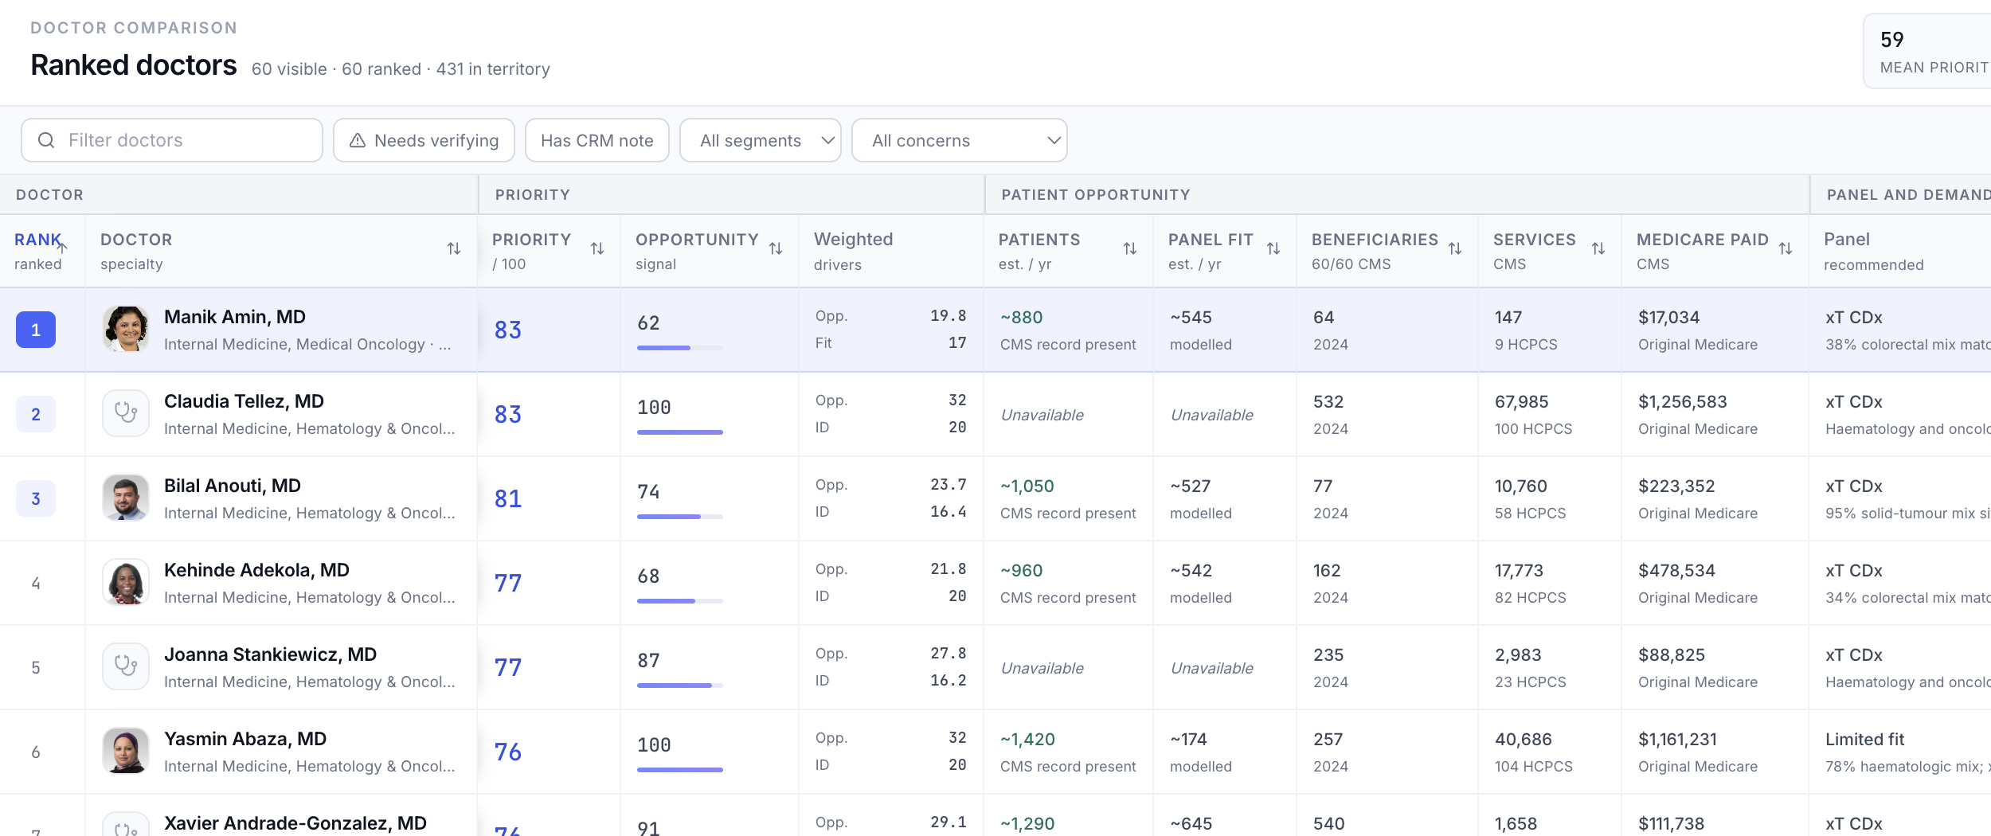
TEMPUS SALES COPILOT · CASE STUDY
An explainable score, not an AI hunch.
Priority is a transparent 0–100 index; it is not a conversion probability or clinical-quality score.
WHAT THE REP SEES
V1 POLICY WEIGHTS
32
Opportunity
20
Identity
17
Panel fit
13
Engagement
10
Freshness
8
Trials
patient estimates + tumour mix
NPPES · CMS · trials
CRM notes
49%
impact + fit
30%
trust
MODELED
PUBLIC
SIMULATED
21% timing
Hand-set and tunable because no historical conversion labels were available.
Priority 83 ≠ 83% likelihood · “fit 100” is relative within the loaded cohort · missing signals are not imputed
04
Notes:
I used a transparent formula because there was no historical outcome data with which to train a reliable predictive model. Opportunity estimates potential patient impact; panel fit connects that opportunity to a Tempus use case; identity and freshness reduce the risk of acting on the wrong or outdated record; engagement and trials represent timing. The exact weights are explicit v1 policy choices, not learned coefficients. The interface shows the raw signals and top weighted drivers, so a rep can understand why someone ranked highly.

Slide 5
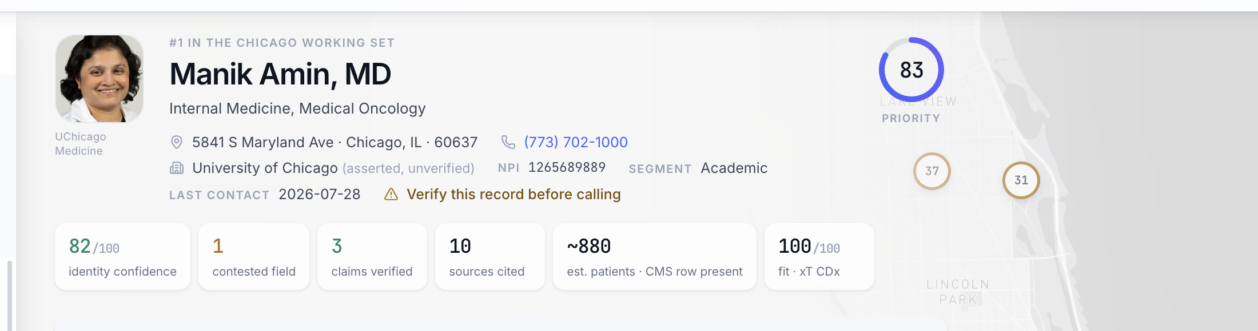
TEMPUS SALES COPILOT · CASE STUDY
Designed to show uncertainty, not hide it.
The prototype validates control and traceability; commercial lift still requires a real-world pilot.
PROVEN TODAY
101 / 101
ASSUMPTIONS
V1
NEXT PILOT
REAL DATA
Golden cases passed
8 / 8 gate-wiring assertions
0 model calls from poisoned CRM
Simulated CRM + vendor estimates
Heuristic weights and fit rules
Public-data coverage is incomplete
Connect Salesforce
Calibrate weights from outcomes
Measure prep time, usefulness, precision@5
PROTOTYPE ACCESS
npm install → npm run dev → localhost:5173
No model keys required · deterministic fallback included
Test results validate pipeline behavior, not 100% AI accuracy · human review remains required
05
Notes:
I refined the prototype through executable golden cases, adversarial CRM fixtures, missing-data behavior, pagination checks, and cross-source contradictions. The current individual suites pass 101 of 101 golden cases, all eight cross-model wiring assertions, and block both hostile CRM fixtures before any model call. Those results validate pipeline behavior, not commercial prediction or 100 percent model accuracy. The key assumptions remain simulated commercial data, heuristic weights, and incomplete public datasets. The next step is a controlled pilot with real Salesforce data and measures such as preparation time, rep usefulness, edits, and precision at the top of the queue.

