Slide 1
Funmart Summary

Slide 2
Summary
KPIs
Order Frequency
Payment Methods
Monthly Overview
Cohort Analysis

Slide 3
KPIs
Orders | Revenue | Average Order Value
12,000 | AED 880,866 | AED 73.41
Table 1.1: Key Performance Indicators. This data is from 2020-01-01 to 2021-12-31. There were 12,000 orders during this time with a total revenue of AED 880,866 and average order value of AED 73.41. | Table 1.1: Key Performance Indicators. This data is from 2020-01-01 to 2021-12-31. There were 12,000 orders during this time with a total revenue of AED 880,866 and average order value of AED 73.41. | Table 1.1: Key Performance Indicators. This data is from 2020-01-01 to 2021-12-31. There were 12,000 orders during this time with a total revenue of AED 880,866 and average order value of AED 73.41.

Slide 4
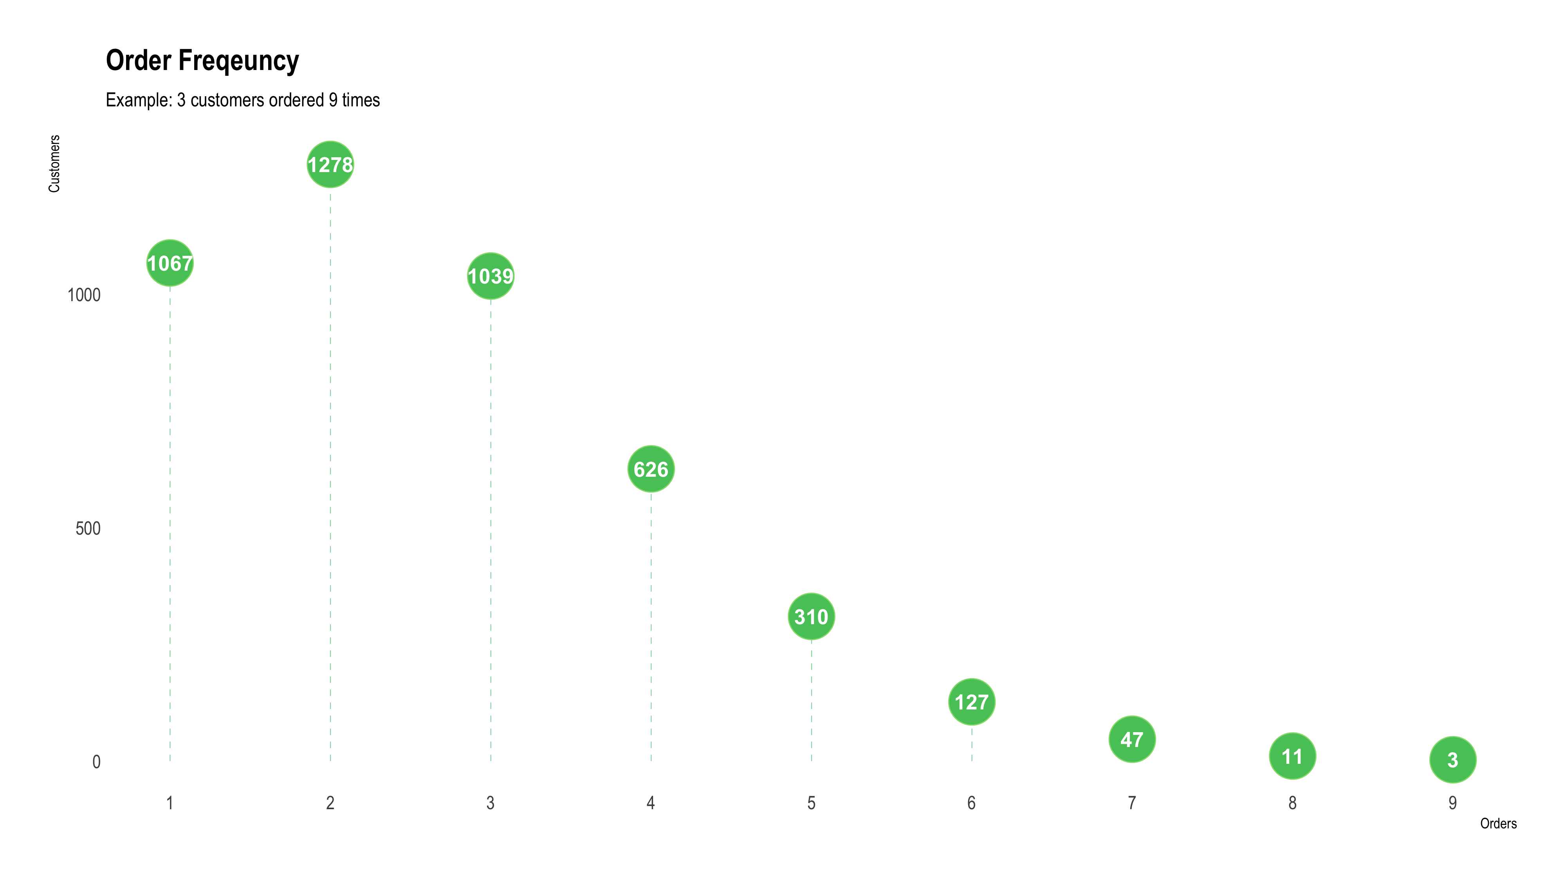

Slide 5
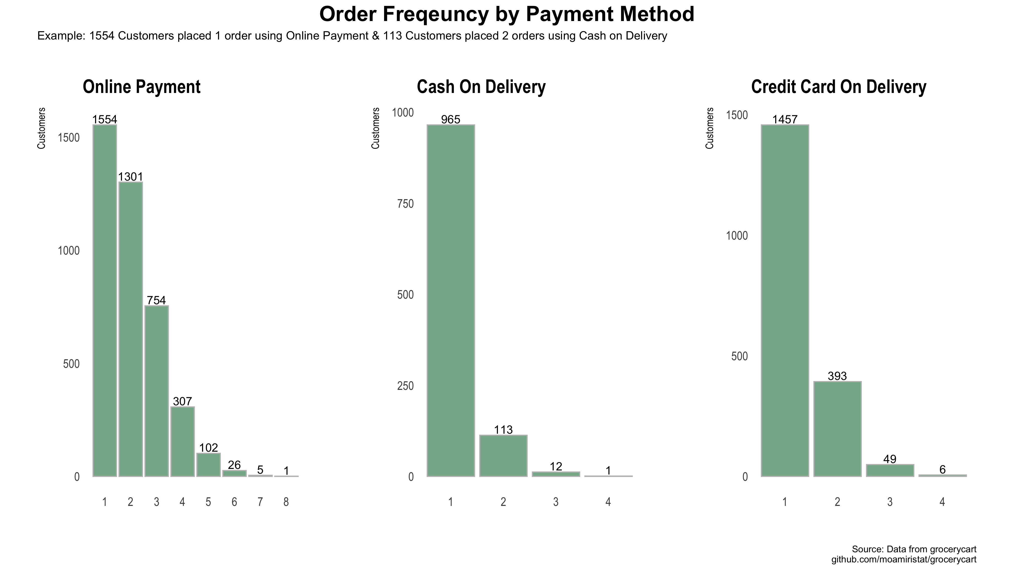

Slide 6
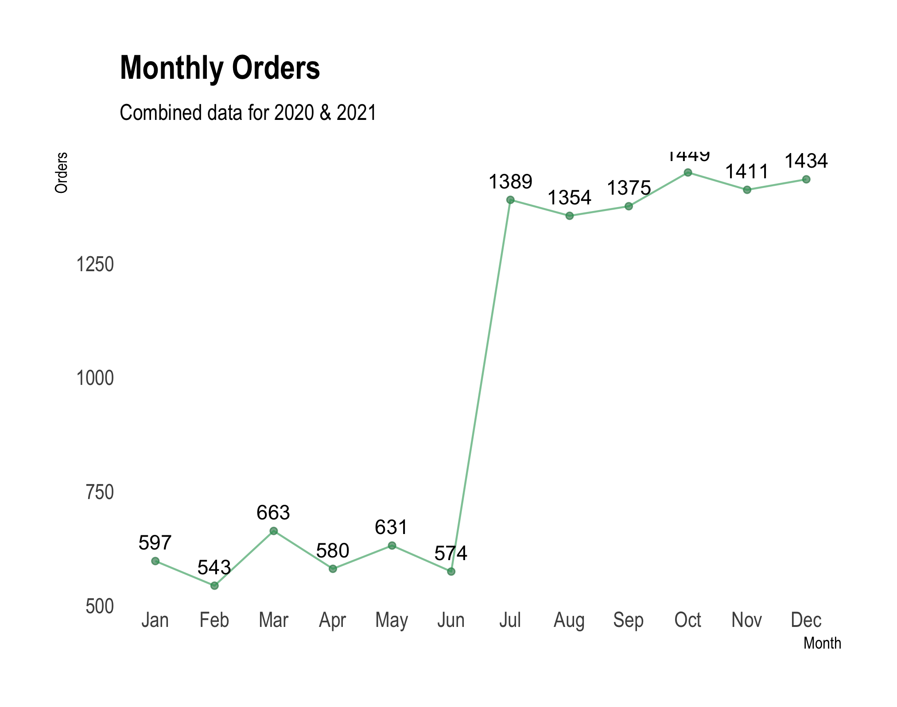
Monthly Overview
Month | AOV | Orders | Customers
Jan | 70.4 | 597 | 570
Feb | 73.4 | 543 | 514
Mar | 74.5 | 663 | 633
Apr | 72.1 | 580 | 549
May | 76.1 | 631 | 585
Jun | 74.9 | 574 | 541
Jul | 73.4 | 1,389 | 1,210
Aug | 73.4 | 1,354 | 1,179
Sep | 73.5 | 1,375 | 1,194
Oct | 74.0 | 1,449 | 1,265
Nov | 72.9 | 1,411 | 1,218
Dec | 72.7 | 1,434 | 1,250
Table 1.2: Average Order Value by Month | Table 1.2: Average Order Value by Month | Table 1.2: Average Order Value by Month | Table 1.2: Average Order Value by Month

Slide 7
