Slide 1
Analysis on Singapore Transport
By Ng Zen Yu (P2123011)

Slide 2
Objectives
In this project, I assumed the role of a data analyst working for a distributor for an electric car company.
Therefore, my project will consist of the following objectives:
Is selling cars in the Singapore's market a sustainable business?
How does selling electric cars stand up to the competition in Singapore?

Slide 3
First Objective
Is selling cars in the Singapore's market a sustainable business?

Slide 4
First dataset
Annual mileage for private owned vehicles
This dataset provides the annual mileage for privately owned vehicles such as cars, buses and motorcycles, but i will only be focusing on the data for cars.

Slide 5
Second dataset
Motor vehicle population by type of vehicle
This dataset provided the number of private vehicles, private hire cars, taxis, buses, motorcycles and other vehicles on the road.
This dataset had text on the top and bottom of the dataset so i had to remove them.
The values had commas in them, and were considered strings so i had to remove the commas and convert the values to floating point numbers.

Slide 6
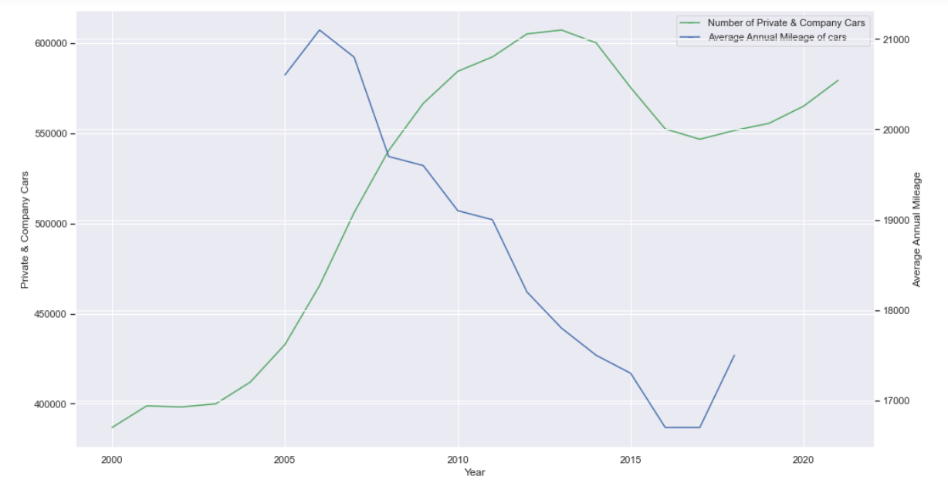
Graph

Slide 7
Analysis
From this graph, we can observe that while the general trend of the annual mileage of cars is decreasing, surprisingly, the general trend of the population of cars has increased rapidly, with the slight decrease being attributed to the zero growth cap on Singapore’s cars at the time.

Slide 8
Insights
From the analysis, we can deduce that there is a clear demand for private cars in Singapore shown by the general increase in car population, despite the fact that cars in Singapore are getting less use. We can assume that cars are generally considered as a lifestyle transportation mode. In addition, this is good for us as electric cars are generally targeted for city transportation that have shorter travel range as compared to petrol cars that are designed for longer distance travel.

Slide 9
Third dataset
Public transport operation and ridership
This dataset provides the rail length, average daily ridership, distance operated, of MRT and LRT trains and the number of point-to-point trips made by private hire cars and taxis.
This dataset had a few null values that used a dash instead of NaN, so i had to convert them. Additionally, the dataset had many zero values so when exporting the dataset i made sure to exclude them.

Slide 10
Fourth dataset
Public Transport Utilisation - Average Trip Distance
This dataset provides the average trip distance travelled by commuters from 2004 to 2014, for MRT, LRT, Bus and Taxi.

Slide 11
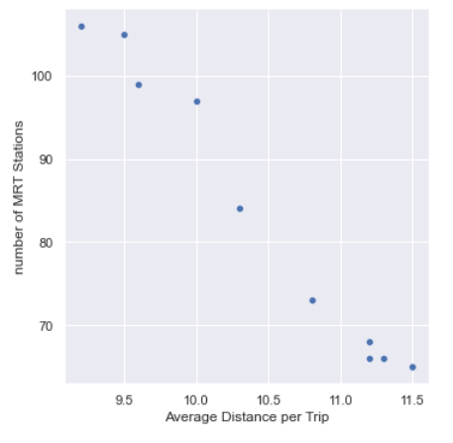
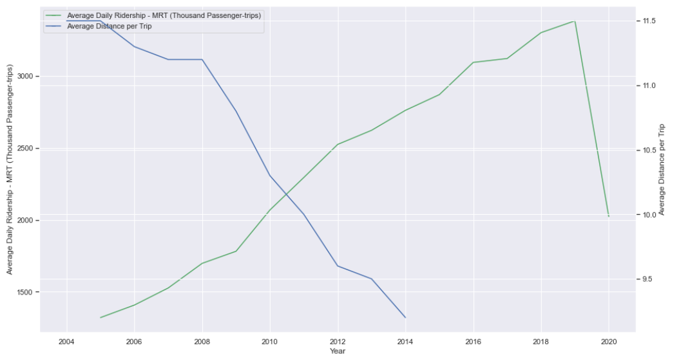
Graphs

Slide 12
Analysis
From the scatterplot, i can infer that there is a strong negative correlation between the number of mrt stations and average distance per trip.
From the line graph we can see that the average daily ridership is generally increasing, while the average distance travelled per trip is generally decreasing.

Slide 13
Insights
SIngapore is world renowned for its efficient public transport system. As shown in the dataset, the ridership has increased tremendously and with the addition of more MRT stations, travel distance has also reduced which implies a shorter travel time.
However, despite the efficiency of its public transport system, we observe the rapid increase in car population as shown in the previous dataset. We can thus conclude that as previously assumed, cars are a prefered mode of transport for the affluent.

Slide 14
Recommendations
From the data, we can conclude that cars in Singapore will increasingly become a lifestyle choice for the wealthy, and luxury cars will be expected to see growth within the car sector. therefore, our marketing and products should be targeted at the luxury sector.

Slide 15
Second Objective
How does selling electric cars stand up to the competition in Singapore?

Slide 16
Fifth dataset
Singapore Energy Data
This dataset contains everything about Singapore electricity and energy. But i only used the USEP (Uniform Singapore Energy Price) from 2005 to 2021 in my analysis.
This dataset had text on the top and bottom of the dataset so i had to remove them.

Slide 17
Sixth dataset
Price of fuel globally
This dataset contains the fuel prices for most of the countries in the world from 1991 to 2016.
This dataset has many unused columns, and had many rows of different countries that i did not need, so i only kept Singapore data for my analysis.

Slide 18
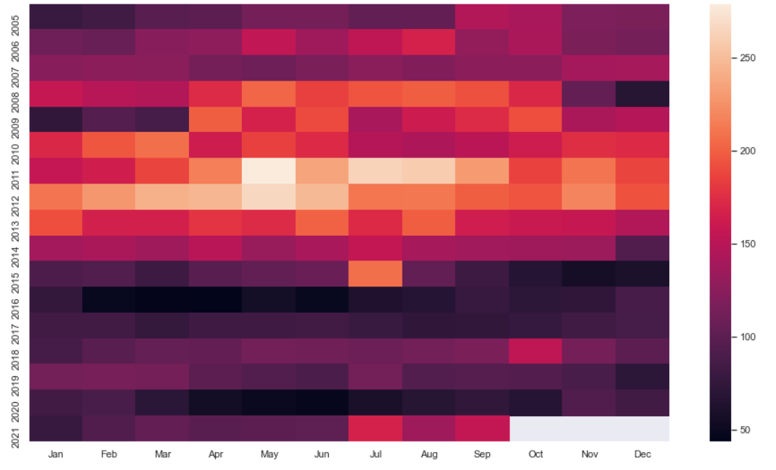
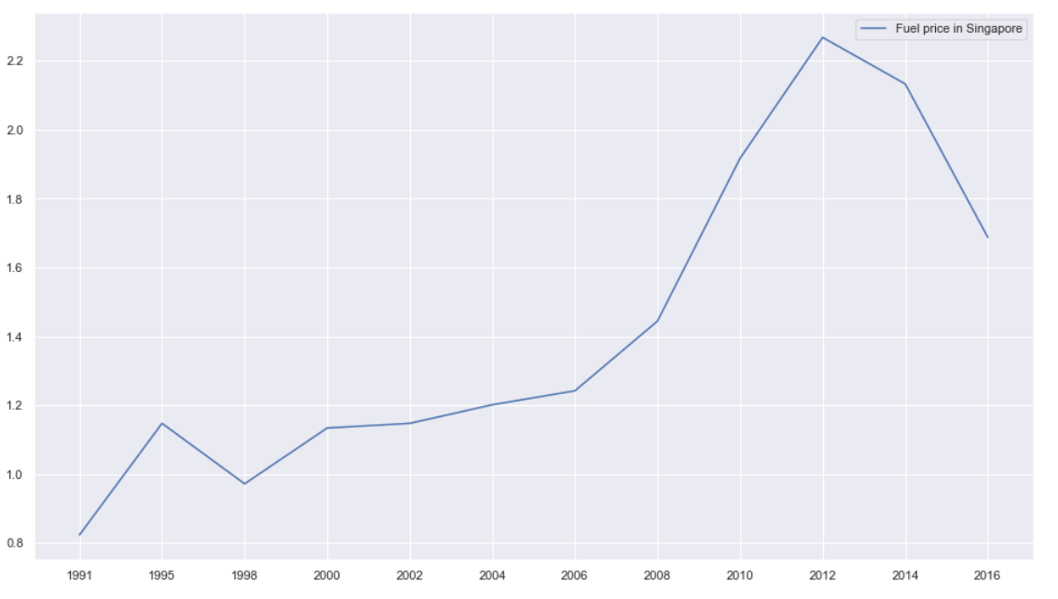
Graph

Slide 19
Analysis
From this heatmap, we can observe that the price of electricity in Singapore is on a downward trend. The price of electricity having peaked in the middle of 2011 and steadily decreasing thereafter.
On the other hand, the line graph showing the price of fuel has a generally on an upward trend and peaked in 2012.

Slide 20
Insights
Singapore's electricity price is generally stable and on a downwards trend while its fuel price are more volatile and on an upwards trend. This may suggest that the cost of car ownership and usage is more predictable and potentially cheaper for electric cars as compared to petrol cars.

Slide 21
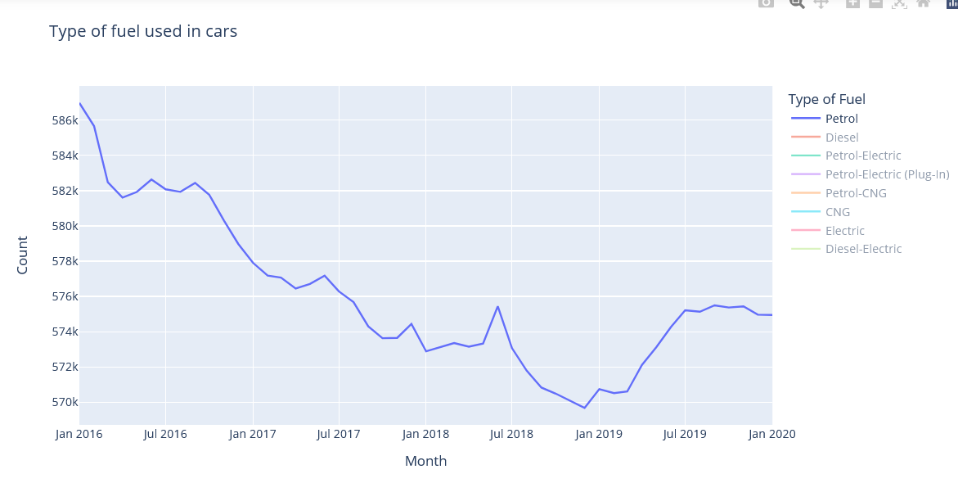
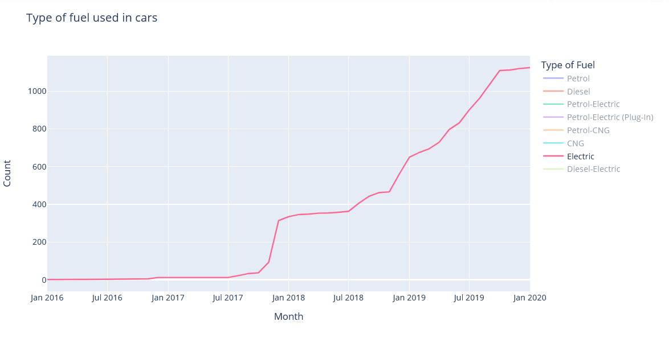
Graph 4

Slide 22
Analysis
From the line graph on the left we can see that there is a decrease in the population of petrol cars, and on the line graph to the right, it shows that the electric car population has grown rapidly.

Slide 23
Insights
It is observed that there is an increasing preference towards electric cars as compared to petrol cars. the number of electric cars has increased by almost 3000% from October 1st 2017 to October 1st 2019.
Furthermore, Singapore plans to phase out ICE(internal combustion engine) vehicles and have all vehicles run on cleaner energy by 2040. (not reflected in data, A policy insight)

Slide 24
Recommendation
Electric cars are attractive and is taking away market share.
From the data, we can conclude that Singapore's car market is prime for electric cars. Should the current trend of growth for electric cars continue, the population of electric cars in Singapore should grow to around 2200 in the next 12 months. therefore we should act fast and ride this trend, and aim to secure at least 10% of this increase in the next 12 months.

Slide 25
URLs for Datasets used
https://tablebuilder.singstat.gov.sg/table/TS/M650391
https://data.gov.sg/dataset/annual-mileage-for-private-motor-vehicles
https://tablebuilder.singstat.gov.sg/table/TS/M651351
https://www.ema.gov.sg/singapore-energy-statistics/Ch05/index5
https://data.worldbank.org/indicator/EP.PMP.SGAS.CD?end=2016&locations=SG&start=1991&view=chart
https://data.gov.sg/dataset/annual-motor-vehicle-population-by-type-of-fuel-used
https://data.gov.sg/dataset/public-transport-utilisation-average-trip-distance

