Slide 1

Parsing Logs via ELK
BSides Austin 2019
Presenter: Mark McLauchlin
Github: https://github/macatak/ELK/

Slide 2

Theme

Slide 3

Overview
Goal – Learn how to get information out of the data in logs
How we’ll do that
Use the open source ELK stack to ingest and enrich logs
What we’ll cover
Setup and configuration of an open source ELK stack running on the localhost
What we won’t cover
Any of the paid features of ELK

Slide 4
Who Am I?
Systems Engineer at a small automobile manufacturing IT start up
Degrees and security certifications that have
nothing to do with this talk
MS-IT focusing on InfoSec
CEH / ECSA

Slide 5
Who are you?
Name
Little bit about yourself
What you hope to get out of this training

Slide 6
Story of the 3 Little pigs
Once upon a time there were 3 little pigs
The 1st little pig did not use any centralized logging like ELK. One day the marketing guy called and said the internet was down. The 1st little pig logged on many different servers trying to find the issue. He knew what to look for but didn’t know exactly where. By the time he found it his company was out of of business and the big bad wolf ate him on his way to the unemployment office.

Slide 7
Story of the 3 Little pigs
The 2nd little pig did use centralized logging. He did as little possible to get the logs into ELK. One day the marketing guy called and said the internet was down. The 2nd little pig looked and looked in Kibana to find the problem. However, he has too many logs coming in and was having a hard time finding the problem. He knew what to look for but had too much data that was unrelated. By the time he found it his company was out of of business and the big bad wolf ate him on his way to the unemployment office.

Slide 8
Story of the 3 Little pigs
The 3rd little pig did use ELK for centralized logging. He put forth a little effort to ensure logs came in and were parsed in a uniform manner. One day the marketing guy called and said the internet was down. The 3rd little pig already knew there was problem because he was it on his awesome Kibana dashboard and already let operation know there was a problem. The marketing guy was impressed and bought him lunch.
Morale of the story? Put a little effort into your log parsing and avoid the unemployment line where you might get eaten by the big bad wolf

Slide 9
Tell a Story
Licensing

Slide 10
What We Will Cover
ELK Components
    Overview
    Installation
    Configuration
Deeper Dives
    Filebeat
    Logstash
    Kibana

Slide 11
What is the ELK Stack?
Base Stack
Elasticsearch - NoSQL database based on the Lucene search engine
Logstash - Log pipeline app that accepts event inputs and can enrich the data
Kibana - Visualization layer and search
The rest of the players
Filebeat – Lightweight log shipper, can also enrich event data
Other beat packages that will not be covered.

Slide 12
Event Data Flow Model (simplified)
Filebeat lives on the server generating the event data and sends it to Logstash
Logstash takes the Filebeat input and sends it to Elasticsearch
Elasticsearch stores the data
Kibana retrieves the data out of Elasticsearch

Slide 13
ELK Stack 101’s

Slide 14
Filebeat 101
What it does
Monitors one or more logs
Can enrich event data (add tags or key:value pairs)
Forwards to Logstash
  Can also send straight to Elasticsearch along with a few other apps
How it does it
Sort of ‘tails’ a file, not real-time
Keeps a pointer in a file to keep track of last read
Why we use it
It is easily configurable
It not resource intensive
It works great

Slide 15
Logstash 101
What it does
Wide variety of support for many inputs and outputs technologies
Capability to parse and enrich data
How it does it
I/O supported through plugins
Parsing/enrichment through filters
Why we use it
Power of slicing and dicing data
Event enrichment

Slide 16
Elasticsearch 101
What it does
Stores data data as an JSON document
How it does it
NoSQL Lucene database (same as Apache Solr)
Why we use it
Very fast searches
API support (do need Logstash or Kibana)
Horizontally scalable

Slide 17
Kibana 101
What it does
Provides easy access to data in Elasticsearch
Can do basic reporting, dashboards, and more
How it does it
Web UI (Node JS)
Why we use it
Search capabilities
Dashboards

Slide 18
Licensing

Slide 19
Basic VM Setup Info
Create a folder for sample log files
  example - /home/<username>/log_samples
  This is where we’ll put our sample logs
Most ELK installs will place the YAML files here:
  /etc/<app_name>
  Logstash has a YML file but we won’t use it
Make a backup of the Elasticsearch and Kibana YAML’s
  /etc/elasticsearch.yml
  /etc/kibana.yml
Create an /etc/logstash/conf_files folder
  This is where we’ll put our Logstash parsers

Slide 20
Lay the Foundation

Slide 21

Downloads
MISC
Copy the GitHub repo
  https://github.com/macatak/ELK/tree/master/AustinBSides2019
Install RPM/DEB package, version 6.6.1
https://www.elastic.co/downloads/past-releases
  Filebeat
  Logstash
  Elasticsearch
  Kibana
  Avoid using .0 (x.0 or x.x.0) releases, quality is sometimes lacking

Slide 22
Elasticsearch Setup

Slide 23
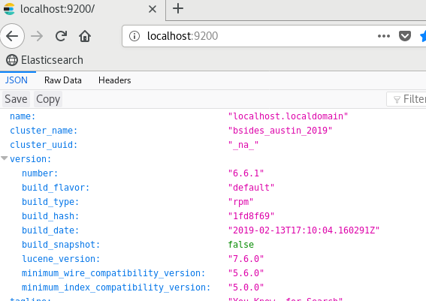
Exercise 1: Elasticsearch Install
Follow the steps in the /exercise/ex1.txt to install Elasticsearch
Validate it is running

Slide 24
elasticsearch.yml file
cluster.name: bsides_austin_2019
  You can name this whatever you want
node.name: ${HOSTNAME}
  This will use the host name as the node name
path.data: /var/lib/elasticsearch
  Where the data will be stored
path.logs: /var/log/elasticsearch
Log file location
network.host: localhost
  Required for localhost setup
http.port: 9200
  Port to be used by Elasticsearch

Slide 25
Licensing

Slide 26
Elasticsearch Questions?

Slide 27
Kibana Setup

Slide 28
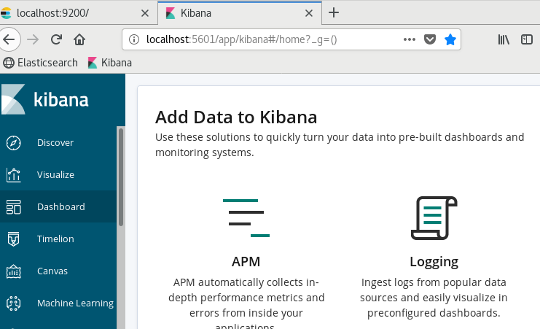
Exercise 2: Kibana Install
Follow the steps in the /exercise/ex2.txt to install Kibana
Validate it is running

Slide 29
Kibana.yml File
server.port: 5601
  Port where Kibana can be accessed
server.host: "localhost"
  Setting for localhost setup
elasticsearch.url: "http://localhost:9200"
  Where Elasticsearch is running
These are not required but can clean up the interface
#xpack.apm.ui.enabled: false
#xpack.apm.enabled: false
#xpack.ml.enabled: false
#xpack.graph.enabled: false

Slide 30
ToDo Dev Tools
Licensing

Slide 31
Kibana Questions?

Slide 32
Filebeat Setup & Deeper Dive

Slide 33
Filebeat YAML Settings
Things you can set in the YAML (but will not covered)
Include/Exclude RegEx’s
  Very useful in the real world
Exclude Files
Multiline Parsing
  Also very useful in the real world
Modules
Reload Period
Dashboard Imports
  Nice to have but only if you need them
SSL/TLS Implementatiol
Processors
Xpack

Slide 34

Exercise 3: Filebeat Setup
Follow the steps in the /exercise/ex3.txt to install filebeat
Make sure you change the path in the yml to the valid path on your VM
/home/bikeride/sample_logs/access_5.log
There is a filebeat.reference.yml with all available settings (there are a LOT of them)

Slide 35
Check the filebeat.yml File
Syntax check on the configuration
  Command : /usr/share/filebeat/bin/filebeat test config -c filebeat.yml
  NOTE: ‘-c filebeat.yml’ is not really really required
  Assumes current working directory is /etc/filebeat/
Issues
  Syntax only, will not catch things like mangled or bad paths
  Indication of these types of errors is no output

Slide 36
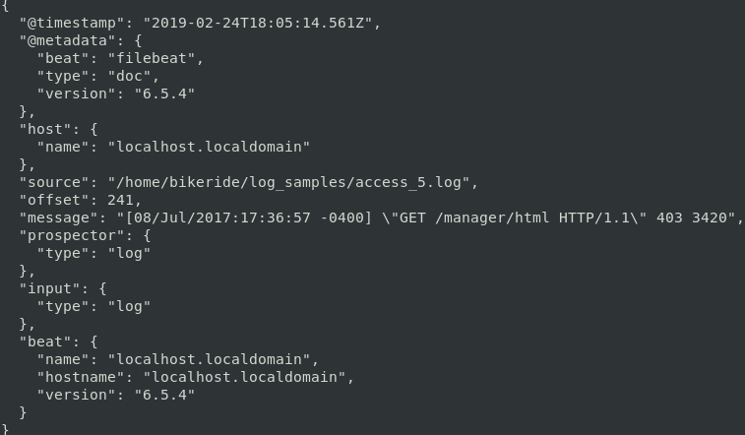
Run Filebeat (Command Line)
Normally Filebeat would be run as a service but for development it can be run from the command line with the output directed to the console.
Command
  /usr/share/filebeat/bin/filebeat -c filebeat.yml
  CTRL+C to stop
Notes:
Open a gedit window and keep copying the contests into the file to demo the tail function

Slide 37
Run Filebeat (Command Line)
Run the command again
What happens?
Why?
What can we do to fix it?

Slide 38
Run Filebeat (Command Line)
The Issue
Filebeat keeps track of where it last read a file
We need to ‘clear’ the memory
  Need to delete the ‘registry’ file
Normally one of two places, depending on how Filebeat was run
    As a service
    /var/lib/filebeat/registry
    From the command line
    /usr/share/filebeat/bin/data/registry
If in doubt search for the file
    find / -name registry | grep filebeat

Slide 39
Filebeat Help
There is a wealth of information online but some items of note:
Debugging a YML
  https://www.elastic.co/guide/en/beats/filebeat/current/enable-filebeat-debugging.html
  Command: filebeat -e -d "publish"
    -e is an override command
    -d is debug mode
    "publish" displays all the "publish" related messages.
YAML tips and gotchas
  https://www.elastic.co/guide/en/beats/filebeat/current/yaml-tips.html

Slide 40
Why is this Important?
The event enrichment is very powerful
  You can use the fields and tags in you Logstash filters
    Easier parsing rules
    Set destination index
It is an easy configuration and low maintenance

Slide 41
Filebeat Questions?

Slide 42
Logstash Deeper Dive

Slide 43
Logstash Inputs
Inputs are based on plugins
An input plugin enables a specific source of events to be read by Logstash.
  ~around 50
  https://www.elastic.co/guide/en/logstash/current/input-plugins.html
Plugins of note
  Beats
    Supports the beat packages (like Filebeat)
  File
    Supports reading from a file
  Syslog
    Supports syslog input
  Generator
    Generates log events

Slide 44
Logstash Filters
Filter plugin performs processing on an event.
  https://www.elastic.co/guide/en/logstash/current/filter-plugins.html
Can add, transform, or remove event data
  This is where the power of Logstash to slice and dice data comes from
Filter plugins of note:
  Dissect - Extracts unstructured event data into fields using delimiters or what separates the values
  Grok - Parses unstructured event data into fields using RegEx
  Geoip - Adds geographical information about an IP address
  Mutate - Performs mutations on fields

Slide 45
Logstash Outputs
Plugin oriented (like Inputs)
  https://www.elastic.co/guide/en/logstash/current/output-plugins.html
Logstash can send data to 1 or more outputs
Output plugins of note:
  Elasticsearch – Sends data to Elasticsearch
  File – Writes to a file
  Stdout – Writes to the console

Slide 46
Logstash Codecs
Codec plugins change the data representation of an event
  https://www.elastic.co/guide/en/logstash/current/codec-plugins.html
Basically stream filters that can operate as part of an input or output
Codecs of note:
  Json - Reads JSON formatted content, creating one event per element in a JSON array
  Json_lines - Reads newline-delimited JSON
  Multiline - Merges multiline messages into a single event
  Nmap - Reads Nmap data in XML format
  Rubydebug – Prints out using the Ruby Awesome print library

Slide 47
Notes on Conf Files
Logstash automatically reads any and all conf files in the (default) /etc/logstash/conf.d folder
Files are read in alphabetical order
If there are numerous conf files Logstash will build a configuration out of them
For what we are doing we will run Logstash from the command line
For multiple conf files use a number naming convention so inputs are read 1st, followed by filters, then outputs

Slide 48
Logstash Filebeat Hands-On

Slide 49
Why is this important?
Filebeats is the easiest method to get events from remote servers into ELK
It supports multiple log streams from a single host
It can perform data enrichment via Fields and Tags
Filebeats can

Slide 50
Exercise 4 : Logstash Setup
Follow the steps in the GitHub repo /exercise/ex4.txt

Slide 51
Logstash Filebeat Setup
All this work will be done in /etc/logstash/conf_files
Open logstash_filebeat_basic.conf in your favorite text editor
Change the path so it points to the correct folder
  . /home/<CHANGE THIS>/sample_logs
Save it
Edit the filebeat_base.yml file
  Uncomment the output.logstash: line
  Uncomment the hosts: ["localhost:5044"]
  Comment out the two console lines (the last 2 lines)
Make sure the Filebeat registry file has been deleted
Start the Filebeat service
  “systemctl start filebeat”

Slide 52
Overview: logstash_filebeat_basic.conf
input {
beats {
port => 5044
}
}
filter {
# filtering goes here
}
output {
#stdout { }
elasticsearch { hosts => ["localhost:9200"] }
}

Slide 53
Filebeat Conf File Syntax Check
Check the syntax of the logstash_filebeat_basic.conf file.
  ‘/usr/share/logstash/bin/logstash -f logstash_filebeat_base.conf -t’
  The ‘-t’ is for test
  The ‘-f’ tells Logstash to use a specific file
Output is verbose but near the bottom you should see “Configuration OK”
<snipped>
Ignoring the 'pipelines.yml' file because modules or command line options are specified
Configuration OK
[INFO ] 2019-03-07 13:45:01.117 [LogStash::Runner] runner - Using config.test_and_exit mode. Config Validation Result: OK. Exiting Logstash
3) This just a syntax check so an “OK” does not mean it will work the way you expect (but is a very good practice to get into doing)

Slide 54
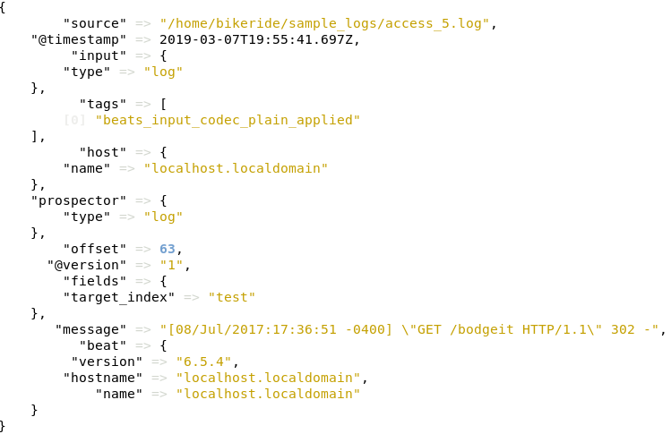
Logstash Filebeat Run
Start Logstash from the command line
  /usr/share/logstash/bin/logstash -f logstash_filebeat_base.conf

Slide 55
Why is this important
In the real world a lot of feeds will come from Filebeat.
We will see later on how Logstash can use the enrichment Filebeat provides in very useful ways
Having said that, we will detour from the Filebeat → Logstash model

Slide 56
Logstash Questions?

Slide 57
Logstash File Hands-On

Slide 58
Logstash and Reading from Files
Open logstash_file_base.conf file in a text editor
Change the path => setting to match the path on your VM
  /home/bikeride/sample_logs/access_5.log

Slide 59
Overview: logstash_file_basic.conf
input {
file {
#type => "log"
# this is the path to the log file
path => "/home/bikeride/sample_logs/access_5.log"
# following 2 lines will configure Logstash to always read from the start
# this is not something you would do in the real world
# but very useful for development
start_position => "beginning"
sincedb_path => "/dev/null"
}
}
filter {
# filtering goes here
}
output {
stdout { }
}

Slide 60
Logstash File Conf File Syntax Check
Check the syntax of the logstash_file_basic.conf file.
  ‘/usr/share/logstash/bin/logstash -f logstash_file_base.conf -t’
  The ‘-t’ is for test
  The ‘-f’ tells Logstash to use a specific file
Output is verbose but near the bottom you should see “Configuration OK”
<snipped>
Ignoring the 'pipelines.yml' file because modules or command line options are specified
Configuration OK
[INFO ] 2019-03-07 13:45:01.117 [LogStash::Runner] runner - Using config.test_and_exit mode. Config Validation Result: OK. Exiting Logstash
3) This just a syntax check but is a very good practice to get into doing.

Slide 61
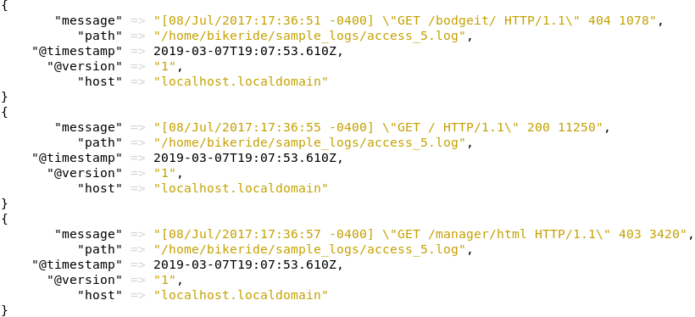
Logstash File Basic Run (stdout)
Start Logstash from the command line
/usr/share/logstash/bin/logstash -f logstash_file_base.conf

Slide 62
Logstash File Basic Run (Elasticsearch)
Open logstash_file_base.conf
Uncomment the Elasticsearch output
Save the conf file
Syntax check?
Start Logstash
  /usr/share/logstash/bin/logstash -f logstash_file_base.conf
Should see the same output
Let’s see what’s in Elasticsearch via Kibana

Slide 63
Validation in Kibana
Open Kibana in a browser
Open the Discover tab (far left)
Why is there no data?
Create the index pattern
  Use logstash*
  Set the timestamp to @timestamp
  Click “Create Index Pattern”
Go back to the Discover tab
The events from the log are displayed

Slide 64
Why is this important?
Logstash is where ‘the rubber meets the road” when it comes to parsing
Conf file development is easier to accomplish and less error prone against a sample log file
Filebeat is useful but a hindrance when it comes to filter development due to the registry

Slide 65
Questions?

Slide 66
Kibana Overview

Slide 67
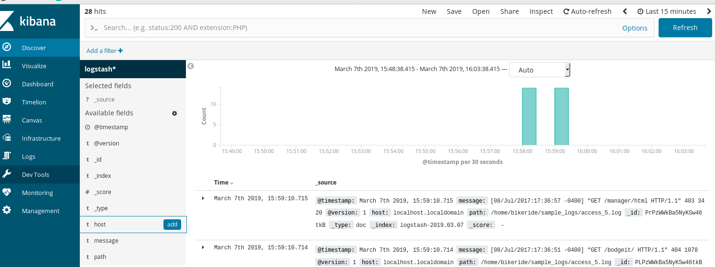
Kibana Overview

Slide 68
Kibana Short Tour
The Time Filter lets you set a time range to search over.
  Quick – Select from various predefined ranges
  Relative – Select relative periods based on time ranges
  Absolute – Define a start and end time range
  Recent – A recently used time range
Auto Refresh
  Sets the Discover page to auto refresh at specific intervals
Search Bar
  Allows searches based on the Apache Lucene Query Parser Syntax
  Supports logical operator (AND/OR/NOT)
  Can save, open, and share searches

Slide 69
Kibana – Short Tour
Fields List
  Shows available fields
  Can set which fields to display
  Provides specific information on the fields
  Can add filters on field values to include or exclude
Document Data
  Shows a graph of events over time.
  Can drag over to drill down
We will circle back to this once we some meaningful data

Slide 70
Kibana Questions?

Slide 71
Logstash Filters

Slide 72
Logstash Filter Development Process
Look at the event log and determine what needs to be parsed (key:values)
  This will probably be an iterative process
Start simple
  Get input and output section right
  Once these are done start with a simple filter
Use console out for validation
Keep in mind that there may be multiple conf files
Lets get started

Slide 73
Logstash Parsing – Adding data
Let’s parse the UofS log
Open u_of_s.conf in a text editor
Uncomment whichever log you want
Run Logstash in the console
What happened?
Look at the data in Kibana
  The important part is the message
  Set to display the message only
  That is what we need to parse

Slide 74
Logstash Parsing - Grok
Grok development can be done online or locally with Logstash
  Locally running from the command line
  There are online grok testers
    http://grokconstructor.appspot.com/do/match
    Online testers can sometimes have mixed results
You need a small log sample
There are many prebuilt grok patterns
  https://github.com/logstash-plugins/logstash-patterns-core/blob/master/patterns/grok-patterns
  https://grokdebug.herokuapp.com/patterns
  These are very useful

Slide 75
Groking grok
Given this log event what do we want to parse?
137.189.160.206 - - [31/Jan/2019:23:29:39 -0600] "GET /~ladd/virginia_pisu.html" 200 915
Source
Timestamp
HTTP method
Request
Response
Bytes returned
Total – 6 Keys

Slide 76
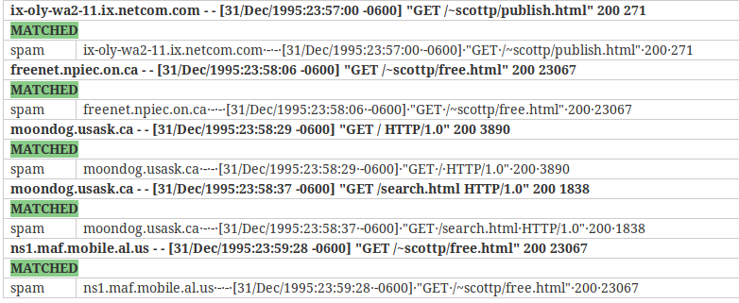
Grok baby steps (online method)
Basic grok pattern syntax:
    %{PATTERN:FieldName}
    Pattern is always upper case
    GREEDYDATA matches anything but is not a good practice
Go to http://grokconstructor.appspot.com/do/match
Paste the contents of uofs_5.log into the input
Start with %{GREEDYDATA:spam}
Click Go

Slide 77
Grok baby steps (online method)
Looking at grok patterns we can use NOTSPACE for the requestor
  %{NOTSPACE:requestor}%{GREEDYDATA:spam}
We don’t care about ‘ - - [‘ so don’t assign a pattern to them
%{NOTSPACE:requestor} - - [%{GREEDYDATA:spam}
That went boom. Any idea why?
Special charaters are escaped by a ‘\’
  %{NOTSPACE:requestor} - - \[%{GREEDYDATA:spam}
We can see the characters we don’t care about are dropped.

Slide 78
Grok Baby Steps - Timestamps
Timestamps can be a pain. Look for a prebuilt pattern that fits (and there are a LOT of them).
You can always build one by adding multiple parsed item into one
  Format: (?<field_name>%{Key1}%{Key2})
  (?<DTS>%{DAY}\/%{MONTH}) etc

Slide 79
Grok Baby Steps – Timestamps (cont)
For this timestamp - 31/Dec/2018:23:57:00 -0600 lets build a dts (Date Time Stamp) field
Paste just the time field in the online grok tester.
Getting started
(?<dts>%{MONTHDAY})
Develop the rest of the parser

Slide 80
Grok Baby Steps – Timestamps (cont)
Solution timestamp - 31/Dec/2018:23:57:00 -0600
(?<dts>%{MONTHDAY}\/%{MONTH}\/%{YEAR}:%{TIME} %{ISO8601_TIMEZONE})
That was probably not very easy and more than a little error prone.
Had we searched the patterns better we would have realized there is a prebuilt pattern for this, HTTPDATE
However, knowing how to build out a field can be a very powerful tool.

Slide 81
Grok Baby Steps (cont)
Grok syntax
filter {
grok {
match => { 'message' => "<GROK FILTER HERE>" }
}
}

Slide 82
Grok Baby Steps (cont)
Back to our full UofS log
Time permitting complete the grok pattern

Slide 83
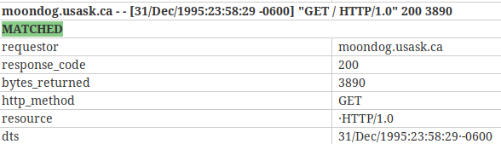
Grok Baby Steps (cont)
Full grok pattern:
%{NOTSPACE:requestor} - - \[%{HTTPDATE:dts}\] \"%{WORD:http_method} \/%{GREEDYDATA:resource}\" %{INT:response_code} %{NUMBER:bytes_returned}

Slide 84
Dissect Filters Overview
Where grok uses RegEx’s to match what’s in a field dissect uses what separates a field
Benefits
  Easier to develop
  Not as resource intensive as grok
    RegEx matching can be resource intensive
  Less error prone
    If you have an INT and you get an alpha the parser breaks
Drawback
No online tester that I know of

Slide 85
Dissect Filters Overview (cont)
Many of the same capabilities as grok
  Can drop data
    %{}
  Can combine in several fields
    %{dts} %{+dts} %{+dts}
    Combines the 3 fields into a DTS field
Back to our full UofS log

Slide 86
Dissect Filters Hands-On
Similar to grok but parses on separators
What separates the values we want?
ix-oly-wa2-11.ix.netcom.com - - [31/Dec/1995:23:57:00 -0600] "GET /~scottp/publish.html" 200 271
%{requestor} - - [%{dts}] "%{http_method} /%{resource}" %{response_code} %{bytes_returned}
Note – only characters that need to be escaped are ?, +, &

Slide 87
Dissect Filters Hands On
Run Logstash from the command line using the UofS_dissect.conf
If stdout looks good edit the conf file and uncomment the Elasticsearch output
Run it again
Go to Kibana and view the results
What is the problem?
Stop Logstash

Slide 88
Kibana Dev Tools Detour
Open the Kibana Dev Tools tab
Dev tools allow you to interact with the Elasticseach backend
Very useful when developing filters among other things.
Some useful commands
  GET _cat/indices – Shows information on all of the indices
    Health Status Index Name UUID Primary Shards Replicas Docs Deleted Docs Size Total Size
    yellow open logstash-2019.03.07 Xd2iFfGrT0uZDvmsnODPJg 5 1 1028 0 239.3kb 239.3kb
    Why is the Logstash index yellow?
    Why is the .kibana index green?
  Delete <index name>
    This is what we want. Delete the Logstash index so we only have the latest data
      DELETE logstash-2019*
    This is VERY powerful, use with care, especially wildcards

Slide 89
Dissect Filters Hands On
Rerun the command line Logstash
Back to our timestamp problem
By default Logstash uses its timestamp and not the timestamp in the log which is not want we want.
Enter the Logstash Date filter

Slide 90
Logstash Date Filter
Date filter will let us use a field as a date in Elasticsearch
Follows the joda format
  http://joda-time.sourceforge.net/apidocs/org/joda/time/format/DateTimeFormat.html
The dts format
  31/Jan/2018:23:59:28 -0600
Joda equivalent ?

Slide 91
Logstash Date Filter - Hands on
Develop that date filter (time permitting)
Date filter info
  https://www.elastic.co/guide/en/logstash/current/plugins-filters-date.html
Logstash conf file filter
  Syntax:
  match => ["field name", "Joda format"]
  target => "dts"
This gets added in the conf file filter section under the dissect filter
date {
match => ["dts", "<your Joda filter here>"]
target => "dts"
}
Use local Logstash to validate

Slide 92
Logstash Date Filter
Solution
date {
match => ["dts", "dd/MMM/YYYY:HH:mm:ss Z"]
target => "dts"
}
Check Kibana to see if it pulled the right date
If not what is the problem and how do we fix it?

Slide 93
Grok Summary
Custom fields
Drop a filed by matching a pattern but do not give it a key
  Create a key value - %{HTTPDATE:dts}
  Drops the data - %{HTTPDATE}
GREEDYDATA will match everything until it gets to the end or matches the next pattern
  “%{GREEDYDATA:eggs}” matches everything
  “%{GREEDYDATA:eggs}%{INT:response}” will stop matching when a number is seen

Slide 94
Back to Kibana
Elasticsearch does a best guess on field types when it builds an index for the first time or when it sees a new field.
What you see in the Kibana Index Pattern is what Elasticsearch picked
We can tell Elasticsearch what types we want by using a template
If we want to use our DTS field as the timestamp we need to delete the current index and push the data through again.
When we recreate the index pattern we can use the DTS field as the timestamp

Slide 95
Back to Kibana
Deleting an index pattern
Go to Kibana → Management → Index Patterns
Select the Logstash* index
Click on the red trash can in the upper right
Rerun Logstash
Recreate the Index Pattern in Kibana but choose the DTS field as the timestamp
Validate that the timestamp is the log’s timestamp

Slide 96
Dissect Summary
Dissects are
  Faster to process
  Use fewer system resources
  More robust
  Easier to develop
When to use a dissect over a grok?
  If the data is uniform go with dissect
  If the data is not uniform then you’ll probably have to sue a grok

Slide 97
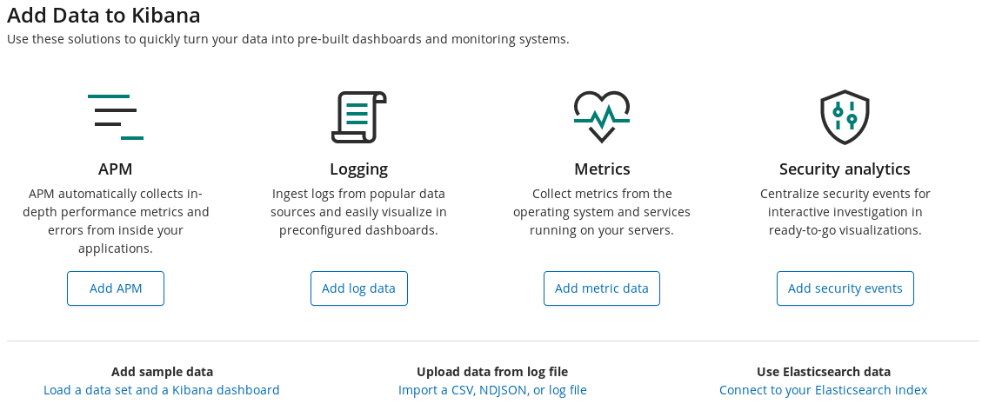
And now, the REALLY easy way
Kibana added a File Data Visualizer feature.
It does a best guess for a parser and shows data on a selected log file.
http://localhost:5601/app/kibana#/home?_g=()

Slide 98
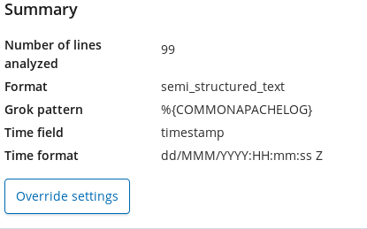
And now, the REALLY easy way (cont)
Click the “upload data from log file”
Select the uofs_100.log
The machine learning will parse the log, give some details, and a grok pattern

Slide 99
And now, the REALLY easy way (cont)
Grok filter based on Kibana:
filter {
grok {
match => { 'message' => "%{COMMONAPACHELOG}" }
}
}

Slide 100
Why is this important?
Knowing how to write filters is critical to parsing logs.
Knowing the options (and there are more we did not cover) will give you a better chance of success
  Spend some time and play around with some of the other filter options
  The more tools you have in your toolbox the better
Choosing the right approach does take time and experience
The ‘easy way’ is a Machine Learning feature.
  It’s currently beta, not supported
  Machine Learning is part of the paid package

Slide 101
Grok Baby Steps (cont)
Licensing

Slide 102
Questions?

Slide 103
Logstash – Logic & Enrichment

Slide 104
Logic & Enrichment - Goals
Use logic in a conf file to add relevant data.
Enrich an event by adding fields and values
Clean up the feed so we are only saving what we need to save
Use the data to send to a specific index

Slide 105
Logic & Enrichment – Using Logic
Logstash supports the following conditionals:
  Logic
    if, else if, and else statements
  Equality
    ==, !=, <, >, <=, >=
  Inclusion
    In and not in
  RegEx
    =~ and !~
  Boolean
    and, or, xor, and nand (not “and”)

Slide 106
Logic & Enrichment – Using Logic
IF formats
if [field name] == expression {
  do this
  }
if [term] in [field name] {
  do this
  }
IF example
if [response_code] == 404 {
mutate { add_tag => “we failed”
}

Slide 107
Logic & Enrichment – Mutate
Mutate filter allows us to add, remove, replace, rename, and modify fields
It operates on an order of precedence or the order of the mutate filters in the conf file.
    When in doubt break out the mutate calls in the conf file
Complete list:
  https://www.elastic.co/guide/en/logstash/current/plugins-filters-mutate.html
Useful for optimizing what is sent to Elasticsearch for storage
  Only send what you need to store.
    If you parse the entire message do you really need to store the message field?
  Add (enrich) by adding tags or fields.

Slide 108
Logic & Enrichment – Mutate
Mutate Examples
Add Field
  mutate {
add_field => [ "field_name", "field_value" ]
  }
Remove Field
    mutate {
    remove_field => [ "field_name1", "field_name2" ]
    }
Lowercase
  useful if a field is going to be part of an index name which is a requirement for index names
  mutate {
  lowercase => [ "fieldname" ]
  }

Slide 109
Logic & Enrichment – Index Names
As we’ve seen, the default index from a Logstash feed is logstash-yyyy.mm.dd
This will not be very useful but is easy to fix
We can designate an index name in the output section of the conf file.
We can also use a field value as part of the index name
This is VERY useful for organizing feeds and searching.
The format for this is

Slide 110
Logic & Enrichment – Index Names
As we’ve seen, the default index from a Logstash feed is logstash-yyyy.mm.dd
  This will not be very useful but is easy to fix
We can designate an index name in the output section of the conf file.
  Example spam_%{YYYY.MM.dd}
  A date is NOT required
We can also use a field value as part of the index name
This is VERY useful for organizing feeds which makes out life in Kibana much easier.
  Format for this is to add a line to the Elasticsearch output
  index => "baseName_%{field_name}_%{+YYYY.MM.dd}
  Example
  index => "spam_%{source}_%{+YYYY.MM.dd}

Slide 111
Exercise 6 – Write a Parser
The h2g2.log
  Set of quotes from the Hitchhikers Guide to the Galaxy.
  Very little data other than what was said and who said it
What we want
  Who said it (source)
  What they said (quote)
  What their occupation is (occupation)
  What planet they are from (home_planet)
What we do not want
  message
  host
  path
Additional Information
  We want the events stored in an indices with the following naming convention:
  h2g2_source_<year>.<month>.<day

Slide 112
Exercise 6 – Info you may need
Arthur & Trillian are from Earth
  Arthur was in radio
  Trillian is an astrophysicist
Ford and Zaphod are from a “small planet in the vicinity of Betelgeuse”
  Ford is a Guide Researcher
  Zaphod is the Ex-President of the Galaxy
Marvin
  From the Sirius Cybernetics Corporation
  He is a Paranoid Android
Deep Thought
  From Magrathea
  Is a supernatural computer

Slide 113
Logic & Enrichment – H2G2.conf
filter {
# filtering goes here
dissect {
mapping => {
'message' => '%{source} - "%{quote}"'
}
}
}

Slide 114
Questions?

Slide 115
Kibana Deeper Dive

Slide 116
Kibana Deeper Dive
Kibana has some very useful features for doing useful things with the data in Elasticsearch
  Searches
    Can be saved for future use
  Visualizations
    Can be based on data or saved searches
    There are a LOT of different types
  Dashboards
    Made up of visualizations
  All of these can be drilled down based on a time period
  Let’s focus on searching. I’ve added in depth visualizations on different sample data and if we have time we’ll go over them

Slide 117
Kibana – Chicago Crime Setup
Lets setup the Chicago Crime Index
This is one of the best indices I have found for sample data
Copy the contents of DevTools-ChicagoCrime.txt into the Dev Tools tab
Run the POST command
Run Logstash locally with the chicago_crime1year.conf file
Create a chicago* index pattern

Slide 118
Kibana – Searching 101
Set the Time Filter to Last 1 year
Expand the Table view and lets look at the fields
  What looks interesting? Why?
  What Might be interesting? Why?
  What does not look interesting? Why?
Visual data can be very helpful in deciding where to spend your efforts
Hopefully, if you’re responsible for this, you have some input on what comes in, why it needs to be searchable, and how it is stored (i.e. key:values and data types).

Slide 119
Kibana – Searching 101
What looks interesting? Why?
  Beat – represents an area
  Block – represents a location
  Date of occurrence – Date is a key field
  Primary Desecription – Main reason for arrest
  Secondary Description – More detail on arrest
  Time – Time of arrest is key
  Ward – More location info
  Coordinates – Can use range searches
  DTS – More location info

Slide 120
Kibana – Searching 101
What Might be interesting? Why?
  Arrest – Either ‘Y’ or ‘N’, depends on use case
  Domestic – depends on your use case
  FBI CD / IUCR – no idea what this means but is numeric, has to be something meaningful to someone
  Location Description – is “sidewalk” useful?

Slide 121
Kibana – Searching 101
What does not look interesting? Why?
Case Number – wll always be unique
X & Y Coordinate – Useful but not for searches
Anything that starts with an “_”. These are internal data fields
Path – This should have been dropped
Host – Normally meaningful but not here

Slide 122
Searching 101 - Visualizations
Visualizations can be helpful in pulling meaningful data
  Tag Cloud – shows top or bottom number of values
    Some of those “maybe useful” would give us some info
  Geo mapping can help on drilling down on locations

Slide 123
Searching 101 - Visualizations
Visualizations 101
Click on the Visualize menu item
Click the “+” to add a new Visualization
Select the type
Select the index
We will be using chicago* for all of these
Save the visualization using a useful name
  <index Name><VisualizationType><data>
  Example:
  Chicago-TagCloud-PrimaryDesc

Slide 124
Searching 101 - Visualizations
Tag Cloud
Lets create a Tag cloud for a few things and see if we can get an idea of what is important.
Beat
Primary Description
Secondary Description
FBI CD
IUCR
Location Descirption
Ward

Slide 125
Searching 101 - Visualizations
Tag Cloud
Lets go through some of these
Let’s go with Primary Description
Select a Tag Cloud visualization
Select a term (Primary_Description.keyword)
Click the Play icon
Is that useful?
Set the size to 20
Is that better?
Change the order to Ascending
Is that useful?
Save them both

Slide 126
Searching 101 - Visualizations
Tag Cloud
For the remainder you create them
Let’s try IUCR
Select a Tag Cloud visualization
Select a term (IUCR.keyword)
Click the Play icon
Is that useful?
Set the size to 20
Change the order to Ascending
Is that useful?
Should we spend time figuring out what IUCR means?
Save them both

Slide 127
Searching 101 - Visualizations
IUCR code (Illinois Uniform Crime Reporting code) which are four digit codes that law enforcement agencies in Illinois generally have adopted to use to classify criminal incidents when taking individual reports. Other states will have their own set of code
Explanation : https://data.cityofchicago.org/Public-Safety/Chicago-Police-Department-Illinois-Uniform-Crime-R/c7ck-438e/data

Slide 128
Searching 101 – Lucene Searches
Bookmark this page - https://lucene.apache.org/core/2_9_4/queryparsersyntax.html

Slide 129
Kibana – Visualizations –

Slide 130
Kibana Deeper Dive

Slide 131
Grok Baby Steps (cont)
Licensing

Slide 132
Lessons Learned
-inurl:elastic.co for troubleshooting
Use tags to write to a index
Too many sub-indices under a wildcard
ECS is new but should use it
https://www.data.gov/ to the rescue
All kinds of data searchable by subject and type
Can search on format (CSV, JSON, etc.)
Can search on attributes
Geospatial if you want to play with Geo Points

Slide 133
Kibana – If we have time...

Slide 134
Kibana Deeper Dive – Setup the Index
We need to tell Elasticsearch how we want the data stored, specifically:
  We need to set a timestamp
  We want to setup a geopoint
    Geopoints can be setup with the following:
      Longitude and Latitude
      An IP
Delete the existing Logstash index
Delete the existing Logstash index pattern
Run Logstash with the es_sampleData.conf file
Set the index pattern as “logstash*”
Set the time filter to Absolute Time Range
  From - 2018-06-17 16:00:00.000
  To 2014-06-17 00:08:00.000.

Slide 135
Kibana – Visualizations - Geo
Display the Geo location from where the requests were originated
Go to the Visualizations tab
Select Coordinate Map
Select the Logstash* index
Click on Geo Coordinates
Select Geohash (only option)
Select geoip.location from the Field drop down
Click the Play icon
Where’s the data?
  Get used to this, it still happens to me
Save this as LS-geo
  Good practice to use the index name in whatever you save

Slide 136
Kibana – Visualizations - Geo
Select Options (next to Data)
Try the different Map types with the different cluster sizes
  NOTE – You have to click Play to see the changes
If you do not have internet access you will lose some of this
  There are paid and free version of geo databases to use.

Slide 137
Kibana – Visualizations – Vertical Bar
Response Codes Over Time
Select a new Visualization – Vertical Bar
In the X Axis select Date Histogram and timestamp as the field
Click Add sub-buckets and select Split Series
Select Terms as the sub aggregation
Select response.keyword the field
Click the Play icon
More values can be added by increasing the count
Save the search as LS-verticalBar-ResponseCodes

Slide 138
Kibana – Visualizations – Tag Cloud
Tag Cloud – Useful as a quick way to see largest or smallest data values
Open a new Kibana Visualize window
Click the “+” to create a new visualization
Select Tag Cloud
Select the Chicago index
Click on the Tags icon
Select Terms for the Aggregation
Under the Field drop down select Primary Description.
For size select 20
Click the Play icon
  Did we forget something?

Slide 139
Kibana – Visualizations – Tag Cloud
User Agents
Select a new Visualization – Tag Cloud
Select Terms for the Aggregation
Under the Field drop down select useragent.name.keyword
Click Play
Save the search as LS-TagCloud-UserAgent

Slide 140
Kibana – Visualizations – Area Chart
Top 5 Countries
Select a new Visualization – Area Chart
In the X Axis select Date Histogram and timestamp as the field
For the Y axis select the Aggregation Type as Sum with Bytes as the field.
For the X axis select Date Histogram with timestamp as the field.
Click Add Sub Buckets – Split Series
Select terms for the sub aggregation and geoip.country_name for the field
Click the Play icon
Save the search as LS-AreaChart-ByCountry

Slide 141
Kibana – Visualizations – Data Table
Top 10 URL’s Requested
Select a new Visualization – Data Table
In the X Axis select Date Histogram and timestamp as the field
Click Add sub-buckets and select Split Rows
Select Terms as the sub aggregation
Select request.keyword as the field
Click the Play icon
More values can be added by increasing the count
Save the search as LS-DataTable-TopURLs

Slide 142
Questions?
Presenter email@example.com

Slide 143
Exercise 5 : Dissect to Parse h2g2.log
Write a conf file to parse the h2g2.log file and output to the console and an
Develop a dissect filter to parse out who said it (source) and what they said (quote)

Slide 144
Grok Summary
Custom fields
Drop a filed by matching a pattern but do not give it a key
  Create a key value - %{HTTPDATE:dts}
  Drops the data - %{HTTPDATE}
GREEDYDATA will match everything until it gets to the end or matches the next pattern
  “%{GREEDYDATA:eggs}” matches everything
  “%{GREEDYDATA:eggs}%{INT:response}” will stop matching when a number is seen

Slide 145
Logic & Enrichment - Mutate
We’ll use Mutate to drop the original message, host, and path to clean up our output
We’ll also use it to enrich the data (add information) that will be available in Elasticsearch

Slide 146
Kibana Deeper Dive
To really learn about Kibana we need a large data set with a lot of different attributes
Elastic provides a sample data set
  https:/​/​github.​com/​elastic/​elk-​index-​size-​tests/​blob/​master/​logs.​gz
  The Github logs_100K is a subset of that with the year set to 2108
It is convenient because there is a lot of info online so easy to expand.To really learn about Kibana we need a large data set with a lot of different attributes
Elastic provides a sample data set
https:/​/​github.​com/​elastic/​elk-​index-​size-​tests/​blob/​master/​logs.​gz
It is convenient because there is a lot of info online so easy to expand.

