Slide 1
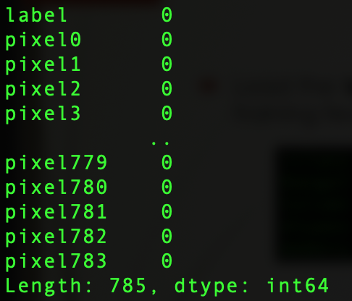
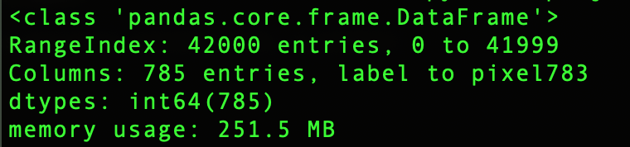
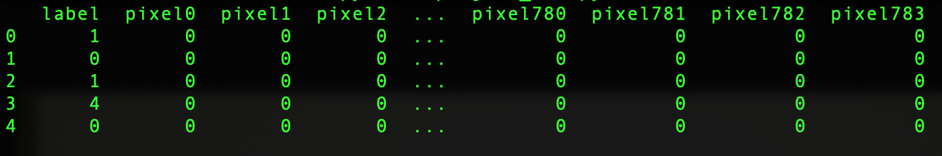
KNN for handwritten digit recognition
Load the training dataset (42,000 images) and set the target (digit label) and training features (pixel values).
Feature description: raw grayscale pixel intensities
are used directly. No empty values and thus no
features are dropped.

Slide 2
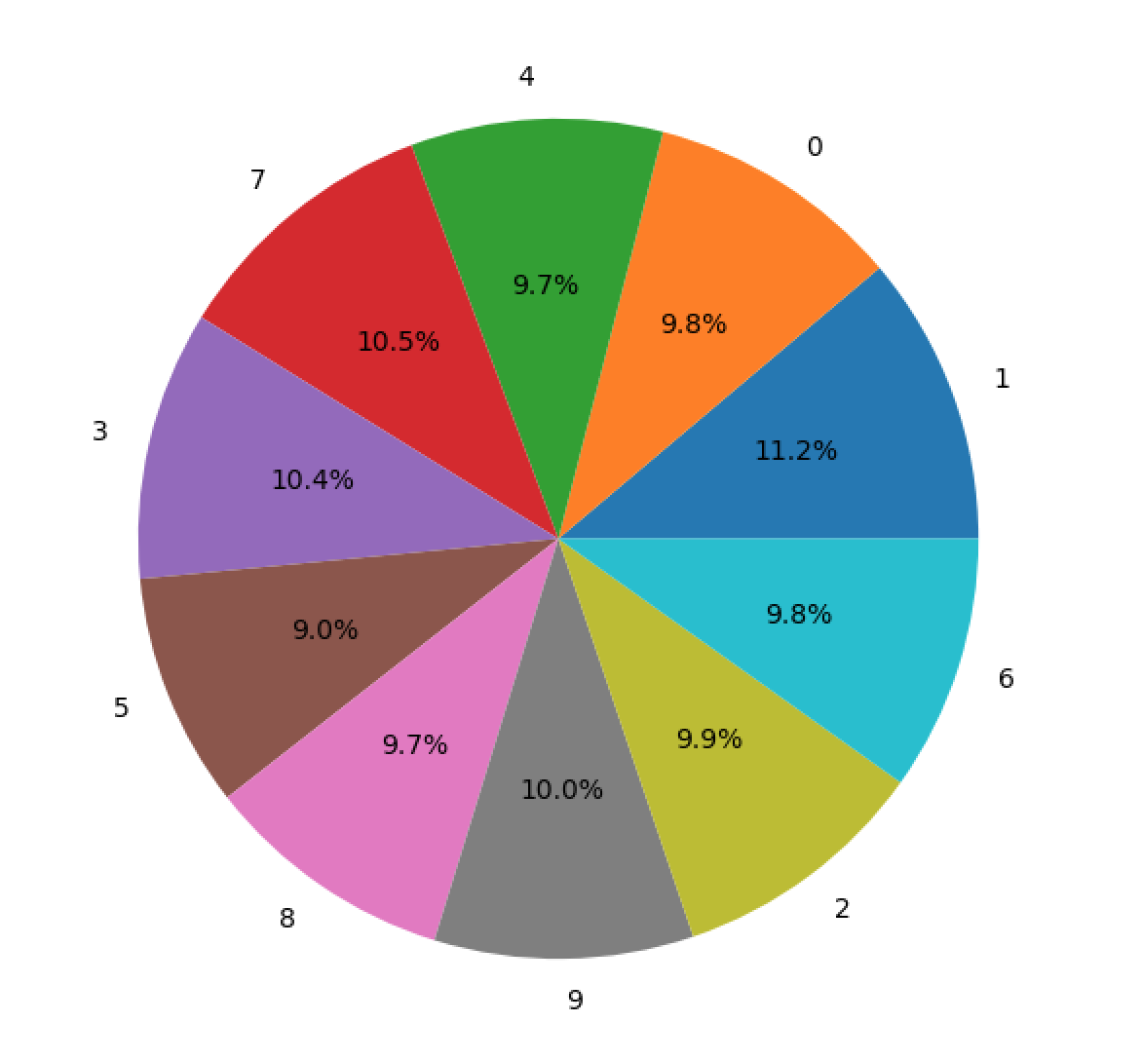
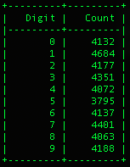
Training Data Analysis
The count of each digit in the training data:

Slide 3
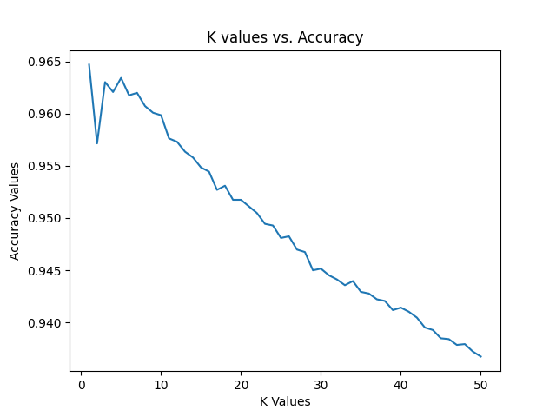
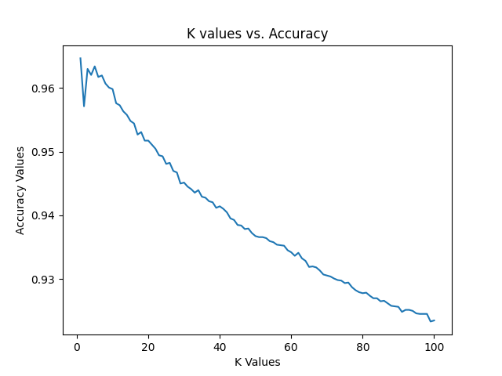
Finding the best K value:
The best K value for the KNN algorithm is found by randomly splitting the training data using train_test_split library from sklearn.
The accuracies are found when K = 1 to 50 and K = 1 to 100. The results are stored in a CSV file. The three best accuracies are found when K = 1 (96.46%), the next best accuracy is found when K = 5 (96.34%) and finally when K = 3 (96.30%). These accuracies are very close to each other.

Slide 4
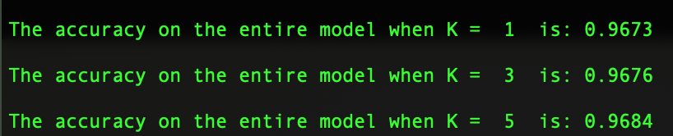
Training the model
The model on the raw pixel intensities of the images in the training set and using the best K value.
For this, a KNN classifier is created, the model is fit on X_train and Y_train. Once fitted, predictions are done on x_test. The predictions are then stored in y_pred. The actual label values are present in y_test.
Accuracy is calculated on the training dataset by taking K = 1, the accuracy is 96.73%, when K = 3, the accuracy is 96.76% and when K = 5, the accuracy is 96.84%

Slide 5
Further plans with KNN
I want to perform five-fold cross validation on the training data set and compute the average accuracy, precision, recall and F1 score over the five folds.
For the next project checkpoint, I want to introduce my model to the testing dataset and be able to make prediction on the testing dataset.
I want to find the accuracy of the model on the testing set
I want to plot graphs to discuss my findings
As a group, we want to compare the performance of different Machine Learning algorithms on the Kaggle handwritten digit recognition dataset and report our findings.
My GitHub link: Project_Checkpoint_1_submission
https://github.com/monicabernard/CAP-5610_Machine-Learning.git

