Slide 1
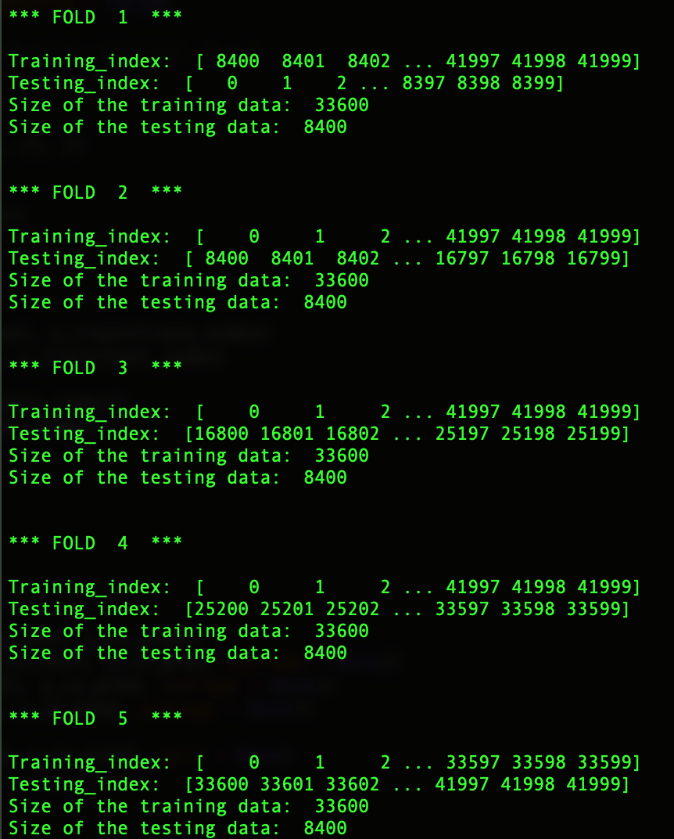
KNN FOR HANDWRITTEN DIGIT RECOGNITION:
FIVE-FOLD CROSS VALIDATION
At each fold, the training data is divided into two sets.
The first set has 33600 images for training purpose
The second set has 8400 images for testing.
Five-fold cross validation was performed by taking K = 3 and K = 5. The results were very similar.

Slide 2
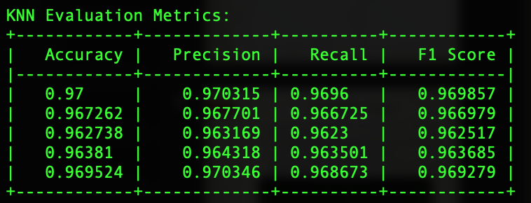
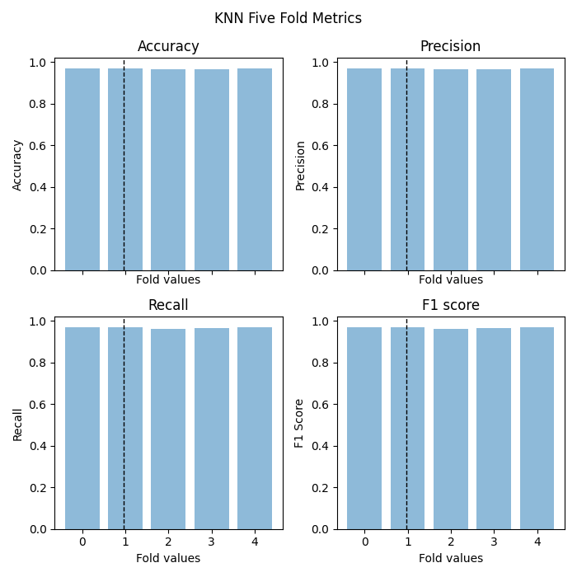
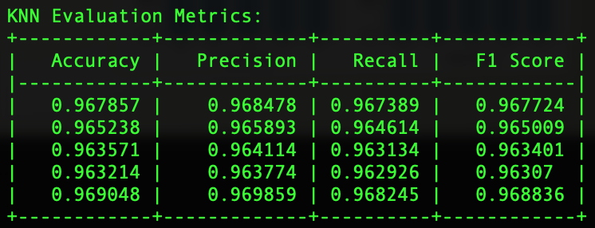
Evaluation Metrics over Five-Folds
Accuracy, Precision, Recall and F1 score over five-folds when K = 3 and K = 5
K = 3:
K = 5:

Slide 3
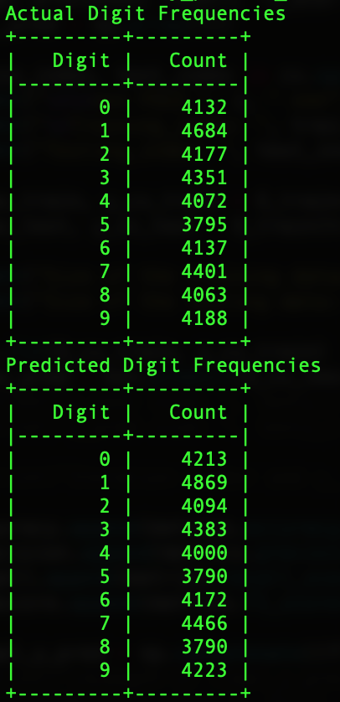
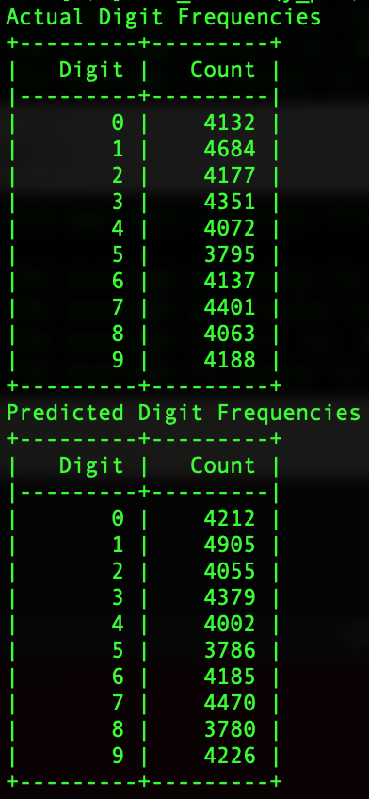
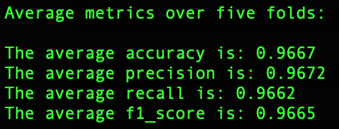
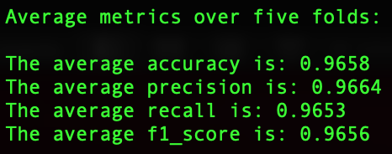
Average Five-Fold Values
The average values of accuracy, precision, recall and F1 score for K = 3 and K = 5 are shown.
K = 3 K = 3 K = 5
K = 5

Slide 4
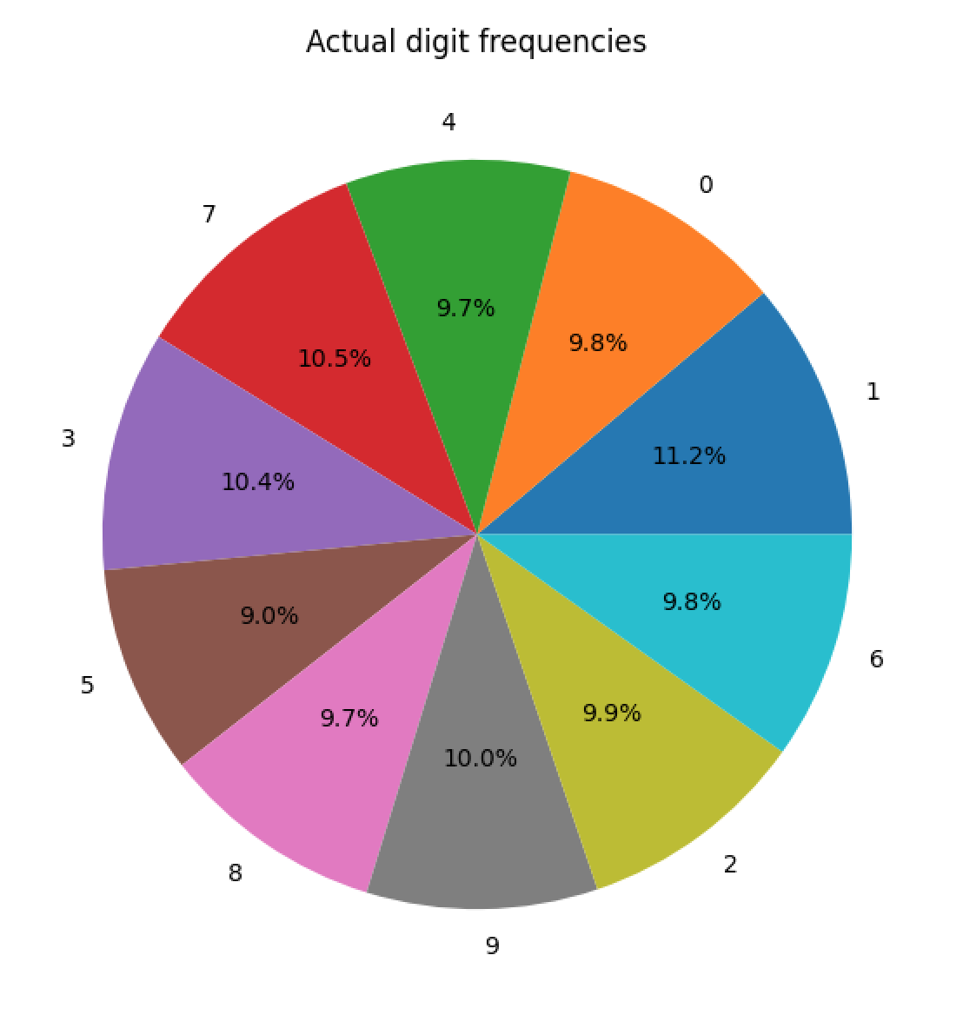
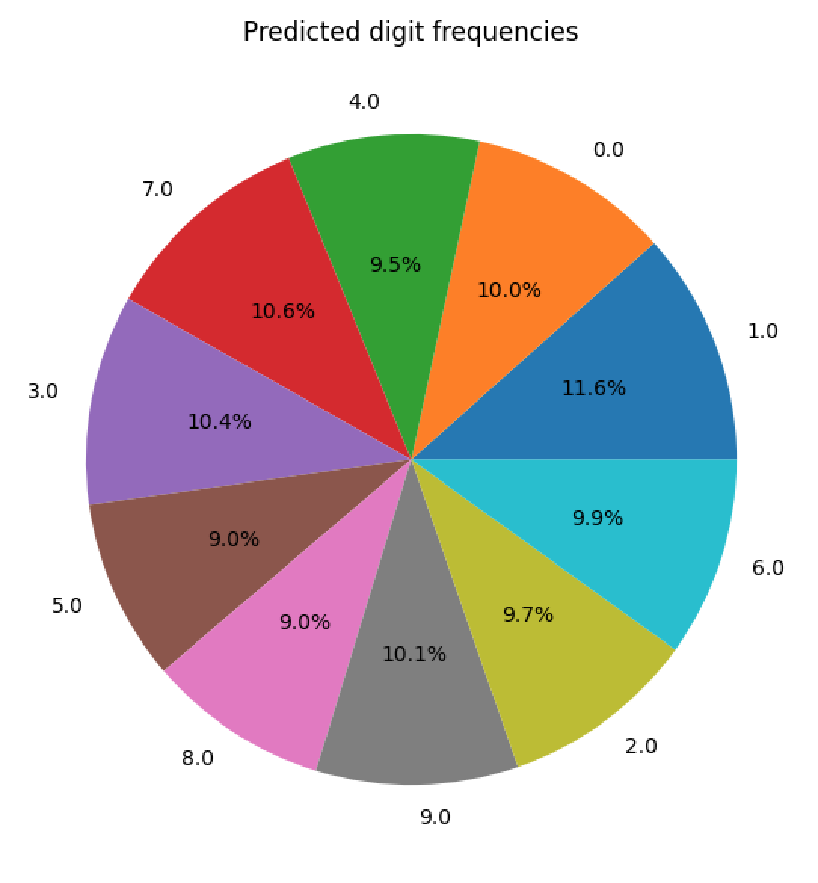
Digit Frequencies when K = 3

Slide 5
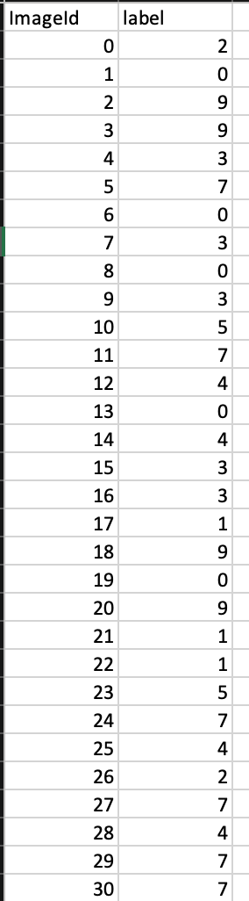
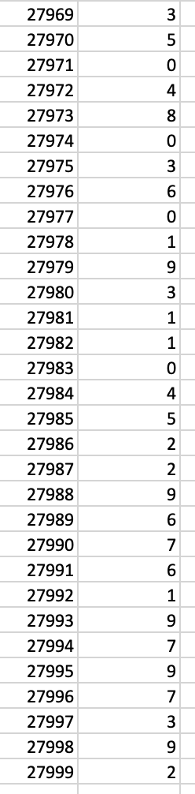
Predictions made on the Testing data:
Screenshots from the CSV file:
These screenshots show the first few and last few predictions from the output CSV file when K = 3.
Comparing my result with 100% output accuracy, I got an accuracy of 96.80% (first with K = 3 and then K = 5) as shown in the screenshot below.
My GitHub link: Project_Checkpoint_2_submission
https://github.com/monicabernard/CAP-5610_Machine-Learning.git

