Slide 1
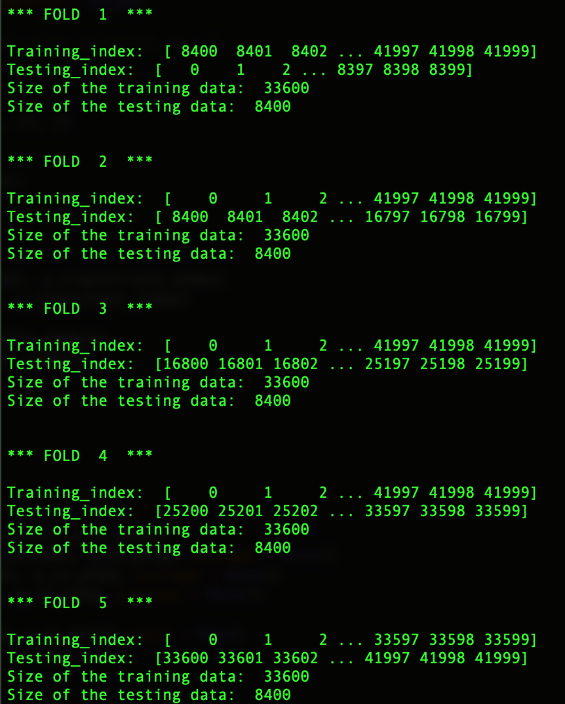
KNN FOR HANDWRITTEN DIGIT RECOGNITION:
FIVE-FOLD CROSS VALIDATION
Five-fold cross validation was performed by taking K = 1, 3 and K = 5. The results were similar for all K values.
At each fold, the training data is divided into two sets.
The first set has 33600 images for training purpose
The second set has 8400 images for testing.

Slide 2
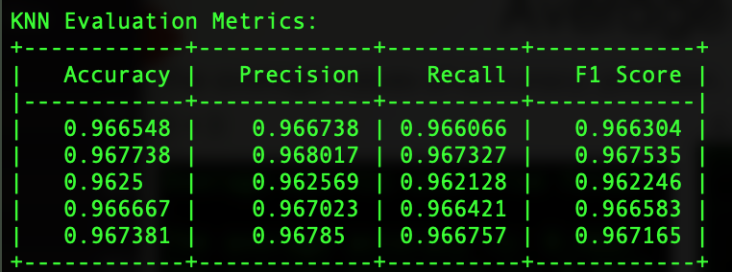
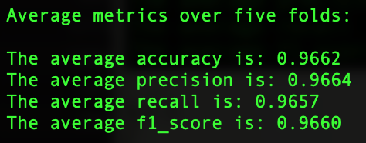
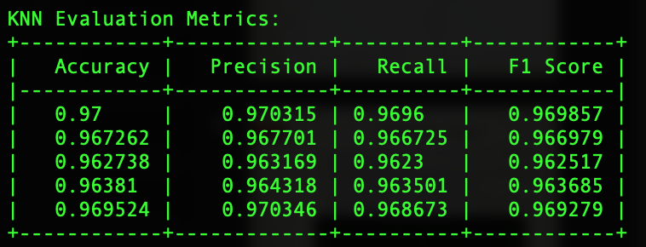
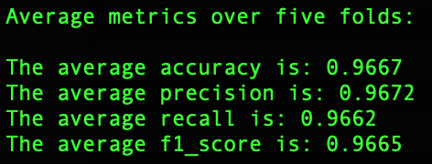
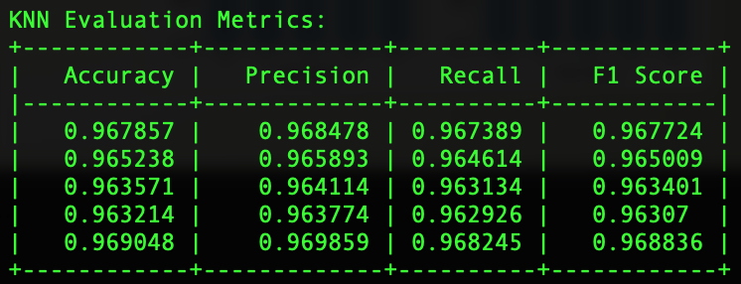
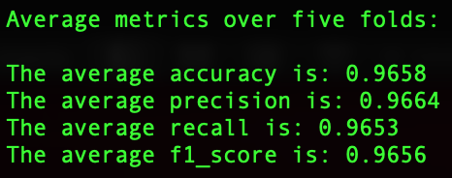
Evaluation Metrics over Five-Folds
Accuracy, Precision, Recall and F1 score over five-folds when K = 1, 3 and 5
K = 1
K = 3
K = 5

Slide 3
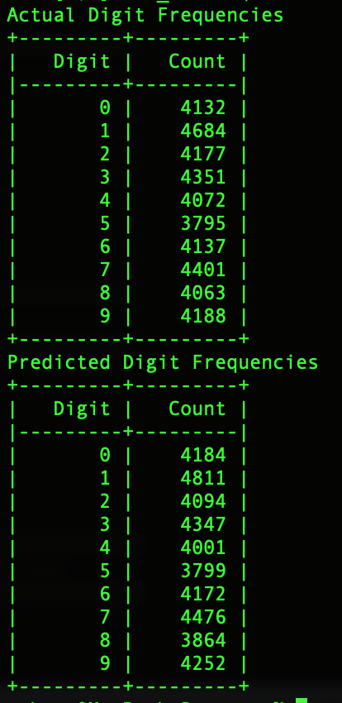
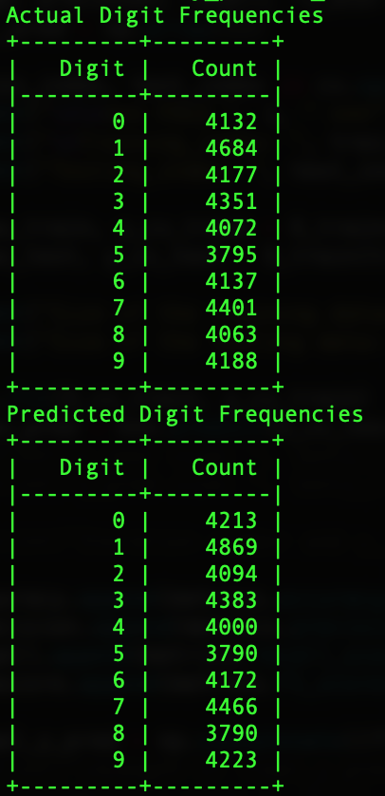
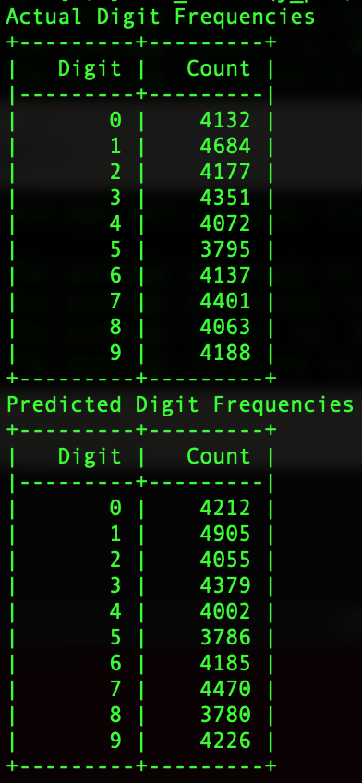
Digit Frequencies
K = 1
K = 3
K = 5

Slide 4
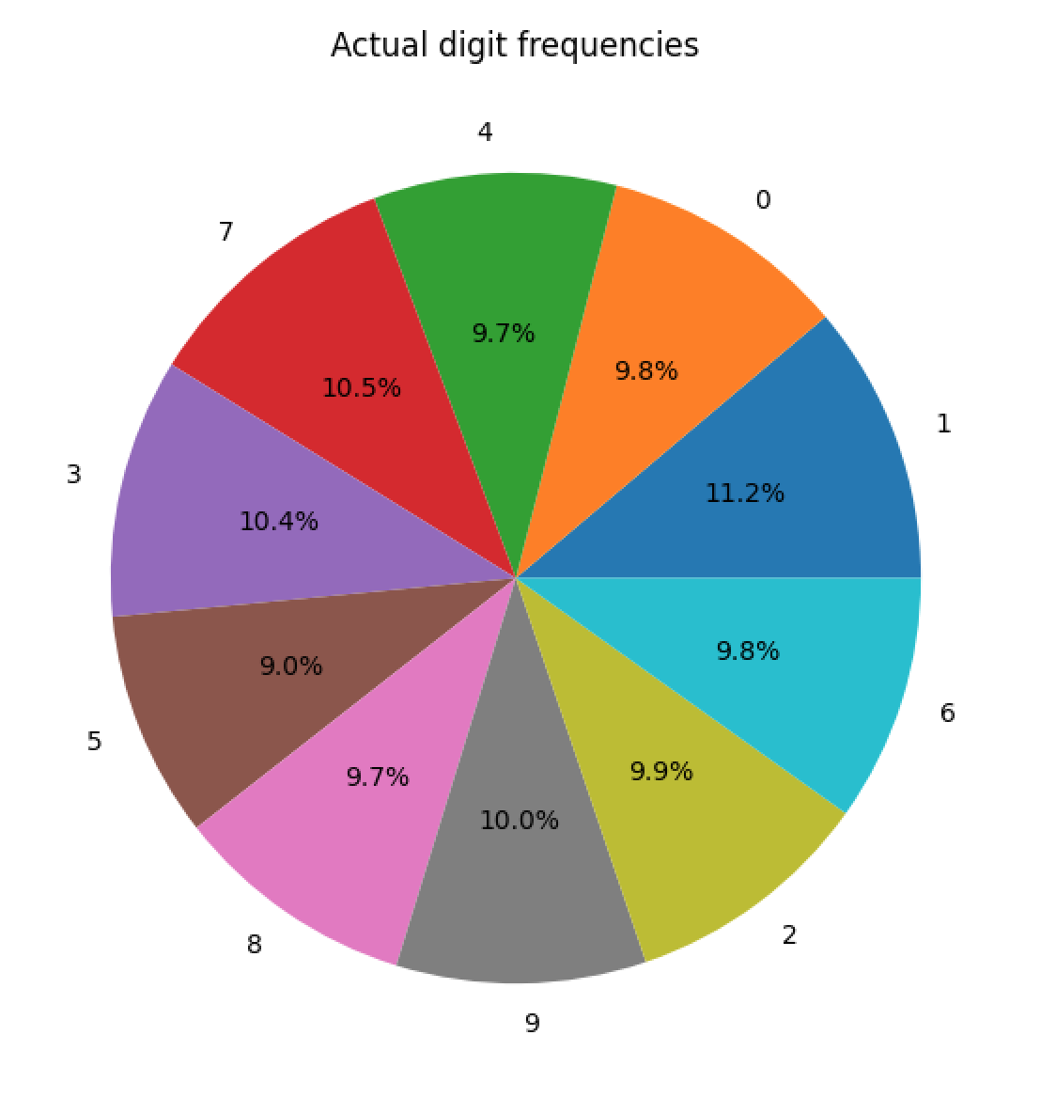
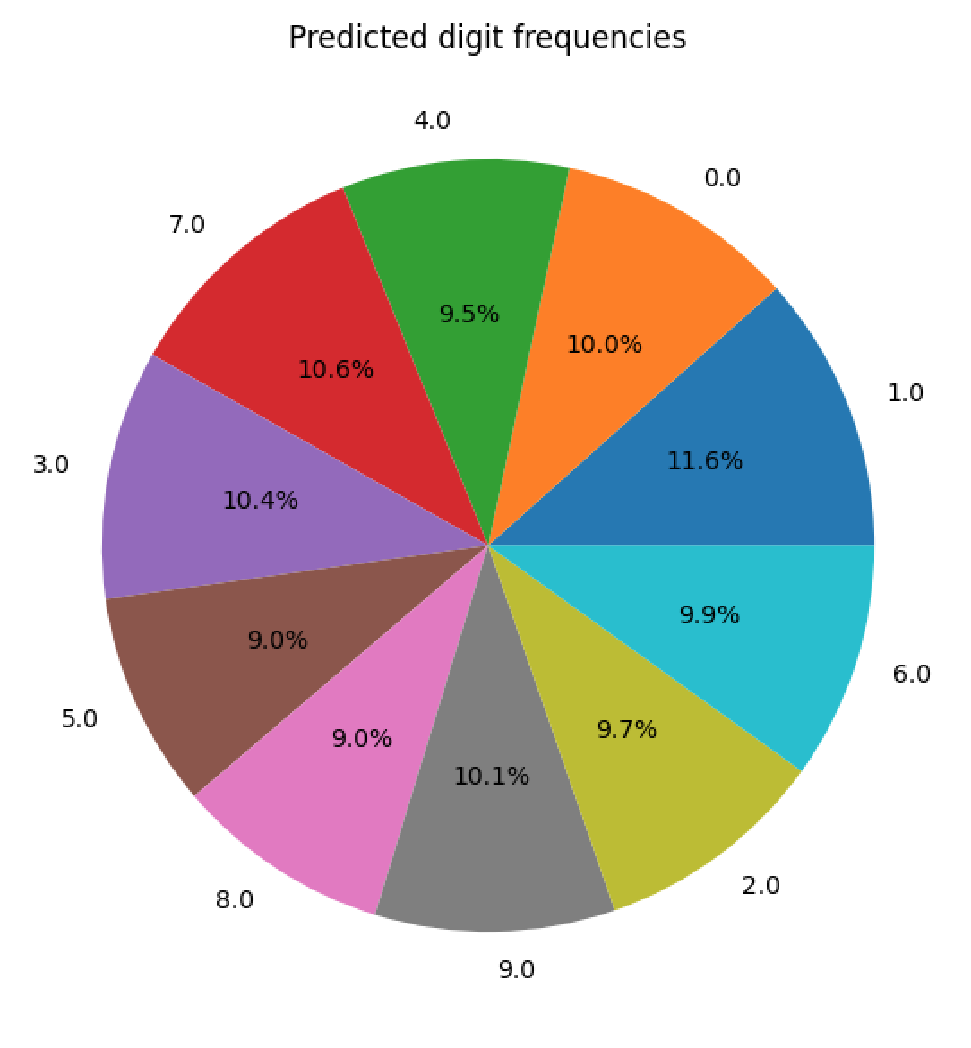
Digit Frequencies when K = 3

Slide 5
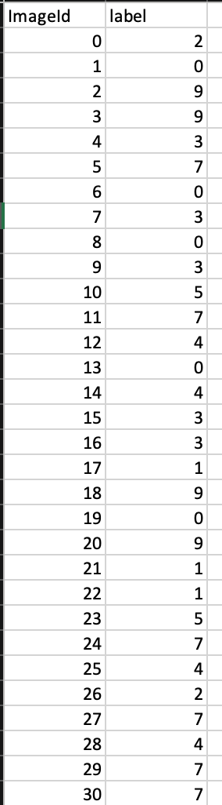
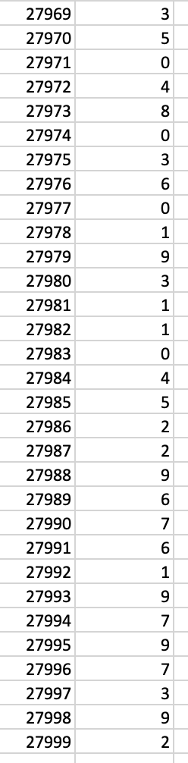
Predictions made on the Testing data:
Screenshots from the output CSV file:
These screenshots show the first few and last few predictions from the output CSV file when K = 3.
Comparing my result with 100% output accuracy, I got an accuracy of 97% (K = 1, K = 3 and then K = 5 respectively) as shown in the screenshot below.
My GitHub link: Project_Checkpoint_2_submission:
GitHub Link

