Slide 1
LeNet-5 on MNIST
Reproducing a classic CNN baseline and comparing it with modern practice
Neural Networks Fundamentals | Project 16
Szamotuła K. & Behnke M.

Slide 2
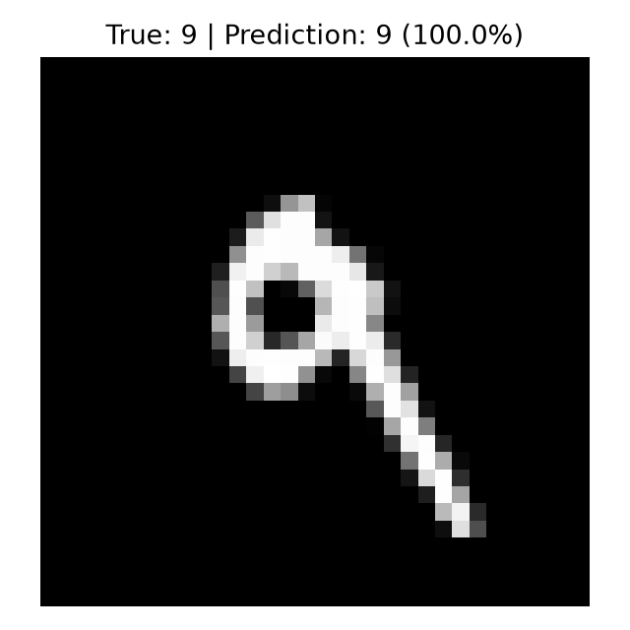
The task is simple enough to reveal the model
MNIST removes most data-engineering noise, so the architecture and training choices are easy to inspect.
Input: centered grayscale handwritten digit
Output: one of ten classes, 0 through 9
Dataset: 60,000 train images and 10,000 test images
Project goal: reproduce LeNet-style CNN behavior cleanly and reproducibly
The final demo loads the checkpoint and predicts a held-out MNIST digit.

Slide 3
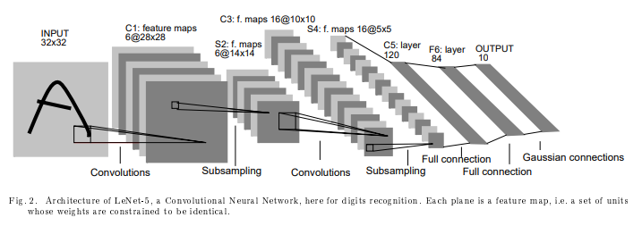
LeNet-5 is small, structured, and historically specific
The reproduction uses the original 32x32 input shape, partial connectivity, trainable subsampling, and RBF outputs.
The model has exactly 60,000 trainable parameters and returns class penalties: lower RBF distance means a better class match.

Slide 4
The small CNN reaches high accuracy in seconds
Final cluster run results from outputs/metrics.json.
98.94%
98.93%
1.07%
best validation accuracy
test accuracy
test error
This satisfies the course feasibility constraint comfortably: the full final run trained end-to-end on CPU in 146.91 seconds.

Slide 5
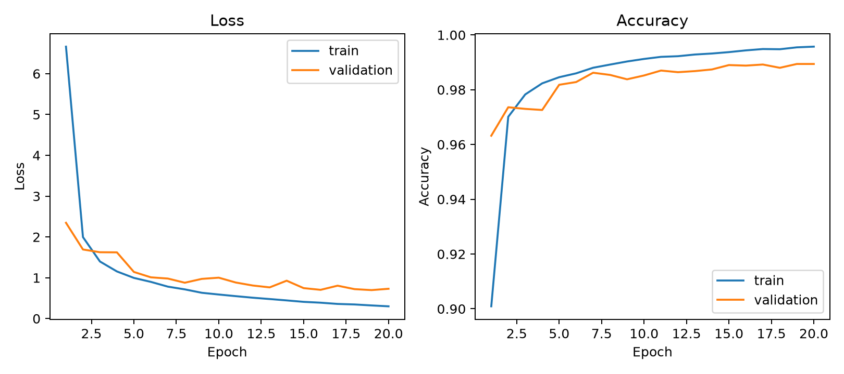
Training is stable across the 20-epoch historical run
Loss continues to improve while validation accuracy plateaus near 98.6%.

Slide 6
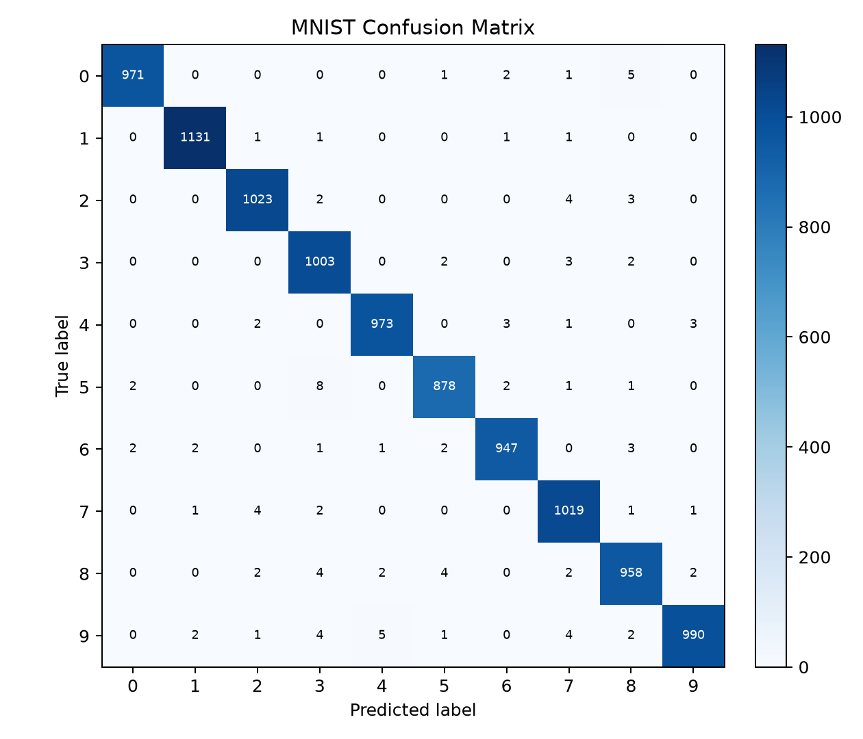
Most errors are rare and concentrated among similar digits
The confusion matrix shows strong diagonal performance across all ten classes.
Most predictions lie on the diagonal
Remaining mistakes are sparse
Errors usually involve similar digit shapes
Accuracy alone still does not prove robustness on real handwriting

Slide 7
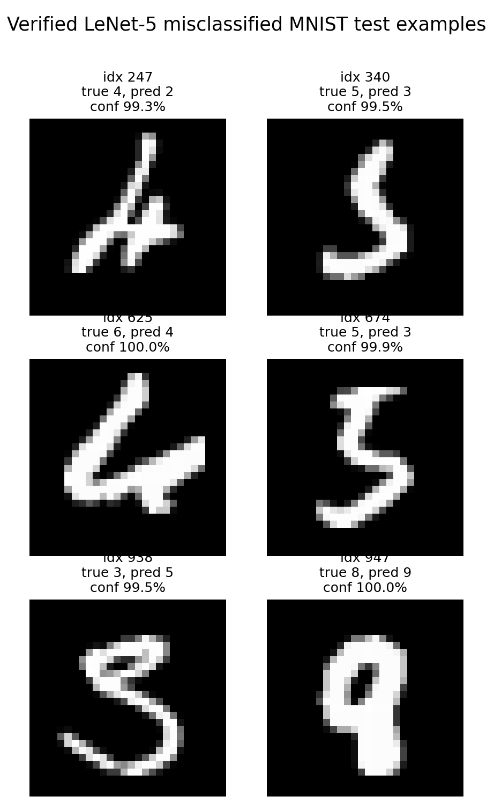
The remaining errors are visually understandable
The model usually fails on ambiguous handwriting, not random easy digits.
Several mistakes have unusual stroke shapes
Some predictions are confidently wrong
This is useful for explaining model limits
The demo should be treated as MNIST-style, not real-world handwriting

Slide 8
The wow demo classifies a digit drawn live
A browser canvas sends the drawing to the trained PyTorch checkpoint and returns class probabilities.
7
python app.py
Open http://127.0.0.1:5000, draw a digit, and click Classify.
Uses the committed checkpoint
Crops and rescales the browser drawing
Shows prediction plus probability bars
Backup: python demo.py --sample-index 7

Slide 9
We matched the historical range, but not the best run
LeCun et al. reported about 0.8-0.95% MNIST test error for LeNet-5.
0.8-0.95%
1.07%
LeNet-5 reported by LeCun et al.
our reproduction
Gap: 0.12 points vs. the 0.95% run; 0.27 points vs. the best 0.8% figure.

Slide 10
ResNet-18 is more accurate but far less efficient
The modern baseline improves accuracy by 0.25 percentage points, but with a much larger model.
LeNet-5
ResNet-18
98.93% test accuracy
99.18% test accuracy
60,000 parameters
11,172,810 parameters
146.91 s CPU training
726.28 s CPU training
0.26 MB checkpoint
44.77 MB checkpoint
For MNIST, ResNet wins on accuracy; LeNet wins on simplicity, speed, and explainability.

Slide 11
The project succeeds as a clean, honest reproduction
A small CNN, trained end-to-end, gives high accuracy and a clear explanation of what changed from 1998.
Working training, evaluation, figure, and demo scripts
98.93% test accuracy with a 60,000-parameter model
Takeaway
Limitations are explicit instead of hidden
LeNet still teaches the core CNN idea clearly.

