Slide 1
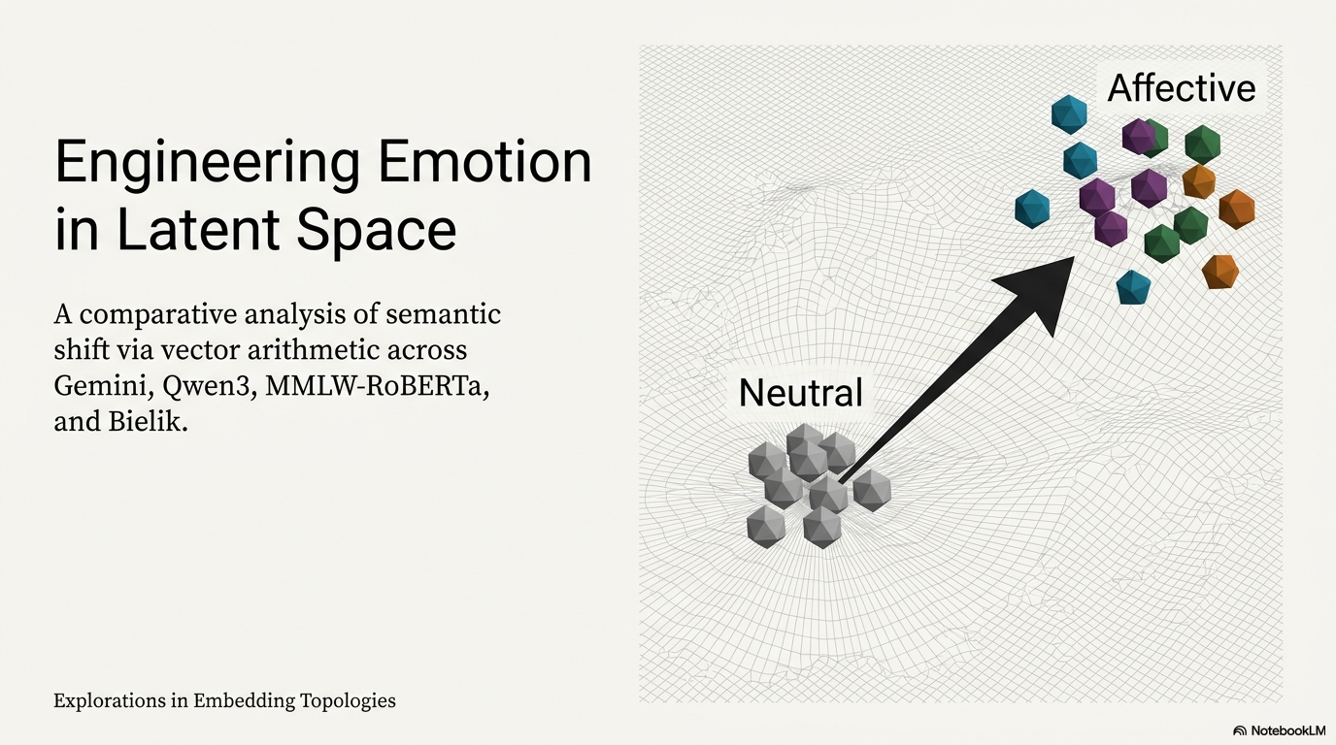
Do simple vector operations create interpretable semantic shifts across models and languages?

Slide 2
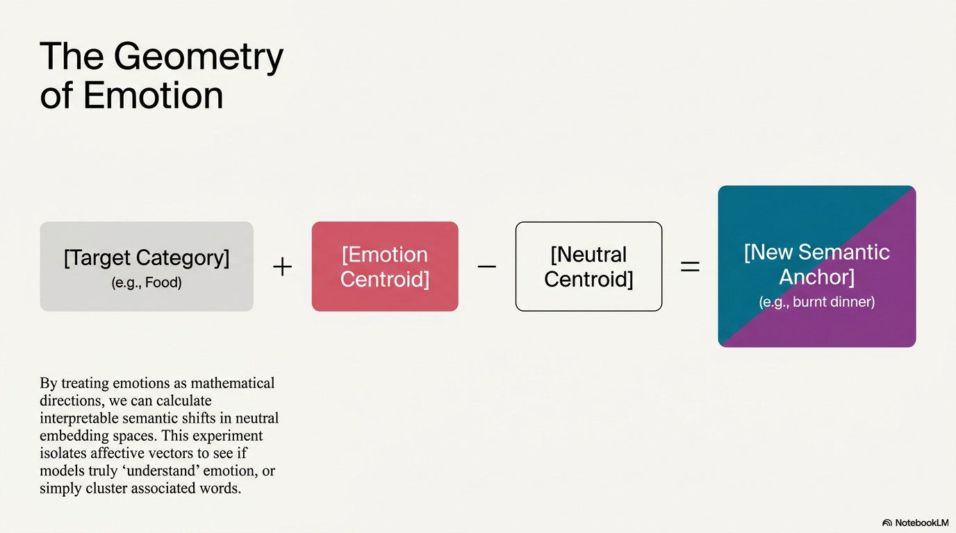
By treating emotions as mathematical directions,
we can calculate interpretable semantic shifts
in neural embedding spaces.
This experiment isolates affective vectors to see if models truly ‘understand’ emotion, or simply cluster associated words.

Slide 3
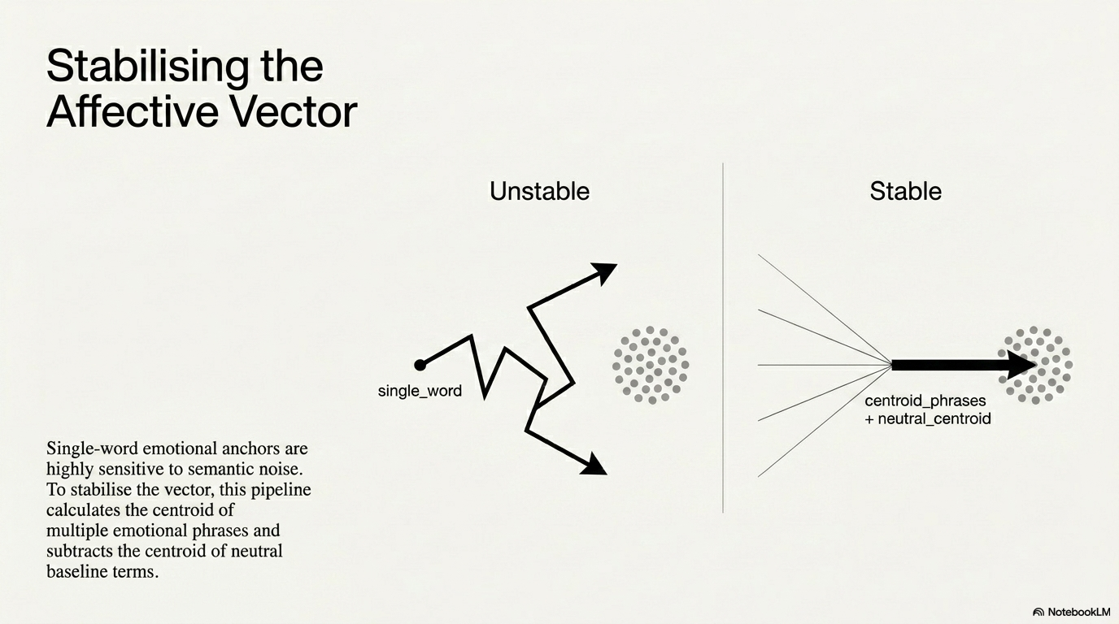
Single-word emotional anchors are highly sensitive to semantic noise. To stabilise the vector, this pipeline calculates the centroid of multiple emotional phrases.

Slide 4
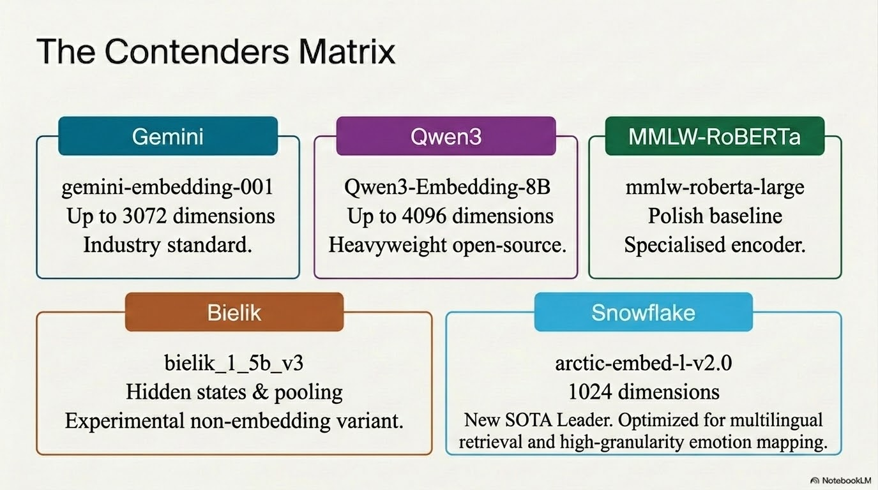

Slide 5
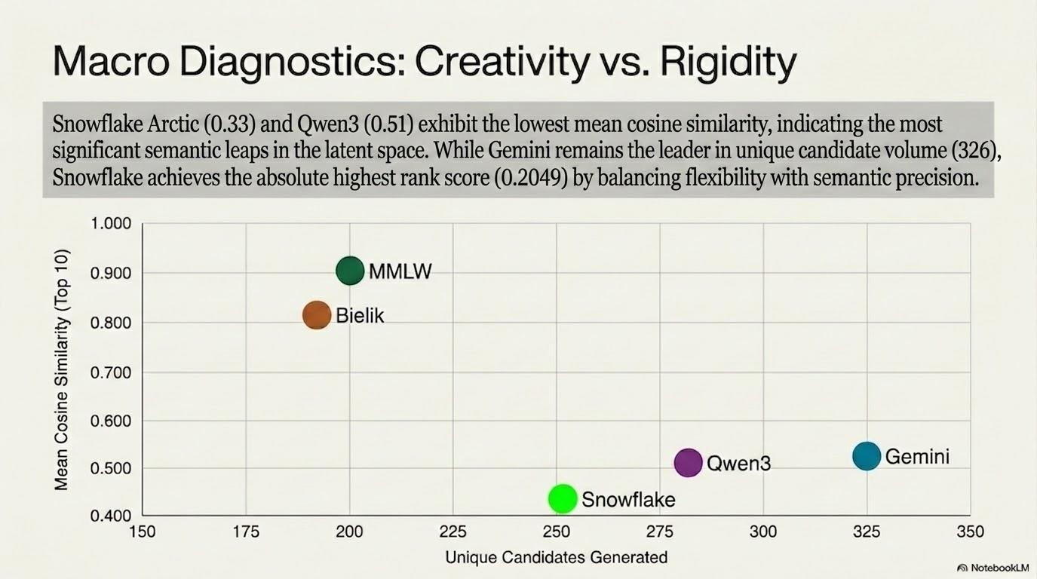

Slide 6
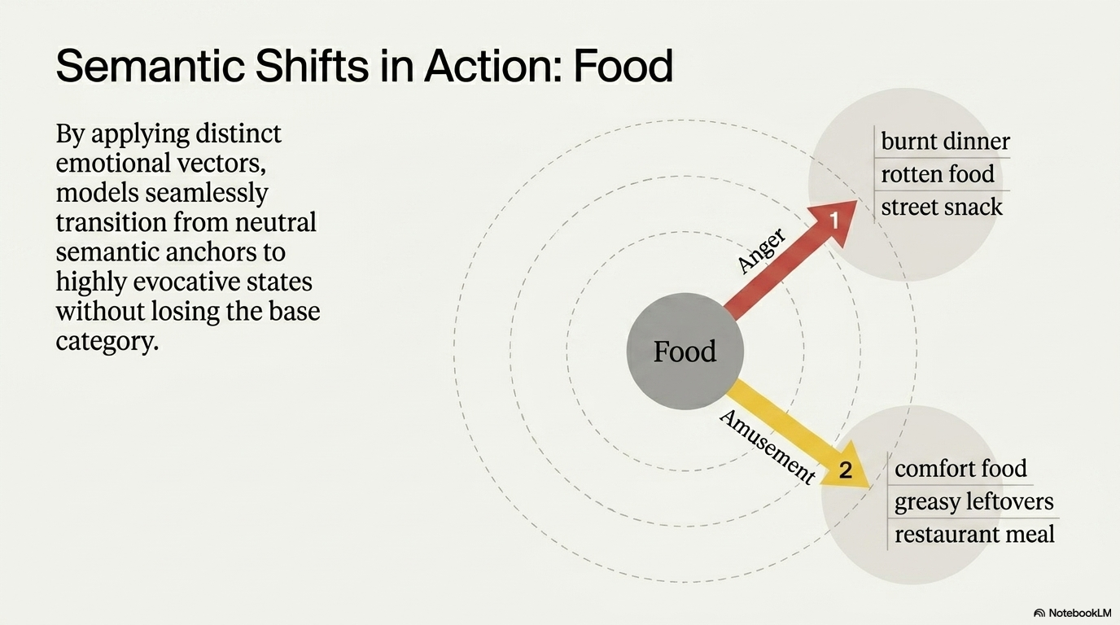

Slide 7
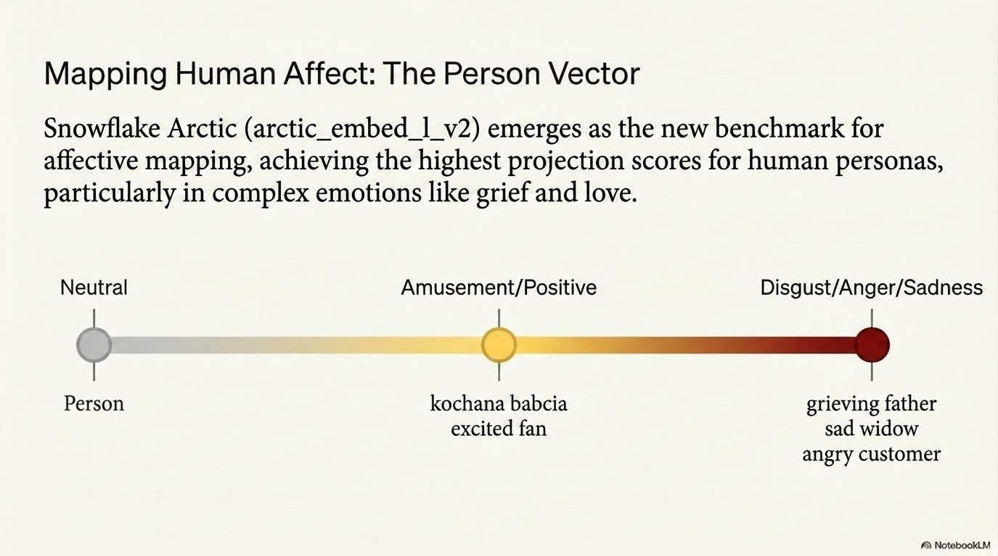

Slide 8
