Slide 1
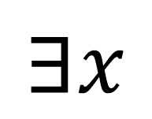
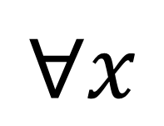

Logic, Predicates, & Quantifiers
$$∀x$$
$$∃!x (x=3)$$
∀x (F(x)→C(x))
∃!x P(x)→∃x P(x)
∃x (S(x)∧N(x))
$$∃x$$

Slide 2
Logical Equivalence & De Morgan's Laws

Slide 3
Homework 1 Review
With a partner:
Review Homework 1.
Share your solutions and look at your partner's solutions.
Focus on the exercises with Python code.

Slide 4

Check your understanding
Decide whether each of the following are a tautology or a contradiction or neither.
1. $p∨¬p$
2. $p∧¬p$
3. $p↔¬p$
4. $p→¬p$
Tautology. It is always true no matter the value of $p$.
Contradiction. It is always false no matter the value of $p$.
Contradiction. It is always false no matter the value of $p$.
Neither. It is sometimes true and sometimes false depending on the value of $p$.

Slide 5
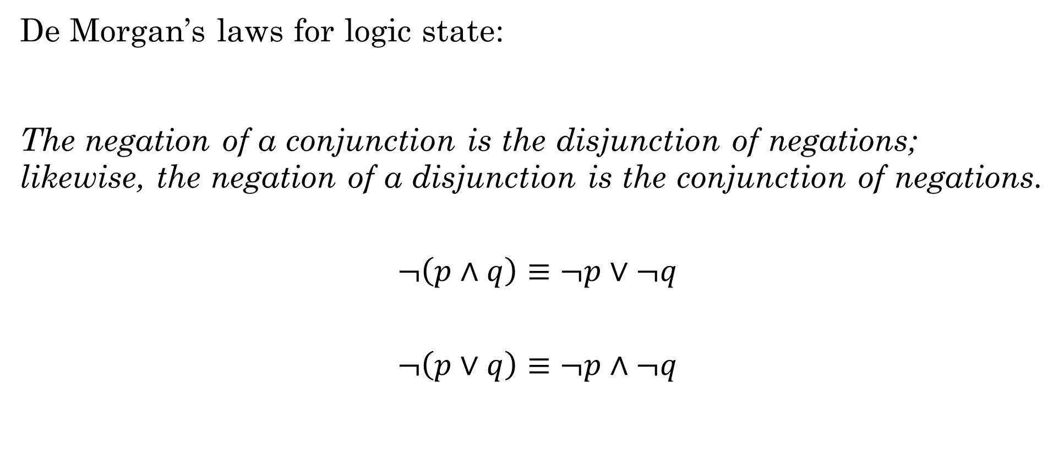
De Morgan's Laws
De Morgan’s laws for logic state:
The negation of a conjunction is the disjunction of negations; likewise, the negation of a disjunction is the conjunction of negations.
$$¬\left(p∧q\right)≡¬p∨¬q$$
$$¬\left(p∨q\right)≡¬p∧¬q$$

Slide 6

Example
Simplify this expression using De Morgan's Laws:
$¬\left(¬p∨q\right)$
1. $(¬¬p∧¬q)$
2. $(p∧¬q)$
$¬\left(¬p∨q\right)≡(p∧¬q)$

Slide 7
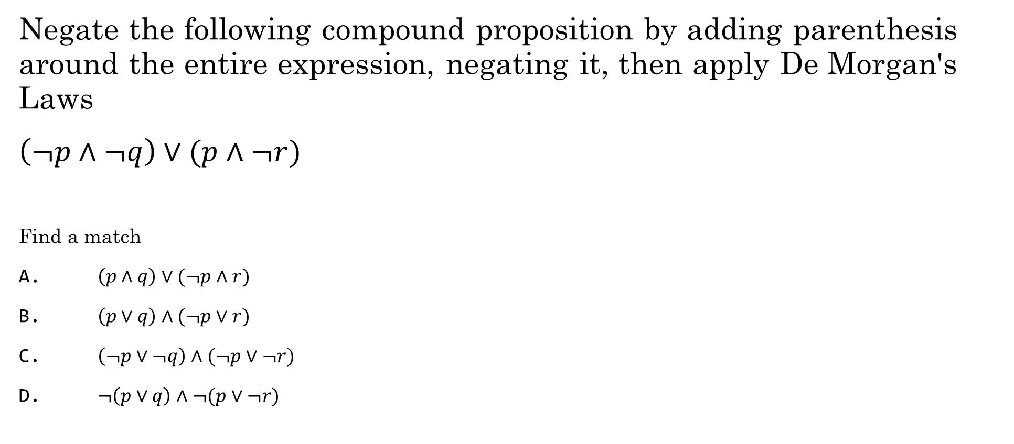
You try it
Negate the following compound proposition by adding parenthesis around the entire expression, negating it, then apply De Morgan's Laws
$\left(¬p∧¬q\right)∨(p∧¬r)$
Find a match
A. $\left(p∧q\right)∨(¬p∧r)$
B. $\left(p∨q\right)∧(¬p∨r)$
C. $\left(¬p∨¬q\right)∧(¬p∨¬r)$
D. $¬\left(p∨q\right)∧¬(p∨¬r)$

Slide 8

English Conversions
$p=$ It is sunny
$q=$We will go outside
Translate these propositions into English:
$p∧q$
$¬(p∧q)$
$¬p∧¬q$
$p→q$
$¬p→¬q$
$¬q→¬p$
It is sunny and we will go outside.
It is not sunny or we will not go outside.
It is not sunny and we will not go outside.
If it is sunny, then we will go outside.
If it is not sunny, then we will not go outside. (Inverse)
If we don't go outside, then it is not sunny (Contrapositive)

Slide 9


Translate from English to Logic
You cannot ride a roller coaster if you are under 4 feet tall unless you are older than 16 years old.
$r=$You can ride a roller coaster
$s=$You are under 4 feet tall
$t=$You are older than 16
Hint: $p→q$ can be pronounced as $q if p$
$$(s∧¬t)→¬r$$
Notes:
If you are under 4 feet tall and not older than 16, then you cannot ride the roller coaster.
-r, if s ^ -t
(s ^ -t) -> -r
Another way, start with the contrapositive: If you can ride the roller coaster, then you must be over 4 feet or older than 16.
r -> (-s v t)

Slide 10
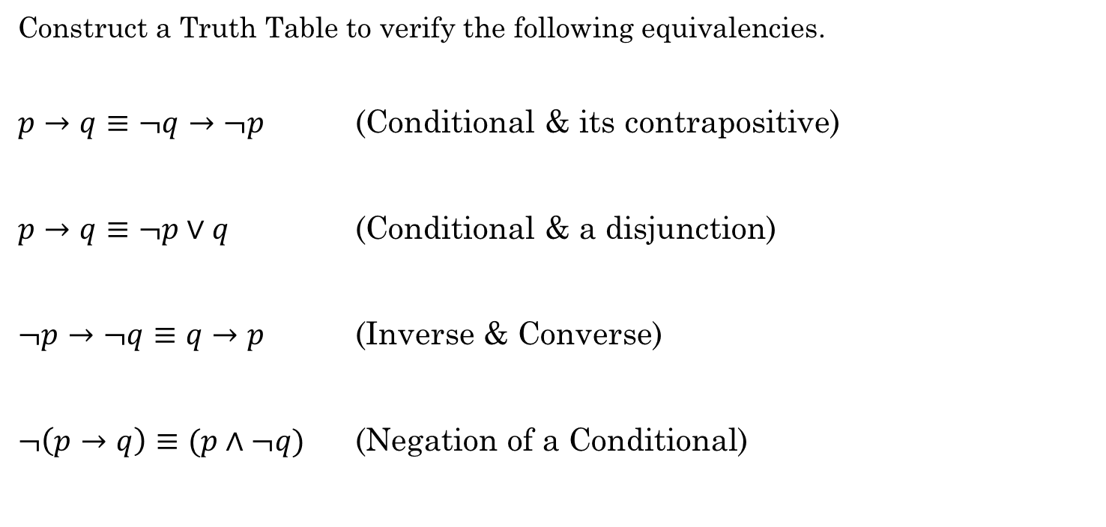
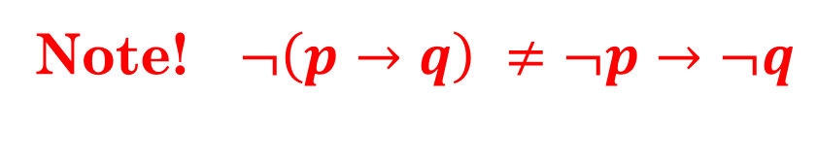
Let's Practice
Construct a Truth Table to verify the following equivalencies.
$p→q≡¬q→¬p$ (Conditional & its contrapositive)
$p→q≡¬p∨q$ (Conditional & a disjunction)
$¬p→¬q≡q→p$ (Inverse & Converse)
$¬\left(p→q\right)≡(p∧¬q)$ (Negation of a Conditional)
Note! $¬\left(p→q\right) ≠¬p→¬q$
Notes:
Each group choose a different one to do, then they show each other their truth tables.

Slide 11
Laws of Propositional Logic
Table 1.5.1: Laws of propositional logic.
Idempotent laws: | p ∨ p ≡ p | p ∧ p ≡ p
Associative laws: | ( p ∨ q ) ∨ r ≡ p ∨ ( q ∨ r ) | ( p ∧ q ) ∧ r ≡ p ∧ ( q ∧ r )
Commutative laws: | p ∨ q ≡ q ∨ p | p ∧ q ≡ q ∧ p
Distributive laws: | p ∨ ( q ∧ r ) ≡ ( p ∨ q ) ∧ ( p ∨ r ) | p ∧ ( q ∨ r ) ≡ ( p ∧ q ) ∨ ( p ∧ r )
Identity laws: | p ∨ F ≡ p | p ∧ T ≡ p
Domination laws: | p ∧ F ≡ F | p ∨ T ≡ T
Double negation law: | ¬¬p ≡ p
Complement laws: | p ∧ ¬p ≡ F ¬T ≡ F | p ∨ ¬p ≡ T ¬F ≡ T
De Morgan's laws: | ¬( p ∨ q ) ≡ ¬p ∧ ¬q | ¬( p ∧ q ) ≡ ¬p ∨ ¬q
Absorption laws: | p ∨ (p ∧ q) ≡ p | p ∧ (p ∨ q) ≡ p
Conditional identities: | p → q ≡ ¬p ∨ q | p ↔ q ≡ ( p → q ) ∧ ( q → p )
Irani, Sandy. Discrete Mathematics. Zyante Inc, 2020

Slide 12
Let's Practice
With a group of 2-3 people, do the following additional exercises:
1.4.1 (pick any two)
1.4.4 (pick any two)
1.4.6
Challenge 1.5.2 and 1.5.3
1.5.4

Slide 13
Group Activity: Logic Puzzles
https://colab.research.google.com/github/byui-cse/cse280-course-notebooks/blob/main/notebooks/solve-some-logic-puzzles.ipynb

Slide 14
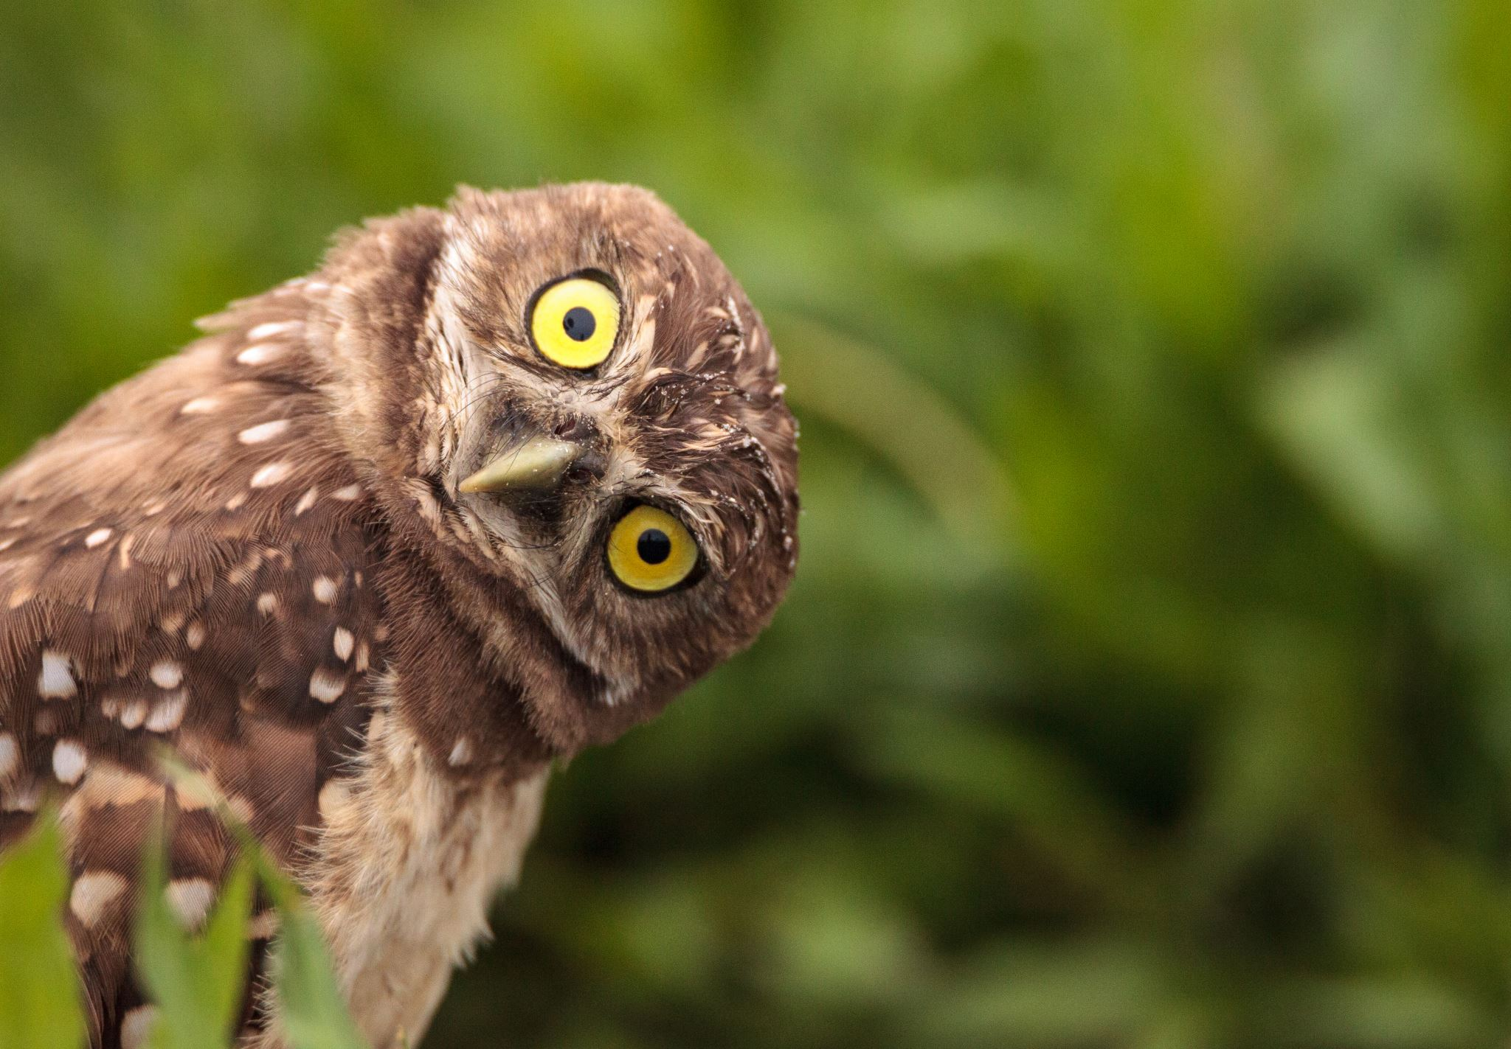

Consider the statement:
$x>5$
Is this a proposition?
$x+1>x$
Is this a proposition?
$x$ is even
Proposition?
Each of these statements has two parts: a variable and a predicate.
A predicate is a T/F statement that depends on one or more variables.
$P(x)$ = "$x$is even"

Slide 15

Consider the statement:
$x>5$
Let $P(x)$ represent the predicate "$x$ is greater than 5"
Now, we can turn it into a proposition by giving $x$ a value.
What is the truth value of:
$P(4)$?
$P(6)$?

Slide 16

What is a predicate?
A T/F statement that depends on one or more variables
A function that returns True or False
What are the possible inputs (AKA domain)?
What are the possible outputs (AKA codomain)?
Python Example
seq = [0, 1, 2, 3, 5, 8, 13]
result = list(filter(lambda x: x%2 != 0, seq))
What is the predicate?
It depends
{true, false}
True
False
example

Slide 17

Quantifiers
This is called "Quantification"
Predicates are not propositions because they contain free variables.
One way to turn a predicate into a proposition is by assigning values to the variables.
Another way to create a proposition from a predicate is to assign a range of values rather than plugging in specific values.
$P\left(x\right): x<5$
$P\left(4\right)=True$

Slide 18



Quantifiers
This is called "Quantification"
Another way to create a proposition from a predicate is to assign a range of values rather than plugging in specific values.
Let $P(x)$ be the predicate "x is greater than 5"
Is $P(x)$ true for ALL values of $x?$
Is $P(x)$ true for SOME values of $x?$
$$∀x P(x)$$
$$∃x P(x)$$

Slide 19



Quantifier Symbols
$∀$ Universal quantifier.
Meaning: For every, Every, All, For all
$∃$ Existential quantifier.
Meaning: There is at least one, some, for some, at least one, there is
$¬∀$ Not every
$¬∃$ There is not one, there are none, there are not any
LaTeX for $∀$ is \forall
LaTeX for $∃$ is \exists

Slide 20


Example:
Let $P\left(x\right)$ represent the statement $x+1>x$
What is the truth value of:
$∀x P(x)$, where the universe of discourse or domain is $ℝ$
We can also say:
$∀x∈ℝ, P(x)$
$ℝ$ = Real Numbers

Slide 21

Example:
Let $P\left(x\right)$ represent the statement $x>3$
What is the truth value of:
$∀x P(x)$, where the domain is $ℝ$
$∃x P(x)$

Slide 22

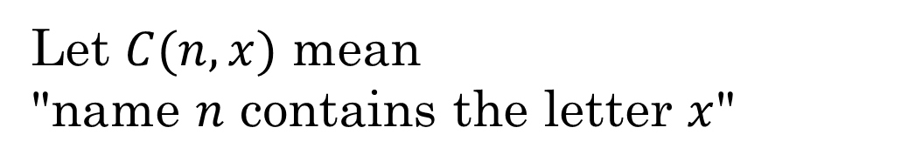
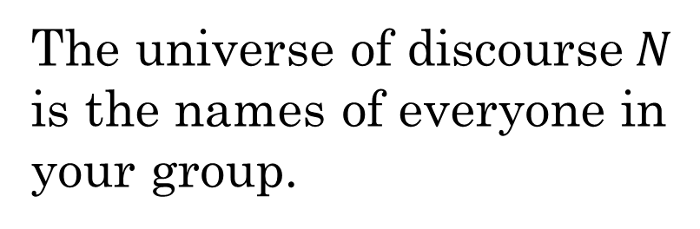
Is it True?
The universe of discourse$N$
is the names of everyone in
your group.
Let $C(n, x)$ mean
"name $n$ contains the letter $x$"
$$∀n C(n,"a")$$

Slide 23

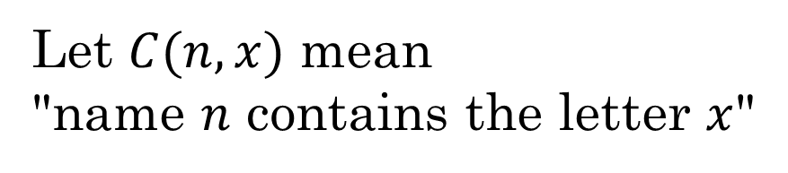
Is it True?
The universe of discourse$N$
is the names of everyone in
your group.
Let $C(n,x)$ mean
"name $n$ contains the letter $x$"
$$¬∀n C(n,"a")$$

Slide 24

Is it True?
The universe of discourse$N$
is the names of everyone in
your group.
Let $C(n,x)$ mean
"name $n$ contains the letter $x$"
$$∃n C(n,"e")$$
How can we express this in Python, without using loops?
len(list(filter(lambda name: 'e' in name, names))) > 0
example

Slide 25
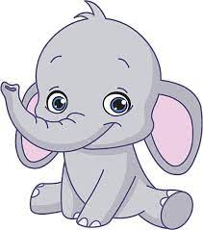


Example:
Express this as a quantified statement:
All elephants are gray.
$∀x \left(Elephant\left(x\right)→Gray\left(x\right)\right)$
Some dogs are white.
$∃x \left(Dog\left(x\right)∧White\left(x\right)\right)$
Notes:
"Some dogs are white".
The correct way to describe this would be: ∃x (Dog(x)∧White(x))
This means there is at least one thing that is a dog and is also white. This is only true if there is such a thing as a dog and that same dog is also white. It guarantees that there is at least one white dog.
If we instead wrote it this way: ∃x (Dog(x)→White(x))
This means that "if" there is something that is a dog, then it is white. This would apply to any thing that is a dog. Also, this statement is true even if there are not any dogs at all, because if Dog(x) is false, then the whole statement is true. So instead of saying "Some dogs are white", this says "If something is a dog, then it is white; if something is not a dog, then it might or might not be white." But it does not guarantee that there is at least one white dog. Only that if there is such a thing as a dog, then it is white.

Slide 26
Work as a team
Additional Exercises:
1.7.2
1.7.3
1.7.4
1.7.6

Slide 27

Practice converting to English:
$$∃x∃y \left(\left(\left(x≥0\right)∧\left(y≥0\right)\right)→\left(xy≥0\right)\right)$$
"For some x and some y, when x≥0 and y≥0 then x times y will be greater than or equal to zero."
Better way:
"The product of some two non-negatives is non-negative"
2 * 3 = 6

Slide 28

Practice converting to English:
$$∀x∀y \left(\left(x<0\right)∧\left(y<0\right)→\left(xy>0\right)\right)$$
"For all x and y, if they are both less than 0 then their product is greater than 0."
Better way:
"The product of two negatives is positive."
-2 * -3 = 6

Slide 29
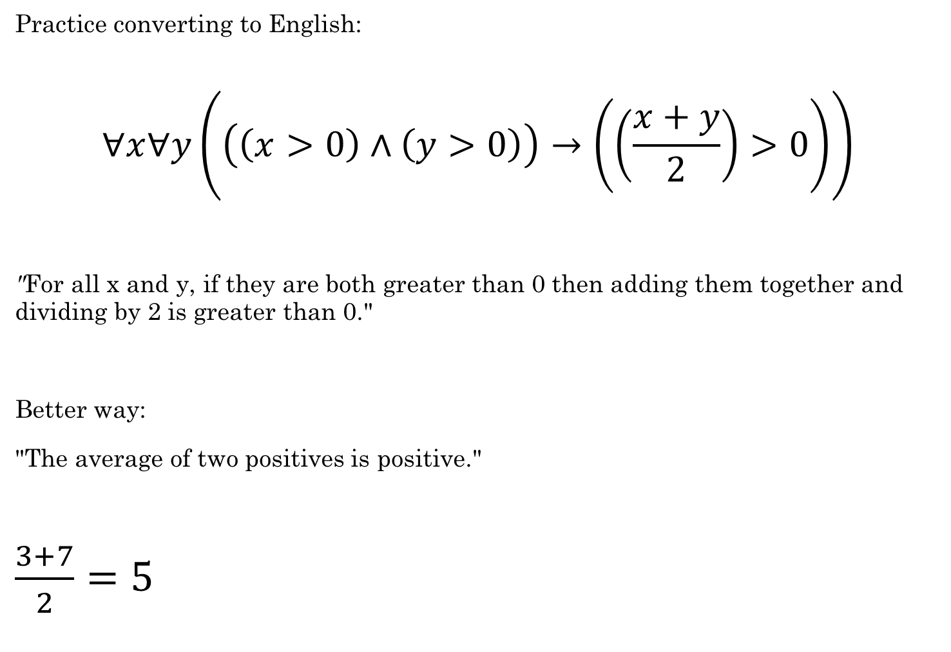
Practice converting to English:
$$∀x∀y\left(\left(\left(x>0\right)∧\left(y>0\right)\right)→\left(\left(\frac{x+y}{2}\right)>0\right)\right)$$
"For all x and y, if they are both greater than 0 then adding them together and dividing by 2 is greater than 0."
Better way:
"The average of two positives is positive."
$\frac{3+7}{2}=5$

Slide 30





De Morgan's Laws
Negate the following:
For quantifiers
$¬∀x P\left(x\right)≡∃x¬P(x)$
$¬∃x P\left(x\right)≡∀x¬P(x)$
$$¬\left(p∨q\right)≡$$
$$¬p∧¬q$$
$$¬\left(p∧q\right)≡$$
$$¬p∨¬q$$
For Nested Quantifiers
¬∀x ∀y P(x, y) ≡ ∃x ∃y ¬P(x, y)
¬∀x ∃y P(x, y) ≡ ∃x ∀y ¬P(x, y)
¬∃x ∀y P(x, y) ≡ ∀x ∃y ¬P(x, y)
¬∃x ∃y P(x, y) ≡ ∀x ∀y ¬P(x, y)

Slide 31










De Morgan's Laws - Examples
Simplify the following using De Morgan's Laws:
$¬∃x P(x)$
$∀x ¬P(x)$
$¬∃x \left(P\left(x\right)∧Q\left(x\right)\right)$
$∀x \left(¬P\left(x\right)∨¬Q\left(x\right)\right)$
$¬∀x \left(P\left(x\right)∧Q\left(x\right)\right)$
$∃x \left(¬P\left(x\right)∨¬Q\left(x\right)\right)$
$$¬∀x∃y P(x,y)$$
$$∃x∀y ¬P(x,y)$$
$¬∃x∀y \left(P\left(x,y\right)∧Q\left(x\right)\right)$
$∀x∃y \left(¬P\left(x,y\right)∨¬Q\left(x\right)\right)$

Slide 32
Let's do a couple of the challenges together.
Challenge 1.9.1
Challenge 1.10.1

Slide 33
Let's practice
With a Kahoot...

Slide 34
Work as a Team
Challenge 1.9.1
Additional Exercise 1.9.2
Challenge 1.10.1
Additional Exercise 1.10.7

