Slide 1
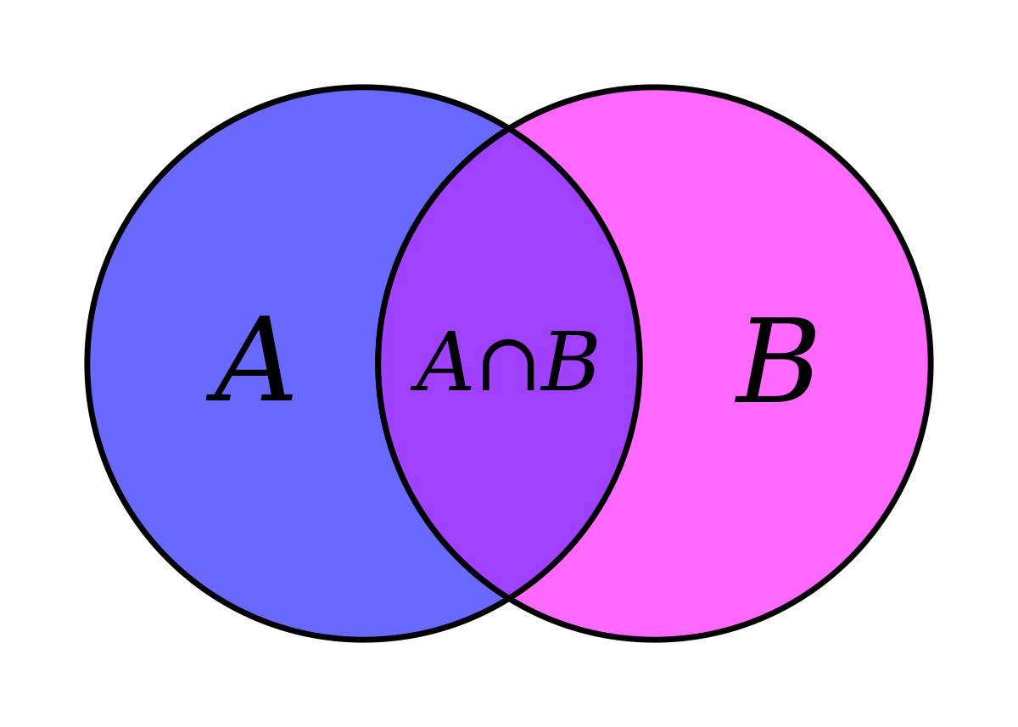
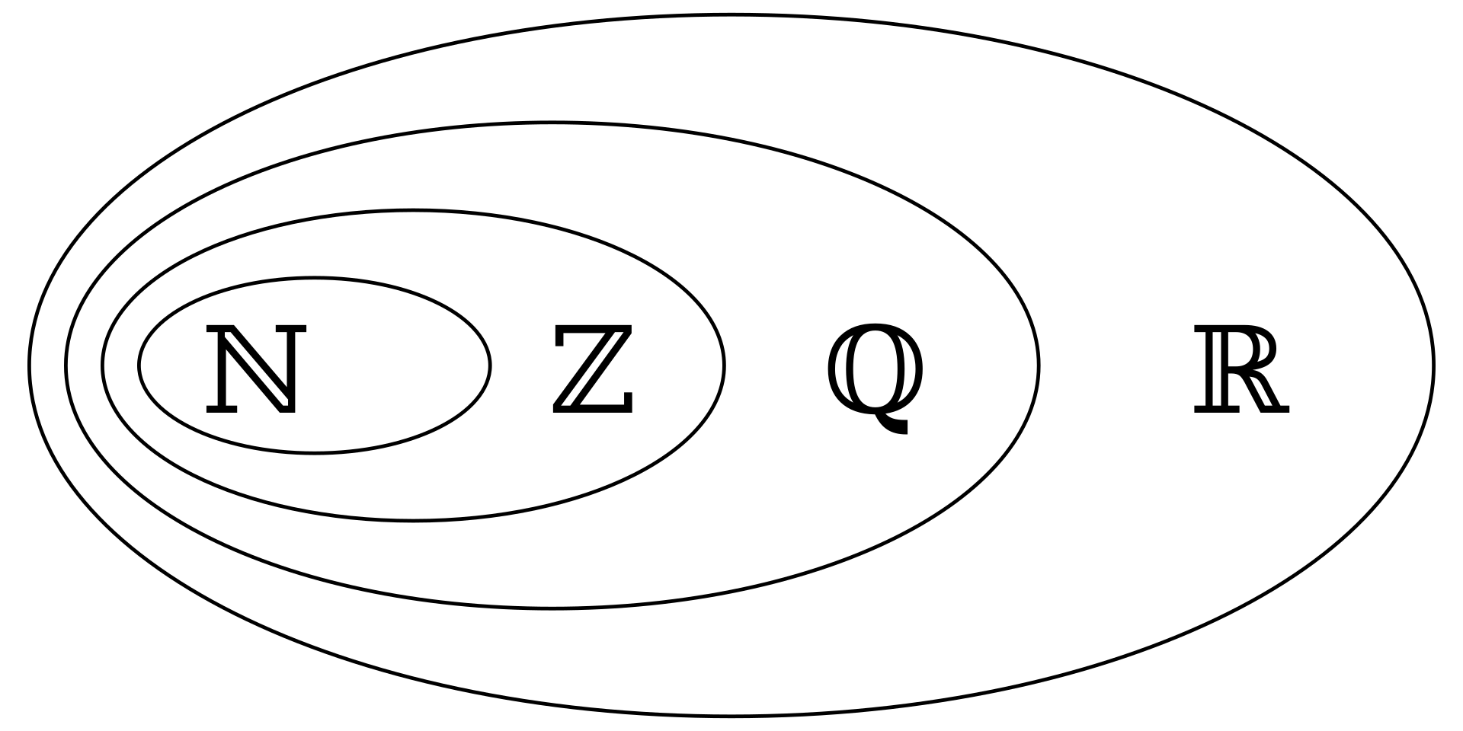
Sets

Slide 2
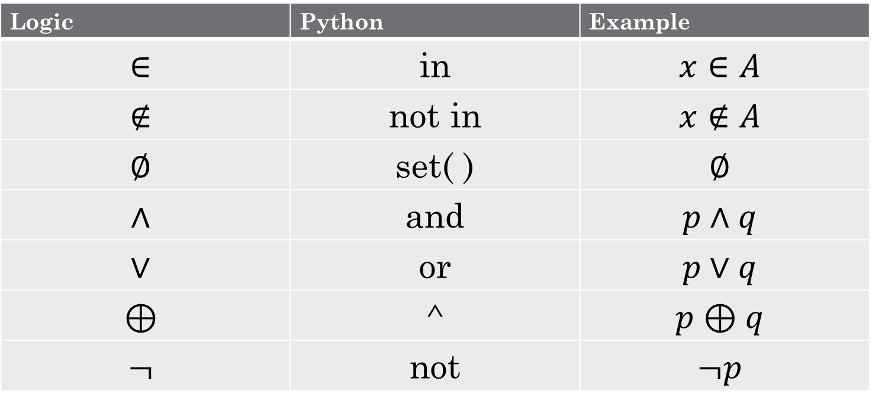
Review some symbols
Logic | Python | Example
$$∈$$ | in | $$x∈A$$
$$∉$$ | not in | $$x∉A$$
$$∅$$ | set( ) | $$∅$$
$$∧$$ | and | $$p∧q$$
$$∨$$ | or | $$p∨q$$
$$⊕$$ | ^ | $$p⊕q$$
$$¬$$ | not | $$¬p$$

Slide 3
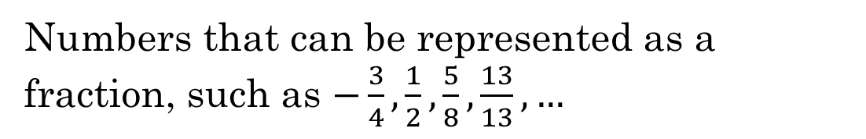





Some special sets
$$ℕ$$
Natural Numbers
$\left\{1,2,3,4,…\right\}$ (although some people include $0$)
$$ℤ$$
Integers
$\{…, −2, −1, 0, 1,2,…\}$
$$ℚ$$
Rational numbers
Numbers that can be represented as a fraction, such as $−\frac{3}{4},\frac{1}{2},\frac{5}{8},\frac{13}{13}, …$
$$ℝ$$
Real numbers
All numbers that can be represented on a continuous number line

Slide 4


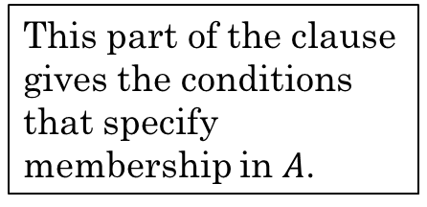
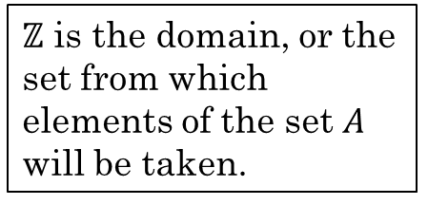
Set Builder Notation
Roster Notation – List all the members of a set. Works well for small sets.
$A=\{2,4,6,8,10\}$
Set Builder Notation – Create or "build" a set with some property or properties. Works to specify any size set.
$A=\{x∈ℤ:0<x≤10 and x is even\}$
$ℤ$ is the domain, or the set from which elements of the set $A$ will be taken.
This part of the clause gives the conditions that specify membership in $A$.

Slide 5

Sets
Union: $A∪B$ A or B or both
Intersection: $A∩B$ A and B
Difference: $A − B$ A minus B
Complement: $\overline{B}$ Not B
Universe
Universe
A
A
A
B
B
B

Slide 6

Sets
Union: $A∪B$ A or B or both
Intersection: $A∩B$ A and B
Difference: $A − B$ A minus B
Complement: $\overline{B}$ Not B
Universe
Universe
A
A
A
B
B
B

Slide 7

Sets
Union: $A∪B$ A or B or both
Intersection: $A∩B$ A and B
Difference: $A − B$ A minus B
Complement: $\overline{B}$ Not B
Universe
Universe
A
A
A
B
B
B

Slide 8

Sets
Union: $A∪B$ A or B or both
Intersection: $A∩B$ A and B
Difference: $A − B$ A minus B
Complement: $\overline{B}$ Not B
Universe
Universe
A
A
A
B
B
B

Slide 9
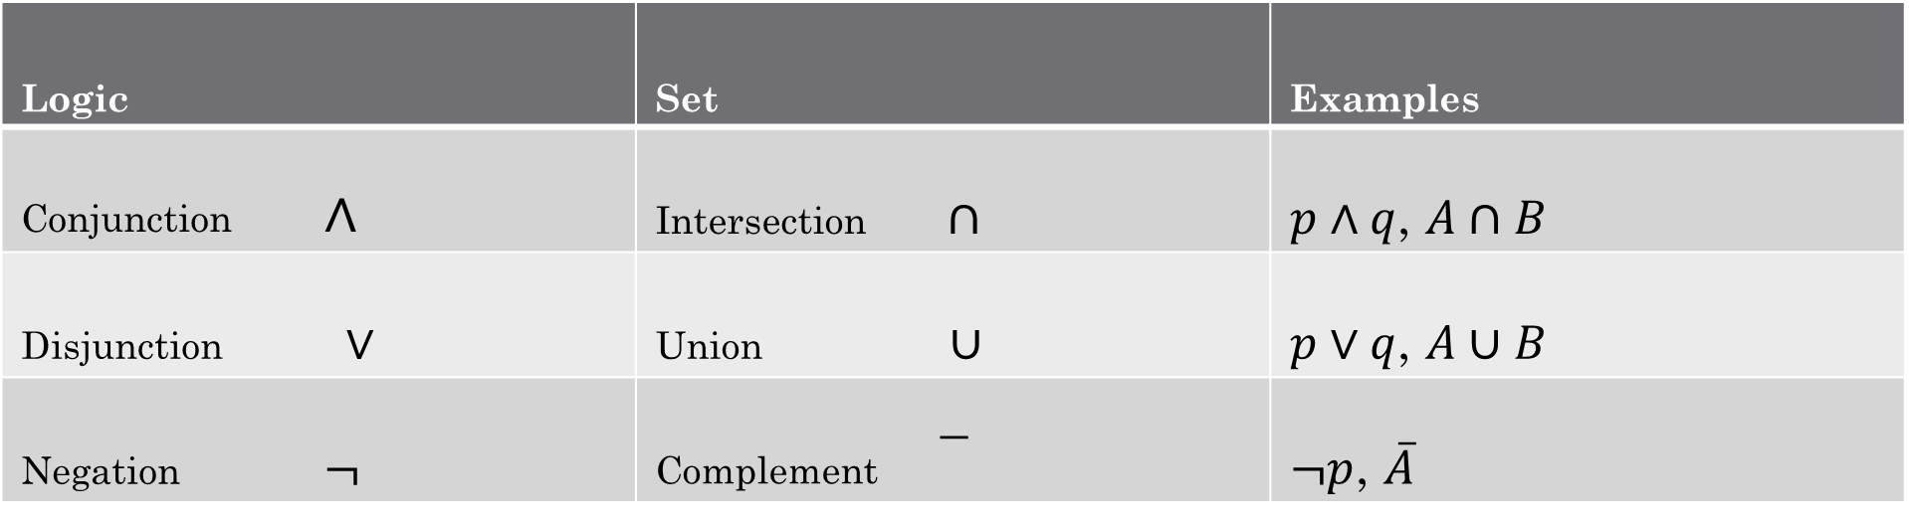
Logical & Set Operators Compared
Logic | Set | Examples
Conjunction $∧$ | Intersection $∩$ | $p∧q$, $A∩B$
Disjunction $∨$ | Union $∪$ | $p∨q$, $A∪B$
Negation $¬$ | Complement | $¬p$, $\overline{A}$

Slide 10
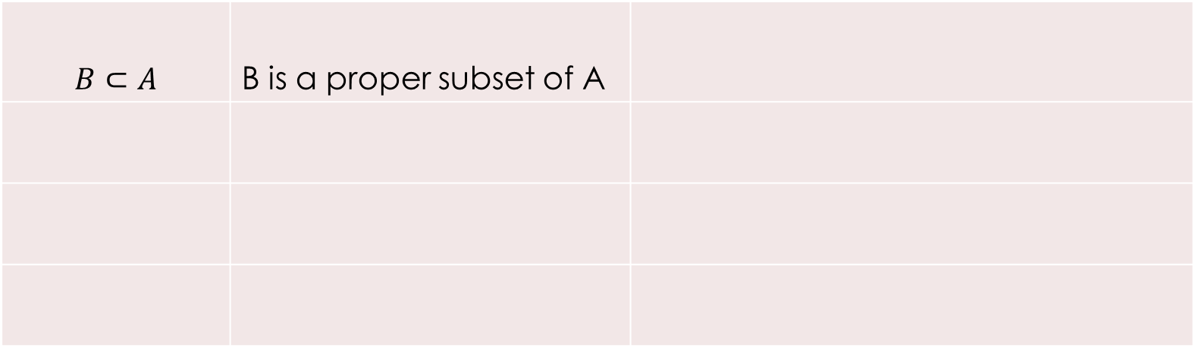
Subsets and Supersets
$$B⊂A$$ | B is a proper subset of A

Slide 11
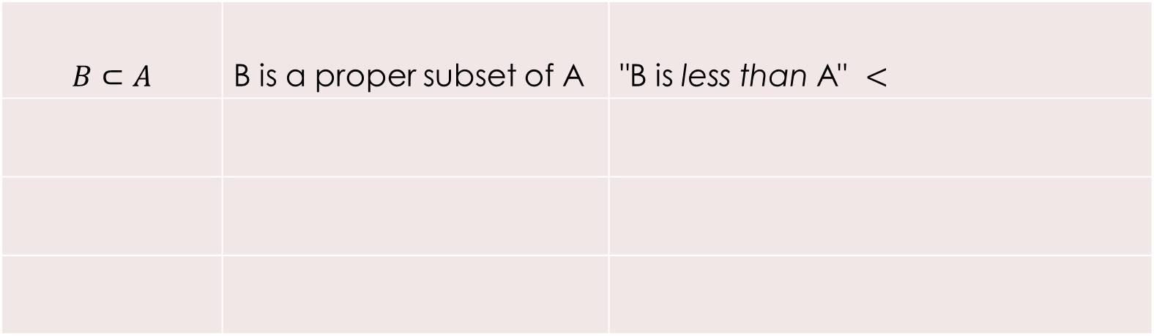
Subsets and Supersets
$$B⊂A$$ | B is a proper subset of A | "B is less than A" $<$

Slide 12
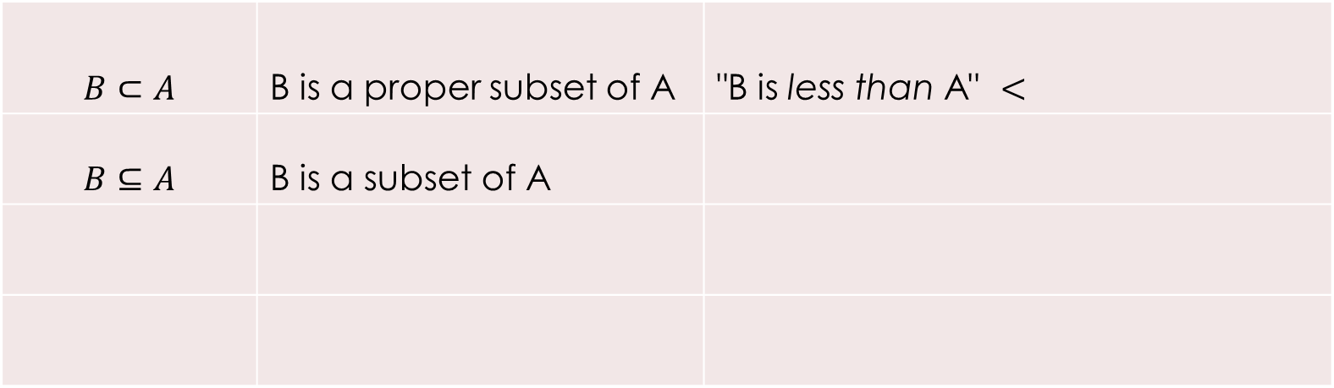
Subsets and Supersets
$$B⊂A$$ | B is a proper subset of A | "B is less than A" $<$
$$B⊆A$$ | B is a subset of A

Slide 13
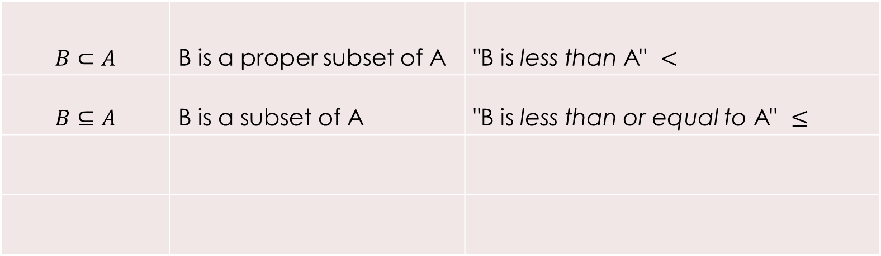
Subsets and Supersets
$$B⊂A$$ | B is a proper subset of A | "B is less than A" $<$
$$B⊆A$$ | B is a subset of A | "B is less than or equal to A" $≤$

Slide 14
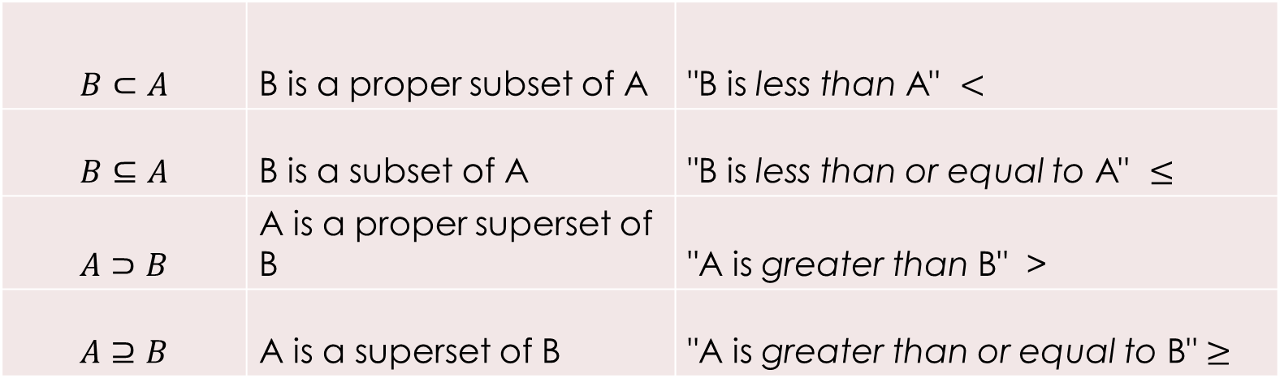
Subsets and Supersets
$$B⊂A$$ | B is a proper subset of A | "B is less than A" $<$
$$B⊆A$$ | B is a subset of A | "B is less than or equal to A" $≤$
$$A⊃B$$ | A is a proper superset of B | "A is greater than B" >
$$A⊇B$$ | A is a superset of B | "A is greater than or equal to B" $≥$

Slide 15

Powerset
The set of all subsets of a set
$A=\{a, b, c\}$
What is the powerset of $A$, which is denoted as $P(A)$?
$\left\{∅, \left\{a\right\}, \left\{b\right\}, \left\{c\right\}, \left\{a, b\right\}, \left\{b,c\right\}, \left\{a,c\right\}, \left\{a,b,c\right\}\right\}$
What is the cardinality of $A$?
$2^{3}=8$ Why?

Slide 16
Some python examples

Slide 17

Cartesian Product
Example:
$A=\{1, 2\}$
$B=\{a, b, c\}$
What is $A×B$?
What is $B×A$?
Note: $A×B ≠B×A$
$$A×B=\left\{\left(a,b\right) \right| a∈A∧b∈B\}$$
$A×B=\{\left(1,a\right), \left(1,b\right), \left(1,c\right), \left(2,a\right), \left(2,b\right), \left(2,c\right)\}$
$$B×A=\{\left(a,1\right),\left(a,2\right),\left(b,1\right),\left(b,2\right),\left(c,1\right),\left(c,2\right)\}$$

Slide 18

Find the Cartesian Product of A with itself where A = {0, 1}:
$A×A= ?$
{(0,0), (0,1), (1,0), (1,1)}
In Python:
A = [0,1]
[(x,y) for x in A for y in A]
Can you generate ${\left\{0,1\right\}}^{5}$ and list them all?
Example

Slide 19
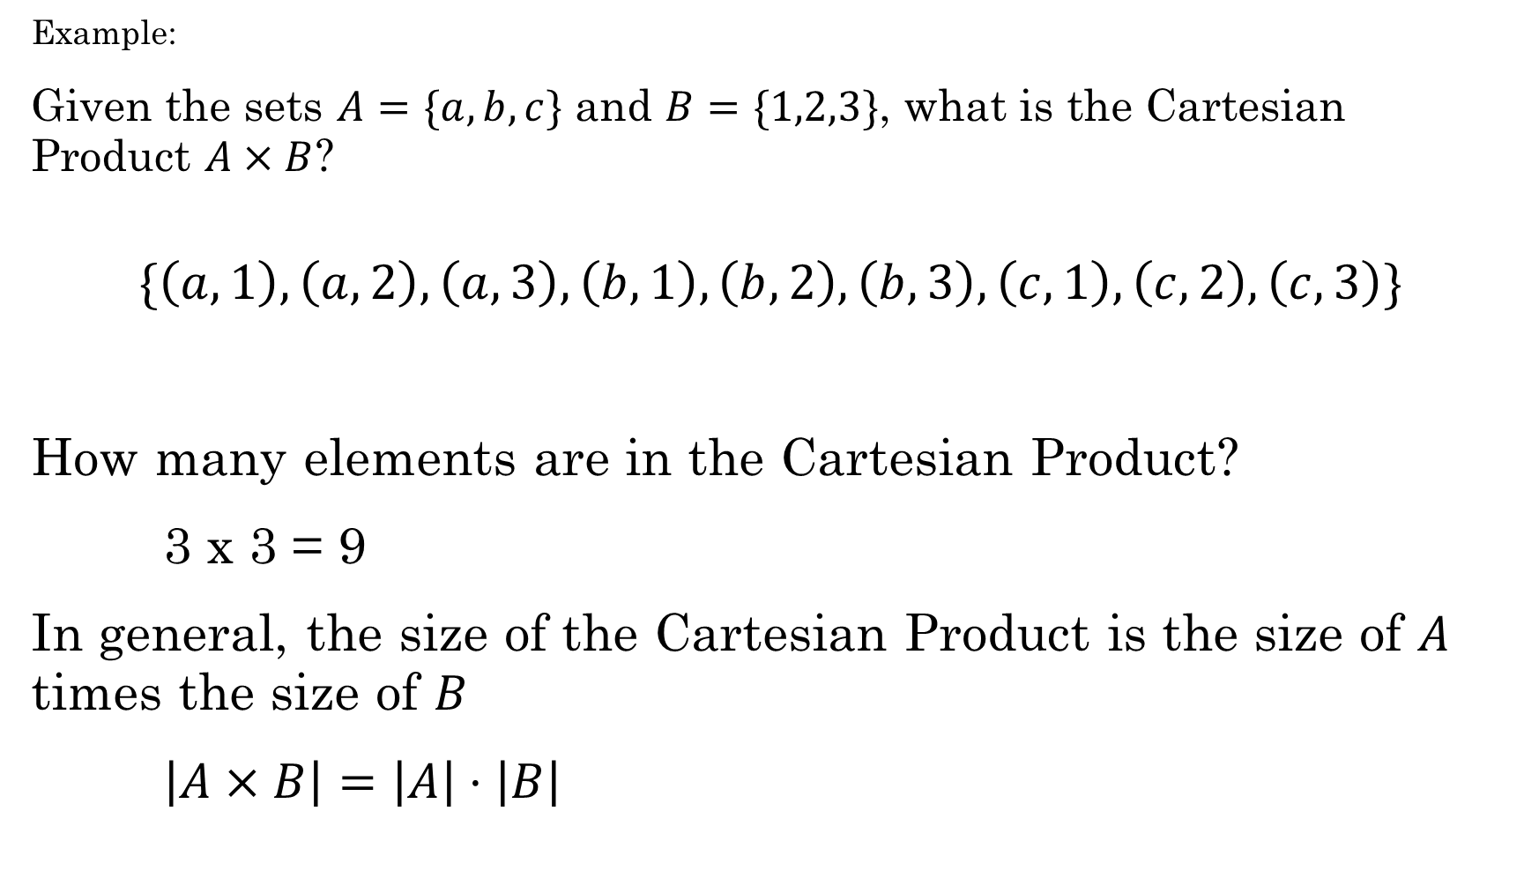
Example:
Given the sets $A=\{a,b,c\}$ and $B=\{1,2,3\}$, what is the Cartesian Product $A×B$?
$$\{\left(a,1\right),\left(a,2\right),\left(a,3\right),\left(b,1\right), \left(b,2\right),\left(b,3\right), \left(c,1\right),\left(c,2\right),\left(c,3\right)\}$$
How many elements are in the Cartesian Product?
3 x 3 = 9
In general, the size of the Cartesian Product is the size of $A$ times the size of $B$
$\left|A×B\right|=\left|A\right|⋅\left|B\right|$

Slide 20

You own an ice cream shop. If you offer 15 different flavors of ice cream, how many types of 3-scoop cones might you be able to claim in your advertising if you use the Cartesian product to build the set of possibilities?
Write Python code! Can you list all the possibilities easily?
Answer: 3375
Example

Slide 21

Bit strings
${\left\{0,1\right\}}^{n}$ represents the set of all bitstrings of length $n$.
For example:
${\left\{0,1\right\}}^{2}=\{00, 01, 10, 11\}$
${\left\{0,1\right\}}^{3}=\left\{000, 001, 010, 011, 100, 101, 110, 111\right\}$
What is the cardinality of ${\left\{0,1\right\}}^{8}$ ?

Slide 22
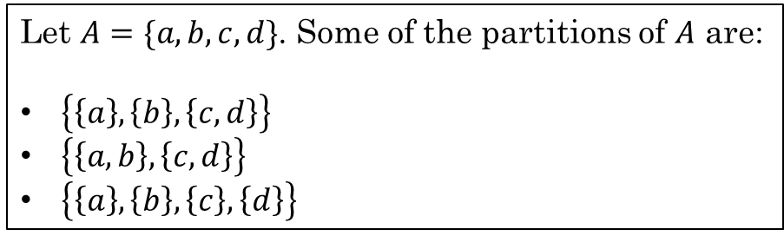
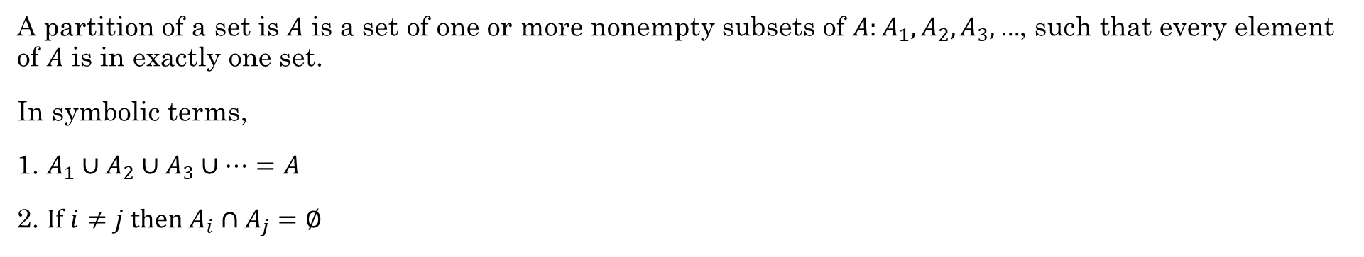
Partitions
A partition of a set is $A$ is a set of one or more nonempty subsets of $A:A_{1},A_{2}, A_{3},…$, such that every element of $A$ is in exactly one set.
In symbolic terms,
1. $A_{1}∪A_{2}∪A_{3}∪⋯=A$
2. $If i≠j then A_{i}∩A_{j}=∅$
Example:
Let $A=\{a,b,c,d\}$. Some of the partitions of $A$ are:
$\left\{\left\{a\right\}, \left\{b\right\}, \left\{c,d\right\}\right\}$
$\left\{\left\{a,b\right\}, \left\{c,d\right\}\right\}$
$\left\{\left\{a\right\}, \left\{b\right\}, \left\{c\right\}, \left\{d\right\}\right\}$
There are 15 different partitions of a set with four elements. For more, look up the Bell numbers.
https://discretemath.org/ads/s-partitions-and-law-of-addition.html

Slide 23




Partitions
What are some ways to partition the set $S=\{1,2,3,4,5,6,7,8,9,10\}$? List at least three.
$$\left\{\left\{1, 3, 5, 7, 9\right\}, \left\{2, 4, 6, 8, 10\right\}\right\}$$
Evens and odds
$$\left\{\{1, 2, 3, 4, 5, 6, 7, 8, 9\}, \left\{10\right\}\right\}$$
Number of digits
$$\left\{\left\{1, 4, 7, 10\right\}, \left\{2, 5, 8\right\}, \{3, 6, 9\}\right\}$$
Modulo 3
$$\left\{\left\{1\right\}, \left\{2\right\}, \left\{3\right\}, \left\{4\right\}, \left\{5\right\}, \left\{6\right\}, \left\{7\right\}, \left\{8\right\}, \left\{9\right\}, \{10\}\right\}$$
All separate

Slide 24
Work as a team on additional exercises:
3.1.4
3.3.1
3.4.3

Slide 25
Work as a team.
3.1.1
3.1.2
3.1.4*
3.2.1
3.2.2
3.3.1*
3.4.3*
3.4.4

