Slide 1
Functions

Slide 2




Quick Review: Cartesian Product
Given these sets:
$A=\{a\}$ $B=\{b, c\}$ $C=\{a, b, d\}$
Write the elements of the following:
1. $A×(B∪C)$
2. $Ρ(A×B)$
$$\left(B∪C\right)=\left\{a,b,c,d\right\}$$
$A×\left(B∪C\right)=\left\{a\right\}×\left\{a,b,c,d\right\}=\{aa, ab, ac, ad\}$
$A×B=\left\{ab, ac\right\}$
$Ρ(A×B)=\left\{∅, \left\{ab\right\}, \left\{ac\right\}, \left\{ab, ac\right\}\right\}$

Slide 3

Quick Review: Bit strings
${\left\{0,1\right\}}^{n}$ represents the set of all bitstrings of length $n$.
For example:
${\left\{0,1\right\}}^{2}=\{00, 01, 10, 11\}$
${\left\{0,1\right\}}^{3}=\left\{000, 001, 010, 011, 100, 101, 110, 111\right\}$
What is the cardinality of ${\left\{0,1\right\}}^{6}$ ?

Slide 4
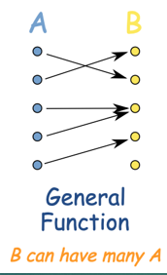
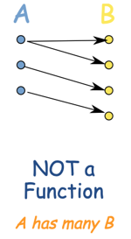
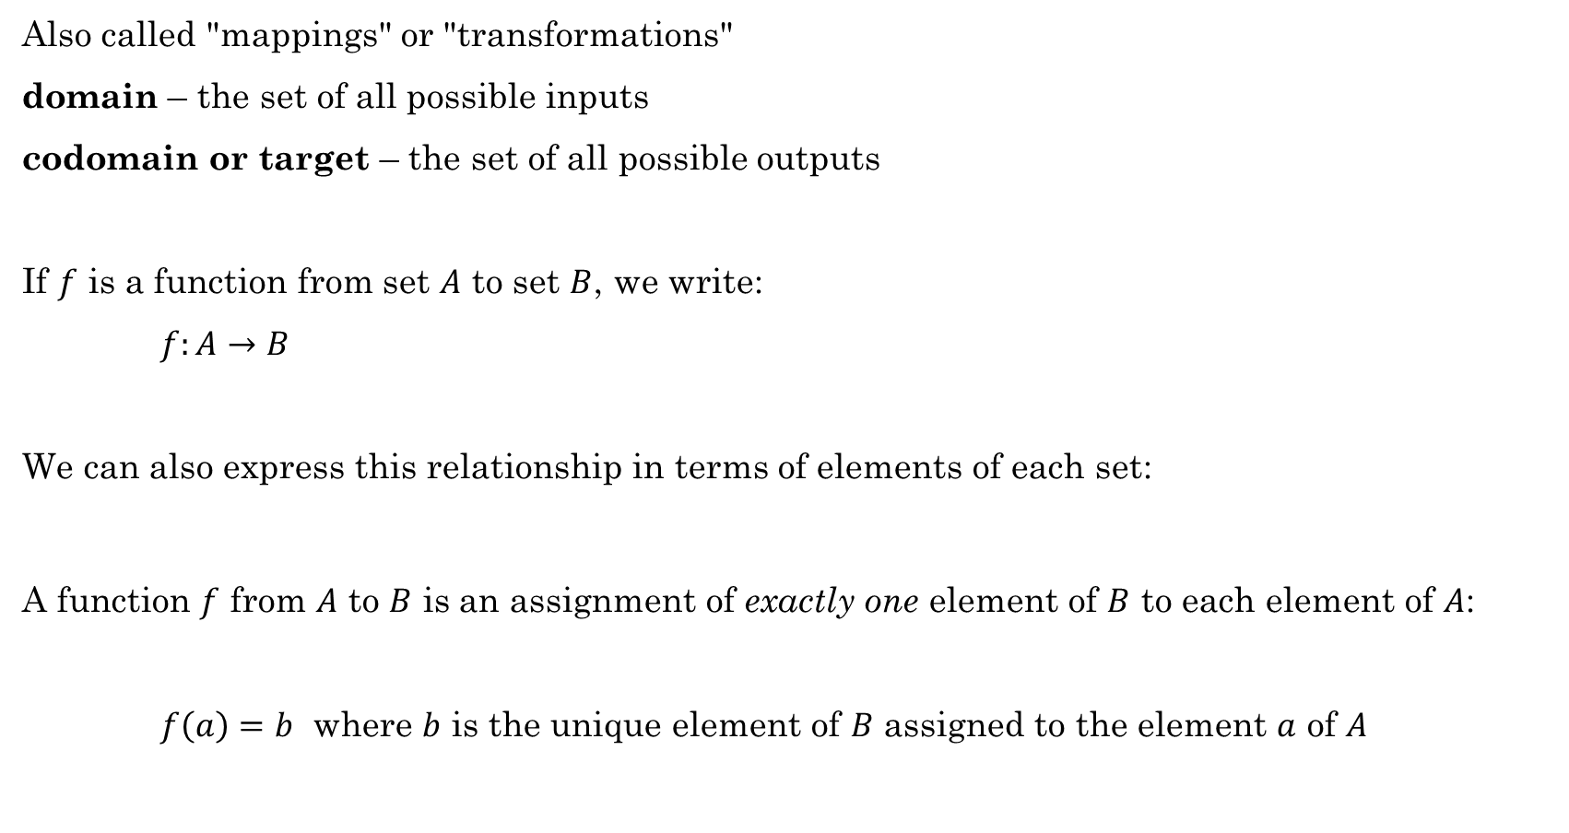
Functions
Also called "mappings" or "transformations"
domain – the set of all possible inputs
codomain or target – the set of all possible outputs
If $f$ is a function from set $A$ to set $B$, we write:
$f:A→B$
We can also express this relationship in terms of elements of each set:
A function $f$ from $A$ to $B$ is an assignment of exactly one element of $B$ to each element of $A$:
$f\left(a\right)=b$ where $b$ is the unique element of $B$ assigned to the element $a$ of $A$
Rosen, Kenneth. Discrete Mathematics and Its Applications, 7th Edition. McGraw-Hill, 2012

Slide 5
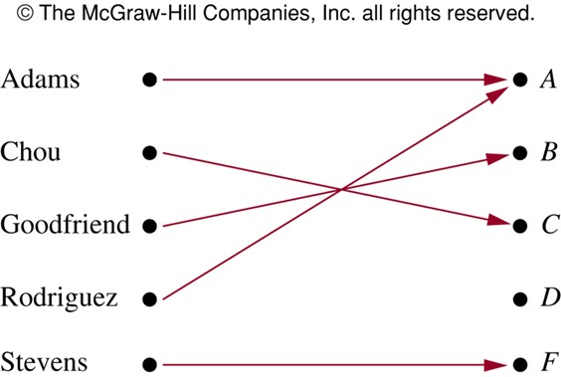
Functions
the set of all possible inputs
domain – ?
codomain – ?
range or image – Those members of the codomain that are actually used.
Example:
Function assigning grades in a discrete math class.
What is the domain?
{Adams, Chou, Goodfriend, Rodriguez, Stevens}
What is the codomain?
{A, B, C, D, F}
What is the range?
{A, B, C, F}
the set of all possible outputs
Note: A function $f:A→B$ is a subset of $A×B$
Rosen, Kenneth. Discrete Mathematics and Its Applications, 7th Edition. McGraw-Hill, 2012

Slide 6

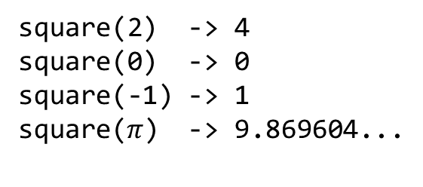


Functions
Example: $f\left(x\right)=x^{2}$
This function definition is not complete until we define the domain and target
What is the domain and target?
def square(n: float) -> float:
return n * n
$f:ℝ→ℝ, where f\left(x\right)=x^{2}$
$f:ℤ→ℤ, where f\left(x\right)=x^{2}$
def square(n: int) -> int:
return n * n
In Python:
def square(n):
return n * n
What is the domain?
All Real numbers (ℝ)?
int, float, ?
square(2) -> 4
square(0) -> 0
square(-1) -> 1
square($π$) -> 9.869604...
What is the codomain?
All positive Real numbers along with 0 ($ℝ^{+}∪\{0\}$)
int, float, ?
Example

Slide 7
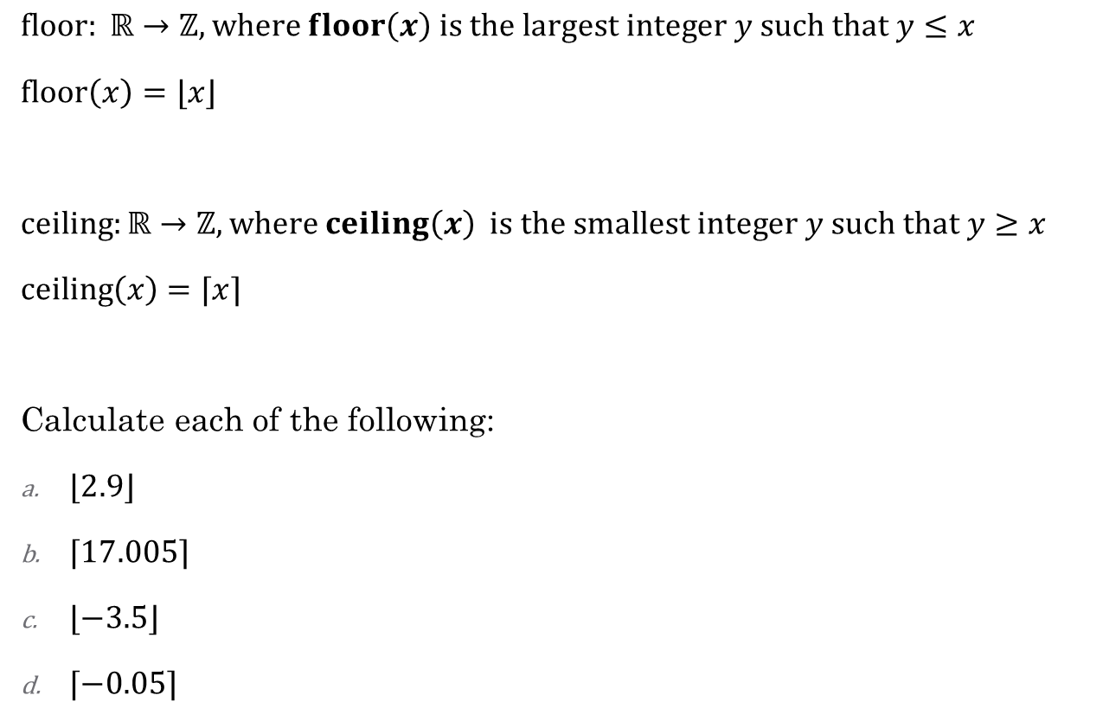


Floor and Ceiling
$floor: ℝ→ℤ, where floor\left(x\right) is the largest integer y such that y≤x$
$floor\left(x\right)=⌊x⌋$
$ceiling:ℝ→ℤ, where ceiling\left(x\right) is the smallest integer y such that y≥x$
$ceiling\left(x\right)=⌈x⌉$
Calculate each of the following:
$⌊2.9⌋$
$⌈17.005⌉$
$⌊−3.5⌋$
$⌈−0.05⌉$
Example: $floor\left(1.8\right)=\left\lfloor 1.8\right\rfloor =1$
Example: $ceiling\left(1.8\right)= \left\lceil 1.8\right\rceil =2$
In Python:
from math import floor, ceil
floor(-3.5) # -4
ceil(-0.5) # 0
2
18
-4
0
Example

Slide 8
Describing Functions
one-to-one
onto
both one-to-one
and onto

Slide 9



Classify these functions
Are the following functions one-to-one (injective), onto (surjective), neither, or both (bijective)?
a) $f:ℤ→ℤ. f\left(x\right)=x+1$
One-to-one and onto, which is a bijection
b) $f:ℤ→ℤ. f\left(x\right)=3x$
One-to-one but not onto
c) $f:ℝ→ℝ. f\left(x\right)=3x$
One-to-one and onto, which is a bijection
d) $f:{\left\{0,1\right\}}^{3}→{\left\{0,1\right\}}^{3}.$ The output is obtained by reversing the input. For example, $f\left(011\right)=110$
One-to-one and onto, which is a bijection
e) $f:{\left\{0,1\right\}}^{3}→{\left\{0,1\right\}}^{2}.$ The output is obtained by dropping the first bit. For example, $f\left(011\right)=11$
Onto but not one-to-one

Slide 10

Function Classification
$$F(x)=x^{2},x∈ℝ$$
What is the codomain? Does it matter?
Select all that apply.
onto
one-to-one
injection
bijection
surjection
not a function
one-to-one
onto
both one-to-one
and onto

Slide 11
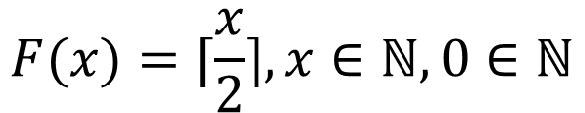
Function Classification
$$F(x)=⌈\frac{x}{2}⌉,x∈ℕ,0∈ℕ$$
Select all that apply.
onto
one-to-one
injection
bijection
surjection
not a function
one-to-one
onto
both one-to-one
and onto

Slide 12
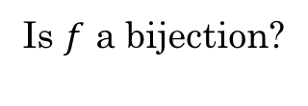
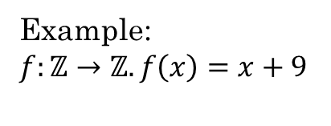
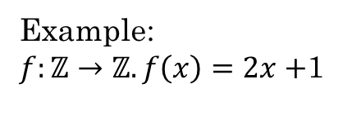
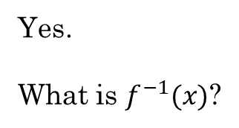
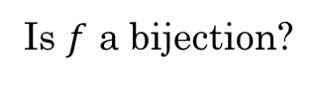
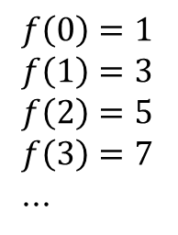

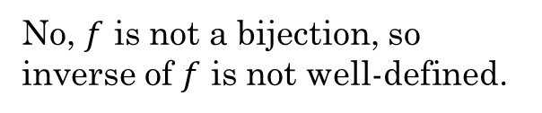
Inverse of a Function
A function $f$ has an inverse if and only if $f$ is a bijection.
The inverse can be obtained by swapping the items in each pair in $f$. $f^{−1}=\{\left(y,x\right):\left(x,y\right)∈f\}$
Example:
$f:ℤ→ℤ. f\left(x\right)=x+9$
Example:
$f:ℤ→ℤ. f\left(x\right)=2x+$1
Is $f$ a bijection?
Is $f$ a bijection?
Yes.
What is $f^{−1}(x)$?
$f\left(0\right)=1$
$f\left(1\right)=3$
$f\left(2\right)=5$
$f\left(3\right)=7$
...
No, $f$ is not a bijection, so inverse of $f$ is not well-defined.
$f^{−1}\left(x\right)=x−9$

Slide 13
Do Additional Exercises
4.3.2
4.4.1
4.4.2 a-d

Slide 14


Exponents and Logarithms
You want to share a bag of Skittles with your friends. The bag has 33 Skittles. How many times can you divide your bag of skittles in half if you keep the larger pile each time?
$$\left\lceil \log_{2}33\right\rceil =6$$
If you keep the smaller pile each time?
$\left\lfloor \log_{2}33\right\rfloor =$5

