Slide 1
Relations

Slide 2

Cartesian Product Review
Example:
$A=\{1, 2\}$
$B=\{a, b, c\}$
What is $A×B$?
What is $B×A$?
Note: $A×B ≠B×A$
$$A×B=\left\{\left(a,b\right) \right| a∈A∧b∈B\}$$
$A×B=\{\left(1,a\right), \left(1,b\right), \left(1,c\right), \left(2,a\right), \left(2,b\right), \left(2,c\right)\}$
$$B×A=\{\left(a,1\right),\left(a,2\right),\left(b,1\right),\left(b,2\right),\left(c,1\right),\left(c,2\right)\}$$

Slide 3
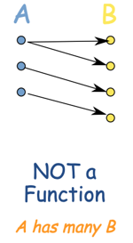
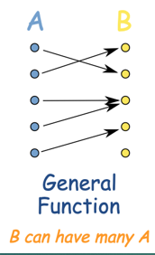
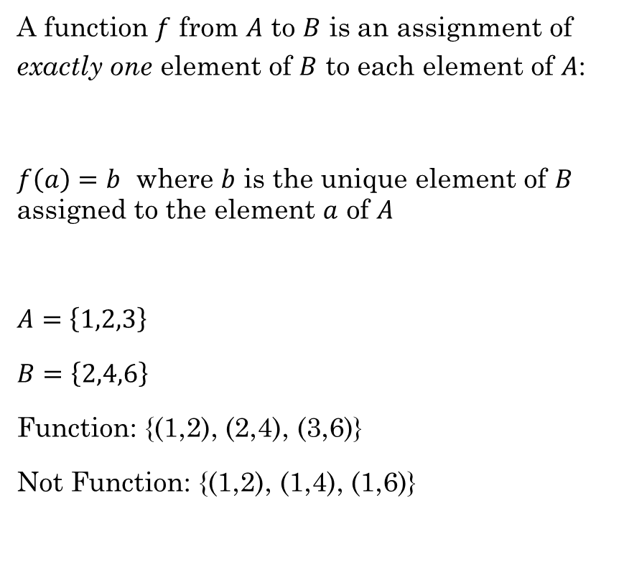

Functions Review
A function $f$ from $A$ to $B$ is an assignment of exactly one element of $B$ to each element of $A$:
$f\left(a\right)=b$ where $b$ is the unique element of $B$ assigned to the element $a$ of $A$
$A=\left\{1,2,3\right\}$
$B=\left\{2,4,6\right\}$
Function: {(1,2), (2,4), (3,6)}
Not Function: {(1,2), (1,4), (1,6)}
This is called
a Relation
Function
This is a special
kind of relation.
$$b = 2a$$
Student ID to Class ID
Rosen, Kenneth. Discrete Mathematics and Its Applications, 7th Edition. McGraw-Hill, 2012

Slide 4
Homework Review
Review Homework 04 from last week with a partner.
4.4
4.5
4.6
4.7

Slide 5
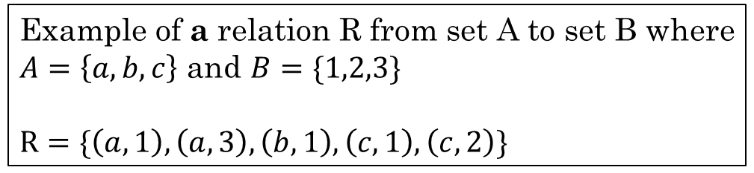
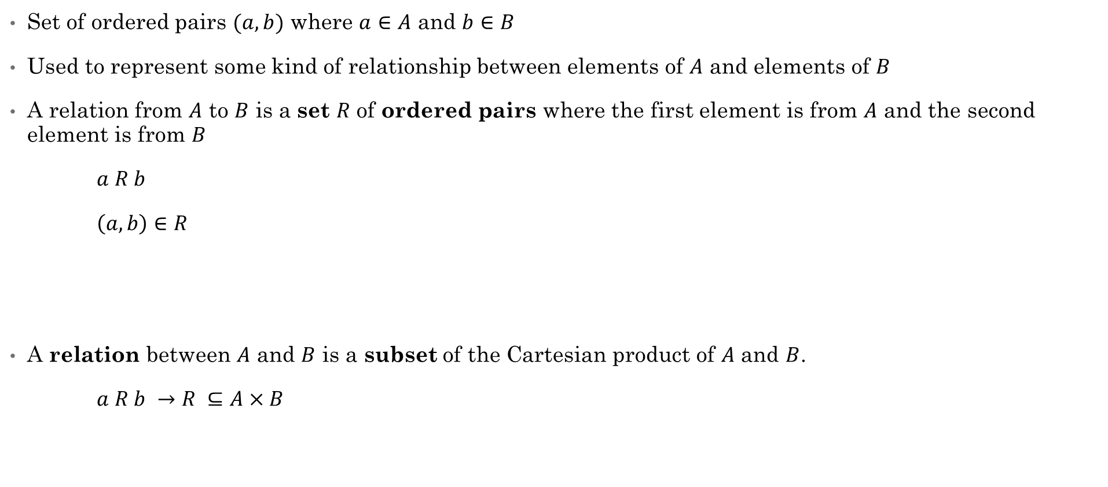
Relation
Set of ordered pairs $(a,b)$ where $a∈A$ and $b∈B$
Used to represent some kind of relationship between elements of $A$ and elements of $B$
A relation from $A$ to $B$ is a set $R$ of ordered pairs where the first element is from $A$ and the second element is from $B$
$a R b$
$\left(a,b\right)∈R$
A relation between $A$ and $B$ is a subset of the Cartesian product of $A$ and $B$.
$a R b →$ $R ⊆A×B$
Example of a relation R from set A to set B where
$A=\left\{a,b,c\right\}$ and $B=\{1,2,3\}$
$R=\{\left(a,1\right),\left(a,3\right),\left(b,1\right), \left(c,1\right),\left(c,2\right)\}$
Rosen, Kenneth. Discrete Mathematics and Its Applications, 7th Edition. McGraw-Hill, 2012

Slide 6
Example:
We can represent a set of ordered pairs as a 2-D Matrix, where a 0 or 1 indicates whether a given (row, column) is in the set:
$$\{\left(a,1\right),\left(a,2\right),\left(a,3\right),\left(b,1\right), \left(b,2\right),\left(b,3\right), \left(c,1\right),\left(c,2\right),\left(c,3\right)\}$$
 | 1 | 2 | 3
a | 1 | 1 | 1
b | 1 | 1 | 1
c | 1 | 1 | 1

Slide 7
Example:
$$\{\left(a,1\right),\left(a,3\right),\left(b,1\right),\left(c,2\right),\left(c,3\right)\}$$
 | 1 | 2 | 3
a | 1 | 0 | 1
b | 1 | 0 | 0
c | 0 | 1 | 1

Slide 8

Example:
Given the sets $A=\{a,b,c\}$ and $B=\{1,2,3\}$, which of the following is a valid relation $R$ from $A$ to $B$?
{(a,1), (1,a)}
{(a,1), (a,2), (b,2)}
{(1,a), (2,a), (3,a)}
{(b,1), (b,3), (c,1)}
b. | 1 | 2 | 3
a | 1 | 1 | 0
b | 0 | 1 | 0
c | 0 | 0 | 0
d. | 1 | 2 | 3
a | 0 | 0 | 0
b | 1 | 0 | 1
c | 1 | 0 | 0

Slide 9

Properties of Relations
Reflexive
Anti-reflexive
Symmetric
Anti-symmetric
Transitive
reflexive: $∀x∈A, xRx$
anti-reflexive: $∀x∈A, ¬(xRx)$
symmetric: $∀a∀b, aRb →bRa$
anti-symmetric: $∀a∀b, aRb∧bRa →a=b$
transitive: $∀a∀b∀c, aRb∧bRc→aRc$

Slide 10



Reflexive
A relation is reflexive if every element of A is related to itself.
$∀a∈A \left(\left(a,a\right)∈R\right)$
$∀a∈A aRa$
What are some mathematical relations that are reflexive?
Example:
$R$ = set of all people $(x,y)$ with the same mother and father.
$xRx$ for every person $x$
" You have the same mother and father as yourself "
Reflexive math relations:
$= ∀x x=x$
$≥ ∀x x≥x$
$≤ ∀x x≤x$
Rosen, Kenneth. Discrete Mathematics and Its Applications, 7th Edition. McGraw-Hill, 2012

Slide 11
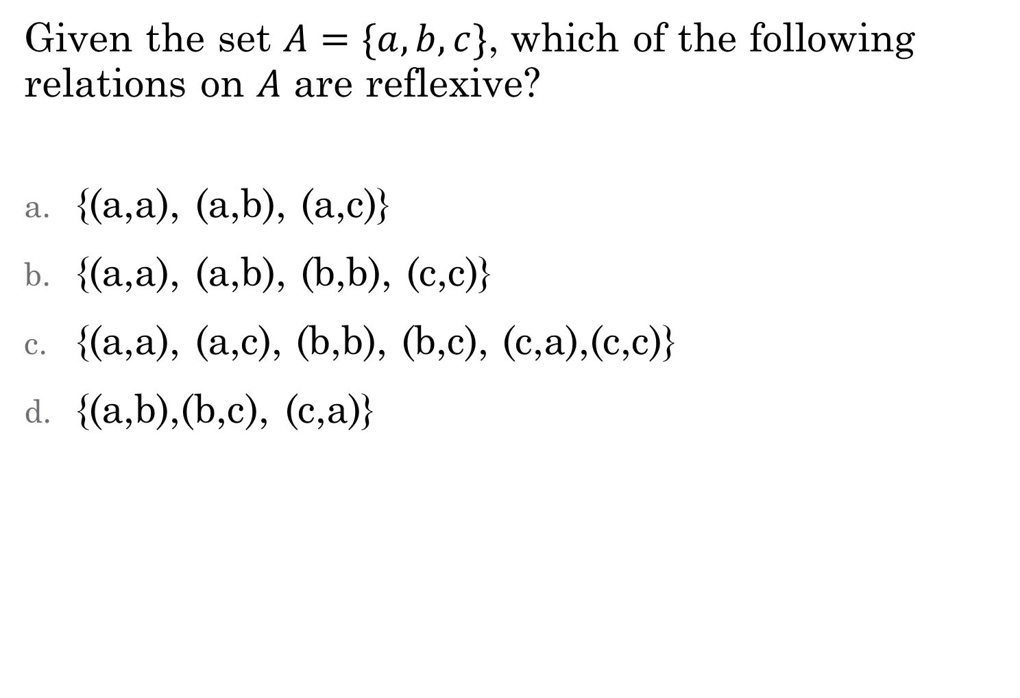
Given the set $A=\{a,b,c\}$, which of the following relations on $A$ are reflexive?
{(a,a), (a,b), (a,c)}
{(a,a), (a,b), (b,b), (c,c)}
{(a,a), (a,c), (b,b), (b,c), (c,a),(c,c)}
{(a,b),(b,c), (c,a)}
Not reflexive. Missing (b,b) and (c,c)
Not reflexive. Missing (a,a), (b,b), and (c,c)

Slide 12
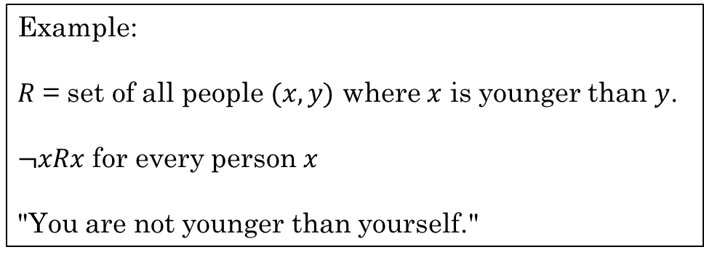
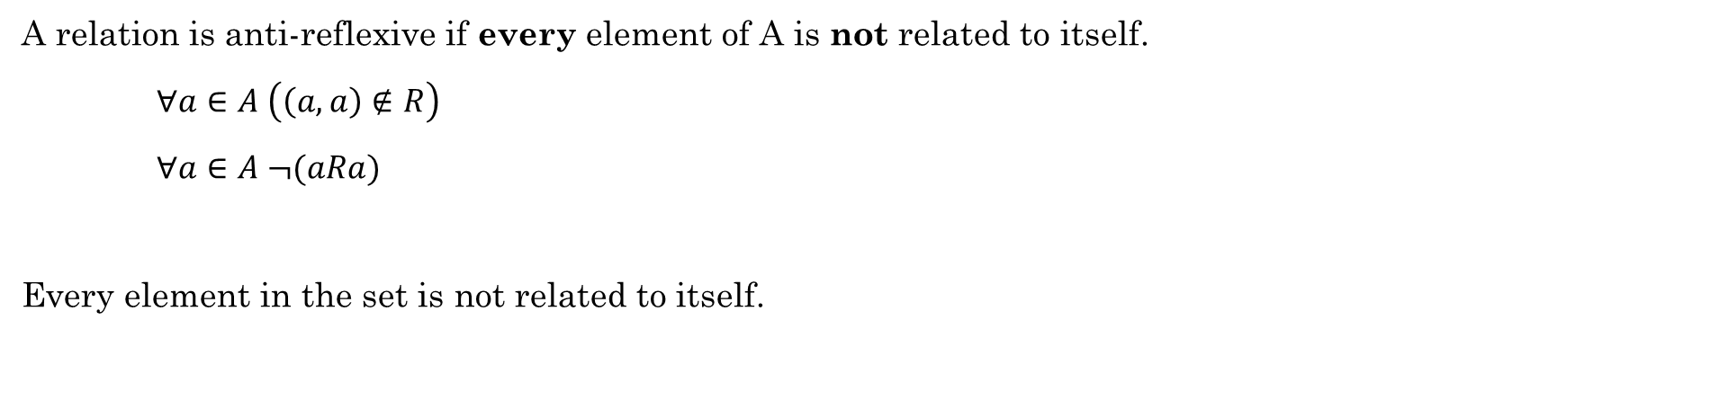
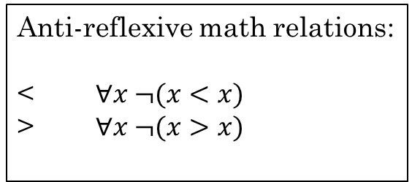
Anti-reflexive
A relation is anti-reflexive if every element of A is not related to itself.
$∀a∈A \left(\left(a,a\right)∉R\right)$
$∀a∈A ¬(aRa)$
Every element in the set is not related to itself.
Example:
$R$ = set of all people $(x,y)$ where $x$ is younger than $y$.
$¬xRx$ for every person $x$
"You are not younger than yourself."
Anti-reflexive math relations:
< $∀x ¬(x<x)$
> $∀x ¬(x>x)$

Slide 13
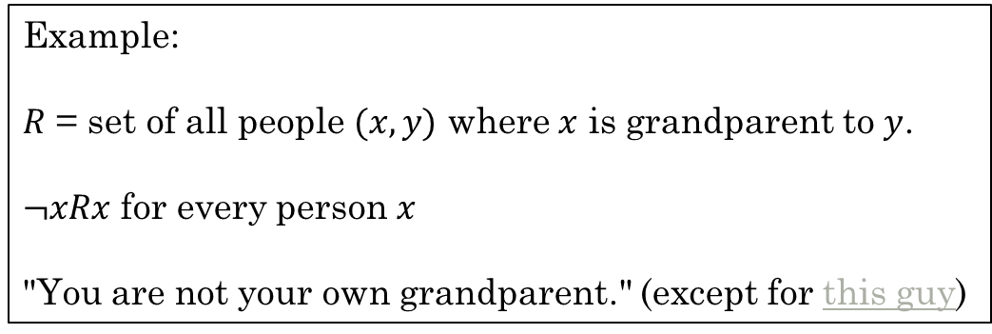
Anti-reflexive
A relation is anti-reflexive if every element of A is not related to itself.
$∀a∈A \left(\left(a,a\right)∉R\right)$
$∀a∈A ¬(aRa)$
Every element in the set is not related to itself.
Example:
$R$ = set of all people $(x,y)$ where $x$ is grandparent to $y$.
$¬xRx$ for every person $x$
"You are not your own grandparent." (except for this guy)

Slide 14
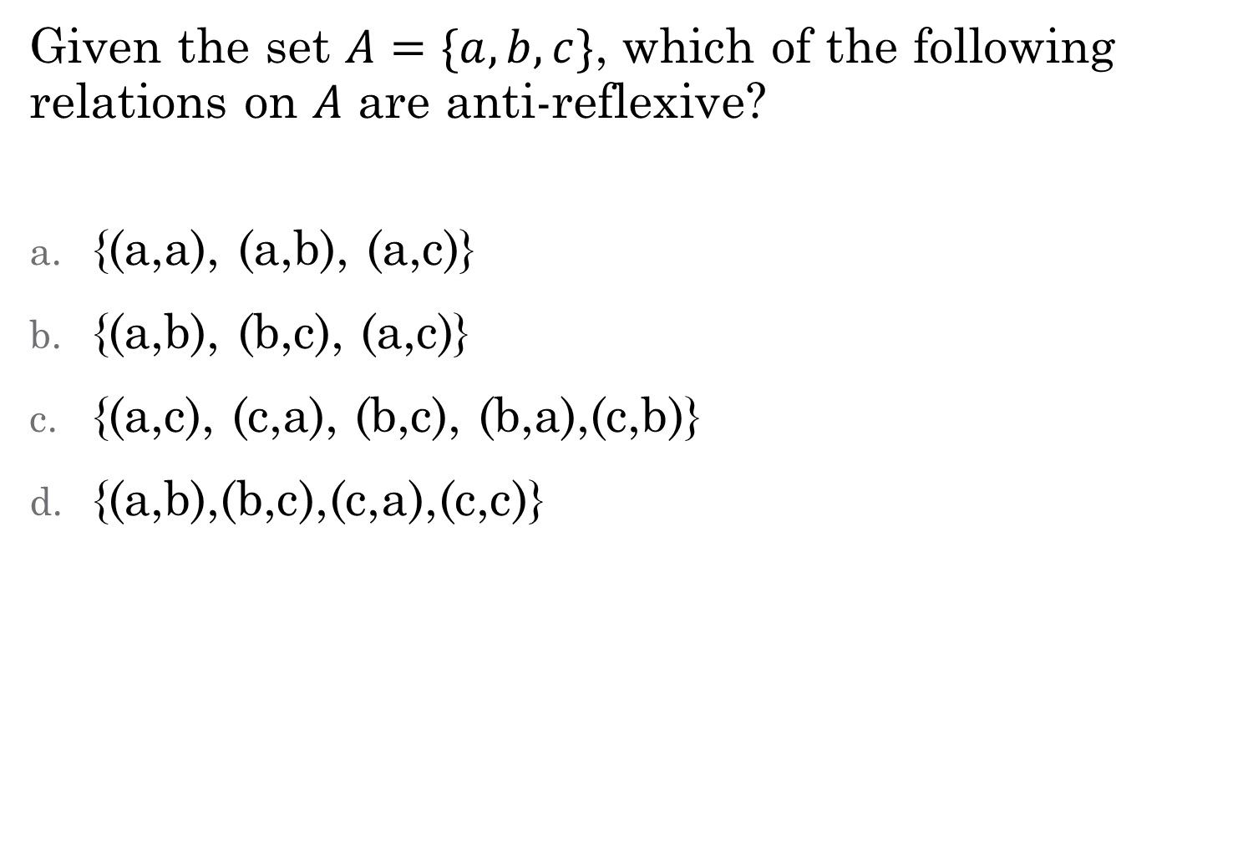
Given the set $A=\{a,b,c\}$, which of the following relations on $A$ are anti-reflexive?
{(a,a), (a,b), (a,c)}
{(a,b), (b,c), (a,c)}
{(a,c), (c,a), (b,c), (b,a),(c,b)}
{(a,b),(b,c),(c,a),(c,c)}
Not anti-reflexive. Contains (a,a)
Not reflexive. Contains (c,c)

Slide 15


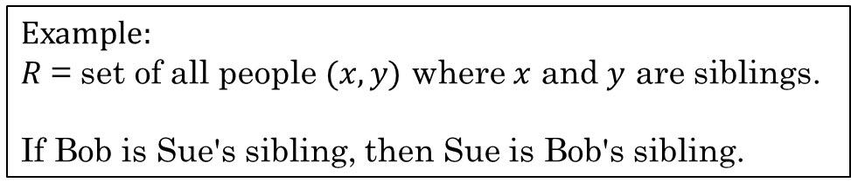
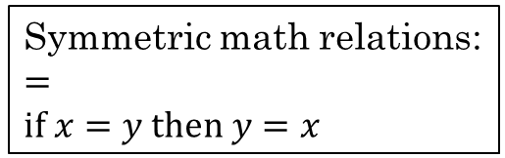

Symmetric
A relation is symmetric if $\left(b,a\right)∈R$ whenever $\left(a,b\right)∈R$ for all $a,b∈A$.
$∀a∀b\left(\left(a,b\right)∈R →\left(b,a\right)∈R\right)$
$∀a∀b \left(aRb →bRa\right)$
If $a$ is related to $b$, then $b$ is related to $a$.
Which of these relations are symmetric?
$R=\left\{\left(1,1\right), \left(1,2\right), \left(2,1\right)\right\}$
$R=\left\{\left(1,1\right), \left(2,2\right), \left(2,3\right), \left(3,2\right)\right\}$
$R=\left\{\left(1,2\right)\right\}$
$R=\left\{\left(1,1\right), \left(1,2\right), \left(1,3\right), \left(2,1\right)\right\}$
Example:
$R$ = set of all people $(x,y)$ where $x$ and $y$ are siblings.
If Bob is Sue's sibling, then Sue is Bob's sibling.
Symmetric math relations:
$=$
$if x=y then y=x$
Yes, symmetric
Yes, symmetric
No, not symmetric. Missing $\left(2,1\right)$
No, not symmetric. Missing $\left(3,1\right)$
Rosen, Kenneth. Discrete Mathematics and Its Applications, 7th Edition. McGraw-Hill, 2012

Slide 16
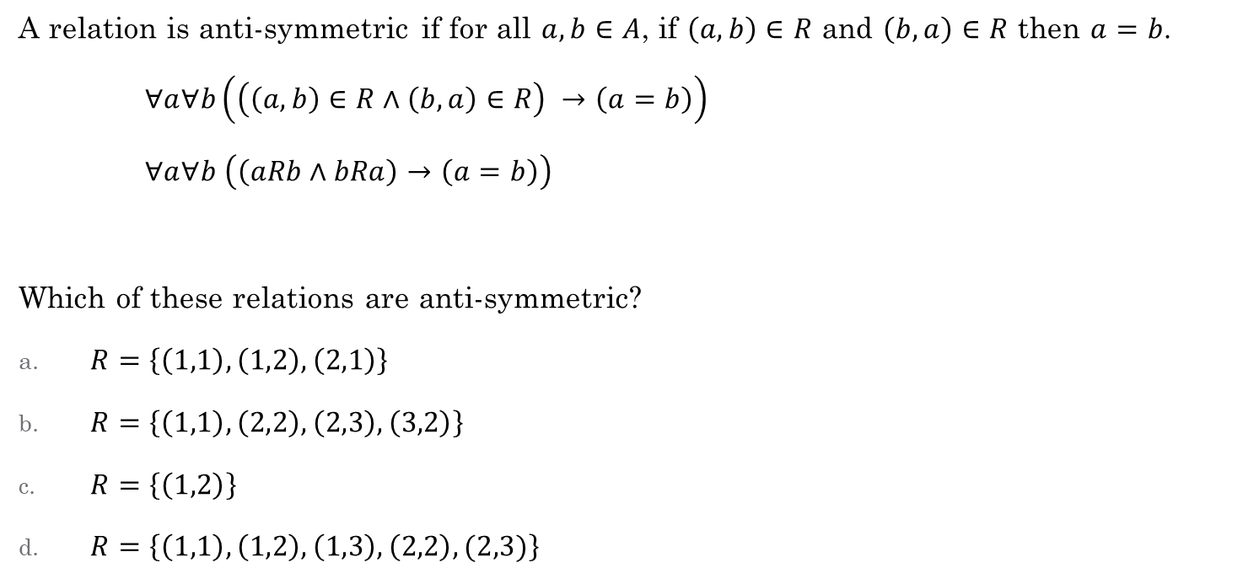
Anti-symmetric
A relation is anti-symmetric if for all $a,b∈A$, if $\left(a,b\right)∈R$ and $\left(b,a\right)∈R$ then $a=b$.
$∀a∀b\left(\left(\left(a,b\right)∈R∧\left(b,a\right)∈R\right) →\left(a=b\right)\right)$
$∀a∀b \left(\left(aRb∧bRa\right)→\left(a=b\right)\right)$
Which of these relations are anti-symmetric?
$R=\left\{\left(1,1\right), \left(1,2\right), \left(2,1\right)\right\}$
$R=\left\{\left(1,1\right), \left(2,2\right), \left(2,3\right), \left(3,2\right)\right\}$
$R=\left\{\left(1,2\right)\right\}$
$R=\left\{\left(1,1\right), \left(1,2\right), \left(1,3\right), \left(2,2\right), (2,3)\right\}$
Another way of thinking about it:
Anti-symmetric means the relation does not contain any symmetric pairs
No, contains (2,1) and (1,2)
No, contains (2,3) and (3,2)
Yes. Anti-symmetric
Yes. Anti-symmetric
Rosen, Kenneth. Discrete Mathematics and Its Applications, 7th Edition. McGraw-Hill, 2012

Slide 17
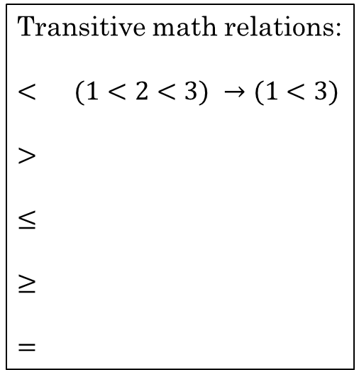
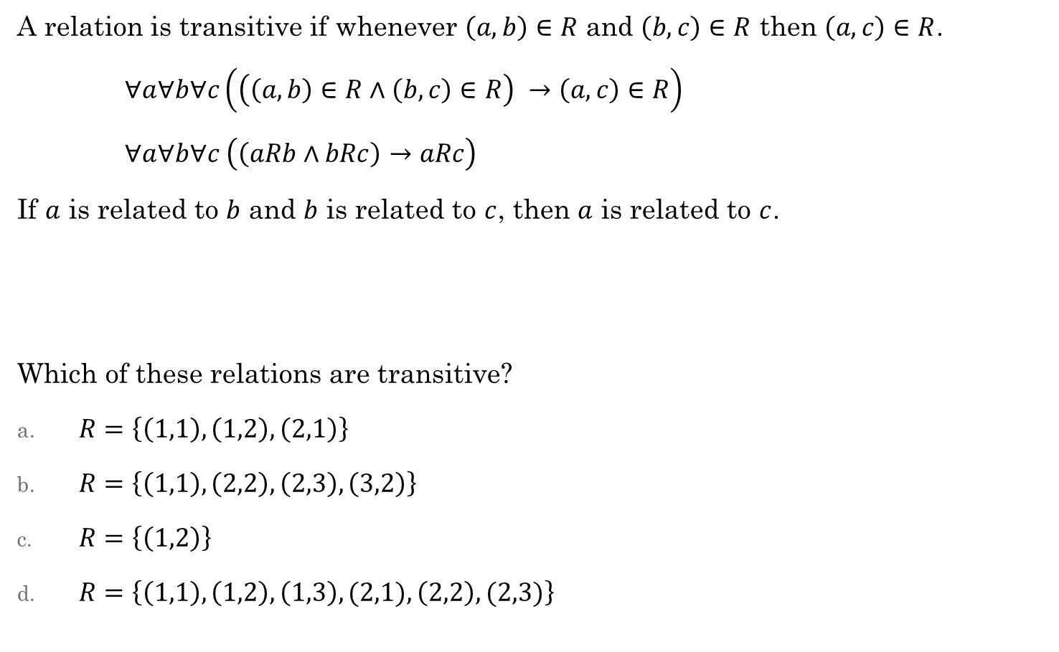
Transitive
A relation is transitive if whenever $\left(a,b\right)∈R$ and $\left(b,c\right)∈R$ then $\left(a,c\right)∈R$.
$∀a∀b∀c\left(\left(\left(a,b\right)∈R∧\left(b,c\right)∈R\right) →\left(a,c\right)∈R\right)$
$∀a∀b∀c \left(\left(aRb∧bRc\right)→aRc\right)$
If $a$ is related to $b$ and $b$ is related to $c$, then $a$ is related to $c$.
Which of these relations are transitive?
$R=\left\{\left(1,1\right), \left(1,2\right), \left(2,1\right)\right\}$
$R=\left\{\left(1,1\right), \left(2,2\right), \left(2,3\right), \left(3,2\right)\right\}$
$R=\left\{\left(1,2\right)\right\}$
$R=\left\{\left(1,1\right), \left(1,2\right), \left(1,3\right),(2,1), \left(2,2\right), (2,3)\right\}$
Example:
Same parent as.
Bob has same parent as Sue and Sue has the same parent as Bill. Bob has the same parent as Bill.
Transitive math relations:
$<$ $(1<2<3) →(1<3)$
$>$
$≤$
$≥$
$=$
No, missing (2,2)
No, missing (3,3)
Yes. Transitive
Yes. Transitive
Rosen, Kenneth. Discrete Mathematics and Its Applications, 7th Edition. McGraw-Hill, 2012

Slide 18

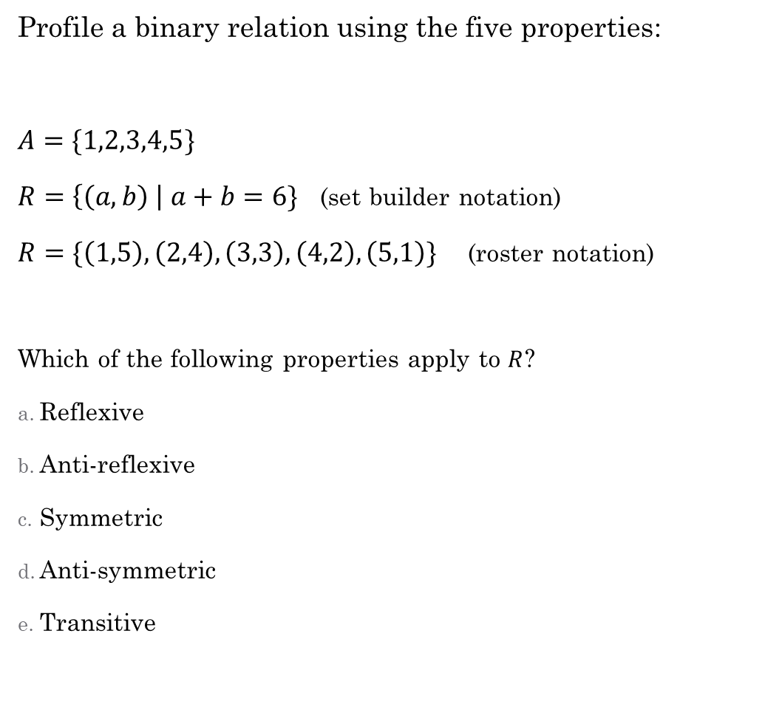
reflexive: $∀x∈A xRx$
anti-reflexive: $∀x∈A, ¬(xRx)$
symmetric: $∀a∀b aRb →bRa$
anti-symmetric: $∀a∀b aRb∧bRa →a=b$
transitive: $∀a∀b∀c aRb∧bRc→aRc$
Profile a binary relation using the five properties:
$A=\{1,2,3,4,5\}$
$R=\left\{\left(a,b\right) \right| a+b=6\}$ (set builder notation)
$R=\{\left(1,5\right), \left(2,4\right), \left(3,3\right), \left(4,2\right), \left(5,1\right)\}$ (roster notation)
Which of the following properties apply to $R$?
Reflexive
Anti-reflexive
Symmetric
Anti-symmetric
Transitive

Slide 19
Additional Exercises with a partner
6.1.3
6.1.4 a-b
6.2.1 a-d
6.2.4

Slide 20
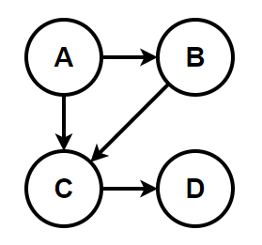
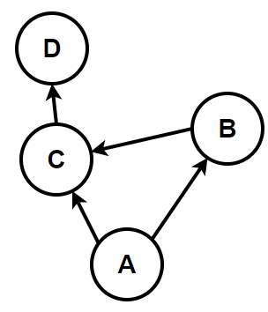
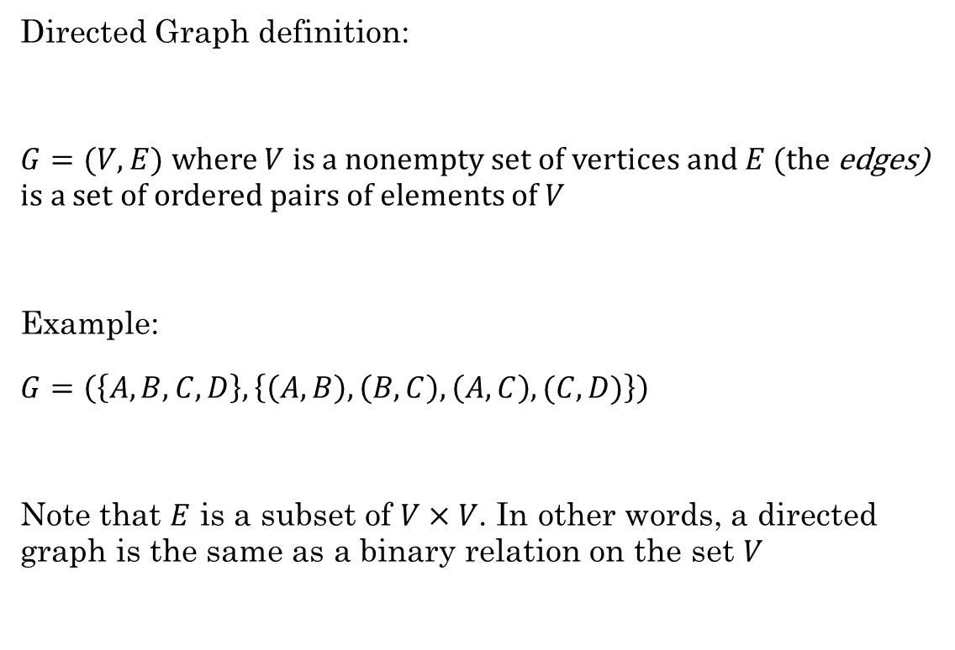
Directed Graphs
Directed Graph definition:
$G=(V,E)$ where $V$ is a nonempty set of vertices and $E$ (the edges) is a set of ordered pairs of elements of $V$
Example:
$G=\left(\left\{A, B, C, D\right\}, \left\{\left(A,B\right), \left(B,C\right), \left(A,C\right), (C,D)\right\}\right)$
Note that $E$ is a subset of $V×V$. In other words, a directed graph is the same as a binary relation on the set $V$
It can be helpful to draw it, but this is not necessary to be considered a graph
These both represent the same graph

Slide 21
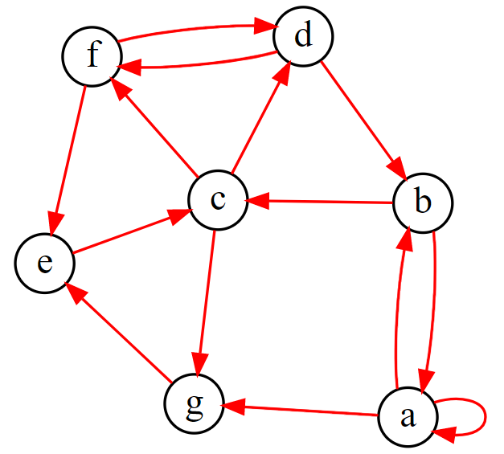
Directed Graphs
With a partner, discuss the following terms using this graph.
What is the in-degree of vertex a? What is the out-degree of vertex c?
What is the head of edge (b,c)?
What is the tail of edge (e,c)?
Which vertex has a self-loop?
Find a trail. (no edge occurs more than once)
Find a path. (no vertex occurs more than once)
Find a circuit. (no edge occurs more than once)
Find a cycle. (no edge or vertex occurs more than once)
Notes:
g = '''
digraph {
layout=neato;
label="Sample Graph";
labeljust=l;
labelloc=t;
edge [arrowsize=0.75; color=red]; # specifies the arrowhead size
node [shape=circle; fixedsize=true; width=0.30]; # specifies the node size/shape
a->b;a->g;a->a;
b->c; b->a;
c->d; c->f; c->g;
d->b;
e->c;
g->e;
f->e;
f->d; d->f;
}
'''

Slide 22

How do directed graphs show the properties of binary relations?
Reflexive
Anti-reflexive
Symmetric
Anti-symmetric
Transitive
Equivalence relation
reflexive: $∀x∈A, xRx$
anti-reflexive: $∀x∈A, ¬(xRx)$
symmetric: $∀a∀b aRb →bRa$
anti-symmetric: $∀a∀b aRb∧bRa →a=b$
transitive: $∀a∀b∀c aRb∧bRc→aRc$

