Slide 1
Relations Graph Powers & Matrix Multiplication

Slide 2
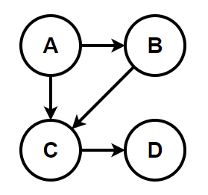
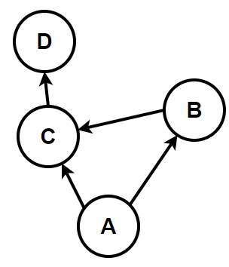
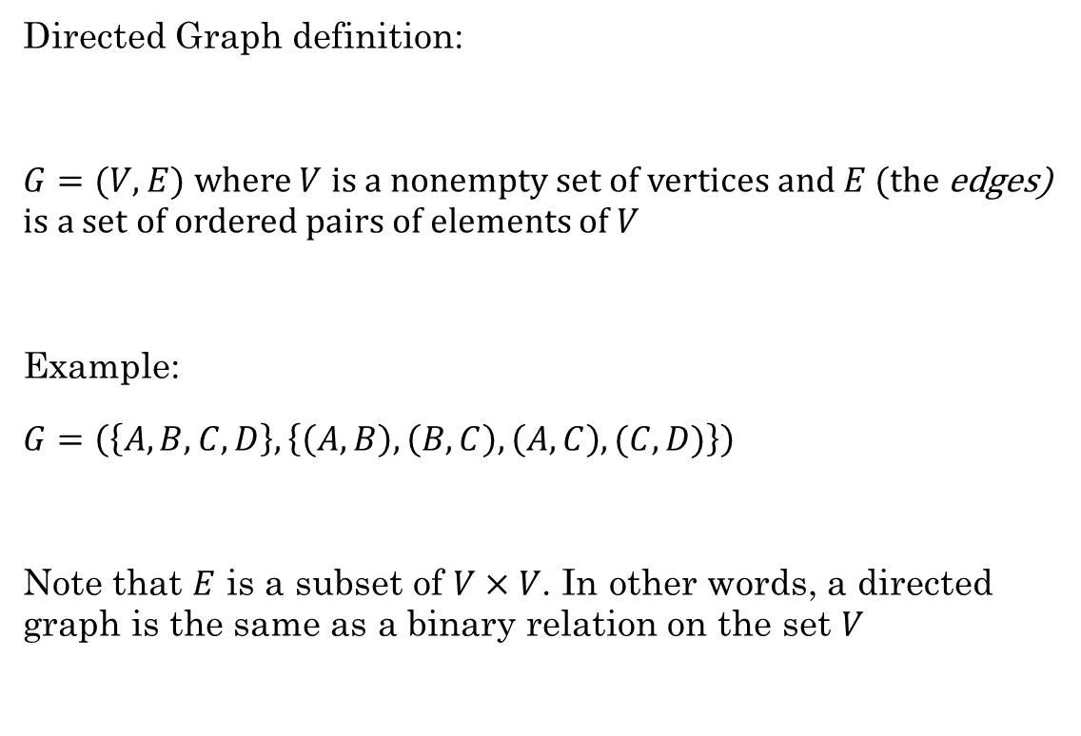
Directed Graphs
Directed Graph definition:
$G=(V,E)$ where $V$ is a nonempty set of vertices and $E$ (the edges) is a set of ordered pairs of elements of $V$
Example:
$G=\left(\left\{A, B, C, D\right\}, \left\{\left(A,B\right), \left(B,C\right), \left(A,C\right), (C,D)\right\}\right)$
Note that $E$ is a subset of $V×V$. In other words, a directed graph is the same as a binary relation on the set $V$
It can be helpful to draw it, but this is not necessary to be considered a graph
These both represent the same graph

Slide 3
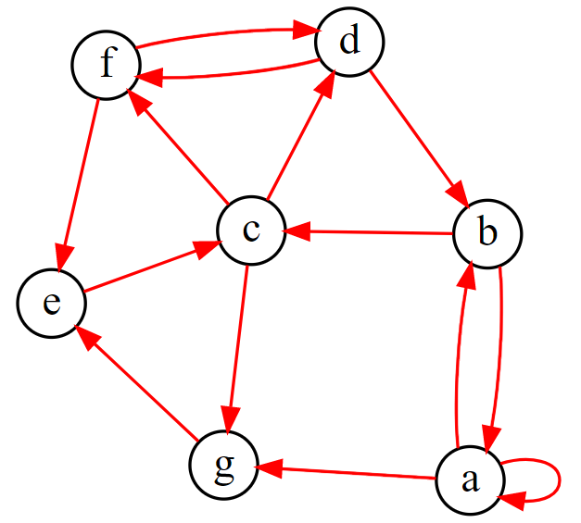
Directed Graphs
With a partner, discuss the following terms using this graph.
What is the in-degree of vertex a? What is the out-degree of vertex c?
What is the head of edge (b,c)?
What is the tail of edge (e,c)?
Which vertex has a self-loop?
Find a trail. (no edge occurs more than once)
Find a path. (no vertex occurs more than once)
Find a circuit. (no edge occurs more than once)
Find a cycle. (no edge or vertex occurs more than once)
Notes:
g = '''
digraph {
layout=neato;
label="Sample Graph";
labeljust=l;
labelloc=t;
edge [arrowsize=0.75; color=red]; # specifies the arrowhead size
node [shape=circle; fixedsize=true; width=0.30]; # specifies the node size/shape
a->b;a->g;a->a;
b->c; b->a;
c->d; c->f; c->g;
d->b;
e->c;
g->e;
f->e;
f->d; d->f;
}
'''

Slide 4

How do directed graphs show the properties of binary relations?
Reflexive
Anti-reflexive
Symmetric
Anti-symmetric
Transitive
Equivalence relation
reflexive: $∀x∈A, xRx$
anti-reflexive: $∀x∈A, ¬(xRx)$
symmetric: $∀a∀b aRb →bRa$
anti-symmetric: $∀a∀b aRb∧bRa →a=b$
transitive: $∀a∀b∀c aRb∧bRc→aRc$

Slide 5
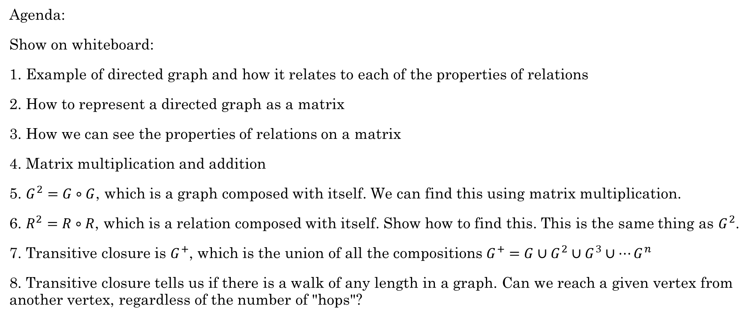
Agenda:
Show on whiteboard:
1. Example of directed graph and how it relates to each of the properties of relations
2. How to represent a directed graph as a matrix
3. How we can see the properties of relations on a matrix
4. Matrix multiplication and addition
5. $G^{2}=G∘G$, which is a graph composed with itself. We can find this using matrix multiplication.
6. $R^{2}=R∘R$, which is a relation composed with itself. Show how to find this. This is the same thing as $G^{2}$.
7. Transitive closure is $G^{+}$, which is the union of all the compositions $G^{+}=G∪G^{2}∪G^{3}∪⋯G^{n}$
8. Transitive closure tells us if there is a walk of any length in a graph. Can we reach a given vertex from another vertex, regardless of the number of "hops"?

Slide 6
Remainder of slides are a draft

Slide 7
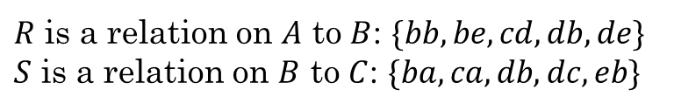
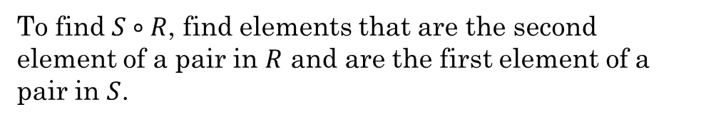
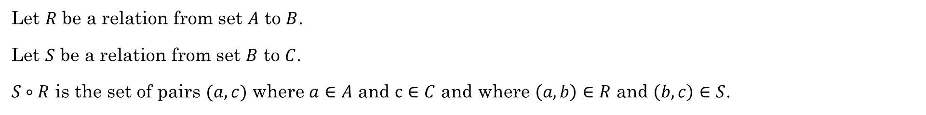
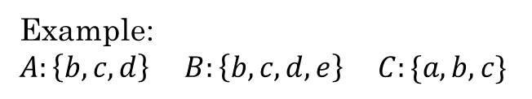


Composition of Relations
Let $R$ be a relation from set $A$ to $B$.
Let $S$ be a relation from set $B$ to $C$.
$S∘R$ is the set of pairs $(a,c)$ where $a∈A$ and $c∈C$ and where $\left(a,b\right)∈R$ and $\left(b,c\right)∈S$.
Example:
$A:\left\{b,c,d\right\}$ $B:\left\{b,c,d,e\right\}$ $C:\{a,b,c\}$
$R$ is a relation on $A$ to $B$: $\{bb, be, cd, db, de\}$
$S$ is a relation on $B$ to $C$: $\{ba, ca, db, dc, eb\}$
To find $S∘R$, find elements that are the second element of a pair in $R$ and are the first element of a pair in $S$.
What is $S∘R$?
$$\{ba, bb, cb, cc, da, db\}$$

Slide 8
Composition of a Relation with Itself
Sometimes we want to compose a relation with itself. When might this be useful?
Let $R$ be a relation on the set of all people such that $\left(x,y\right)∈R$ if $x$ is a parent of $y$.
Then $\left(x,z\right)∈R∘R$ iff there is an $x$ and $y$ such that $\left(x,y\right)∈R$ and $\left(y, z\right)∈R$.
Thus, person $x$ is the parent of person $y$ and $y$ is the parent of $z$.
What is the relationship between $x$ and $z$?
$x$ is the grandparent of $z$
$R∘R$ is also written as $R^{2}$
$R^{2}$ represents all walks of length 2 in a directed graph, or all second-order relations.

Slide 9

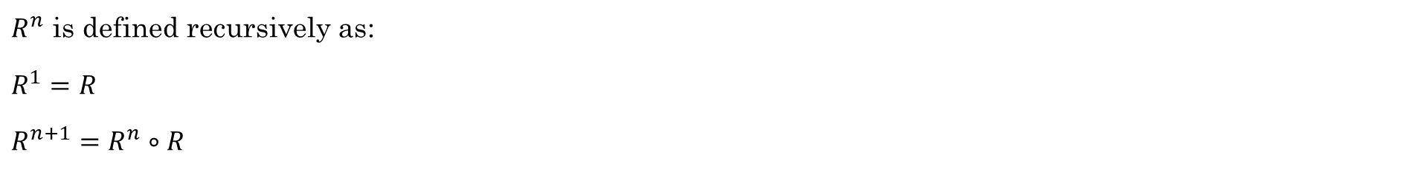

Powers of a Relation
$R^{n}$ is defined recursively as:
$R^{1}=R$
$R^{n+1}=R^{n}∘R$
$R^{n}$ represents all walks of length $n$
$R^{1}=R$ $R^{2}=R∘R$ $R^{3}=R^{2}∘R=\left(R∘R\right)∘R$ $R^{4}=R^{3}∘R=\left(\left(R∘R\right)∘R\right)∘R$ $⋯$
Represents all walks of length 2
Represents all walks of length 3
Represents all walks of length 4

Slide 10
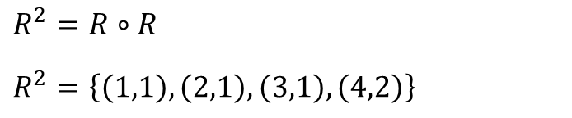

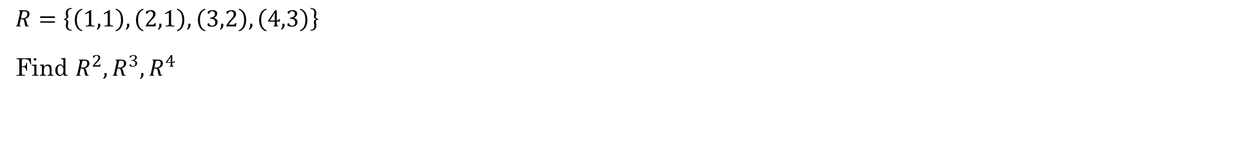
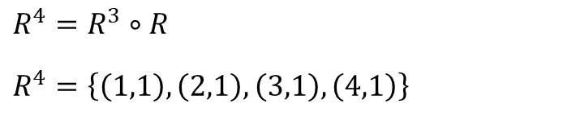
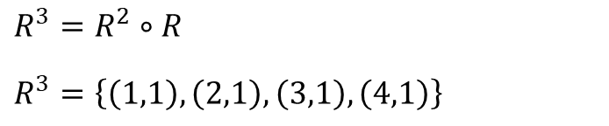
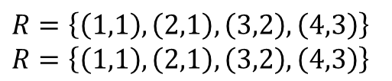
Example
$R=\left\{\left(1,1\right), \left(2,1\right), \left(3,2\right), \left(4,3\right)\right\}$
Find $R^{2},R^{3},R^{4}$
$R=\left\{\left(1,1\right), \left(2,1\right), \left(3,2\right), \left(4,3\right)\right\}$
$R=\left\{\left(1,1\right), \left(2,1\right), \left(3,2\right), \left(4,3\right)\right\}$
$R^{2}=R∘R$
$R^{2}=\left\{\left(1,1\right), \left(2,1\right), \left(3,1\right), \left(4,2\right)\right\}$
$R^{3}=R^{2}∘R$
$R^{3}=\left\{\left(1,1\right), \left(2,1\right), \left(3,1\right), \left(4,1\right)\right\}$
$R^{4}=R^{3}∘R$
$R^{4}=\left\{\left(1,1\right), \left(2,1\right), \left(3,1\right), \left(4,1\right)\right\}$
Note that $R^{n}=R^{3}$ for any $n=4, 5, 6,…$

Slide 11
Additional Exercises:
6.4.1

Slide 12
Matrix vs properties
How can we use a matrix to determine the properties of a relation?
Reflexive
Anti-reflexive
Symmetric
Anti-symmetric

Slide 13
Matrix addition / multiplication

Slide 14
Compute $G∘G$

Slide 15
Transitive Closure ( $G^{+}$ )

Slide 16
Additional Exercises:
6.5.1
6.5.2 (if enough time)
6.6.1

Slide 17
Work on Homework as a Team

