Slide 1
Equivalence Relations & Relational Databases

Slide 2

Quick Review
How do directed graphs show the properties of binary relations?
How do matrices show the properties of binary relations?
Reflexive
Anti-reflexive
Symmetric
Anti-symmetric
Transitive
reflexive: $∀x∈A, xRx$
anti-reflexive: $∀x∈A, ¬(xRx)$
symmetric: $∀a∀b aRb →bRa$
anti-symmetric: $∀a∀b aRb∧bRa →a=b$
transitive: $∀a∀b∀c aRb∧bRc→aRc$

Slide 3

Equivalence Relation
A binary relation that is
Reflexive
Symmetric
Transitive
the same ______ as
The same parent as
The same name as
The same birthday as
C variables – the same first 31 characters
$a\sim b$ means "$a$ is equivalent to $b$"
All equivalent variable names in C:
number_of_named_tropical_storms
number_of_named_tropical_storms_atlantic
number_of_named_tropical_storms_pacific
number_of_named_tropical_storms_2020
number_of_named_tropical_storms_2021

Slide 4
Key Point: Whenever you have a relation where something has the same ______ as something else, you have an equivalence relation (usually)
• x has the same age as y
• the same birthday as
• the same name as
• the same major as
• the same first three bits as
• the same first 31 characters as
• the same ... as

Slide 5

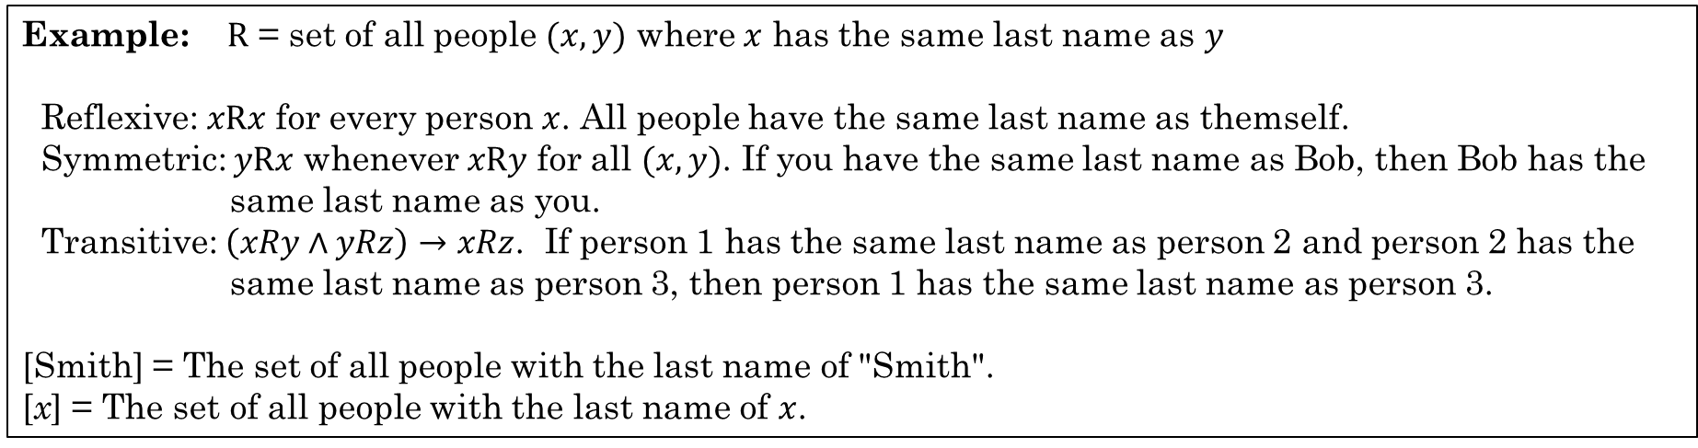

Equivalence Classes
If $A$ is the domain of an equivalence relation $R$ and $a∈A$ then ${\left[a\right]}_{R}$ is the set of all $x∈A$ such that $a\sim x$.
${\left[a\right]}_{R}=\left\{x | \left(a,x\right)∈R\right\}$
a is equivalent to x
${\left[a\right]}_{R}=\left\{x | a\sim x\right\}$
If there is an equivalence relation $R$ on set $A$, the set of all elements $x$ related to an element $a∈A$ is the equivalence class.
Example: $R$ = set of all people $(x,y)$ where $x$ has the same last name as $y$
Reflexive: $xRx$ for every person $x$. All people have the same last name as themself.
Symmetric: $yRx$ whenever $xRy$ for all $(x,y)$. If you have the same last name as Bob, then Bob has the same last name as you.
Transitive: $\left(xRy∧yRz\right)→xRz$. If person 1 has the same last name as person 2 and person 2 has the same last name as person 3, then person 1 has the same last name as person 3.
[Smith] = The set of all people with the last name of "Smith".
[x] = The set of all people with the last name of $x$.
Rosen, Kenneth. Discrete Mathematics and Its Applications, 7th Edition. McGraw-Hill, 2012

Slide 6
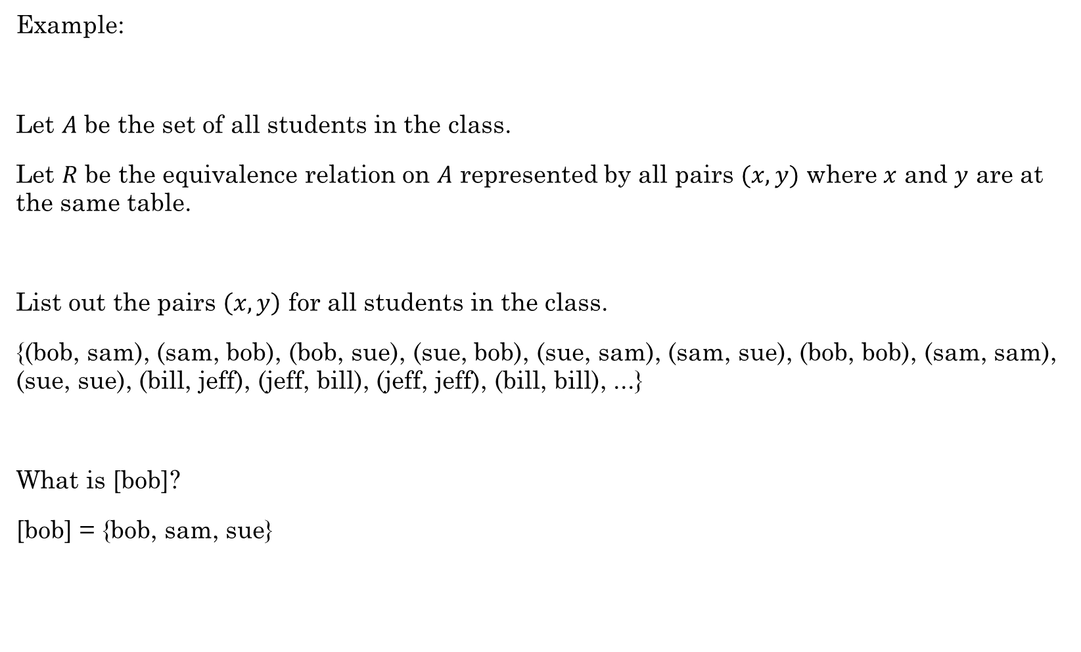
Example:
Let $A$ be the set of all students in the class.
Let $R$ be the equivalence relation on $A$ represented by all pairs $(x,y)$ where $x$ and $y$ are at the same table.
List out the pairs $\left(x,y\right)$ for all students in the class.
{(bob, sam), (sam, bob), (bob, sue), (sue, bob), (sue, sam), (sam, sue), (bob, bob), (sam, sam), (sue, sue), (bill, jeff), (jeff, bill), (jeff, jeff), (bill, bill), ...}
What is [bob]?
[bob] = {bob, sam, sue}
This subset of $A$ consists of all students at the same table as bob. This is the set of all students equivalent to bob with respect to $R$. This subset is an equivalence class of the relation.

Slide 7

Example
Domain: All people
$R$ = $\left\{\left(x,y\right)\right| x and y have the same mother\}$
Is this an equivalence relation?
Reflexive?
Symmetric?
Transitive?
What is an equivalence class in this relation?
Each equivalence class is the set of people with the same mother. The equivalence classes form a partition on the set of all people.
Yes. You have the same mother as yourself.
Yes. If Bob has the same mother as Sue, then Sue has the same mother as Bob.
Yes. If Bob has the same mother as Sue and Sue has the same mother as
Bill, then Bob has the same mother as Bill.

Slide 8

Example
Domain: All people
$R$ = $\left\{\left(x,y\right)\right| x and y have the same parent\}$
Is this an equivalence relation?
Reflexive?
Symmetric?
Transitive?
It is not an equivalence relation.
Yes. You have the same parent as yourself.
Yes. If Bob has the same parent as Sue, then Sue has the same parent as Bob.
No. Bob and Sue can have the same mother. Sue and Bill can have the same father. That does not imply that Bob and Bill have the same father.

Slide 9





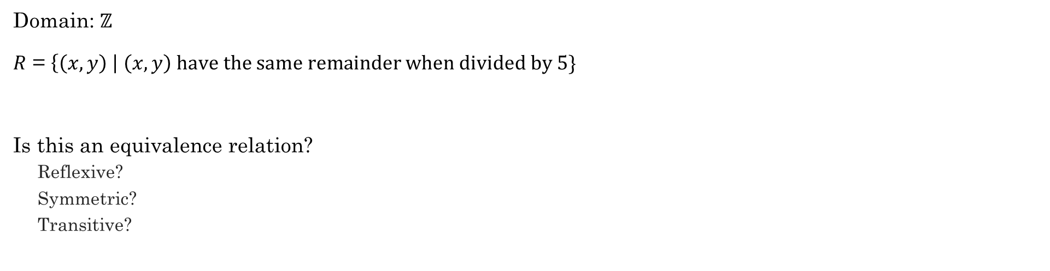
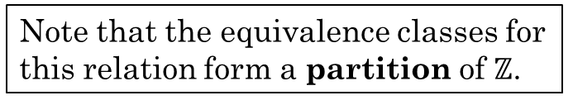






Example
Domain: $ℤ$
$R$ = $\left\{\left(x,y\right) \right| \left(x,y\right) have the same remainder when divided by 5\}$
Is this an equivalence relation?
Reflexive?
Symmetric?
Transitive?
Yes. $x$ has the same remainder as itself.
Yes. If $x$ as the same remainder as $y$, then $y$ has the same remainder as $x$.
Yes. If $x$ has the same remainder as $y$ and $y$ has the same remainder as $z$, then $x$ has the same remainder as $z$.
What are the equivalence classes for this relation?
${\left[0\right]}_{R}$:
$\{−10, −5, 0, 5, 10, 15, 20, …\}$
${\left[1\right]}_{R}$:
$\{−9, −4, 1, 6, 11, 16, 21,…\}$
${\left[2\right]}_{R}$:
$\{−8, −3, 2, 7, 12, 17, 22,…\}$
${\left[3\right]}_{R}$:
$\{−7, −2, 3, 8, 13, 18, 23,…\}$
Note that the equivalence classes for this relation form a partition of $ℤ$.
${\left[4\right]}_{R}$:
$\{−6, −1, 4, 9, 14, 19, 24,…\}$

Slide 10
Relational Databases
name | email | phone | job title | manager | hometown
Bob | bob@company.com | 867-5309 | Computer Scientist | Sue | Rexburg
Sue | sue@company.com | 555-5555 | Senior Computer Scientist | John | Idaho Falls
Carl | carl@company.com | 555-5432 | Engineer | Sue | Rexburg
Selection
Projection
Which part is the Selection, and which is the Projection?
In SQL (Structured Query Language):
SELECT name, phone, email FROM employees WHERE hometown="Rexburg";
Bob | 867-5309 | bob@company.com
Carl | 555-5432 | carl@company.com
In Python:
[(x[0], x[2], x[4]) for x in employees if x[5]=="Rexburg"]
Live Demo

Slide 11
Relational Databases
Class activity
https://tinyurl.com/cse280-relations

Slide 12
Additional Exercises
6.9.1
6.9.2
6.10.1
6.10.2
6.10.4

Slide 13
Extras

Slide 14
From Additional Exercises 6.9.2
Equivalence classes in Python

