Slide 1
Relations

Slide 2

Cartesian Product Review
Example:
$A=\{1, 2\}$
$B=\{a, b, c\}$
What is $A×B$?
What is $B×A$?
Note: $A×B ≠B×A$
$$A×B=\left\{\left(a,b\right) \right| a∈A∧b∈B\}$$
$A×B=\{\left(1,a\right), \left(1,b\right), \left(1,c\right), \left(2,a\right), \left(2,b\right), \left(2,c\right)\}$
$$B×A=\{\left(a,1\right),\left(a,2\right),\left(b,1\right),\left(b,2\right),\left(c,1\right),\left(c,2\right)\}$$

Slide 3
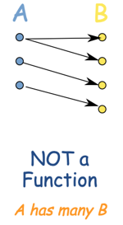
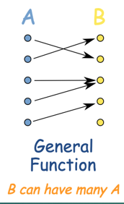
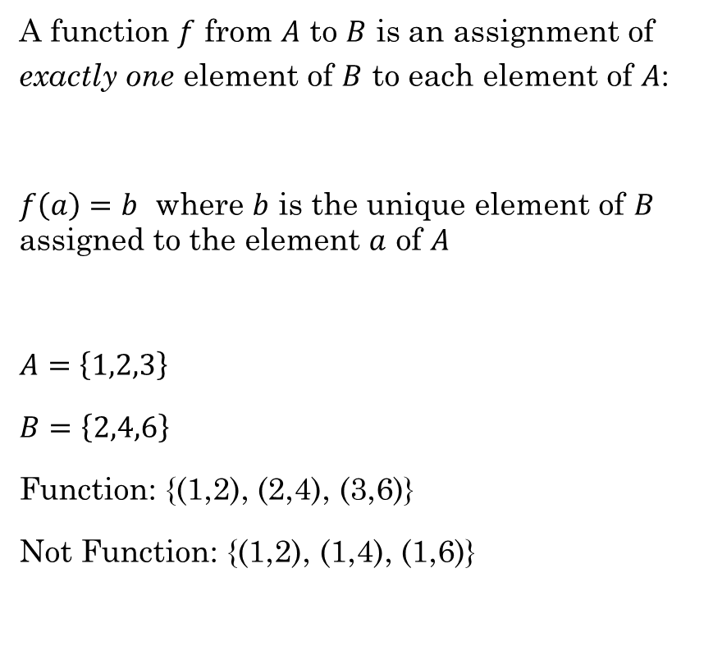

Functions Review
A function $f$ from $A$ to $B$ is an assignment of exactly one element of $B$ to each element of $A$:
$f\left(a\right)=b$ where $b$ is the unique element of $B$ assigned to the element $a$ of $A$
$A=\left\{1,2,3\right\}$
$B=\left\{2,4,6\right\}$
Function: {(1,2), (2,4), (3,6)}
Not Function: {(1,2), (1,4), (1,6)}
This is called
a Relation
Function
This is a special
kind of relation.
$$b = 2a$$
Student ID to Class ID
Rosen, Kenneth. Discrete Mathematics and Its Applications, 7th Edition. McGraw-Hill, 2012

Slide 4
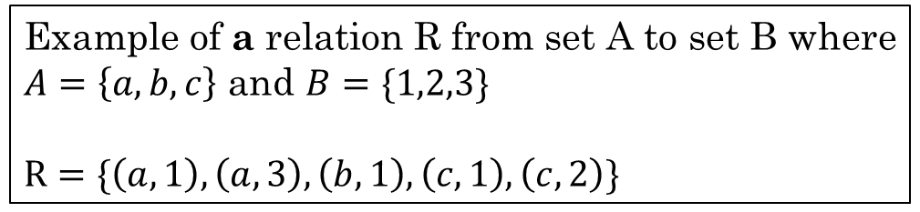
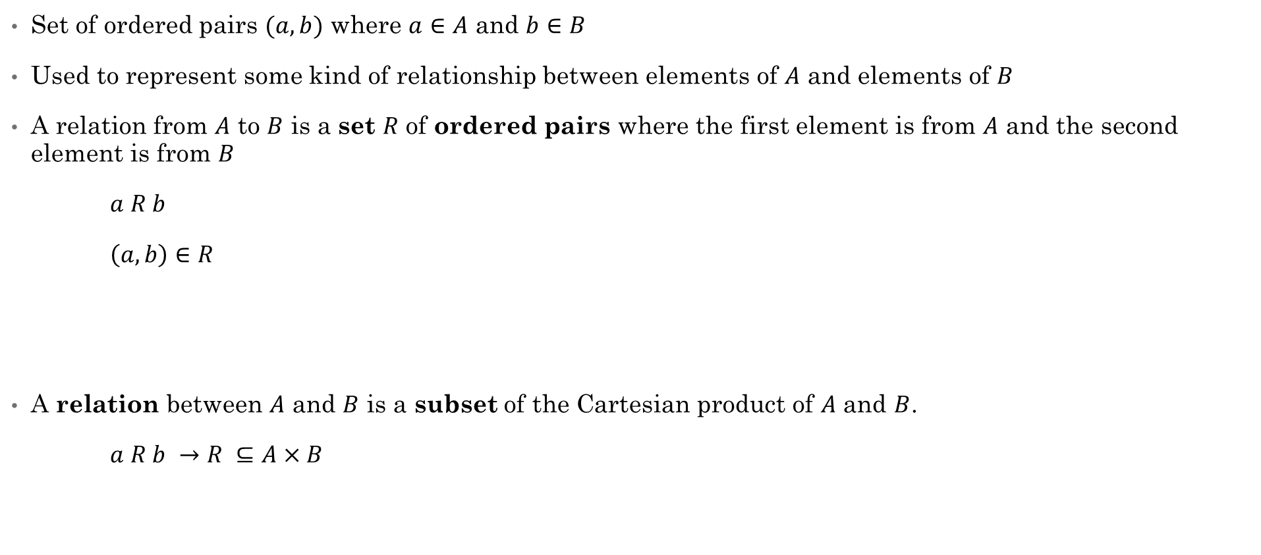
Relation
Set of ordered pairs $(a,b)$ where $a∈A$ and $b∈B$
Used to represent some kind of relationship between elements of $A$ and elements of $B$
A relation from $A$ to $B$ is a set $R$ of ordered pairs where the first element is from $A$ and the second element is from $B$
$a R b$
$\left(a,b\right)∈R$
A relation between $A$ and $B$ is a subset of the Cartesian product of $A$ and $B$.
$a R b →$ $R ⊆A×B$
Example of a relation R from set A to set B where
$A=\left\{a,b,c\right\}$ and $B=\{1,2,3\}$
$R=\{\left(a,1\right),\left(a,3\right),\left(b,1\right), \left(c,1\right),\left(c,2\right)\}$
Rosen, Kenneth. Discrete Mathematics and Its Applications, 7th Edition. McGraw-Hill, 2012

Slide 5
Example:
We can represent a set of ordered pairs as a 2-D Matrix, where a 0 or 1 indicates whether a given (row, column) is in the set:
$$\{\left(a,1\right),\left(a,2\right),\left(a,3\right),\left(b,1\right), \left(b,2\right),\left(b,3\right), \left(c,1\right),\left(c,2\right),\left(c,3\right)\}$$
 | 1 | 2 | 3
a | 1 | 1 | 1
b | 1 | 1 | 1
c | 1 | 1 | 1

Slide 6
Example:
$$\{\left(a,1\right),\left(a,3\right),\left(b,1\right),\left(c,2\right),\left(c,3\right)\}$$
 | 1 | 2 | 3
a | 1 | 0 | 1
b | 1 | 0 | 0
c | 0 | 1 | 1

Slide 7

Example:
Given the sets $A=\{a,b,c\}$ and $B=\{1,2,3\}$, which of the following is a valid relation $R$ from $A$ to $B$?
{(a,1), (1,a)}
{(a,1), (a,2), (b,2)}
{(1,a), (2,a), (3,a)}
{(b,1), (b,3), (c,1)}
b. | 1 | 2 | 3
a | 1 | 1 | 0
b | 0 | 1 | 0
c | 0 | 0 | 0
d. | 1 | 2 | 3
a | 0 | 0 | 0
b | 1 | 0 | 1
c | 1 | 0 | 0

Slide 8

Properties of Relations
Reflexive
Anti-reflexive
Symmetric
Anti-symmetric
Transitive
reflexive: $∀x∈A, xRx$
anti-reflexive: $∀x∈A, ¬(xRx)$
symmetric: $∀a∀b, aRb →bRa$
anti-symmetric: $∀a∀b, aRb∧bRa →a=b$
transitive: $∀a∀b∀c, aRb∧bRc→aRc$

Slide 9



Reflexive
A relation is reflexive if every element of A is related to itself.
$∀a∈A \left(\left(a,a\right)∈R\right)$
$∀a∈A aRa$
What are some mathematical relations that are reflexive?
Example:
$R$ = set of all people $(x,y)$ with the same mother and father.
$xRx$ for every person $x$
" You have the same mother and father as yourself "
Reflexive math relations:
$= ∀x x=x$
$≥ ∀x x≥x$
$≤ ∀x x≤x$
Rosen, Kenneth. Discrete Mathematics and Its Applications, 7th Edition. McGraw-Hill, 2012

Slide 10
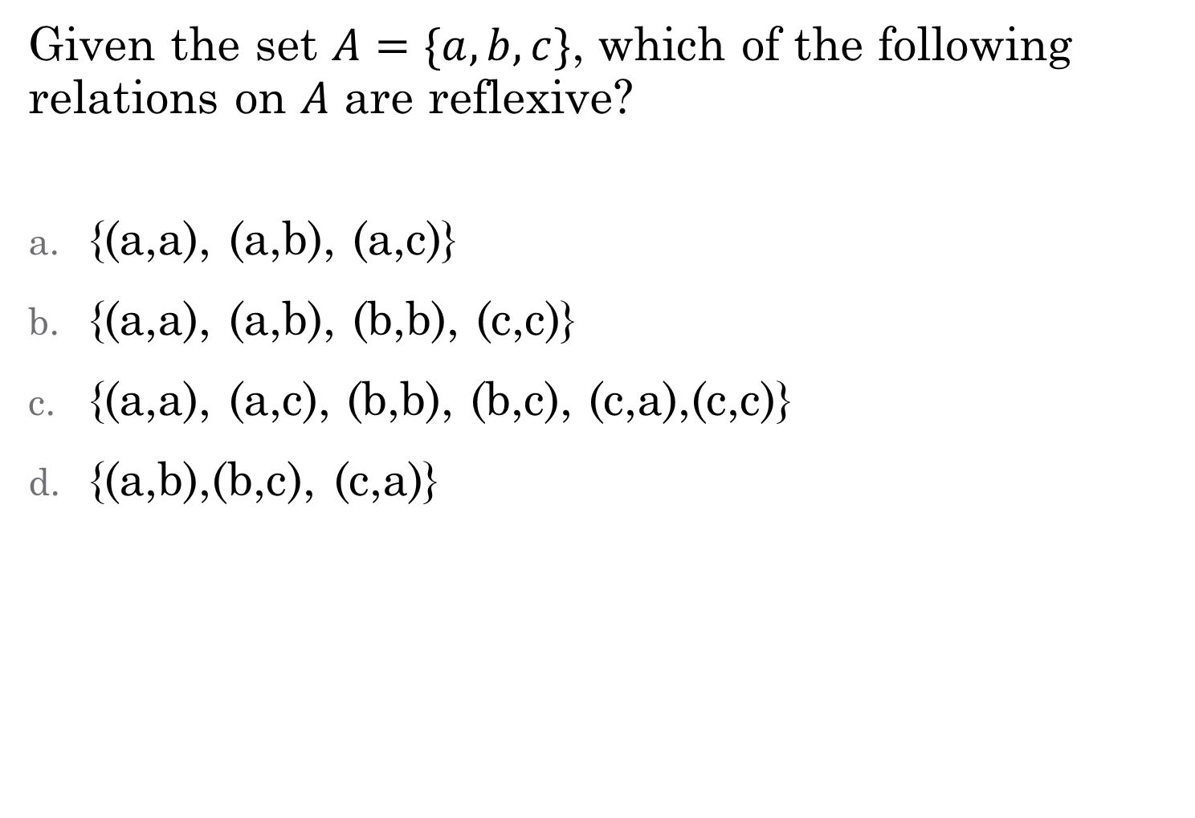
Given the set $A=\{a,b,c\}$, which of the following relations on $A$ are reflexive?
{(a,a), (a,b), (a,c)}
{(a,a), (a,b), (b,b), (c,c)}
{(a,a), (a,c), (b,b), (b,c), (c,a),(c,c)}
{(a,b),(b,c), (c,a)}
Not reflexive. Missing (b,b) and (c,c)
Not reflexive. Missing (a,a), (b,b), and (c,c)

Slide 11
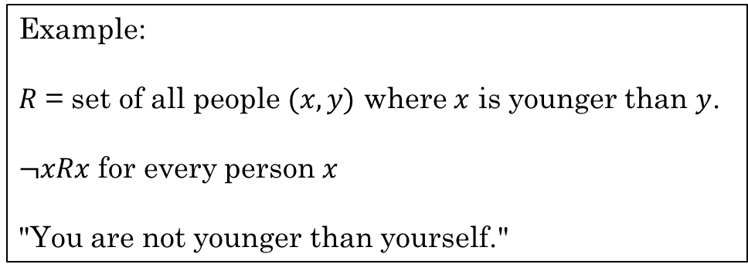
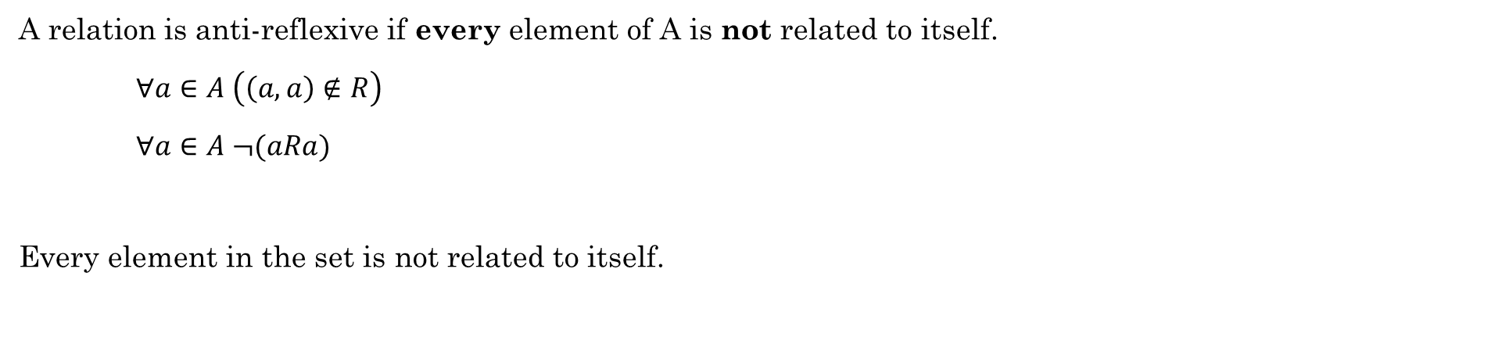
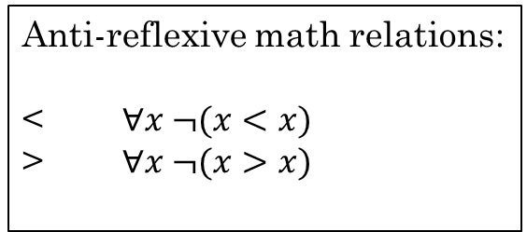
Anti-reflexive
A relation is anti-reflexive if every element of A is not related to itself.
$∀a∈A \left(\left(a,a\right)∉R\right)$
$∀a∈A ¬(aRa)$
Every element in the set is not related to itself.
Example:
$R$ = set of all people $(x,y)$ where $x$ is younger than $y$.
$¬xRx$ for every person $x$
"You are not younger than yourself."
Anti-reflexive math relations:
< $∀x ¬(x<x)$
> $∀x ¬(x>x)$

Slide 12
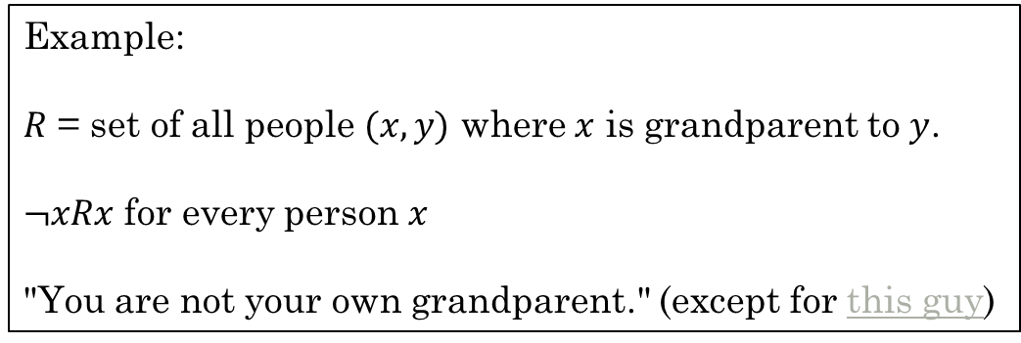
Anti-reflexive
A relation is anti-reflexive if every element of A is not related to itself.
$∀a∈A \left(\left(a,a\right)∉R\right)$
$∀a∈A ¬(aRa)$
Every element in the set is not related to itself.
Example:
$R$ = set of all people $(x,y)$ where $x$ is grandparent to $y$.
$¬xRx$ for every person $x$
"You are not your own grandparent." (except for this guy)

Slide 13
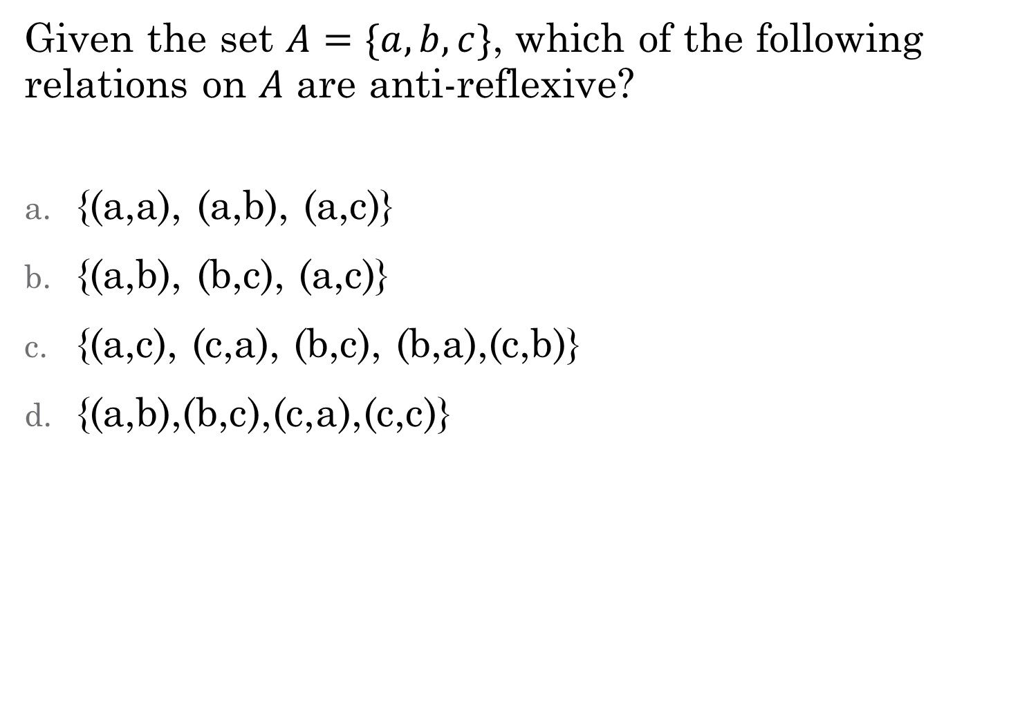
Given the set $A=\{a,b,c\}$, which of the following relations on $A$ are anti-reflexive?
{(a,a), (a,b), (a,c)}
{(a,b), (b,c), (a,c)}
{(a,c), (c,a), (b,c), (b,a),(c,b)}
{(a,b),(b,c),(c,a),(c,c)}
Not anti-reflexive. Contains (a,a)
Not reflexive. Contains (c,c)

Slide 14


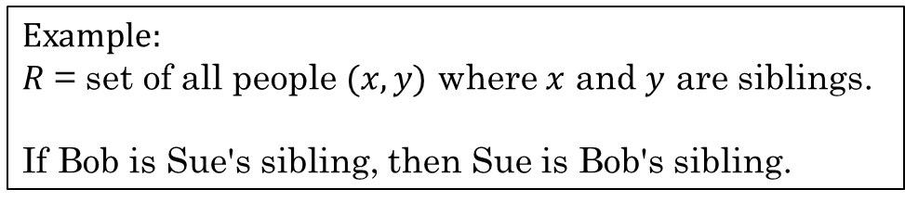
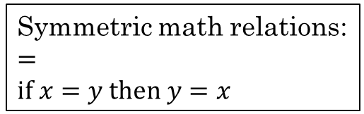

Symmetric
A relation is symmetric if $\left(b,a\right)∈R$ whenever $\left(a,b\right)∈R$ for all $a,b∈A$.
$∀a∀b\left(\left(a,b\right)∈R →\left(b,a\right)∈R\right)$
$∀a∀b \left(aRb →bRa\right)$
If $a$ is related to $b$, then $b$ is related to $a$.
Which of these relations are symmetric?
$R=\left\{\left(1,1\right), \left(1,2\right), \left(2,1\right)\right\}$
$R=\left\{\left(1,1\right), \left(2,2\right), \left(2,3\right), \left(3,2\right)\right\}$
$R=\left\{\left(1,2\right)\right\}$
$R=\left\{\left(1,1\right), \left(1,2\right), \left(1,3\right), \left(2,1\right)\right\}$
Example:
$R$ = set of all people $(x,y)$ where $x$ and $y$ are siblings.
If Bob is Sue's sibling, then Sue is Bob's sibling.
Symmetric math relations:
$=$
$if x=y then y=x$
Yes, symmetric
Yes, symmetric
No, not symmetric. Missing $\left(2,1\right)$
No, not symmetric. Missing $\left(3,1\right)$
Rosen, Kenneth. Discrete Mathematics and Its Applications, 7th Edition. McGraw-Hill, 2012

Slide 15
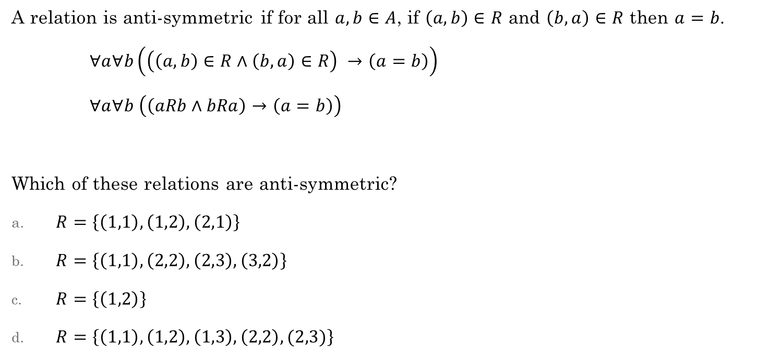
Anti-symmetric
A relation is anti-symmetric if for all $a,b∈A$, if $\left(a,b\right)∈R$ and $\left(b,a\right)∈R$ then $a=b$.
$∀a∀b\left(\left(\left(a,b\right)∈R∧\left(b,a\right)∈R\right) →\left(a=b\right)\right)$
$∀a∀b \left(\left(aRb∧bRa\right)→\left(a=b\right)\right)$
Which of these relations are anti-symmetric?
$R=\left\{\left(1,1\right), \left(1,2\right), \left(2,1\right)\right\}$
$R=\left\{\left(1,1\right), \left(2,2\right), \left(2,3\right), \left(3,2\right)\right\}$
$R=\left\{\left(1,2\right)\right\}$
$R=\left\{\left(1,1\right), \left(1,2\right), \left(1,3\right), \left(2,2\right), (2,3)\right\}$
Another way of thinking about it:
Anti-symmetric means the relation does not contain any symmetric pairs
No, contains (2,1) and (1,2)
No, contains (2,3) and (3,2)
Yes. Anti-symmetric
Yes. Anti-symmetric
Rosen, Kenneth. Discrete Mathematics and Its Applications, 7th Edition. McGraw-Hill, 2012

Slide 16
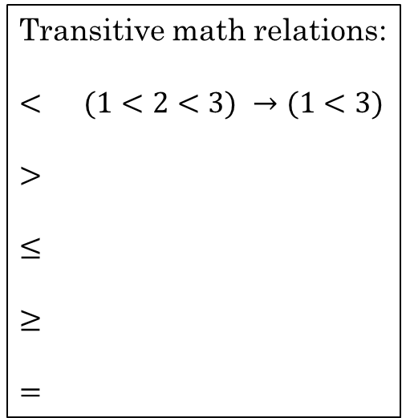
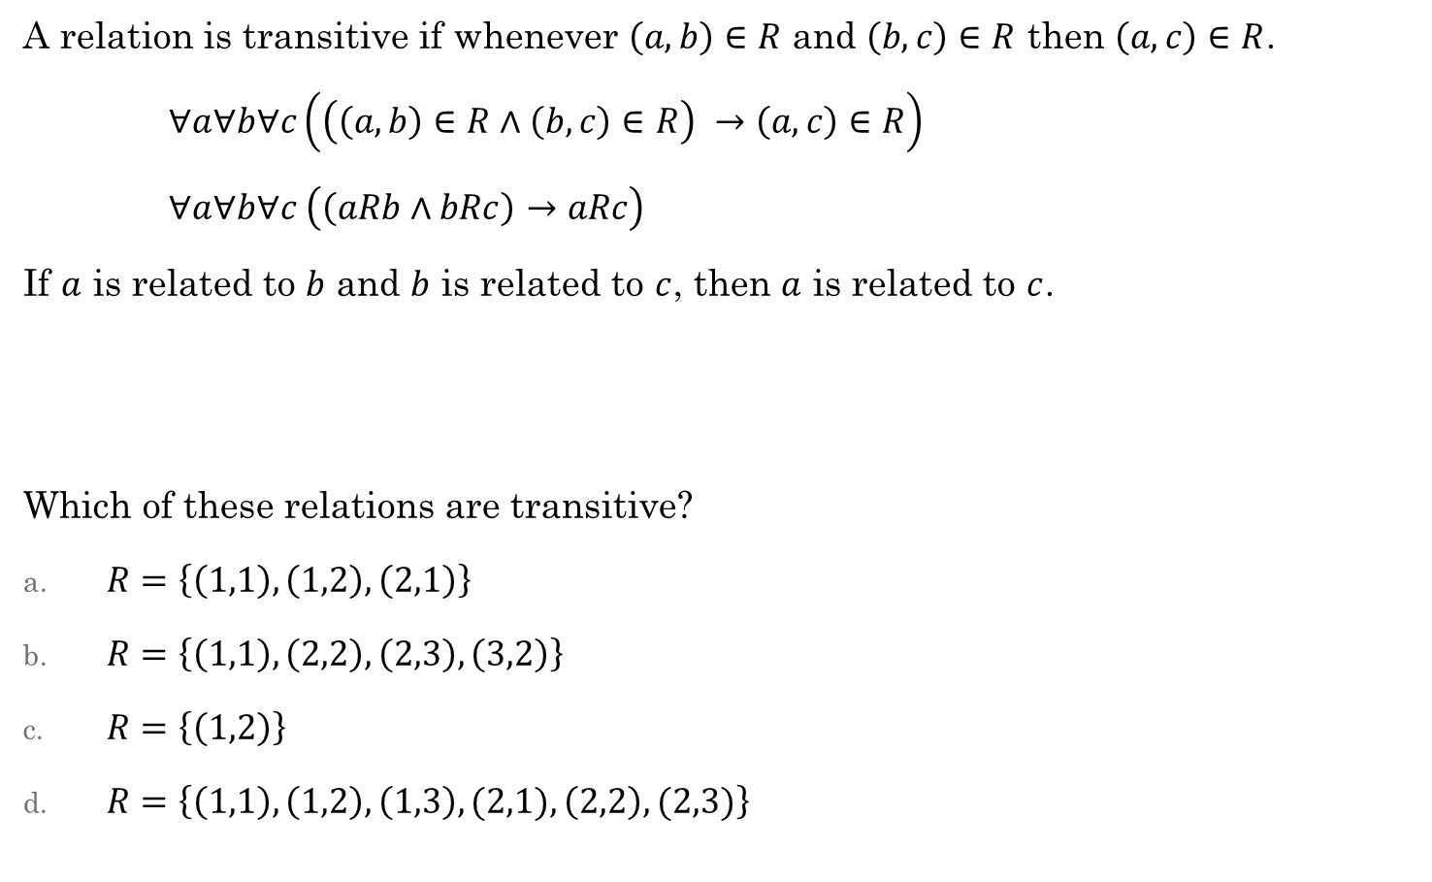
Transitive
A relation is transitive if whenever $\left(a,b\right)∈R$ and $\left(b,c\right)∈R$ then $\left(a,c\right)∈R$.
$∀a∀b∀c\left(\left(\left(a,b\right)∈R∧\left(b,c\right)∈R\right) →\left(a,c\right)∈R\right)$
$∀a∀b∀c \left(\left(aRb∧bRc\right)→aRc\right)$
If $a$ is related to $b$ and $b$ is related to $c$, then $a$ is related to $c$.
Which of these relations are transitive?
$R=\left\{\left(1,1\right), \left(1,2\right), \left(2,1\right)\right\}$
$R=\left\{\left(1,1\right), \left(2,2\right), \left(2,3\right), \left(3,2\right)\right\}$
$R=\left\{\left(1,2\right)\right\}$
$R=\left\{\left(1,1\right), \left(1,2\right), \left(1,3\right),(2,1), \left(2,2\right), (2,3)\right\}$
Example:
Same parent as.
Bob has same parent as Sue and Sue has the same parent as Bill. Bob has the same parent as Bill.
Transitive math relations:
$<$ $(1<2<3) →(1<3)$
$>$
$≤$
$≥$
$=$
No, missing (2,2)
No, missing (3,3)
Yes. Transitive
Yes. Transitive
Rosen, Kenneth. Discrete Mathematics and Its Applications, 7th Edition. McGraw-Hill, 2012

Slide 17

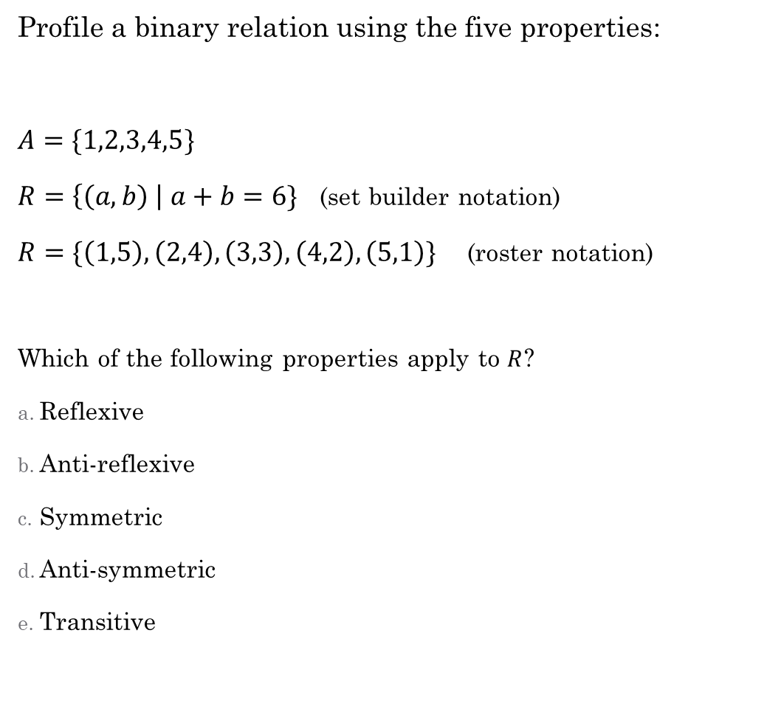
reflexive: $∀x∈A xRx$
anti-reflexive: $∀x∈A, ¬(xRx)$
symmetric: $∀a∀b aRb →bRa$
anti-symmetric: $∀a∀b aRb∧bRa →a=b$
transitive: $∀a∀b∀c aRb∧bRc→aRc$
Profile a binary relation using the five properties:
$A=\{1,2,3,4,5\}$
$R=\left\{\left(a,b\right) \right| a+b=6\}$ (set builder notation)
$R=\{\left(1,5\right), \left(2,4\right), \left(3,3\right), \left(4,2\right), \left(5,1\right)\}$ (roster notation)
Which of the following properties apply to $R$?
Reflexive
Anti-reflexive
Symmetric
Anti-symmetric
Transitive

Slide 18
Additional Exercises with a partner
6.1.3
6.1.4 a-b
6.2.1 a-d
6.2.4

Slide 19
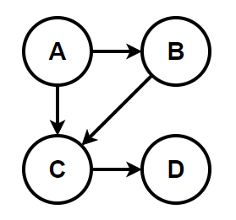
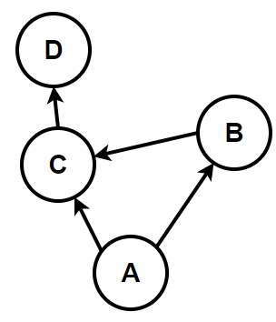
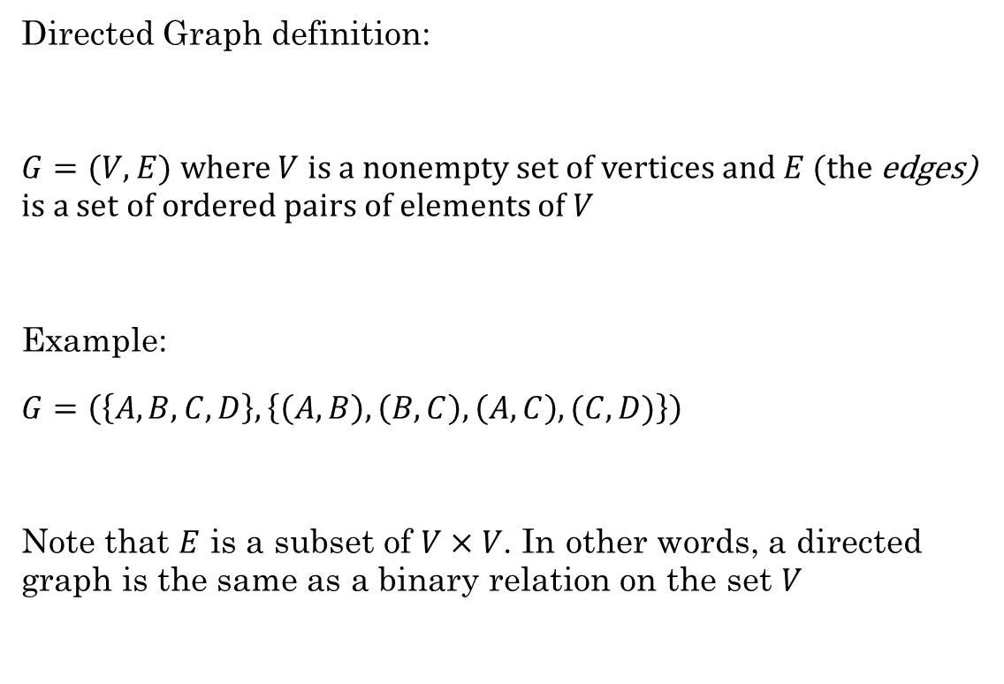
Directed Graphs
Directed Graph definition:
$G=(V,E)$ where $V$ is a nonempty set of vertices and $E$ (the edges) is a set of ordered pairs of elements of $V$
Example:
$G=\left(\left\{A, B, C, D\right\}, \left\{\left(A,B\right), \left(B,C\right), \left(A,C\right), (C,D)\right\}\right)$
Note that $E$ is a subset of $V×V$. In other words, a directed graph is the same as a binary relation on the set $V$
It can be helpful to draw it, but this is not necessary to be considered a graph
These both represent the same graph

Slide 20
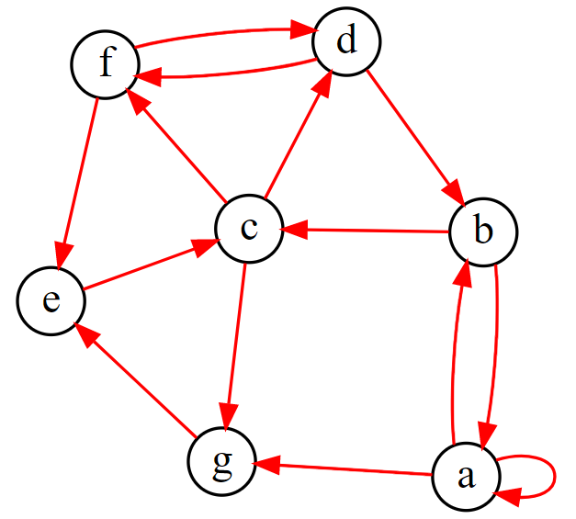
Directed Graphs
With a partner, discuss the following terms using this graph.
What is the in-degree of vertex a? What is the out-degree of vertex c?
What is the head of edge (b,c)?
What is the tail of edge (e,c)?
Which vertex has a self-loop?
Find a trail. (no edge occurs more than once)
Find a path. (no vertex occurs more than once)
Find a circuit. (no edge occurs more than once)
Find a cycle. (no edge or vertex occurs more than once)
Notes:
g = '''
digraph {
layout=neato;
label="Sample Graph";
labeljust=l;
labelloc=t;
edge [arrowsize=0.75; color=red]; # specifies the arrowhead size
node [shape=circle; fixedsize=true; width=0.30]; # specifies the node size/shape
a->b;a->g;a->a;
b->c; b->a;
c->d; c->f; c->g;
d->b;
e->c;
g->e;
f->e;
f->d; d->f;
}
'''

Slide 21
Directed Graphs
Directed Graph definition:
$G=(V,E)$ where $V$ is a nonempty set of vertices and $E$ (the edges) is a set of ordered pairs of elements of $V$
Example:
$G=\left(\left\{A, B, C, D\right\}, \left\{\left(A,B\right), \left(B,C\right), \left(A,C\right), (C,D)\right\}\right)$
Note that $E$ is a subset of $V×V$. In other words, a directed graph is the same as a binary relation on the set $V$
It can be helpful to draw it, but this is not necessary to be considered a graph
These both represent the same graph

Slide 22
Directed Graphs
With a partner, discuss the following terms using this graph.
What is the in-degree of vertex a? What is the out-degree of vertex c?
What is the head of edge (b,c)?
What is the tail of edge (e,c)?
Which vertex has a self-loop?
Find a trail. (no edge occurs more than once)
Find a path. (no vertex occurs more than once)
Find a circuit. (no edge occurs more than once)
Find a cycle. (no edge or vertex occurs more than once)
Notes:
g = '''
digraph {
layout=neato;
label="Sample Graph";
labeljust=l;
labelloc=t;
edge [arrowsize=0.75; color=red]; # specifies the arrowhead size
node [shape=circle; fixedsize=true; width=0.30]; # specifies the node size/shape
a->b;a->g;a->a;
b->c; b->a;
c->d; c->f; c->g;
d->b;
e->c;
g->e;
f->e;
f->d; d->f;
}
'''

Slide 23

How do directed graphs show the properties of binary relations?
Reflexive
Anti-reflexive
Symmetric
Anti-symmetric
Transitive
Equivalence relation
reflexive: $∀x∈A, xRx$
anti-reflexive: $∀x∈A, ¬(xRx)$
symmetric: $∀a∀b aRb →bRa$
anti-symmetric: $∀a∀b aRb∧bRa →a=b$
transitive: $∀a∀b∀c aRb∧bRc→aRc$

Slide 24
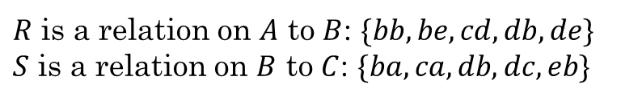
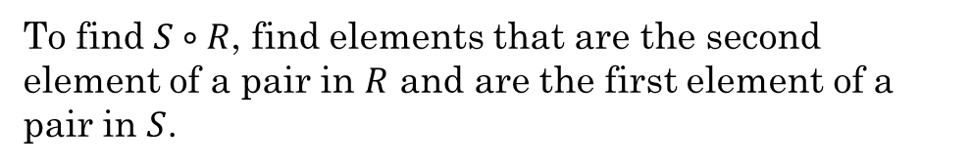
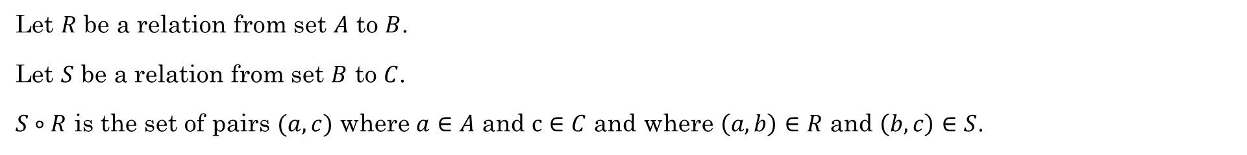
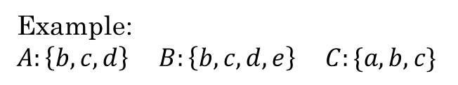


Composition of Relations
Let $R$ be a relation from set $A$ to $B$.
Let $S$ be a relation from set $B$ to $C$.
$S∘R$ is the set of pairs $(a,c)$ where $a∈A$ and $c∈C$ and where $\left(a,b\right)∈R$ and $\left(b,c\right)∈S$.
Example:
$A:\left\{b,c,d\right\}$ $B:\left\{b,c,d,e\right\}$ $C:\{a,b,c\}$
$R$ is a relation on $A$ to $B$: $\{bb, be, cd, db, de\}$
$S$ is a relation on $B$ to $C$: $\{ba, ca, db, dc, eb\}$
To find $S∘R$, find elements that are the second element of a pair in $R$ and are the first element of a pair in $S$.
What is $S∘R$?
$$\{ba, bb, cb, cc, da, db\}$$

Slide 25
Composition of a Relation with Itself
Sometimes we want to compose a relation with itself. When might this be useful?
Let $R$ be a relation on the set of all people such that $\left(x,y\right)∈R$ if $x$ is a parent of $y$.
Then $\left(x,z\right)∈R∘R$ iff there is an $x$ and $y$ such that $\left(x,y\right)∈R$ and $\left(y, z\right)∈R$.
Thus, person $x$ is the parent of person $y$ and $y$ is the parent of $z$.
What is the relationship between $x$ and $z$?
$x$ is the grandparent of $z$
$R∘R$ is also written as $R^{2}$
$R^{2}$ represents all walks of length 2 in a directed graph, or all second-order relations.

Slide 26

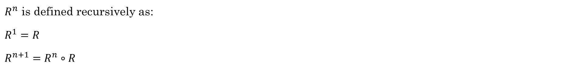

Powers of a Relation
$R^{n}$ is defined recursively as:
$R^{1}=R$
$R^{n+1}=R^{n}∘R$
$R^{n}$ represents all walks of length $n$
$R^{1}=R$ $R^{2}=R∘R$ $R^{3}=R^{2}∘R=\left(R∘R\right)∘R$ $R^{4}=R^{3}∘R=\left(\left(R∘R\right)∘R\right)∘R$ $⋯$
Represents all walks of length 2
Represents all walks of length 3
Represents all walks of length 4

Slide 27
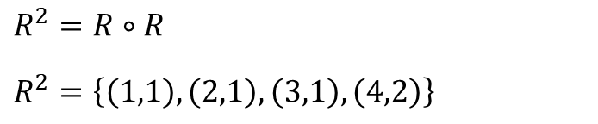

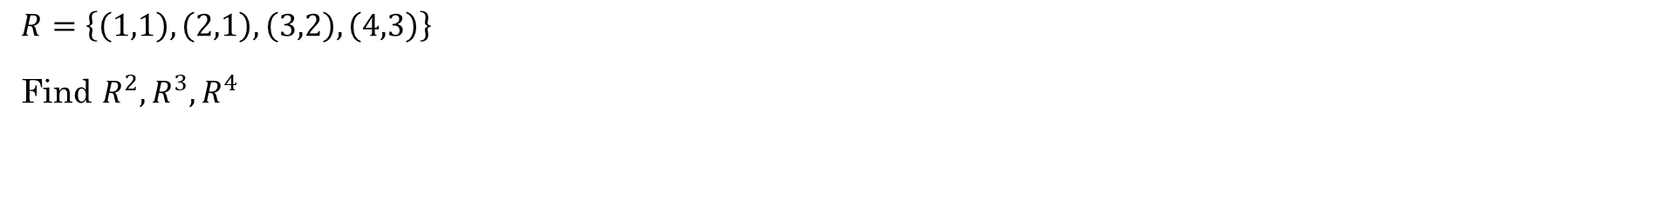
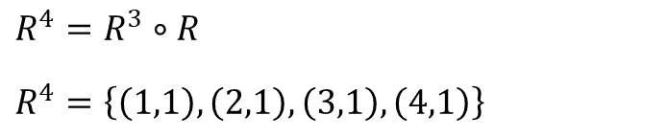
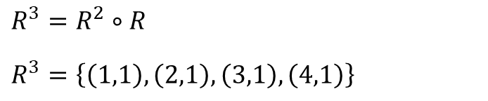
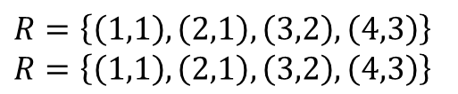
Example
$R=\left\{\left(1,1\right), \left(2,1\right), \left(3,2\right), \left(4,3\right)\right\}$
Find $R^{2},R^{3},R^{4}$
$R=\left\{\left(1,1\right), \left(2,1\right), \left(3,2\right), \left(4,3\right)\right\}$
$R=\left\{\left(1,1\right), \left(2,1\right), \left(3,2\right), \left(4,3\right)\right\}$
$R^{2}=R∘R$
$R^{2}=\left\{\left(1,1\right), \left(2,1\right), \left(3,1\right), \left(4,2\right)\right\}$
$R^{3}=R^{2}∘R$
$R^{3}=\left\{\left(1,1\right), \left(2,1\right), \left(3,1\right), \left(4,1\right)\right\}$
$R^{4}=R^{3}∘R$
$R^{4}=\left\{\left(1,1\right), \left(2,1\right), \left(3,1\right), \left(4,1\right)\right\}$
Note that $R^{n}=R^{3}$ for any $n=4, 5, 6,…$

Slide 28
Matrix vs properties
How can we use a matrix to determine the properties of a relation?
Reflexive
Anti-reflexive
Symmetric
Anti-symmetric

Slide 29
Equivalence Relations & Relational Databases

Slide 30

Quick Review
How do directed graphs show the properties of binary relations?
How do matrices show the properties of binary relations?
Reflexive
Anti-reflexive
Symmetric
Anti-symmetric
Transitive
reflexive: $∀x∈A, xRx$
anti-reflexive: $∀x∈A, ¬(xRx)$
symmetric: $∀a∀b aRb →bRa$
anti-symmetric: $∀a∀b aRb∧bRa →a=b$
transitive: $∀a∀b∀c aRb∧bRc→aRc$

Slide 31

Equivalence Relation
A binary relation that is
Reflexive
Symmetric
Transitive
the same ______ as
The same parent as
The same name as
The same birthday as
C variables – the same first 31 characters
$a\sim b$ means "$a$ is equivalent to $b$"
All equivalent variable names in C:
number_of_named_tropical_storms
number_of_named_tropical_storms_atlantic
number_of_named_tropical_storms_pacific
number_of_named_tropical_storms_2020
number_of_named_tropical_storms_2021

Slide 32
Key Point: Whenever you have a relation where something has the same ______ as something else, you have an equivalence relation (usually)
• x has the same age as y
• the same birthday as
• the same name as
• the same major as
• the same first three bits as
• the same first 31 characters as
• the same ... as

Slide 33

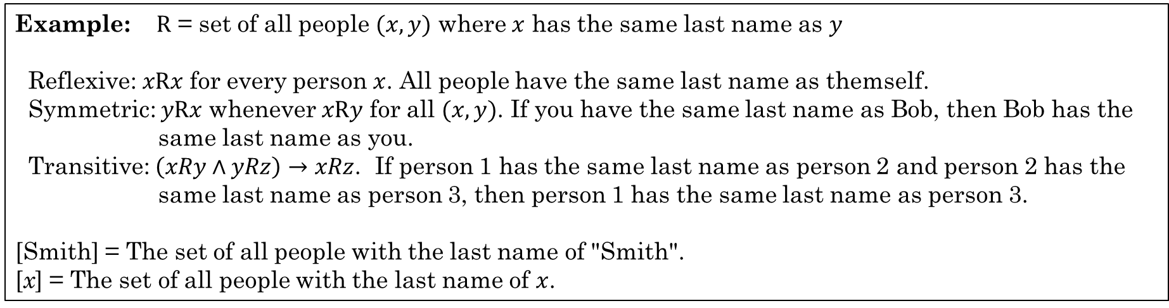

Equivalence Classes
If $A$ is the domain of an equivalence relation $R$ and $a∈A$ then ${\left[a\right]}_{R}$ is the set of all $x∈A$ such that $a\sim x$.
${\left[a\right]}_{R}=\left\{x | \left(a,x\right)∈R\right\}$
a is equivalent to x
${\left[a\right]}_{R}=\left\{x | a\sim x\right\}$
If there is an equivalence relation $R$ on set $A$, the set of all elements $x$ related to an element $a∈A$ is the equivalence class.
Example: $R$ = set of all people $(x,y)$ where $x$ has the same last name as $y$
Reflexive: $xRx$ for every person $x$. All people have the same last name as themself.
Symmetric: $yRx$ whenever $xRy$ for all $(x,y)$. If you have the same last name as Bob, then Bob has the same last name as you.
Transitive: $\left(xRy∧yRz\right)→xRz$. If person 1 has the same last name as person 2 and person 2 has the same last name as person 3, then person 1 has the same last name as person 3.
[Smith] = The set of all people with the last name of "Smith".
[x] = The set of all people with the last name of $x$.
Rosen, Kenneth. Discrete Mathematics and Its Applications, 7th Edition. McGraw-Hill, 2012

Slide 34
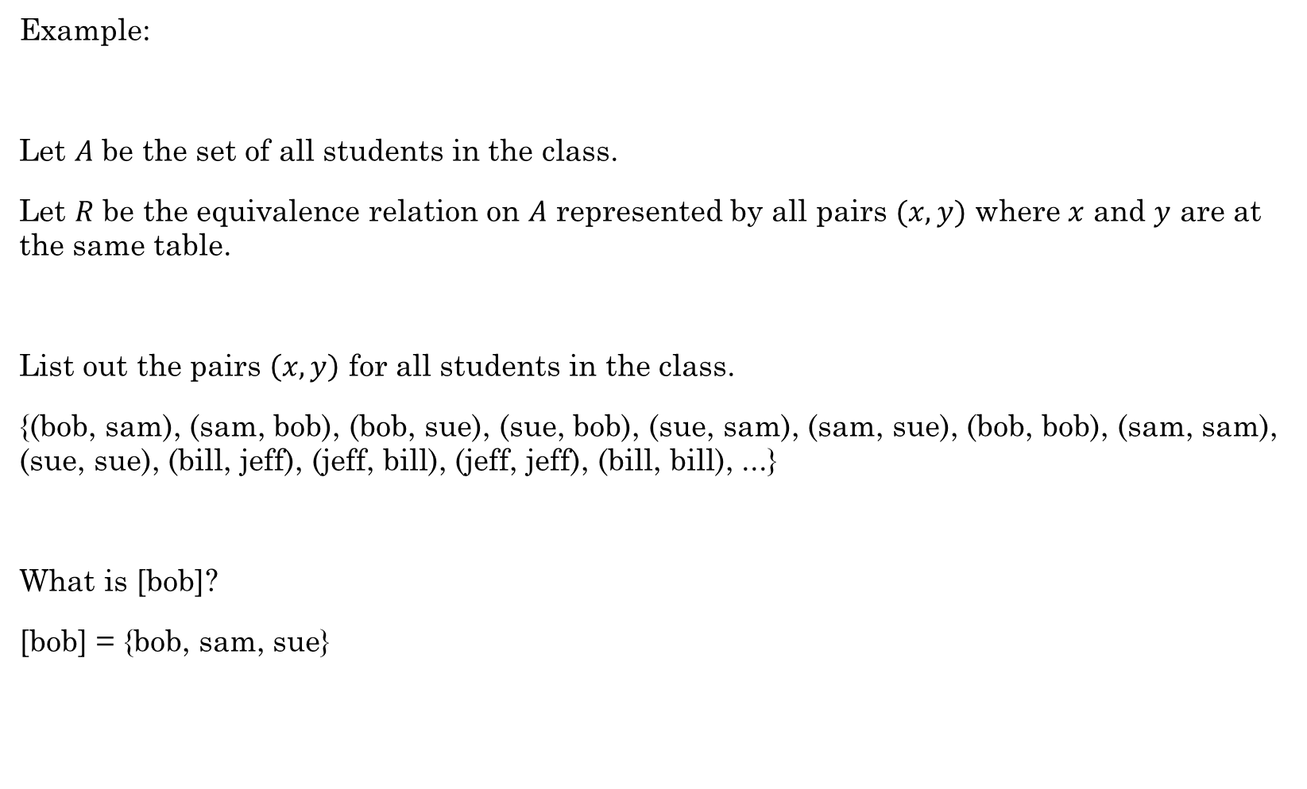
Example:
Let $A$ be the set of all students in the class.
Let $R$ be the equivalence relation on $A$ represented by all pairs $(x,y)$ where $x$ and $y$ are at the same table.
List out the pairs $\left(x,y\right)$ for all students in the class.
{(bob, sam), (sam, bob), (bob, sue), (sue, bob), (sue, sam), (sam, sue), (bob, bob), (sam, sam), (sue, sue), (bill, jeff), (jeff, bill), (jeff, jeff), (bill, bill), ...}
What is [bob]?
[bob] = {bob, sam, sue}
This subset of $A$ consists of all students at the same table as bob. This is the set of all students equivalent to bob with respect to $R$. This subset is an equivalence class of the relation.

Slide 35

Example
Domain: All people
$R$ = $\left\{\left(x,y\right)\right| x and y have the same mother\}$
Is this an equivalence relation?
Reflexive?
Symmetric?
Transitive?
What is an equivalence class in this relation?
Each equivalence class is the set of people with the same mother. The equivalence classes form a partition on the set of all people.
Yes. You have the same mother as yourself.
Yes. If Bob has the same mother as Sue, then Sue has the same mother as Bob.
Yes. If Bob has the same mother as Sue and Sue has the same mother as
Bill, then Bob has the same mother as Bill.

Slide 36

Example
Domain: All people
$R$ = $\left\{\left(x,y\right)\right| x and y have the same parent\}$
Is this an equivalence relation?
Reflexive?
Symmetric?
Transitive?
It is not an equivalence relation.
Yes. You have the same parent as yourself.
Yes. If Bob has the same parent as Sue, then Sue has the same parent as Bob.
No. Bob and Sue can have the same mother. Sue and Bill can have the same father. That does not imply that Bob and Bill have the same father.

Slide 37





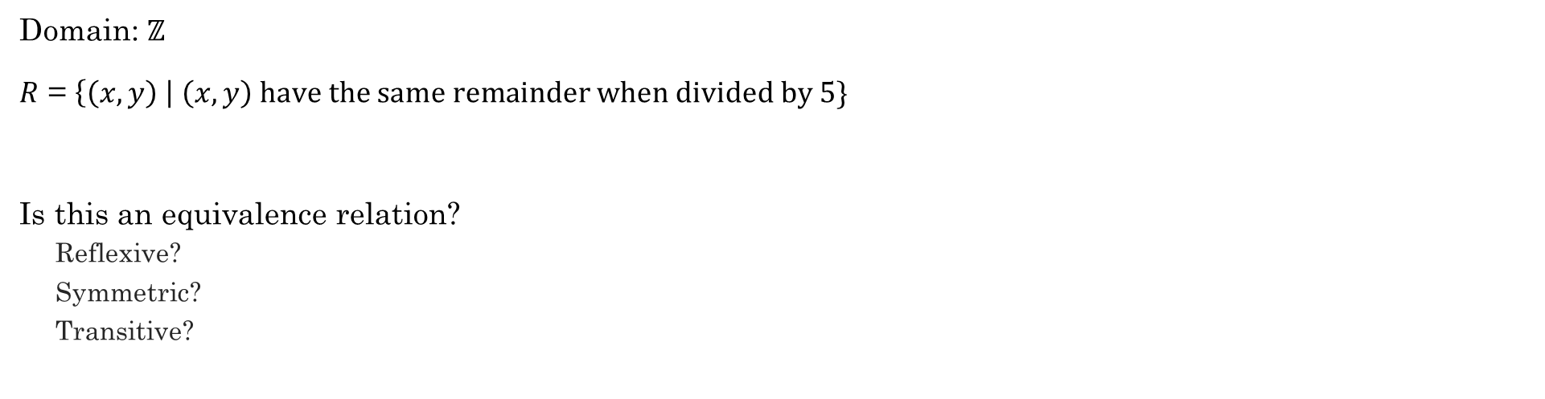
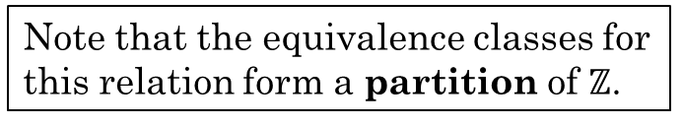






Example
Domain: $ℤ$
$R$ = $\left\{\left(x,y\right) \right| \left(x,y\right) have the same remainder when divided by 5\}$
Is this an equivalence relation?
Reflexive?
Symmetric?
Transitive?
Yes. $x$ has the same remainder as itself.
Yes. If $x$ as the same remainder as $y$, then $y$ has the same remainder as $x$.
Yes. If $x$ has the same remainder as $y$ and $y$ has the same remainder as $z$, then $x$ has the same remainder as $z$.
What are the equivalence classes for this relation?
${\left[0\right]}_{R}$:
$\{−10, −5, 0, 5, 10, 15, 20, …\}$
${\left[1\right]}_{R}$:
$\{−9, −4, 1, 6, 11, 16, 21,…\}$
${\left[2\right]}_{R}$:
$\{−8, −3, 2, 7, 12, 17, 22,…\}$
${\left[3\right]}_{R}$:
$\{−7, −2, 3, 8, 13, 18, 23,…\}$
Note that the equivalence classes for this relation form a partition of $ℤ$.
${\left[4\right]}_{R}$:
$\{−6, −1, 4, 9, 14, 19, 24,…\}$

Slide 38
Relational Databases
name | email | phone | job title | manager | hometown
Bob | bob@company.com | 867-5309 | Computer Scientist | Sue | Rexburg
Sue | sue@company.com | 555-5555 | Senior Computer Scientist | John | Idaho Falls
Carl | carl@company.com | 555-5432 | Engineer | Sue | Rexburg
Selection
Projection
Which part is the Selection, and which is the Projection?
In SQL (Structured Query Language):
SELECT name, phone, email FROM employees WHERE hometown="Rexburg";
Bob | 867-5309 | bob@company.com
Carl | 555-5432 | carl@company.com
In Python:
[(x[0], x[2], x[4]) for x in employees if x[5]=="Rexburg"]

Slide 39
Relational Databases
Activity
https://tinyurl.com/cse280-relations

