Slide 1
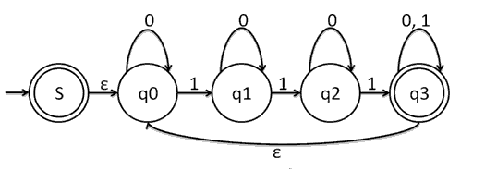
FSMs

Slide 2
Modeling Computation
Modeling computation helps us to answer questions such as
Given a task, can it be done using a computer?
If so, how can the task be carried out?
We can study computation using different structures
Grammars
Finite State Machines
Turing Machines
In this class, we will touch briefly on Finite State Machines
Rosen, Kenneth. Discrete Mathematics and Its Applications, 7th Edition. McGraw-Hill, 2012
Notes:
This section is a brief introduction to modeling computation...thinking about what a computer can and cannot do. And if a computer can do something, how long will it take. Is it relatively fast to solve a problem, or is it solvable, but will take so long the sun will burn out before it finds the solution.

Slide 3
Finite State Machines
Many types of machines, including computer components, can be modeled using finite state machines.
The basis for many types of programs:
spell checkers
grammar checkers
searching text
speech recognition
markup language transformation (HTML, Markdown, LaTeX, etc.)
network protocols
...
Rosen, Kenneth. Discrete Mathematics and Its Applications, 7th Edition. McGraw-Hill, 2012
Notes:
Briefly talk about a few examples of the types of things that might be modeled using a finite state machine.

Slide 4
Finite State Machines
Different types of FSMs can model different things.
We will look at two types of FSMs:
1. Produce output
2. Recognize a language / bitstring / sequence of inputs / property

Slide 5
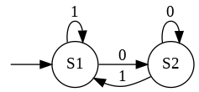
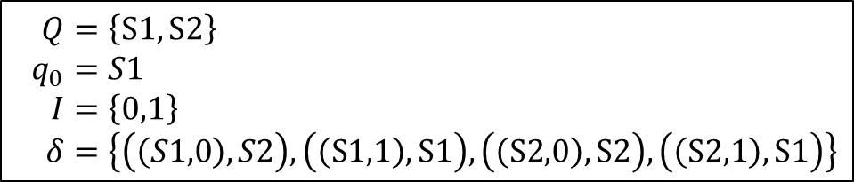
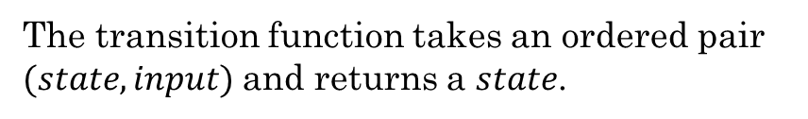
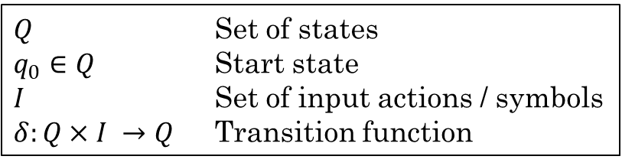
Finite State Machines
All FSMs include:
Finite set of states
Starting state
Input alphabet or input actions
Transition function
The FSM is given a sequence of inputs. The transition function determines the next state based on the current state and the current input.
$Q$ Set of states
$q_{0}∈Q$ Start state
$I$ Set of input actions / symbols
$δ:Q×I →Q$ Transition function
Example:
$$Q=\left\{S1, S2\right\} \\ q_{0}=S1 \\ I=\left\{0,1\right\} \\ δ=\left\{\left(\left(S1,0\right),S2\right), \left(\left(S1,1\right),S1\right), \left(\left(S2,0\right),S2\right), \left(\left(S2,1\right),S1\right)\right\}$$
We can also represent a transition function using a state diagram:
The transition function takes an ordered pair $(state, input)$and returns a $state$.
Rosen, Kenneth. Discrete Mathematics and Its Applications, 7th Edition. McGraw-Hill, 2012
Notes:
All FSMs include a start state, a set of states, a set of inputs, and a transition function (which tells each state what to do on a given input).

Slide 6
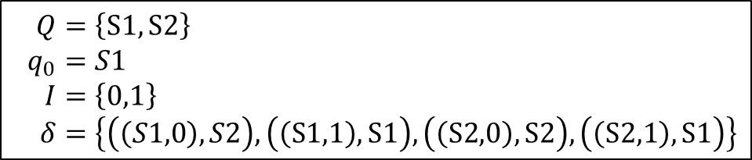
Finite State Machines
Example:
$$Q=\left\{S1, S2\right\} \\ q_{0}=S1 \\ I=\left\{0,1\right\} \\ δ=\left\{\left(\left(S1,0\right),S2\right), \left(\left(S1,1\right),S1\right), \left(\left(S2,0\right),S2\right), \left(\left(S2,1\right),S1\right)\right\}$$
Example Input: 1001101
Which is the last state given this input?
Rosen, Kenneth. Discrete Mathematics and Its Applications, 7th Edition. McGraw-Hill, 2012
Notes:
This is the example from the previous slide. Now show students how to trace through the FSM using the given input. The last state given the input 1001101 will be S1.

Slide 7
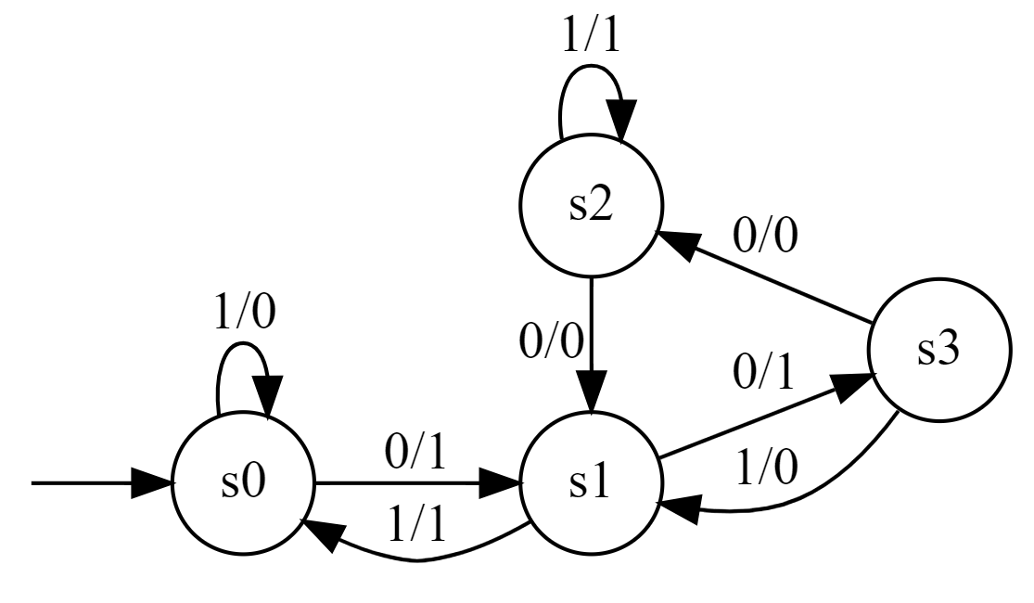
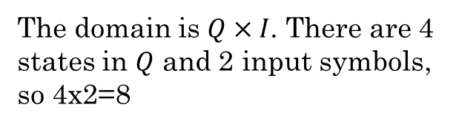
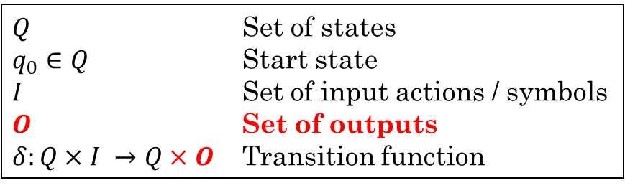

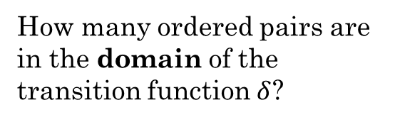

FSM with Output
Some FSMs produce output from an output alphabet or output set.
The output is determined based on the current state and the current input.
$Q$ Set of states
$q_{0}∈Q$ Start state
$I$ Set of input actions / symbols
$O$ Set of outputs
$δ:Q×I →Q×O$ Transition function
Example:
$$Q=\left\{s0, s1, s2, s3\right\} \\ q_{0}=s0 \\ I=\left\{0,1\right\} \\ O=\left\{0,1\right\} \\ δ=$$
How many ordered pairs are in the domain of the transition function $δ$?
The domain is $Q×I$. There are 4 states in $Q$ and 2 input symbols, so 4x2=8
$$\{ \\ \left(s0,0\right)→\left(s1,1\right), \\ \left(s0,1\right)→\left(s0,0\right), \\ \left(s1,0\right)→\left(s3,1\right), \\ \left(s1,1\right)→\left(s0,1\right), \\ \left(s2,0\right)→\left(s1,0\right), \\ \left(s2,1\right)→\left(s2,1\right), \\ \left(s3,0\right)→\left(s2,0\right), \\ \left(s3,1\right)→\left(s1,0\right) \\ \}$$
Go to the whiteboards and draw this FSM
What would be the output on the input of 1010101?
0111111
Input of 1100101?
0011010
Notes:
Now we'll talk about the first type of FSM, the kind that produces output.
Have students try to draw the FSM specified before showing the drawing.
The labels on the FSM transitions represent input/output. For example, the FSM in the diagram starts in state s0. If the input is a 0, it will output a 1 and transition to state s1. If the input is a 1, it
will output a 0 and transition to state s0.

Slide 8
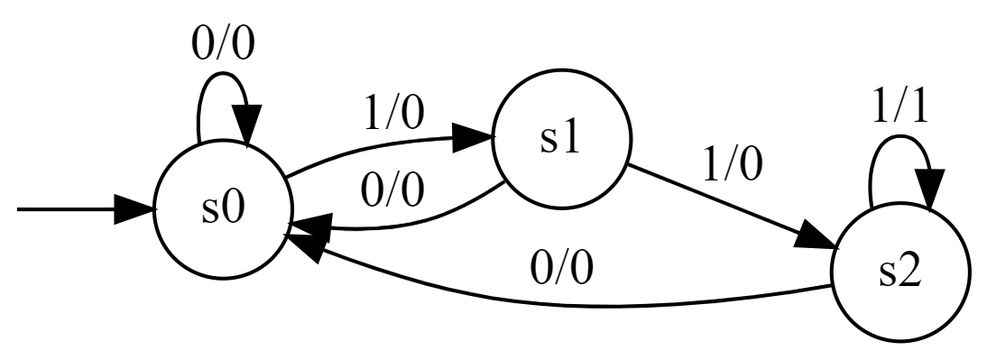
FSM with Output: Example
Imagine a coding scheme in which the receiver of a message knows there has been a transmission error whenever three consecutive 1s appear. Let's build an FSM that will output a 1 whenever it detects three consecutive 1s and a 0 otherwise.
An FSM can only remember its current state. So how many states will we need to "remember" three bits?
Three
Let's draw it.
What would be the output on the input of 101101?
000000
On an input of 101110?
000010
A "$1"$ indicates the receiver detected an error
Rosen, Kenneth. Discrete Mathematics and Its Applications, 7th Edition. McGraw-Hill, 2012
Notes:
In this example scenario, there is a sender and receiver passing a message encoded in binary. The receiver needs to detect if there was an error in the transmission of the message.

Slide 9
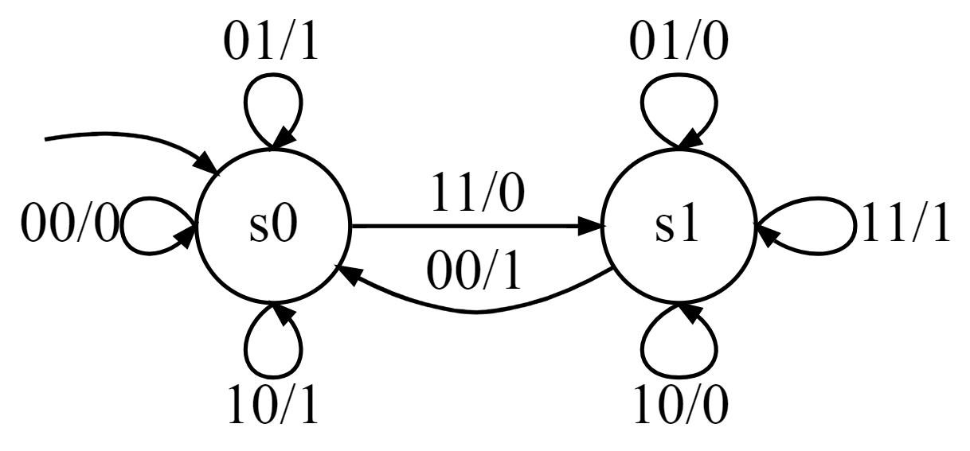


Example: Add two binary numbers
$$Q=\left\{s0, s1\right\} \\ q_{0}=s0 \\ I=\left\{00,01,10,11\right\} \\ O=\left\{0,1\right\} \\ δ=$$
$$\{ \\ \left(s0,00\right)→\left(s0,0\right), \\ \left(s0,01\right)→\left(s0,1\right), \\ \left(s0,10\right)→\left(s0,1\right), \\ \left(s0,11\right)→\left(s1,0\right), \\ \left(s1,00\right)→\left(s0,1\right), \\ \left(s1,01\right)→\left(s1,0\right), \\ \left(s1,10\right)→\left(s1,0\right), \\ \left(s1,11\right)→\left(s1,1\right) \\ \}$$
What is the result of adding these two numbers by hand?
0110
0011
This FSM takes an input consisting of 2 bits at a time and outputs one bit. Now we can add two binary numbers.
1001
Now trace these through the FSM, taking two bits at a time (one from each string from right to left). Does it produce the same result?
Rosen, Kenneth. Discrete Mathematics and Its Applications, 7th Edition. McGraw-Hill, 2012
Notes:
Do the addition by hand, then trace through the FSM to show it results in the same answer.

Slide 10
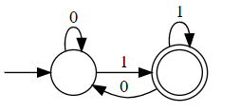
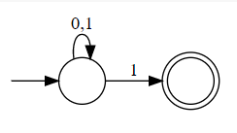
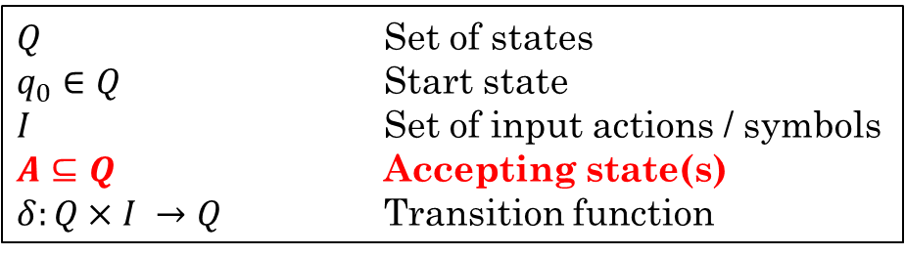
FSMs that Recognize Properties
Some FSMs recognize whether a sequence of inputs has a particular property.
Instead of producing an output, these FSMs have one or more accept states.
If an input string ends on an accept state, we say the input has the property recognized by the FSM, or that the input is a valid string in the language of the FSM.
Can be used to represent a regular language in a graphical way.
Example:
The language of all bitstrings that end with a 1:
"01", "11", "11111", "01010101", ...
Regular expression: (0|1)*1
$Q$ Set of states
$q_{0}∈Q$ Start state
$I$ Set of input actions / symbols
$A⊆Q$ Accepting state(s)
$δ:Q×I →Q$ Transition function
These types of FSMs are also known as Finite State Automata
Notes:
Briefly mention DFA vs NFA... Basically, a DFA requires that each state have a transition for every possible input. An NFA does not. For this class, we will use DFAs.

Slide 11
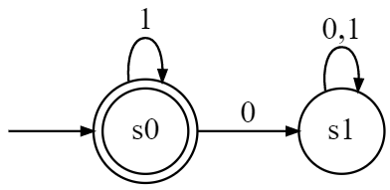
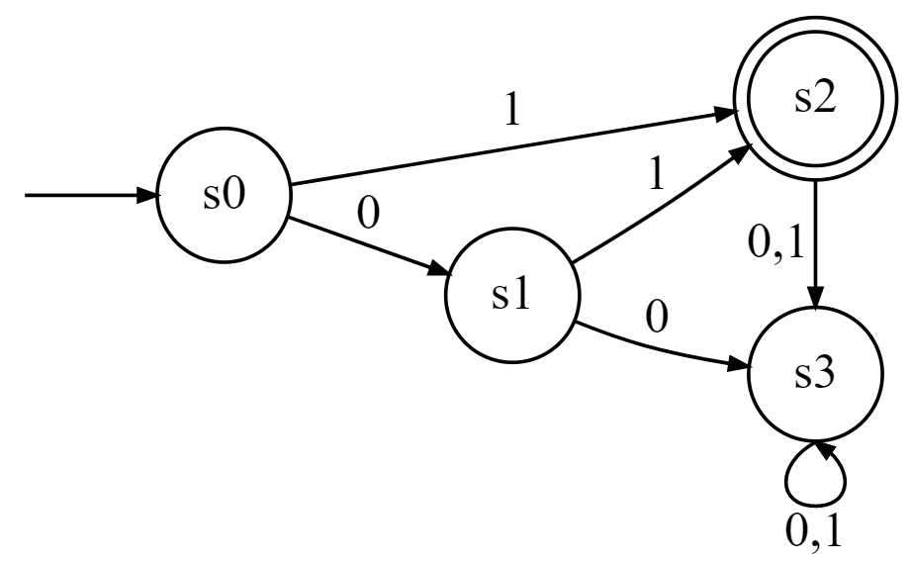
Finite State Automata
Do not produce output.
Have a set of final states (accepting states).
Accepting states are shown using a double circle.
$Q$ Set of states
$q_{0}∈Q$ Start state
$I$ Set of input actions / symbols
$A⊆Q$ Accepting state(s)
$δ:Q×I →Q$ Transition function
Describe the language recognized by these finite state automata.
All bitstrings that contain only 1s
The bitstrings {1, 01}
Notes:
Have students try to describe the language produced by each diagram before revealing the answer.

Slide 12
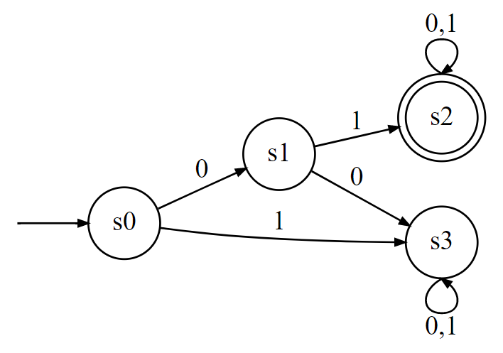
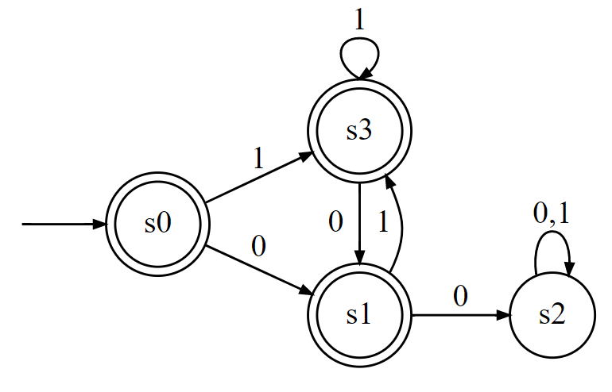
Practice - Finite State Automata
Go to the whiteboards and draw these two finite state automata:
1. The set of bitstrings that begin with 01
2. The set of bitstrings that do not contain two consecutive 0s
Notes:
Have students draw the two FSMs before revealing the diagrams.

Slide 13
Work with a partner to complete the following:
Additional Exercises
7.4.1
7.4.3
7.4.4

Slide 14
FSM Examples in Python
Examples of drawing FSMs using Python

