Slide 1
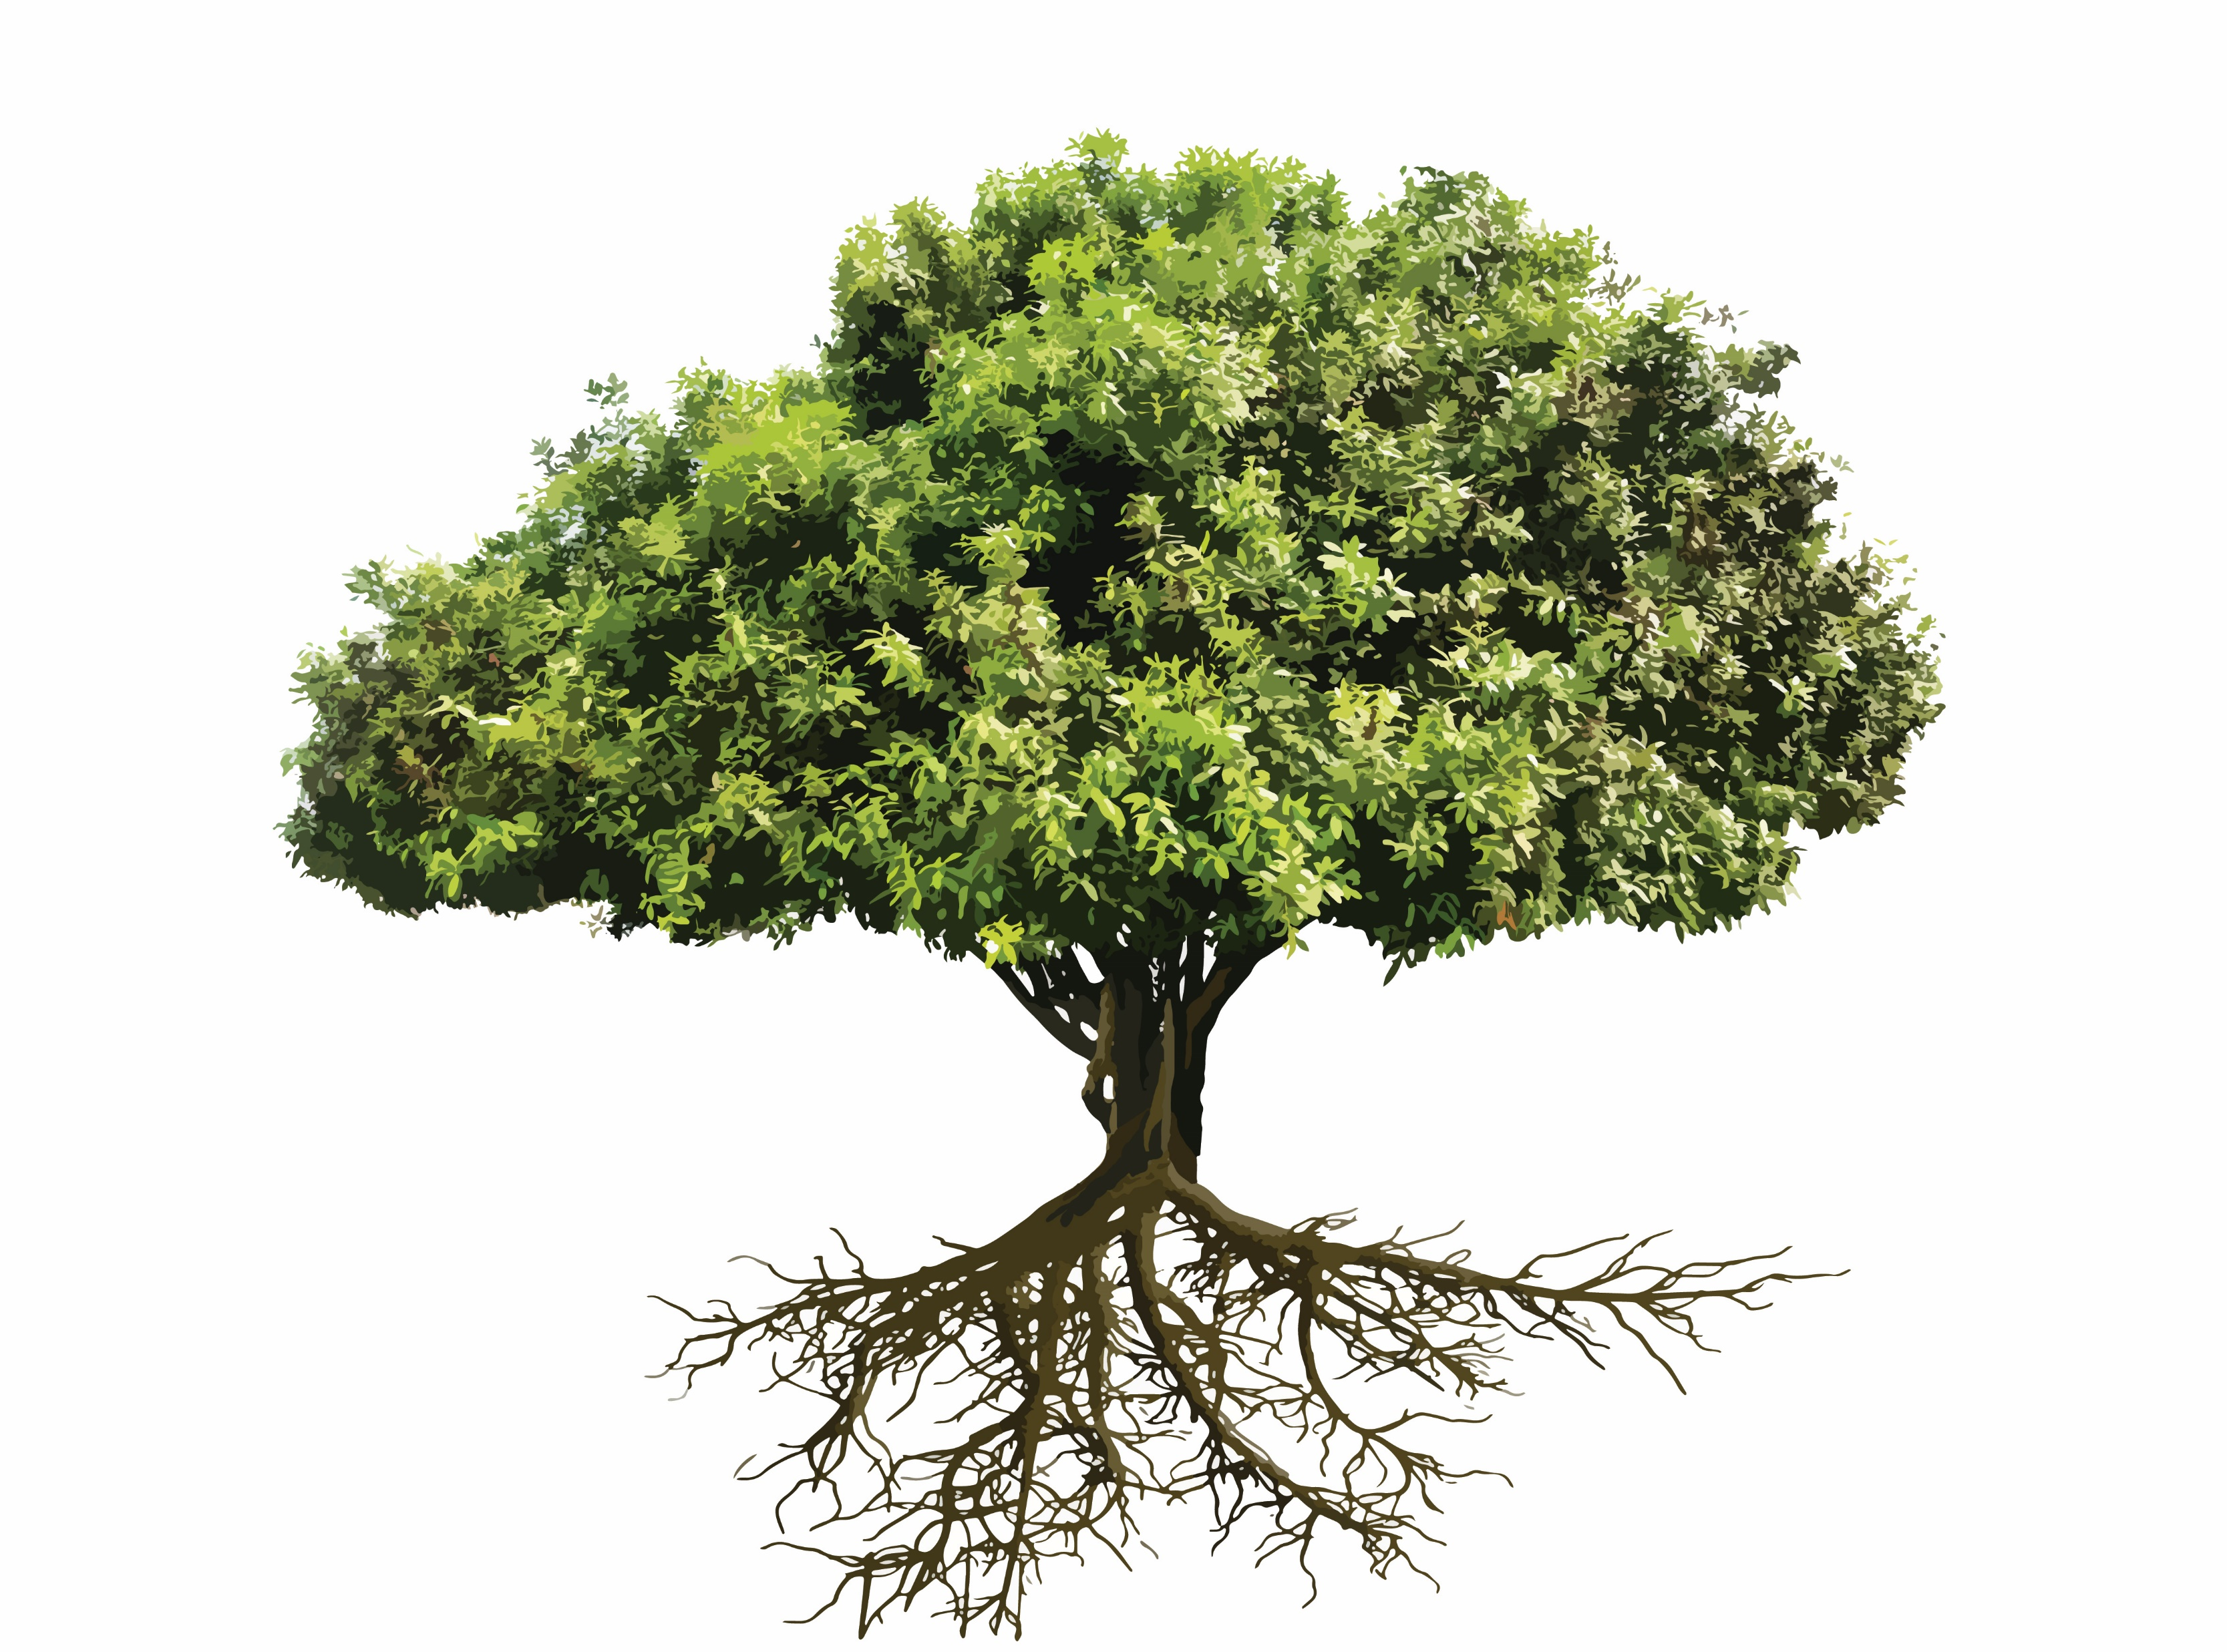
Trees

Slide 2
Homework Review
Review Homework 6 with a partner

Slide 3
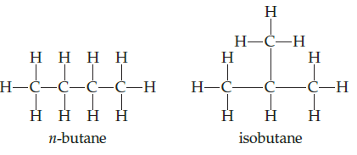
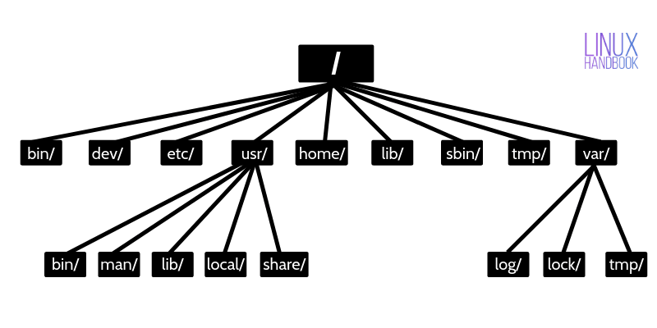
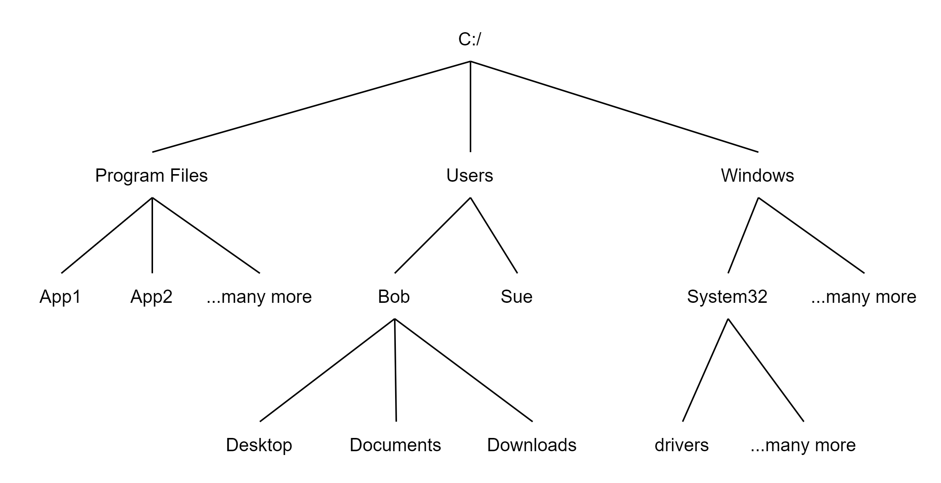
Background
Arthur Cayley, English mathematician, discovered trees in 1857 when he needed a way to count chemical compounds
Fast Searching
Data compression
Modeling games/procedures/decisions/relationships
Filesystem hierarch
Evaluating mathematical expressions
Neff, Rick, and Gopalakrishnan, Ganesh. First Three Odds Double Halve Divide Reciprocate. CRC Press, 2021
Rosen, Kenneth. Discrete Mathematics and Its Applications, 7th Edition. McGraw-Hill, 2012

Slide 4
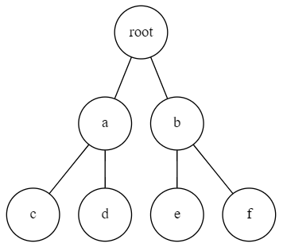
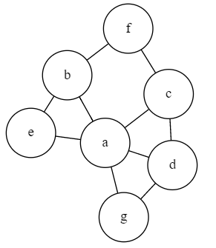
Trees vs Graphs
Both are composed of vertices and edges
Tree: Only one path from one vertex to any other vertex
Graph: More than one path between vertices
Graphic from: https://medium.com/swlh/making-data-trees-in-python-3a3ceb050cfd

Slide 5
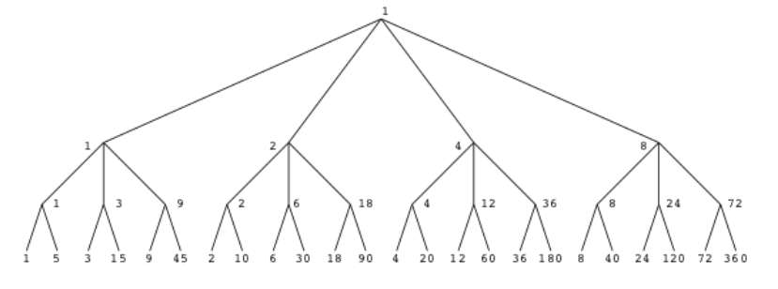
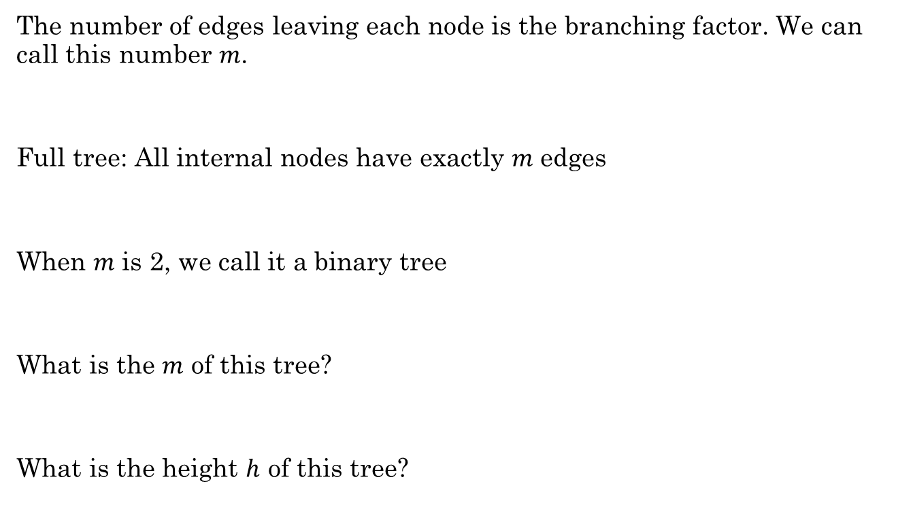

$m$-ary Tree
The number of edges leaving each node is the branching factor. We can call this number $m$.
Full tree: All internal nodes have exactly $m$ edges
When $m$ is 2, we call it a binary tree
What is the $m$ of this tree?
What is the height $h$ of this tree?

Slide 6
Tree Terminology
Free Tree
Rooted Tree
Root
Level
Height
Parent
Child
Ancestor
Descendant
Leaf
Internal vertex
Sibling
Subtree
f
a
c
b
a
e
g
b
e
c
d
f
g
d
e
f
g

Slide 7
Review:
What does it mean if two graphs are isomorphic?
With a partner, complete Additional Exercises:
14.1.2

Slide 8
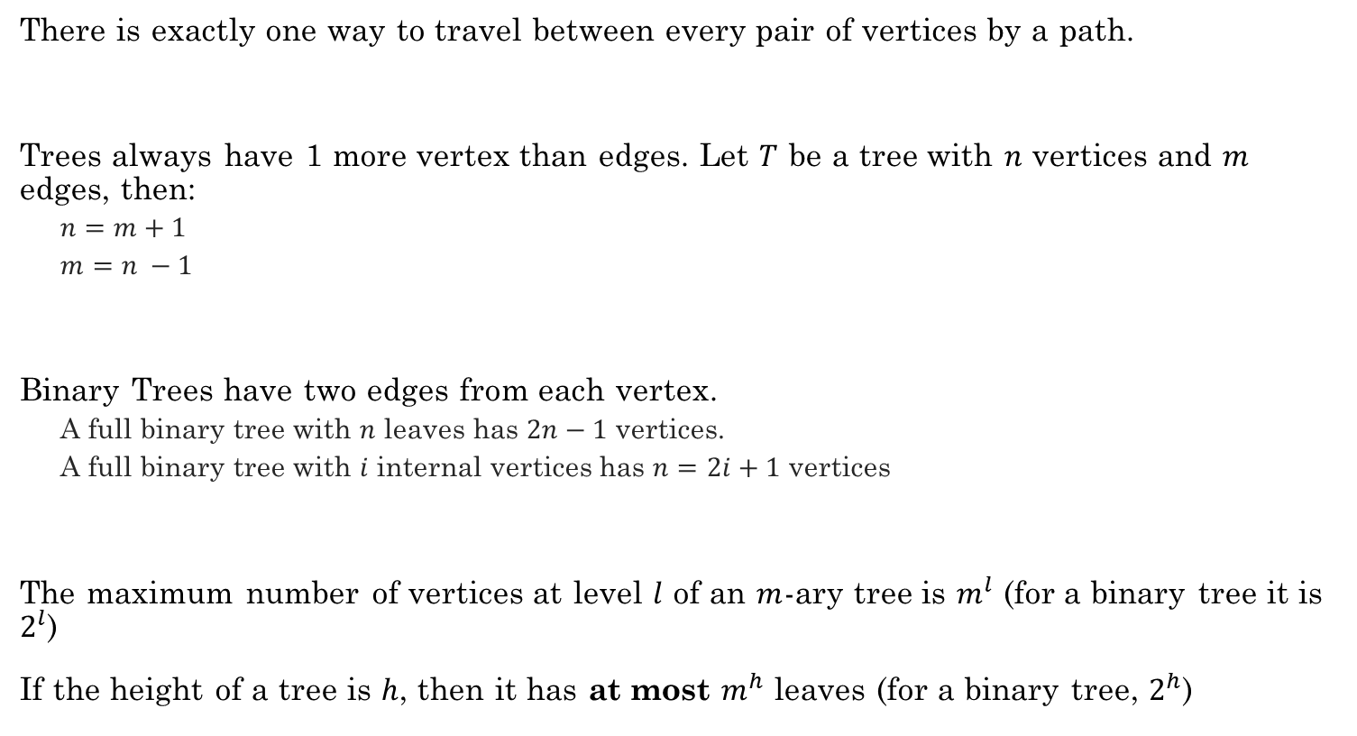
Properties of trees
There is exactly one way to travel between every pair of vertices by a path.
Trees always have 1 more vertex than edges. Let $T$ be a tree with $n$ vertices and $m$ edges, then:
$n=m+1$
$m=n −1$
Binary Trees have two edges from each vertex.
A full binary tree with $n$ leaves has $2n−1$ vertices.
A full binary tree with $i$ internal vertices has $n=2i+1$ vertices
The maximum number of vertices at level $l$ of an $m$-ary tree is $m^{l}$ (for a binary tree it is $2^{l}$)
If the height of a tree is $h$, then it has at most $m^{h}$ leaves (for a binary tree, $2^{h}$)

Slide 9
A Few Tree Applications
Binary Search Trees
Fast searching. Optimize time.
Huffman Trees
Data compression. Optimize space.
Binary tree, but not a binary search tree.
Used to create an optimal prefix code
Game trees
Mathematical expressions

Slide 10
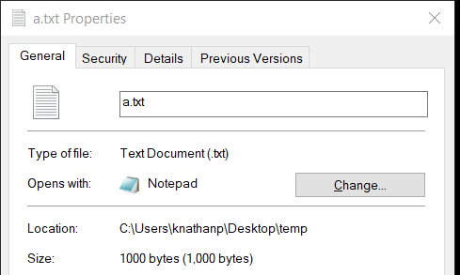
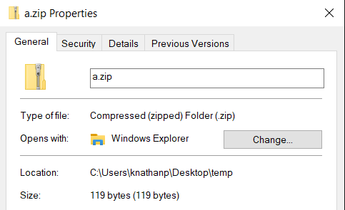

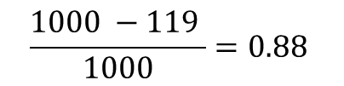
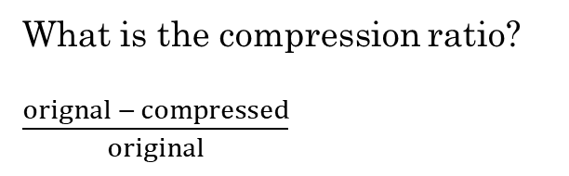
Consider a text file that consists of 1000 a's.
aaaaaaaaaaaaaaaaaaaaaaaaaaaaa
aaaaaaaaaaaaaaaaaaaaaaaaaaaaa
aaaaaaaaaaaaaaaaaaaaaaaaaaaaa
...
How much space would it take to store this file if we use standard ASCII or UTF-8, which each use 1-byte (8-bits) to store the letter "a"?
ZIP compression
Can you think of a way to store this file in a way that would save space?
What is the compression ratio?
$\frac{orignal − compressed}{original}$
$$\frac{1000 −119 }{1000}=0.88$$
$$=88\%$$

Slide 11
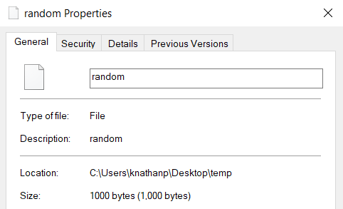
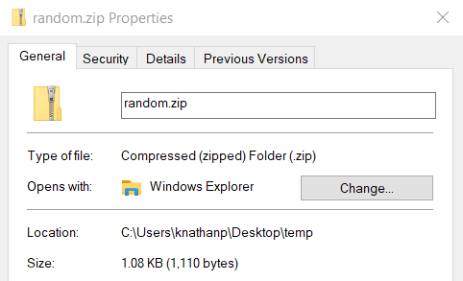
What about a file that consists of 1000 completely random bytes?
q2KVZRbqRiflgI56Es4plUeWoWBkw2b892Ss5JWSJAk5SPaIksHucUoGFMszZ2pqBB
...
Can you think of a way to store this file in a way that would save space?
ZIP compression
Why don't we save any space by compressing it?

Slide 12
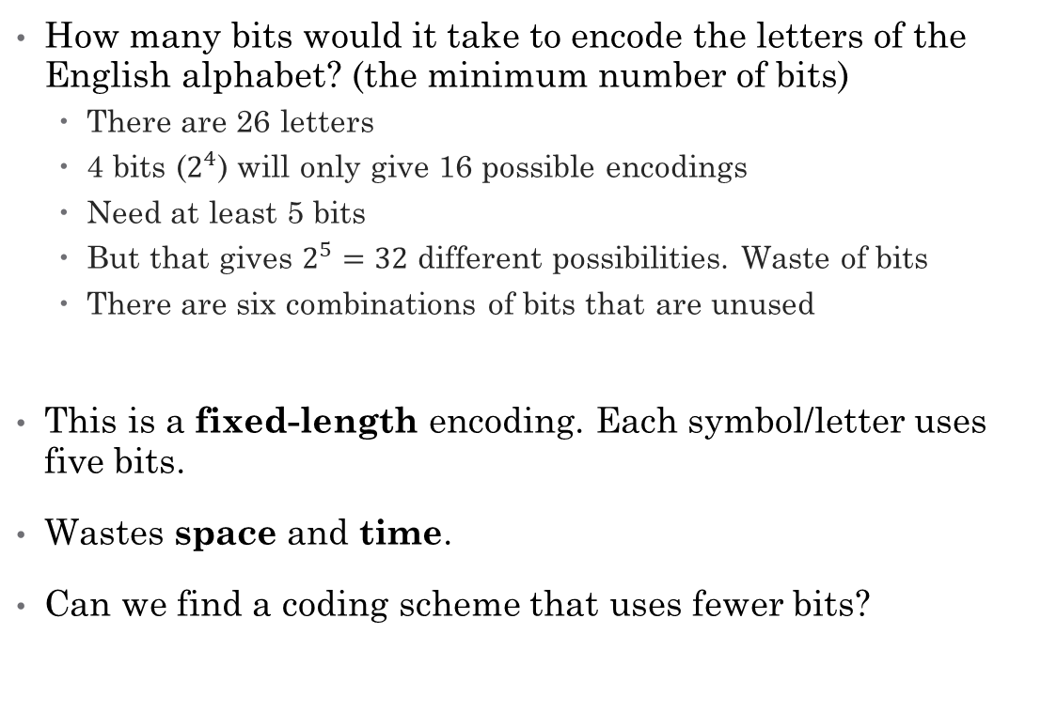
Fixed-length Encoding
Encode means "represent"
A | 0000 | 0
B | 0001 | 1
C | 0010 | 2
D | 0011 | 3
... | ...
O | 1110 | 14
P | 1111 | 15
Q | ? | ?
R | ? | ?
S | ? | ?
T | ? | ?
... | ? | ?
How many bits would it take to encode the letters of the English alphabet? (the minimum number of bits)
There are 26 letters
4 bits ($2^{4}$) will only give 16 possible encodings
Need at least 5 bits
But that gives $2^{5}=32$ different possibilities. Waste of bits
There are six combinations of bits that are unused
This is a fixed-length encoding. Each symbol/letter uses five bits.
Wastes space and time.
Can we find a coding scheme that uses fewer bits?
A | 00000 | 0
B | 00001 | 1
C | 00010 | 2
D | 00011 | 3
... | ...
Z | 11001 | 25
Unused | 11010 | 26
Unused | 11011 | 27
Unused | 11100 | 28
Unused | 11101 | 29
Unused | 11110 | 30
Unused | 11111 | 31
Rosen, Kenneth. Discrete Mathematics and Its Applications, 7th Edition. McGraw-Hill, 2012

Slide 13
Variable-length Encoding
Instead of using a fixed number of bits to represent each letter/symbol, we can use bit strings of different lengths to encode letters.
For efficiency, letters that occur more frequently should be represented using shorter bit strings. Letters that are rarely used should be represented using longer bit strings.
Example:
The letters e, a, t are more common than x and z.
What if we represent the letter e with 0, a with 1, and t with 01?
Then the bit string 0101 could represent eat, tea, eaea, or tt.
e | 0
a | 1
t | 01
Rosen, Kenneth. Discrete Mathematics and Its Applications, 7th Edition. McGraw-Hill, 2012

Slide 14
Prefix Codes
One way to make sure no bit string corresponds to more than one sequence of letters is to encode letters in such a way that the bit string for a letter never occurs as the first part of a bit string for another letter.
This is called a Prefix Code.
Example
To represent the letters e, a, t using a prefix code, we could choose 0 for e, 10 for a, and 11 for t.
The bitstring 10110 represents the word ate. There is no other possible interpretation.
Now we can decode or recover a word from a bitstring without ambiguity.
e | 0
a | 10
t | 11
Rosen, Kenneth. Discrete Mathematics and Its Applications, 7th Edition. McGraw-Hill, 2012

Slide 15
Prefix Codes
e | 0
a | 10
t | 110
n | 1110
s | 1111
A prefix code can be represented using a binary tree.
Leaves represent the characters/symbols we need to represent
Edges represent the encoding bits. A left edge is a 0 and a right edge is a 1.
The bit string used to encode a symbol is the sequence of edges to reach the symbol.
Because this is a tree, the path to get to any leaf is unique.
The sequence of bits formed by the path is a prefix code.
0
1
e
0
1
a
0
1
11111011100
t
0
1
S A N E
n
s
Rosen, Kenneth. Discrete Mathematics and Its Applications, 7th Edition. McGraw-Hill, 2012

Slide 16
Prefix Code Examples
Huffman codes
Country calling codes
ISBN country and publisher assignments
Machine language instruction sets

Slide 17
Where is Huffman Coding used?
JPEG
MP3
DEFLATE algorithm (Huffman Coding is combined with LZ77 compression)
zip, gzip, 7-Zip, C zlib library, PuTTY, ...
PNG files

Slide 18
Huffman Trees
Used to produce a Huffman Coding, which is a prefix code.
It is not only a prefix code, but it is a prefix code using the fewest number of bits possible.
Fundamental algorithm in data compression.
Uses a binary tree.
Store more frequently seen symbols closer to root.
Label the links rather than the nodes. Left link is 0, right link is 1.
Symbols we want to represent are stored at the leaves.
Each symbol is encoded into a unique bitstring by following the structure of the tree.
0
1
e
0
1
a
0
1
t
0
1
n
s

Slide 19

Compression Ratio
How do we know how much space/time we are saving by using a variable-length encoding instead of a fixed-length encoding?
Calculate the compression ratio!
Compression Ratio
$f$: bits per symbol for fixed length encoding
$v$: average bits per symbol with variable length encoding
$\frac{f−v}{f}⋅100$

Slide 20

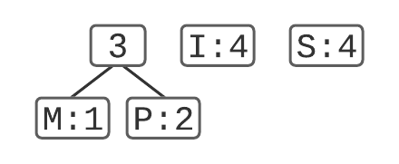
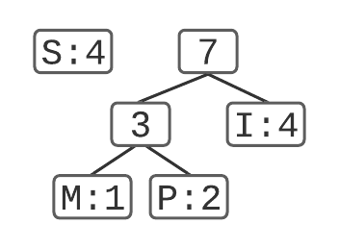
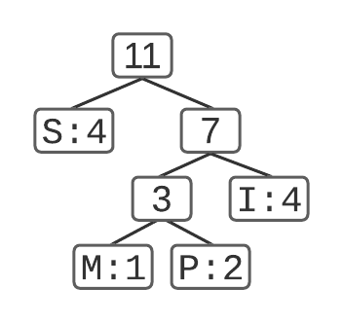
Example: Create a Huffman Tree for the string "MISSISSIPPI"
1. List out the counts
2. Go through the algorithm:
1. List symbols in a priority queue sorted by count (smallest count first)
2. Combine first two symbols (M and P) into a tree and add to the proper place in the queue
3. Repeat again, combining first two items in queue into a tree (M, P, and I) and adding back to the queue.
4. Continue to repeat until only one item is on the queue. This is the completed tree.
3. Extract the encoding for each letter:
100110011001110110111 21 bits
Letter | Count
M | 1
P | 2
I | 4
S | 4
Letter | encoding
M | 100
P | 101
I | 11
S | 0
M I SSI SSI P P I

Slide 21



Example: Create a Huffman Tree for the string "MISSISSIPPI"
Calculate the compression ratio.
How many bits per letter would it take for a fixed-length encoding?
2 bits per letter
0010111110111110010110 22 bits
How many bits on average with this Huffman encoding?
M: 3 bits * 1 letter = 3
P: 3 bits * 2 letters = 6
I: 2 bits * 4 letters = 8
S: 1 bits * 4 letters = 4
Total: 3+6+8+4 = 21
Average bits per letter: 21/11 = 1.91
Letter | Count
M | 1
P | 2
I | 4
S | 4
total | 11
Letter | encoding
M | 00
P | 01
I | 10
S | 11
M I S S I S S I P P I
Letter | encoding
M | 100
P | 101
I | 11
S | 0
Compression ratio:
$\frac{f−v}{f}⋅100$
$f=2$
$v=1.91$
$$\frac{2−1.91}{2}⋅100=4.5\%$$

Slide 22
Example: Create a Huffman Tree for the string "MISSISSIPPI"
Letter | fixed | variable
M | 00 | 100
P | 01 | 101
I | 10 | 11
S | 11 | 0
0010111110111110010110
Fixed
M I S S I S S I P P I
100110011001110110111
Variable
M I SSI SSI P P I

Slide 23
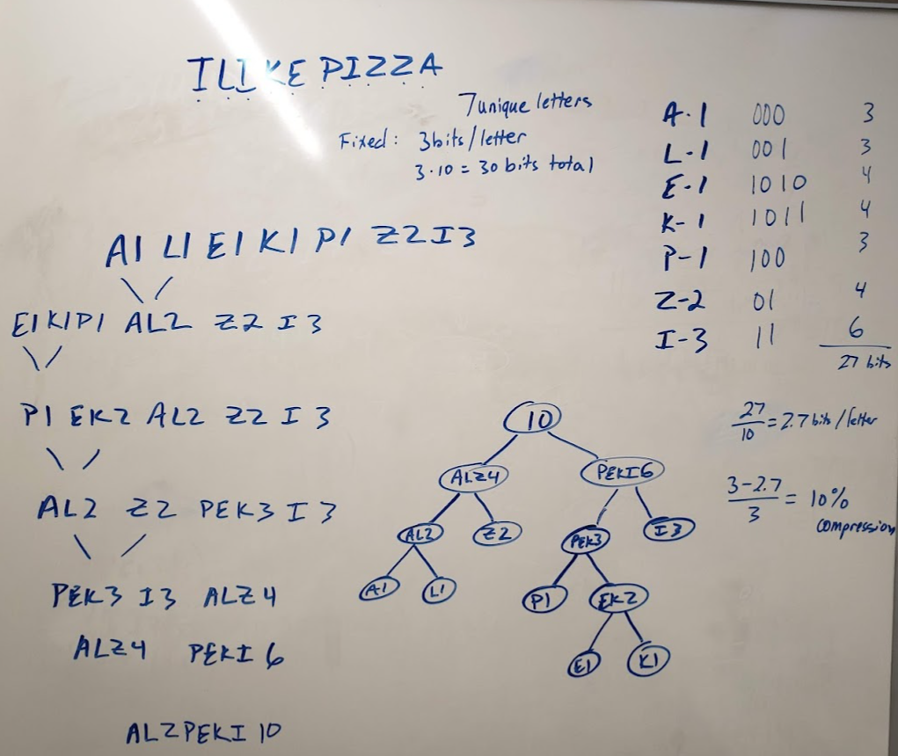

Try it:
Create a Huffman tree and encoding for "I LIKE PIZZA"
How many bits per letter for fixed encoding?
How many bits per letter for Huffman?
Compression: 10%
3
2.7
$$\frac{3−2.7}{3}=10\%$$

Slide 24
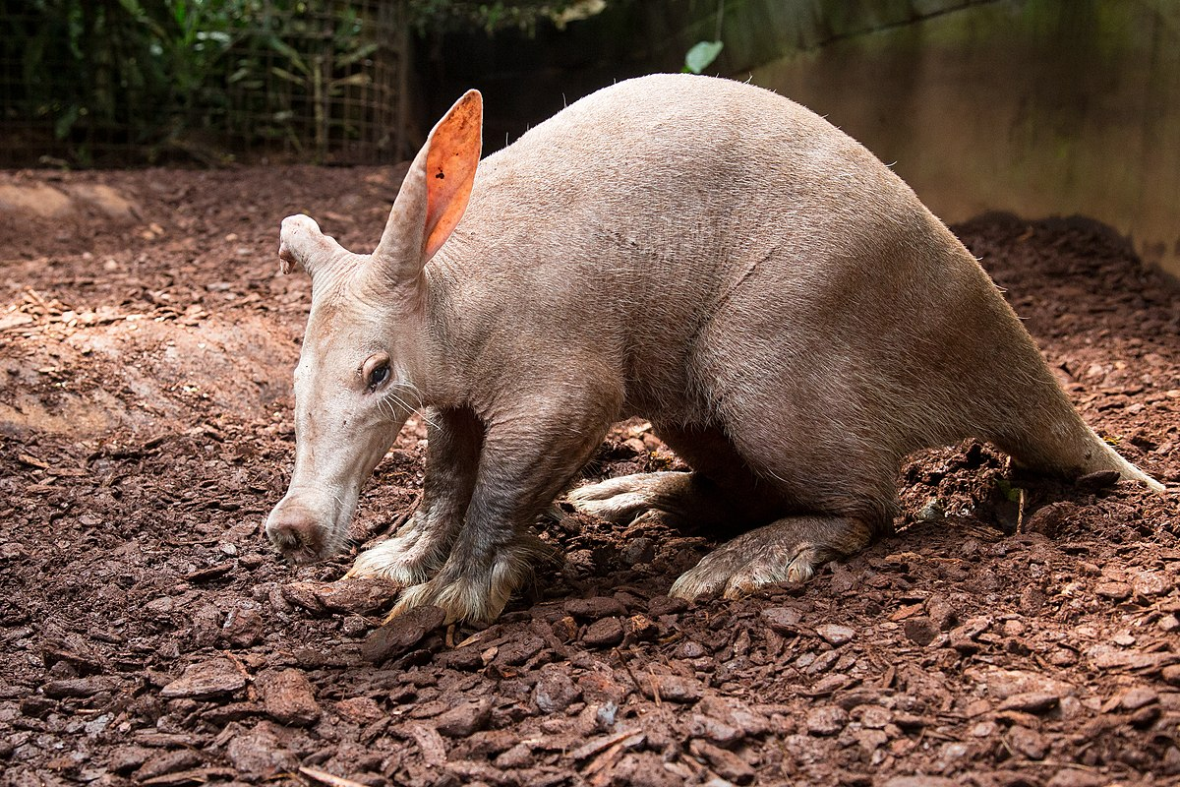
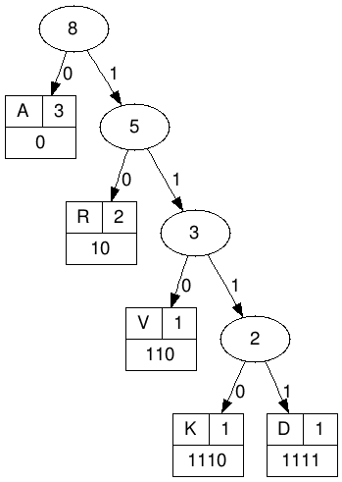
Try it:
Create a Huffman tree and Huffman encoding for "AARDVARK"
 | count
D | 1
K | 1
V | 1
R | 2
A | 3
encoding
1111
1110
110
10
0
001011111100101110
AAR D V AR K
How many bits for fixed length encoding?
How many bits for variable length encoding?
Compression ratio?

Slide 25
Suggested Additional Exercises
14.2.2
14.2.3

Slide 26
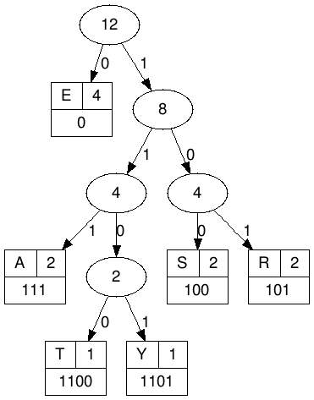
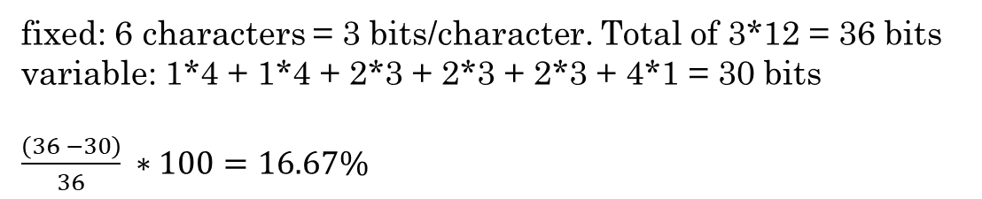
Try it:
Given this Huffman Tree, decode this bitstring:
110010100100111101001111001101
T R EES A R EEA S Y
TREESAREEASY
What is the compression ratio?
fixed: 6 characters = 3 bits/character. Total of 3*12 = 36 bits
variable: 1*4 + 1*4 + 2*3 + 2*3 + 2*3 + 4*1 = 30 bits
$\frac{\left(36 −30\right)}{36} ∗100=16.67\%$

Slide 27
Python Dictionary
Represent a node using a Python dictionary
['name': 'a', 'weight': 3, 'left-child': None, 'right-child': None]
['name': 'dk',
'weight': 2,
'left-child': ['name': 'd',
'weight': 1,
'left-child': None,
'right-child': None],
'right-child': ['name': 'k',
'weight': 1,
'left-child': None,
'right-child': None]
]

Slide 28
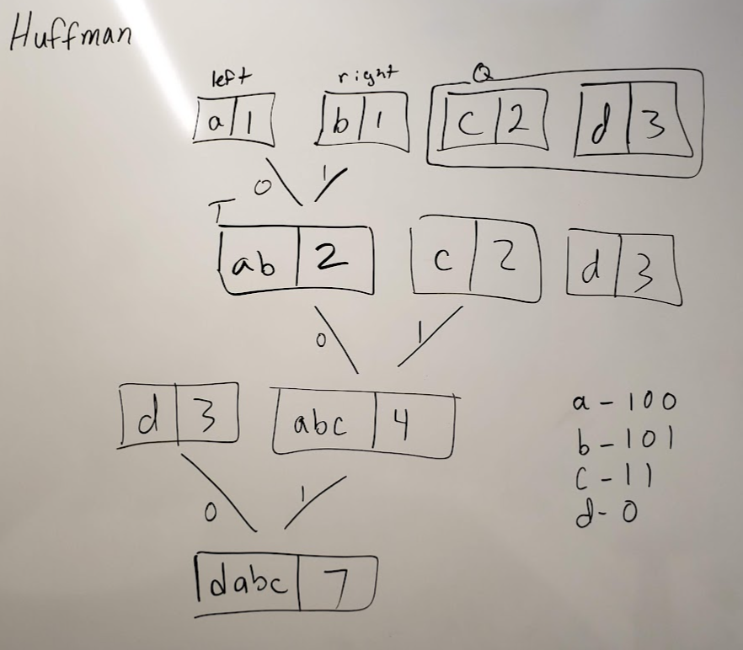
Huffman algorithm
def make_Huffman_tree(Q):
# while Q has more than 1 element
while len(Q) > 1:
# get the first two items in Q, then delete them from Q
Tl = Q[0]
Q = Q[1:]
Tr = Q[0]
Q = Q[1:]
# create a new tree T with Tl and Tr as its
# left and right subtrees, and weight equal to the
# sum of Tl's and Tr's weights.
T = make_tree(Tl, Tr)
# insert T into Q in the proper place based on its weight
insert_tree(T, Q)
# Q[0] now contains T
return T # The same as Q[0]. The only remaining item in Q

Slide 29
Huffman Practical Application
Python Example implementing Huffman Tree

